Slide 1
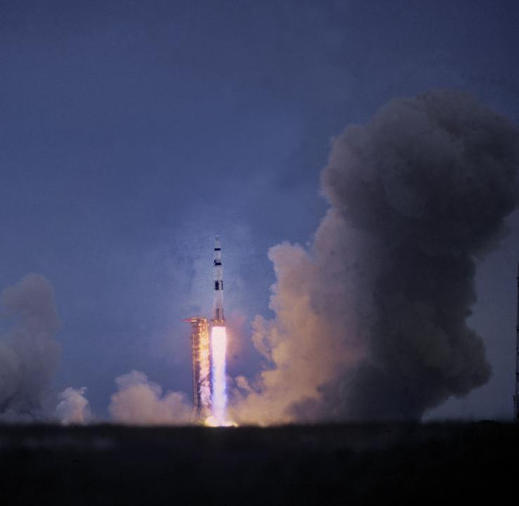
Apollo 13

Slide 2
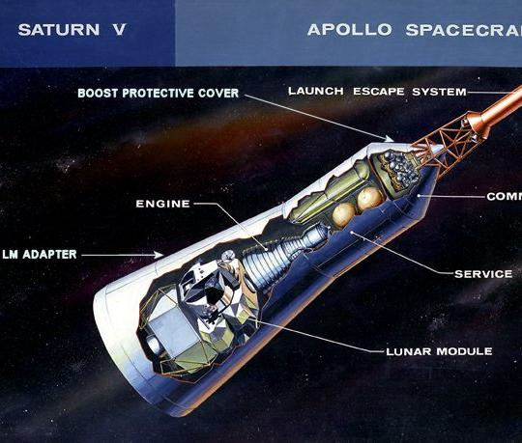
https://www.youtube.com/watch?v=C3J1AO9z0tA
One of the oxygen tanks on the spaceship blew up. To save energy for the trip around the moon so they can return home, the astronauts turn off all electrical equipment in the Command & Space Module and move into the Lunar Module.

Slide 3
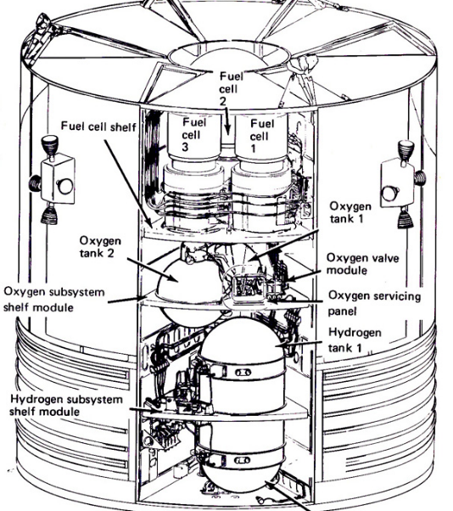
What could have triggered the explosion?

Slide 4
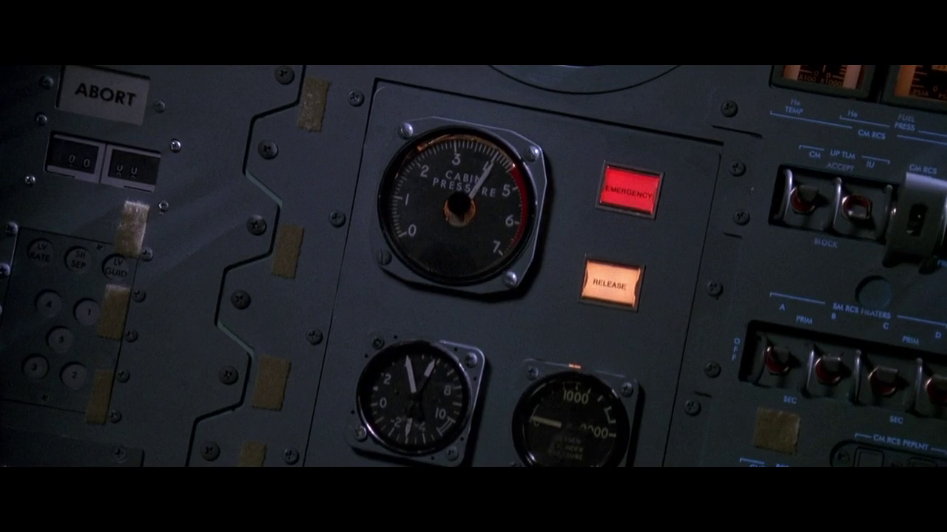

https://www.youtube.com/watch?v=1cYzkyXp0jg&t=13s
The CO₂ detector light turns on to indicate rising levels. At this moment, the astronauts realize the Lunar Module was designed for 2 astronauts over 2 days and not for 3 astronauts over 8 days.
What could the astronauts do to eliminate the CO₂?

Slide 5
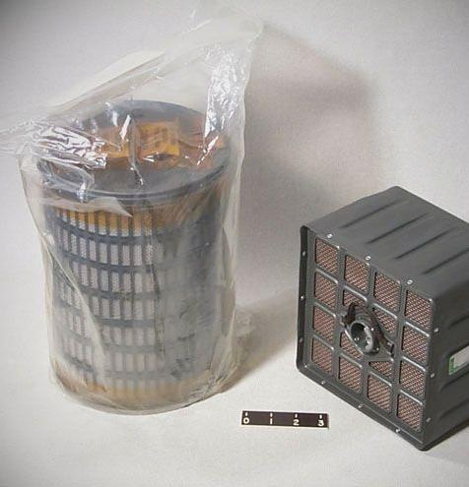
LiOH canisters
They learn that the engineers at Command Central have a plan.
The astronauts need to construct their LiOH canister and connect it.
How can they connect the canister into a space of different shape?

Slide 6
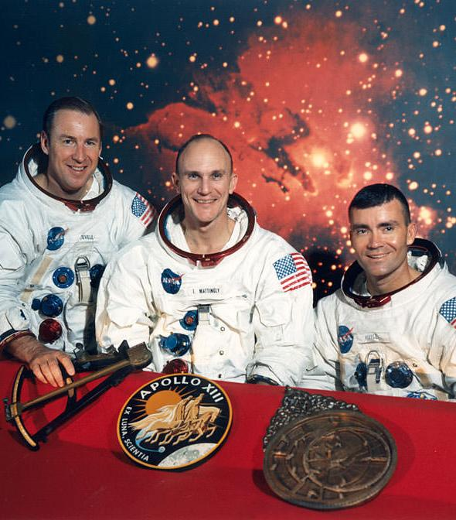
The daily average CO₂ emitted by an astronaut is 18.2 mol CO₂/day/astronaut.
Once the LiOH canister is connected, it will result in nearly immediate CO₂ reduction. Predict the reaction equation for the generation of lithium carbonate.
Calculate the minimum mass of LiOH needed to scrub the CO₂ generated by 3 astronauts for 8 days.

Slide 7
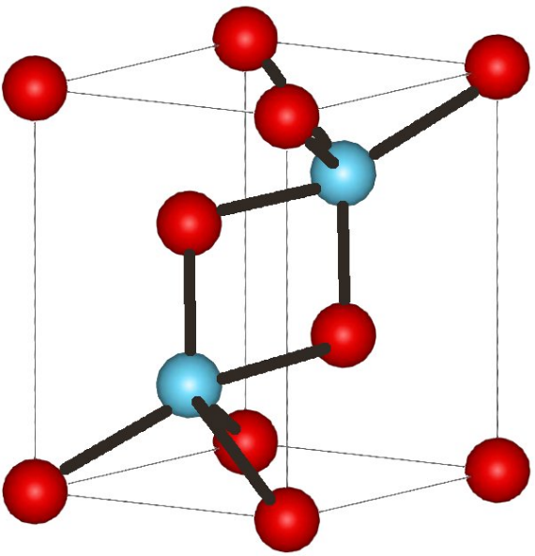
Construct the balanced reaction equation of the reaction between barium hydroxide and carbon dioxide.
What mass of Ba(OH)₂ would handle the CO₂ exhaled by the three astronauts during their eight-day mission?
How does this mass compare to LiOH?
State with a reason which compound is more suitable to be used as a scrubber.

