Slide 1
Migration to Spain

Slide 2
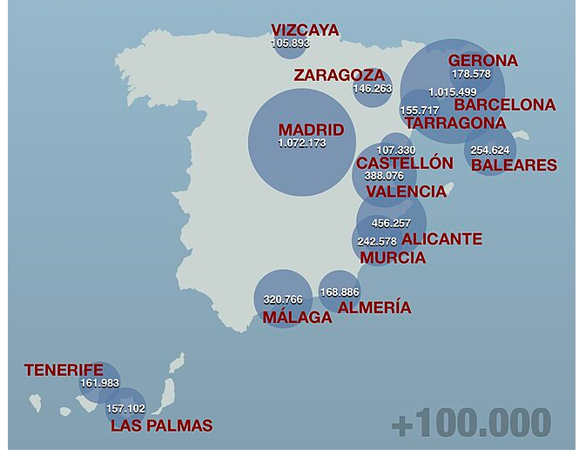
Map of foreign population distribution in Spain (Spanish Census, 2023)
The three provinces with most
foreign nationals in Spain in 2023 are
Madrid (Capital of Spain)
Barcelona
Alicante
Thaneeya lived in Madrid, which is now the biggest province with foreigner nationals

Slide 3
Different motives of immigrations

Slide 4
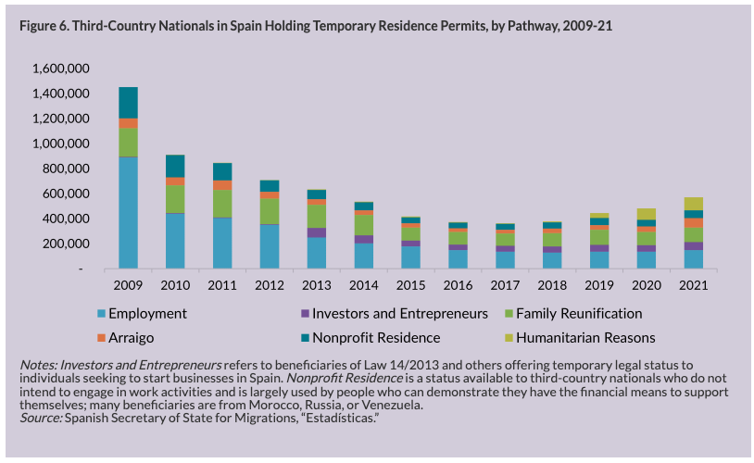
Migration in Spain (Migration Institute of Spain, 2023)
Thaneeya’s arrival
in Spain is for education, which is for a nonprofit residence. This trend was very high in 2009 and dropped to a third by 2021.

Slide 5
What is the landscape of students who immigrate to study in Spain (at Higher Education Level) in 2022/2023?

Slide 6
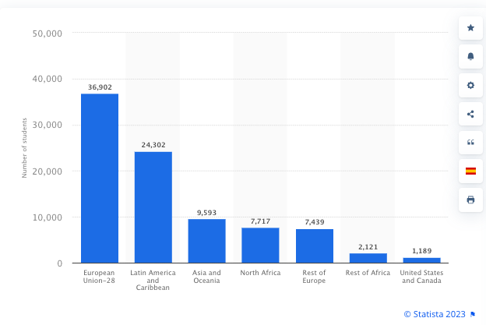
Number of foreign students enrolled in higher education degrees in Spain in the academic year 2022/2023, by origin (Statista, 2023)
In 2022/2023 academic year, the majority of students are from the EU-28 (member of
European Unions), followed by: Latin Americans (because they speak Spanish); Asia and Oceania; North Africa (because it is close to Spain, especially Morocco); rest of Europe (Eastern Europe such as former USSR and the UK); rest of Africa; USA

Slide 7
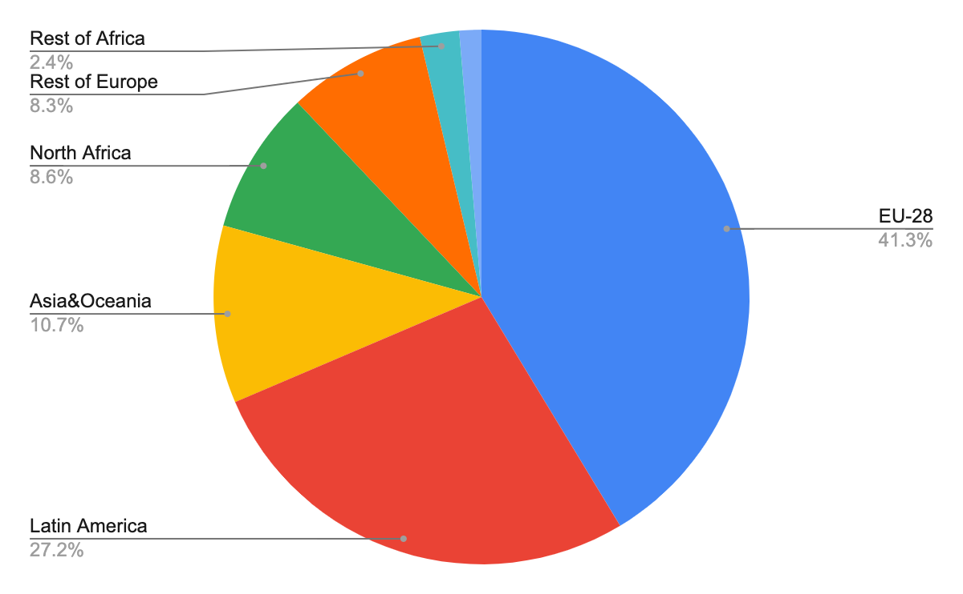
Proportion of foreign students enrolled in higher education degrees in Spain in the academic year 2022/2023, by origin (statista, 2023)
Thaneeya is from Asia, which is now the third biggest group of students who come to study in Spanish Universities.

