Slide 1


Slide 2


Lesson Format
Word/Phrase pronunciation
We help you identify and pronounce each new word or phrase related to the lesson topic
2. Explain the definition
We help you understand the new definition in an easy to understand way.

Slide 3


Lesson Format
3. Example
We provide you with an example and ask you to provide us with an example to ensure you fully understand
4. Quiz
At the end of the lesson we invite you to take the quiz where you can earn a certificate

Slide 4


University Accommodation
Definition will appear here
Example will appear here

Slide 5
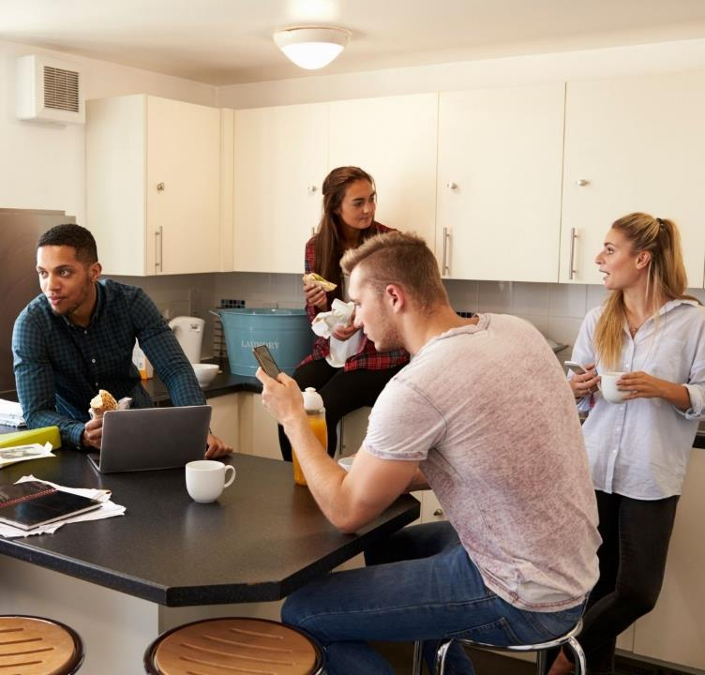
University Halls
Definition will appear here
Example will appear here

Slide 6

University Studios
Definition will appear here
Example will appear here

Slide 7

Courtyard Area
Definition will appear here
Example will appear here

Slide 8
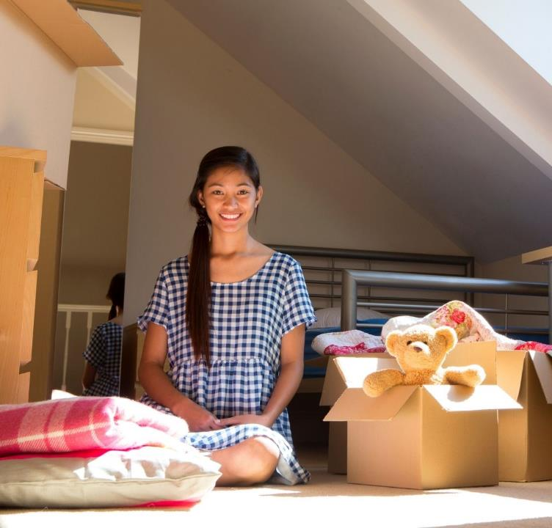
Flat
Definition will appear here
Example will appear here

Slide 9
Gotten Accommodation Sorted
Definition will appear here
Example will appear here

Slide 10
Timely
Definition will appear here
Example will appear here

Slide 11
Private Accommodation
Definition will appear here
Example will appear here

Slide 12
A Span of the Kitchen
Definition will appear here
Example will appear here

Slide 13
Kitchenette
Definition will appear here
Example will appear here

Slide 14
The Facilities
Definition will appear here
Example will appear here

Slide 15
Accommodation Tour
Definition will appear here
Example will appear here

Slide 16
Relatively Short Distance
Definition will appear here
Example will appear here

Slide 17
Studenty Area
Definition will appear here
Example will appear here

Slide 18
Diner Area
Definition will appear here
Example will appear here

Slide 19
En Suite
Definition will appear here
Example will appear here

Slide 20
Games Room
Definition will appear here
Example will appear here

Slide 21
Show Flats
Definition will appear here
Example will appear here

Slide 22
Right on Campus
Definition will appear here
Example will appear here

Slide 23
Common Area
Definition will appear here
Example will appear here

Slide 24


Take the Quiz!
A link will be provided during the lesson for you to take your quiz and earn your certificate. Good luck!
Thank you for following our lesson plan. To sign up to our lessons please feel free to get in touch.

