Slide 1


Unlocking the Power of Exponents and Squares
Join us on a journey to explore the fascinating world of exponents and squares. We'll delve into their definitions, properties, applications, and uncover how they shape our understanding of math and the world around us.
by ONYEDIKACHI ONWURAH

Slide 2

Understanding Exponents
Definition
Example
Exponents represent repeated multiplication of a base number by itself. The exponent indicates the number of times the base is multiplied. For example, 2^3 means 2 multiplied by itself three times: 2 * 2 * 2.
Consider 5^2 (5 to the power of 2). This represents 5 multiplied by itself twice: 5 * 5 = 25. Therefore, 5^2 equals 25. Exponents provide a concise way to express repeated multiplication.

Slide 3
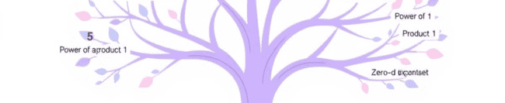
Exponent Properties: The Rules of the Game
1
Product of Powers
2
Quotient of Powers
3
Power of a Power
When multiplying powers with the same base, add the exponents: x^m * x^n = x^(m+n).
When dividing powers with the same base, subtract the exponents: x^m / x^n = x^(m-n).
When raising a power to another power, multiply the exponents: (x^m)^n = x^(m*n).

Slide 4
Squares and Square Roots: Finding Perfect Matches
Squaring
Square Root
Squaring a number means multiplying it by itself. It's the same as raising the number to the power of 2. For example, 4 squared (4^2) is 4 * 4 = 16.
The square root of a number is a value that, when multiplied by itself, equals the original number. For instance, the square root of 16 is 4 because 4 * 4 = 16.

Slide 5
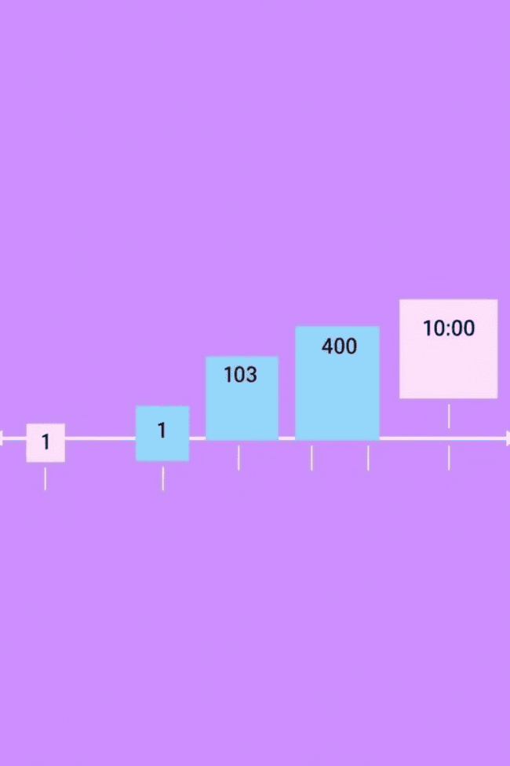


Squaring Numbers: Small and Large
Small Numbers
Large Numbers
Squaring small numbers is straightforward. For example, 3^2 is 3 * 3 = 9. You can easily calculate these squares mentally or using a calculator.
Squaring large numbers can be more challenging. Using a calculator or specialized software can be helpful. For example, 100^2 is 100 * 100 = 10,000.

Slide 6
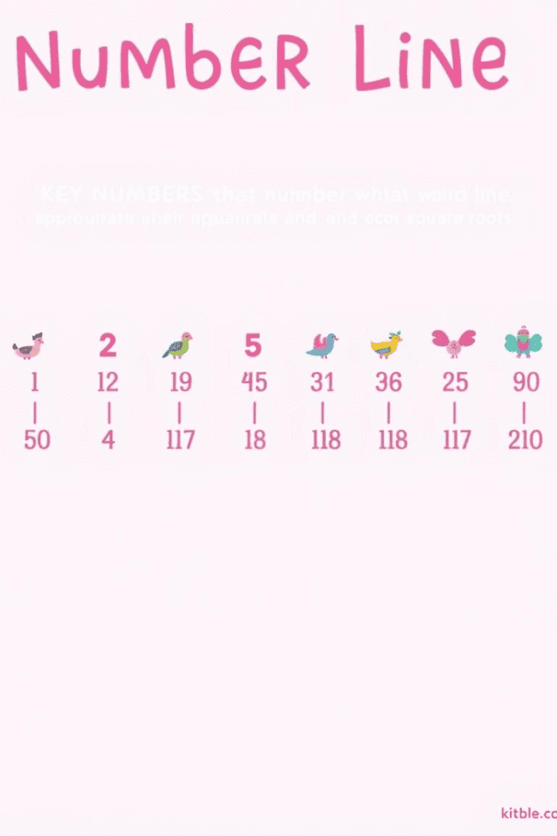
Estimating Squares and Square Roots: Getting Close
1
Estimating Squares
To estimate the square of a number, think of perfect squares near that number. For example, to estimate 7^2, we know 6^2 = 36 and 8^2 = 64. Since 7 is closer to 8, 7^2 will be closer to 64.
2
Estimating Square Roots
To estimate the square root of a number, think of perfect squares near that number. For example, to estimate the square root of 20, we know 16 = 4^2 and 25 = 5^2. Since 20 is closer to 16, the square root of 20 will be closer to 4.

Slide 7




Squares in the Real World: Finding Patterns
Architecture
Squares are fundamental in architectural design. Buildings often feature square windows, doors, and rooms for structural stability and aesthetic appeal.
Construction
Squares are commonly used in construction, as they create strong and rigid structures. Square tiles, beams, and other building materials are essential in constructing buildings, bridges, and other infrastructure.
Technology
Squares are incorporated into various technologies. Computer screens, digital displays, and even the pixels that make up images are based on square grids.

Slide 8
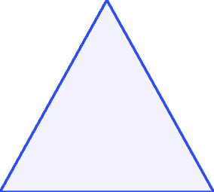
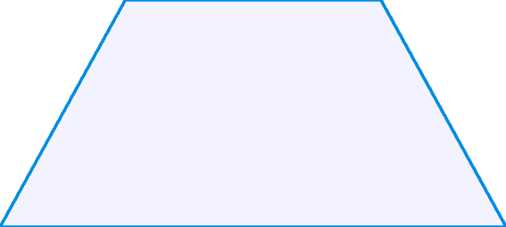

Squares in Geometric Shapes: A Perfect Fit
Area
1
The area of a square is calculated by squaring its side length. For example, a square with a side length of 5 units has an area of 5^2 = 25 square units.
Pythagorean Theorem
2
The Pythagorean Theorem states that in a right triangle, the square of the hypotenuse is equal to the sum of the squares of the other two sides. This theorem plays a crucial role in geometry and trigonometry.
Geometric Patterns
3
Squares form the basis for many geometric patterns, like tessellations and fractals. These patterns can be found in nature, art, and architecture.

Slide 9

Review and Practice: Mastering the Concepts
1
2
Review
Practice
Let's recap what we've learned about exponents and squares. We've explored their definitions, properties, and applications. Understanding these concepts provides a strong foundation for further mathematical exploration.
Practice makes perfect! Work through a set of practice problems to reinforce your understanding of exponents and squares. Apply the concepts to real-world scenarios to see how they connect to our daily lives.

