Slide 1
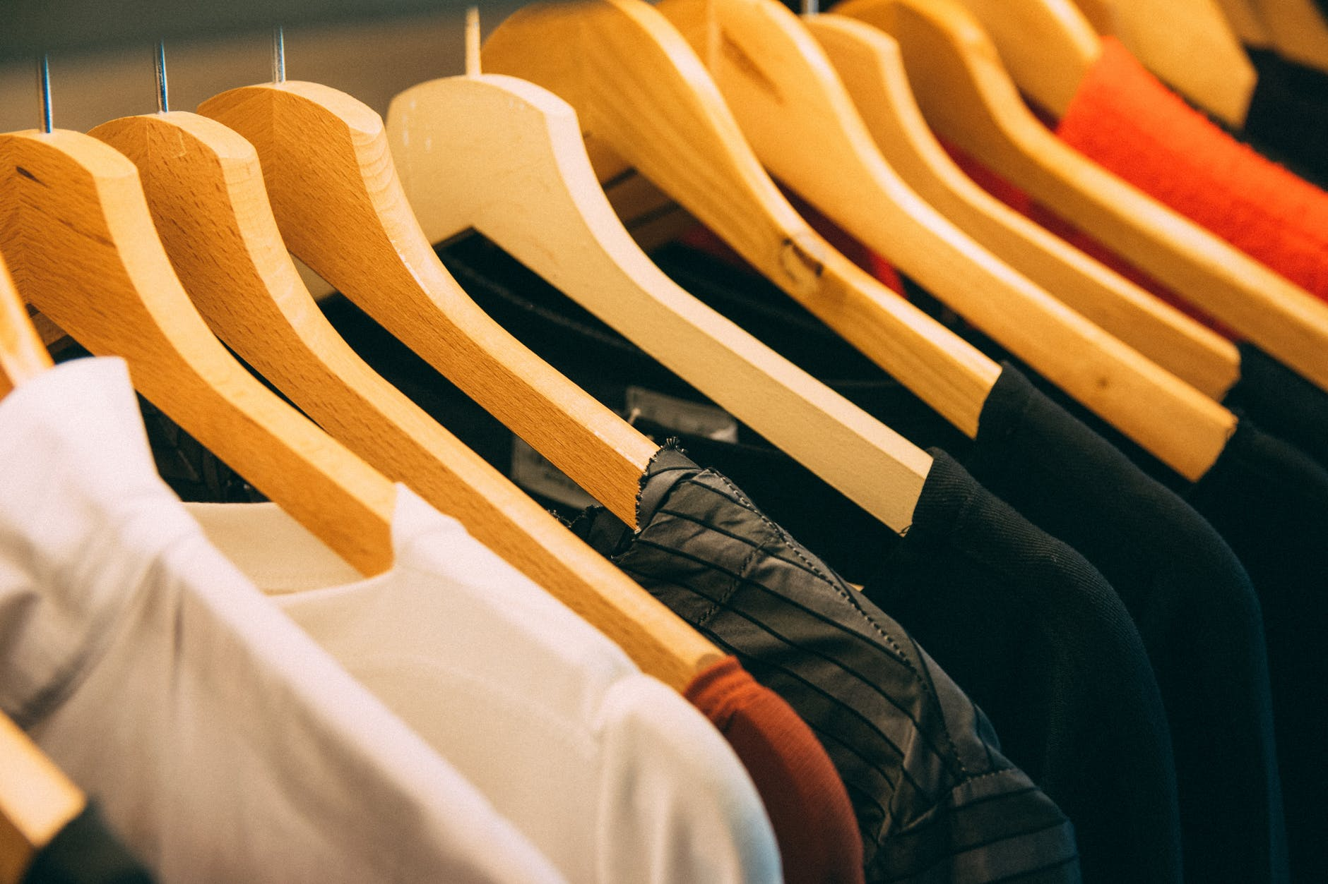
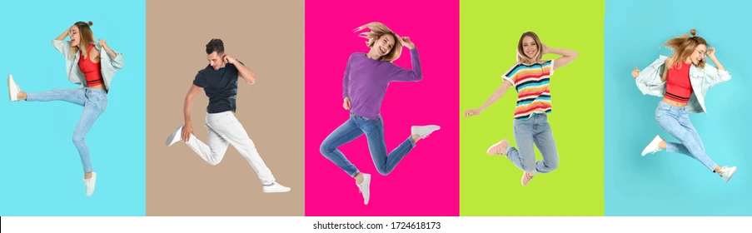
Clothes and fashion

Slide 2
What kind of clothes do you like to wear? Is it important to be fashionable?
Do you prefer comfortable and casual clothes or smart clothes?
Do you spend a lot of time choosing clothes? How do you choose clothes? o
How often do you buy new clothes? Do you spend a lot of money on clothes? What’s the most expensive item of clothing you’ve bought? shoe?

Slide 3
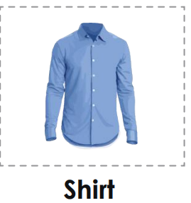
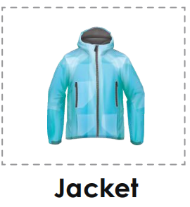
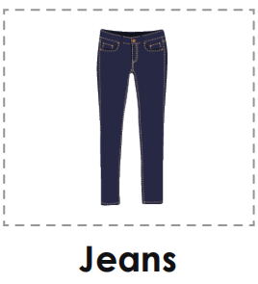
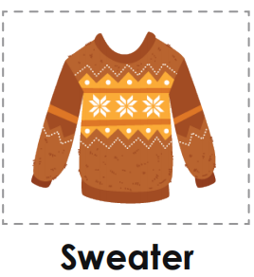
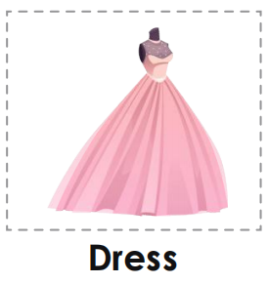
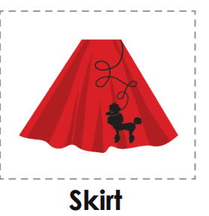
Words on clothes
NEW WORDS!
He wears a shirt to work. That jacket fits you
perfectly.
Jeans are popular among
young people
Peter decided on a blue She wore a pink dress.
sweater.
There's a mark on your skirt.

Slide 4
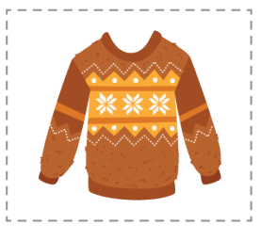
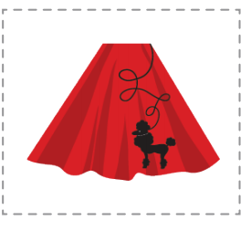
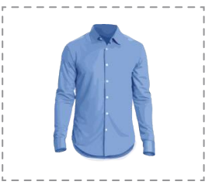
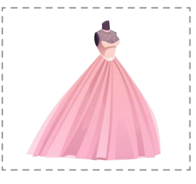
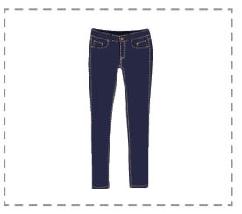
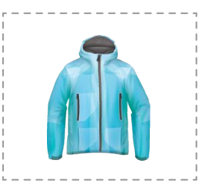
Match the words with the pictures s
skirt dress
jeans shirt
sweater jacket
Make a sentence using the above words

Slide 5
Practice speaking about clothes
1. I wear a sweater when it is cold.
2. I wear a dress to parties.
3. I wear jeans when I get home.
4. This shirt has two pockets. w
This shirt has two pockets.ords to the pictures
I wear pyjamas to sleep. I wear a suit
to work. I wear jeans when I get home

Slide 6
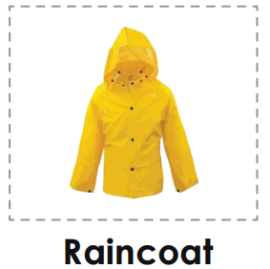
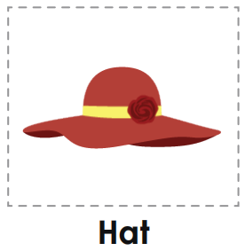
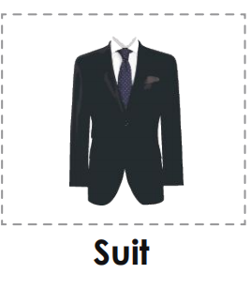
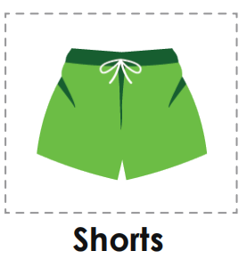
More words on clothes
More Words
I like this purple raincoat. This red hat is pretty.
You look very smart in your He wears a pair of shorts
new suit.

Slide 7
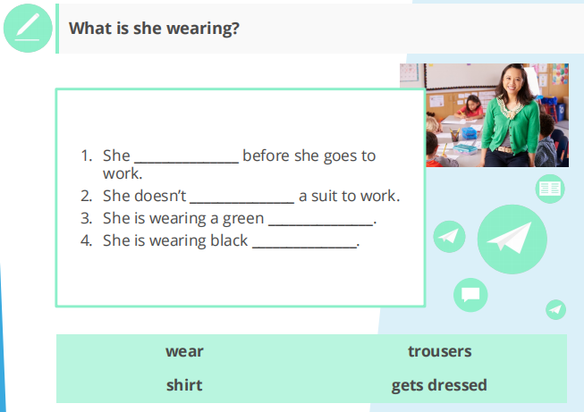
Name the clothes

Slide 8
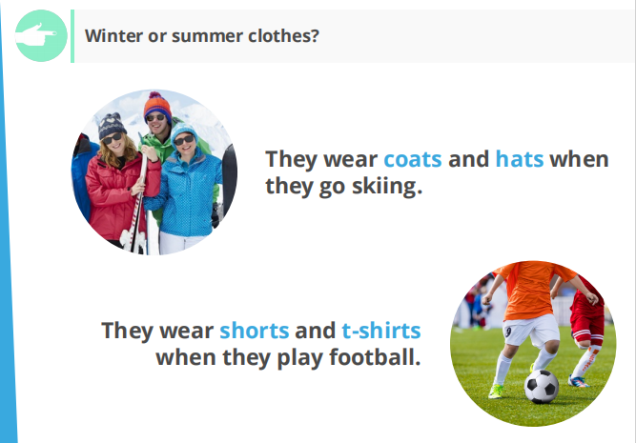
Match the pictures to the words
Shorts
Overalls
Trousers
Jeans

Slide 9
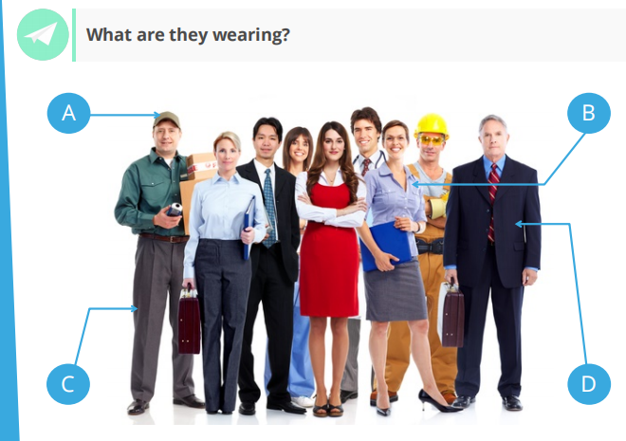
Shoes

Slide 10
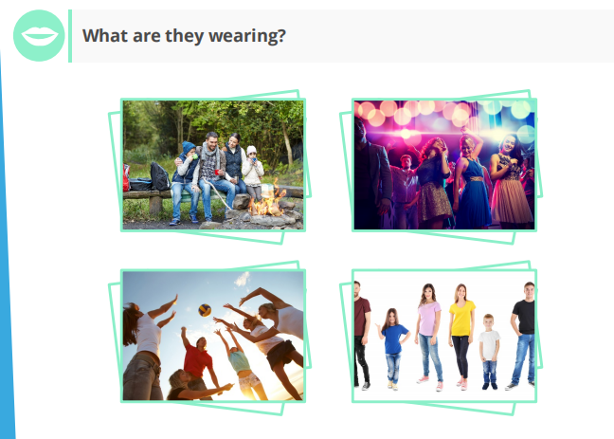
Shoes

Slide 11
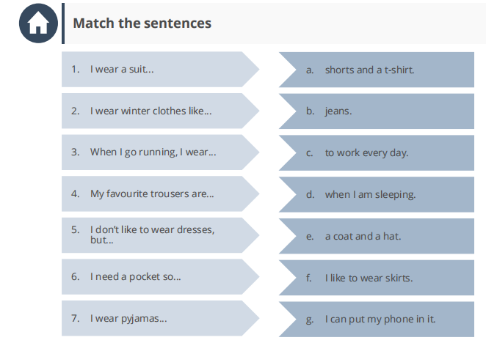
Match the correct words to the images
Boots
High heels
Trainers
Sandals

Slide 12
What are some differences between the clothes worn by old people compared to young people?
Do you prefer smart or casual clothes? Why
Do you like clothes shopping? How do you feel when you buy new clothes? How do you decide which clothes to buy?

