Slide 1
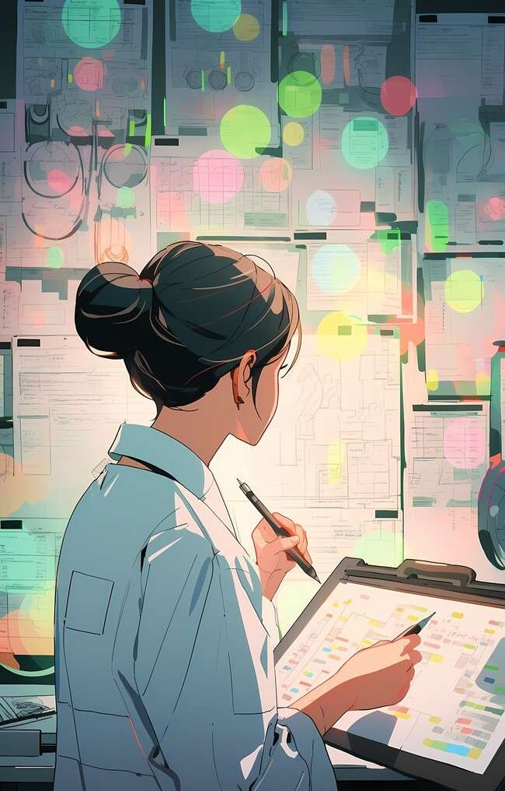
Transforming Spaces: The Art and Science of Linear Transformations

Slide 2
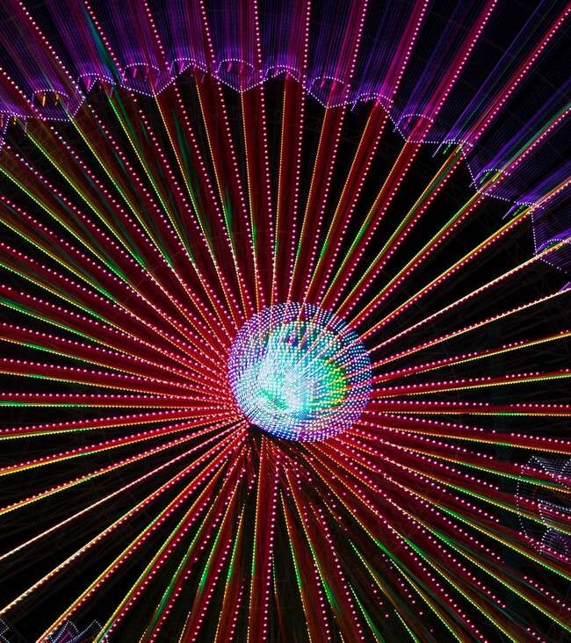

Introduction to Linear Transformations
are mathematical functions that map vectors to other vectors while preserving the operations of vector addition and scalar multiplication. This presentation explores the and behind transforming spaces,
revealing the beauty and utility of these
concepts in various ﬁelds.

Slide 3
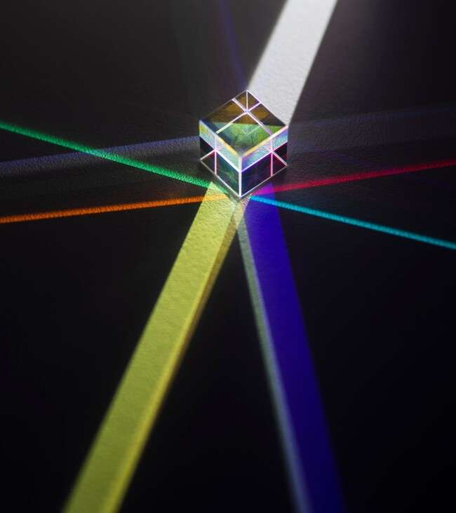



Understanding Vectors
Vectors are the of linear transformations. They represent and
in space. Understanding their properties is crucial for grasping how transformations affect them, leading to fascinating applications in computer graphics, physics, and
engineering.

Slide 4
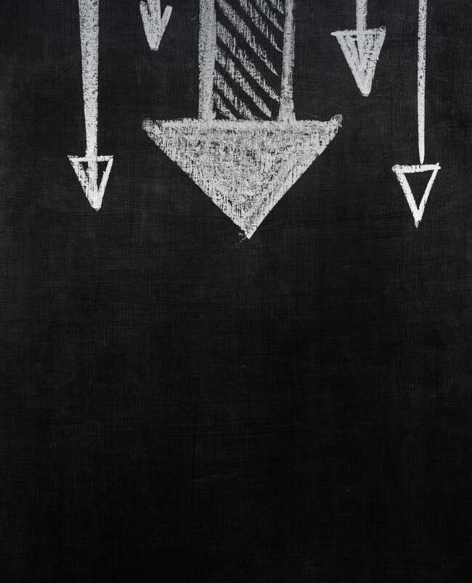




Matrix Representation
Linear transformations can be represented using . Each matrix corresponds to a speciﬁc transformation, such as ,
, or . By manipulating matrices, we can effectively transform spaces and explore their properties and behaviors.

Slide 5
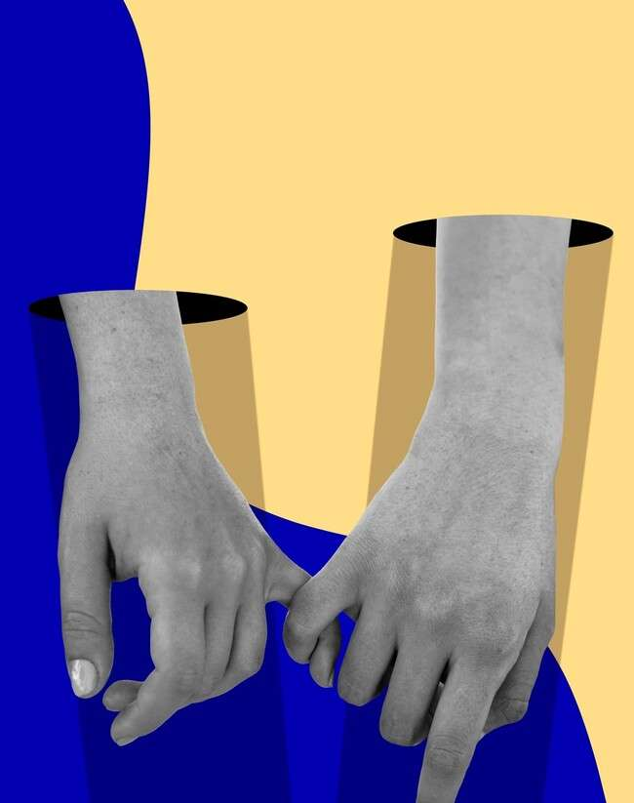

Geometric Interpretations
Visualizing linear transformations provides a
. For example, a scaling transformation enlarges or shrinks shapes, while
a rotation pivots them around a point. These interpretations help us appreciate the
behind mathematical concepts.

Slide 6



Applications in Art
Linear transformations play a signiﬁcant role in and . Artists use transformations to manipulate images, create effects, and
explore new dimensions. Understanding these transformations enhances creativity and opens new avenues for artistic expression.

Slide 7
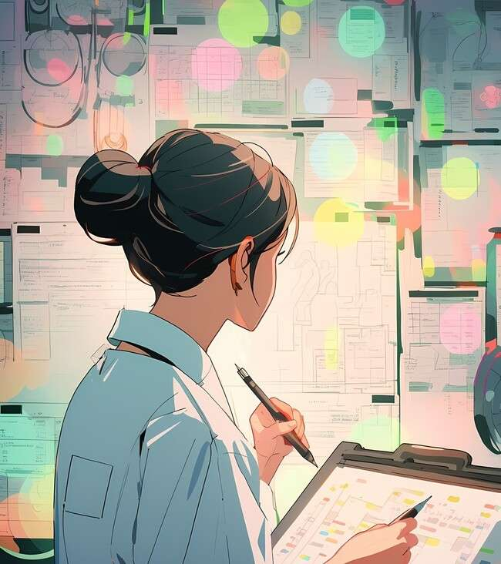


Applications in Science
In science, linear transformations are crucial for and . They help in simplifying complex systems and making predictions. By transforming data spaces, scientists can uncover patterns and insights that drive innovation and discovery.

Slide 8
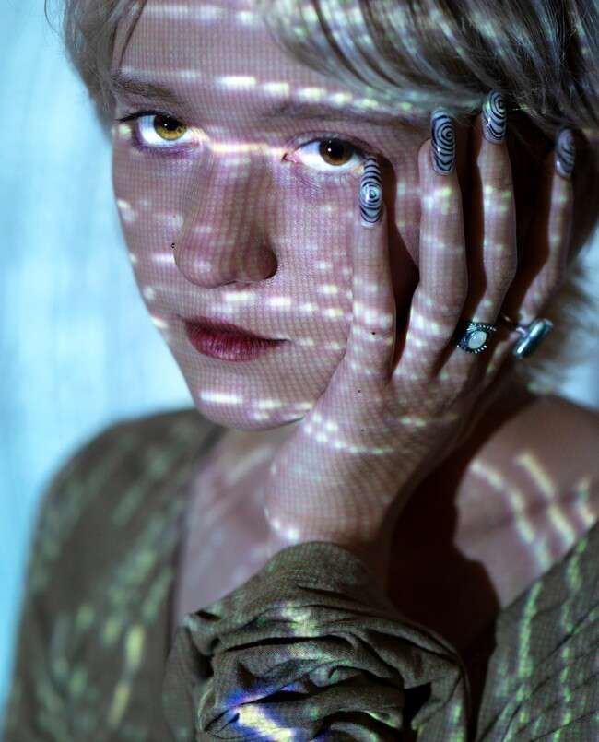


Real-World Examples
From to ,
linear transformations are everywhere. They enhance video games, simulate real-world physics, and even assist in machine learning. Understanding these transformations allows us to harness their power across various industries.

Slide 9
Conclusion: The Beauty of Transformation
Linear transformations blend and , revealing the elegance of mathematical concepts. By transforming spaces, we can create, analyze, and innovate. Embracing these ideas opens up a world of possibilities for both creators and thinkers alike.

Slide 10
Thanks!
Do you have any questions? youremail@email.com
+91 620 421 838
www.yourwebsite.com @yourusername

