Slide 1
Chapter 1: Welcome to Sport and Exercise Psychology
Sport & Exercise Psychology

Slide 2
Objectives of Sport
& Exercise Psychology
Understand the effects of psychological factors on physical and motor performance.
Understand the effects of participation in physical activity on psychological development, health, and well-being.
Notes:
‹#›

Slide 3
Objective 1: Sport & Exercise Psychology Topics
How does anxiety affect a basketball player’s accuracy in free-throw shooting?
Does lacking self-confidence influence a child’s ability to learn to swim?
How does a coach’s reinforcement and punishment influence a team’s cohesion?
Notes:
‹#›

Slide 4
Objective 2: Sport & Exercise Psychology Topics
Does running reduce anxiety and depression?
Do young athletes learn to be overly aggressive from participation in youth sports?
Does participation in daily physical education classes improve a child’s self-esteem?
Notes:
‹#›

Slide 5
Sport Psychology Specialties
Clinical Sport Psychologists
Educational Sport Psychology Specialists

Slide 6
Clinical Sport Psychologists
are licensed psychologists
are trained to work with people with severe emotional disorders
are trained to help athletes with problems such as eating disorders and substance abuse.
Notes:
‹#›

Slide 7
Educational Sport Psychology Specialists
use mental coach approach—understand psychology of human movement
have training in physical education, kinesiology, or exercise and sport science
educate and increase athlete and coach awareness of issues such as anxiety management and confidence development
Notes:
‹#›

Slide 8
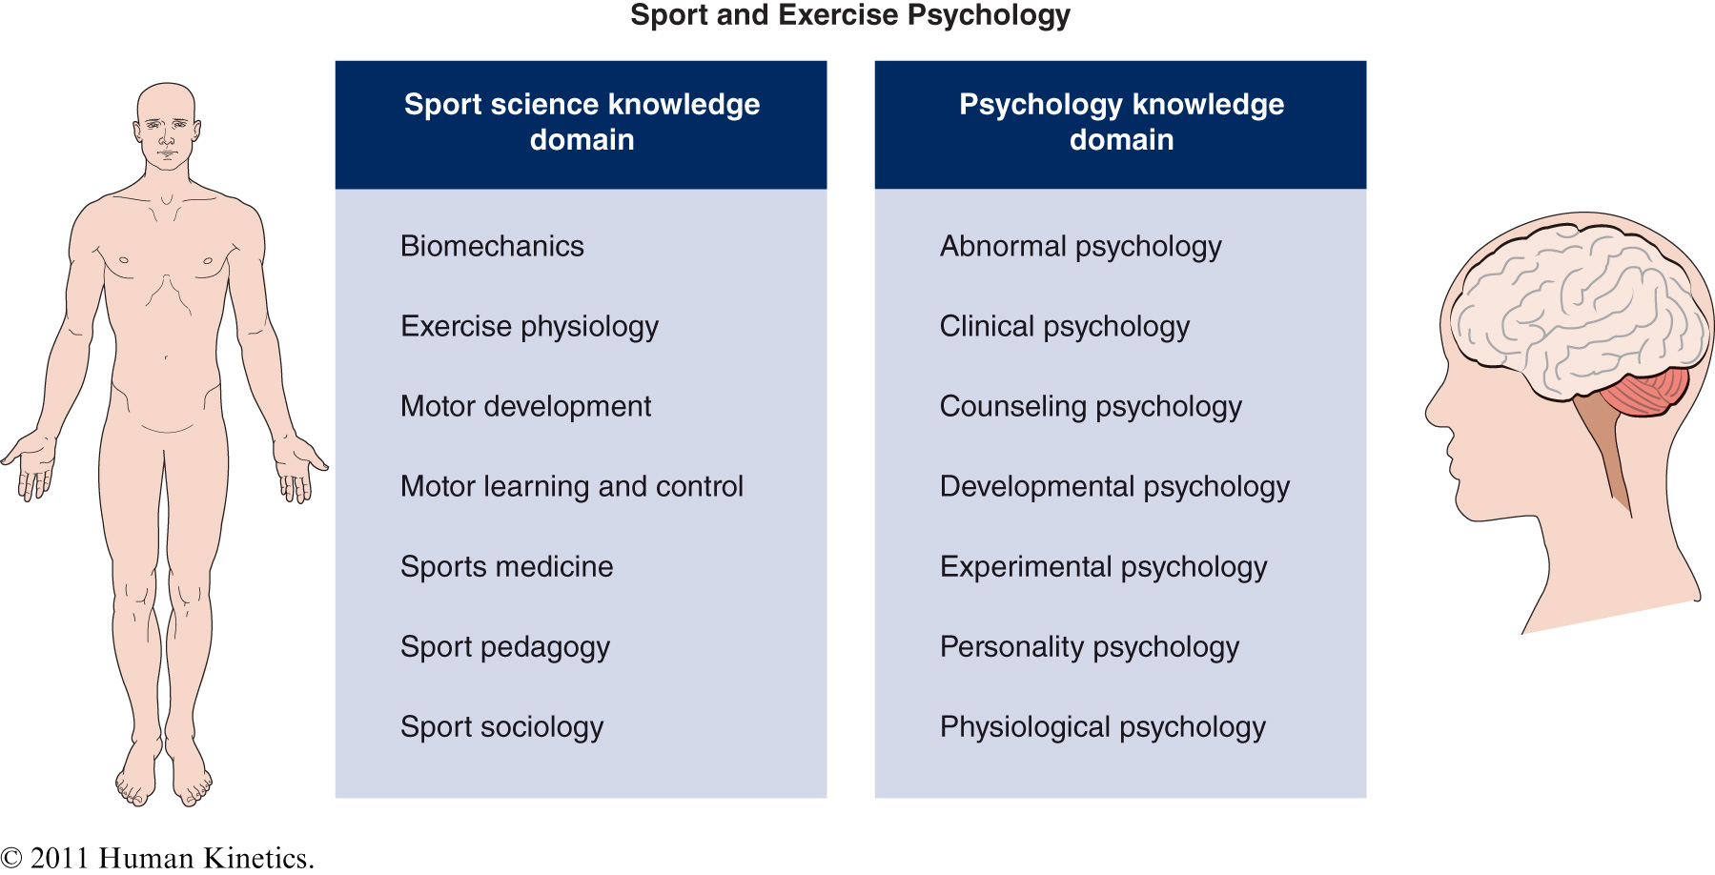
Figure 1.2
Notes:
‹#›

Slide 9
Historical Periods in Sport
& Exercise Psychology
Period 1 Period 2 Period 3 Period 4 Period 5 Period 6 | The early years The Griffith era Preparation for the future Establishment of academic sport psychology Multidisciplinary science and practice in sport and exercise psychology Contemporary sport and exercise psychology | 1893 to 1920 1921 to 1938 1939 to 1965 1966 to 1967 1978 to 2000 2001 to present
Notes:
‹#›

Slide 10
Three Approaches to Sport & Exercise Psychology
Psychophysiological Orientation
Social–Psychological Orientation
Cognitive–Behavioral Orientation

Slide 11
Psychophysiological Orientation
Examines underlying psychophysiological processes of the brain in terms of primary causes of behavior
Example: Biofeedback to a trained marksman

Slide 12
Social–Psychological Orientation
Behavior is determined by a complex interaction of the social environment and the personal makeup of the athlete or exerciser
Example: How a leader’s style and strategies foster group cohesion

Slide 13
Cognitive–Behavioral Orientation
Behavior is determined by both the environment and thoughts (cognitions)
Example: Studying differences in confidence and anxiety among tennis players with or without burnout

Slide 14
Ethical Standards for Sport
& Exercise Psychologists
Competence. Maintain the highest standards in your work and recognize the limits of your expertise
Integrity. Clarify roles and do not falsely advertise
Professional and scientific responsibility. Always place the interests of clients first
(continued)
Notes:
‹#›

Slide 15
Ethical Standards for Sport
& Exercise Psychologists (continued)
Respect for people’s rights and dignity. Respect such fundamental rights as privacy and confidentiality among clients
Concern for the welfare of others. Always contribute to the welfare of those with whom you work
Social responsibility. Contribute to knowledge and human welfare while always protecting participants’ interests
Notes:
‹#›

Slide 16
Sport Psychology & Business Linkage
Lessons learned in high-performance sport can be applied to business
The corporate athlete notion focuses on helping people in business reach their ideal performance states through use of principles of sport psychology and training
Sustain high business performance through leadership development seminars, team-building activities, and one-on-one coaching

