Slide 1

Understanding Von Neumann Architecture
IGCSE Computer Science
Dr. Jyotsna Sharma

Slide 2
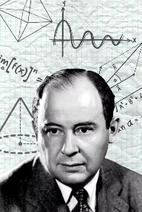
CHAPTER 1: HISTORY
The Origin of Von Neumann Architecture
Designed by the brilliant Hungarian-American mathematician John von Neumann in the 1940s, this revolutionary architecture transformed computing forever.
It was the first architecture to store both programs and data in the same memory, fundamentally changing how computers operated.
Before this, computers had to be physically rewired to change tasks. Von Neumann proposed storing instructions and data in the same memory (RAM).
from fixed-program machines—which required physical rewiring for different tasks—to flexible stored-program machines
Example : World Trade Centre
The building (Hardware) stays the same, but the exhibitions (Programs/Data) inside can be changed whenever they want without rebuilding the walls.
sometimes it is The Gulf Food Exhibition, another time, GITEX

Slide 3
KEY INNOVATION
Key Concept: Stored Programme Architecture
Unified Memory Storage
Sequential Execution
Ultimate Flexibility
Both instructions and data are stored together in main memory as binary code, eliminating the need for separate storage systems.
The CPU fetches instructions one at a time from memory and executes them sequentially, following a predictable pattern.
Programmes can be changed, updated, or replaced simply by modifying memory contents—no physical rewiring required.

Slide 4
CHAPTER 2: COMPONENTS
Main Components of the CPU in
Von Neumann Architecture
Control Unit (CU)
Arithmetic Logic Unit (ALU)
CPU's command centre that coordinates all operations, decodes instructions, and directs data flow throughout the system.
The mathematical brain that performs all calculations (addition, subtraction, multiplication, division) and logical decisions (comparisons and Boolean operations)
Registers
Buses
Tiny, ultra-fast memory locations inside the CPU to store data and instructions currently being processed for immediate access
Electronic pathways (wires) that transfer data, memory addresses, and control signals between CPU components and main memory.

Slide 5
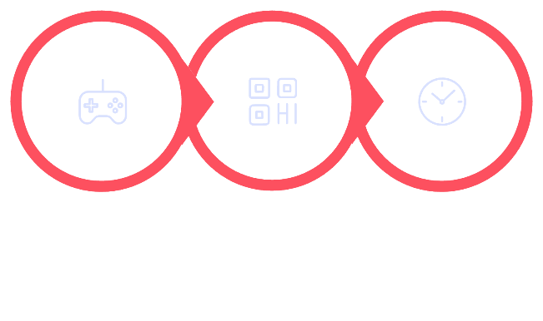



The Control Unit (CU) : The Manager
Key Functions
Sends control signals to other CPU parts to manage and direct data flow throughout the system using the Control Bus
Decodes instructions fetched from memory into executable operations
Works with the system clock to synchronise all CPU activities and maintain timing
Ensures each component performs its task at precisely the right moment
Sends Signals
Decodes Instruction
Syncs Clock
The Control Unit orchestrates the entire CPU's operation cycle with precision timing.

Slide 6
The Arithmetic Logic Unit (ALU) : The Calculator
Arithmetic Operations
Logical Operations
Practical Example
Executes all mathematical calculations including addition, subtraction, multiplication, and division on numeric data.
Performs comparisons (greater than, less than, equal to) and Boolean logic operations (AND, OR, NOT) for decision-making.
IF X > 5 THEN execute specific instruction—the ALU compares X to 5 and determines the program flow.

Slide 7

ESSENTIAL KNOWLEDGE
Key Registers and Their Roles
Registers are the CPU's fastest tiny memory locations, each with a specialised purpose in the instruction cycle:
Register Name
Acronym
Purpose
Program Counter
PC
Holds the memory address of the next instruction to be fetched; automatically increments after each cycle
Memory Address Register
MAR
Stores the address of the data or instruction that needs to be fetched from main memory (like the GPS)
Memory Data Register
MDR
Temporarily holds the actual data or instruction that has been fetched from memory
Current Instruction Register
CIR
Contains the instruction currently being decoded and executed by the Control Unit
Accumulator
ACC
Stores intermediate results from ALU calculations for use in the next operation cycle

Slide 8
Registers explained with simple examples
Register
Function
PC
Points to the next "Address" in line
MAR
The "GPS" – it holds the address of where to go in RAM
MDR
The "Delivery Truck" – it holds the actual data being moved.
CIR
The "Instruction Manual" – holds the current command being decoded.
ACC
The "Working Total" – holds the result of the last calculation.

Slide 9
How Registers Work in the Fetch-Decode-Execute Cycle
01
02
03
Program Counter Initiates
Memory Data Retrieval
Instruction Storage
PC points to the next instruction's memory address, which is then copied to the MAR
MDR fetches the instruction or data from memory at the address specified by MAR
CIR receives and stores the current instruction from MDR for decoding by the Control Unit
04
05
Calculation Processing
Counter Advancement
ALU performs operations and stores calculation results in the ACC for the next cycle
PC automatically increments to point to the next instruction's memory address, continuing the cycle

Slide 10
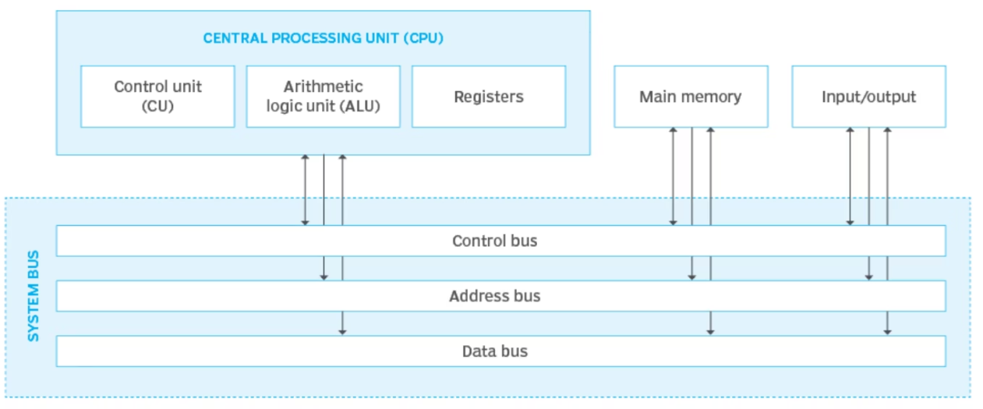
System Bus (The Highway)
Address Bus: (Unidirectional) Like Sheikh Zayed Road signs—they only tell you where to go.
Data Bus: (Bidirectional) Like the actual cars and trucks carrying goods back and forth between the Warehouse (RAM) and the Shop (CPU).
Control Bus: (Bidirectional) Like the traffic lights and police directing the flow so no crashes occur.

Slide 11

CORE PROCESS
The Fetch-Decode-Execute Cycle Explained
1
2
3
Fetch Phase
Decode Phase
Execute Phase
The CPU retrieves the next instruction from main memory using the Program Counter (PC) and Memory Address Register (MAR).
The Control Unit interprets and decodes the instruction stored in the Current Instruction Register (CIR).
The ALU or CU performs the instruction's operation—whether calculation, data movement, or logical decision.
(e.g., "Add these numbers").
And the result is saved in the Accumulator.
The CU gets the address from the PC, tells the MAR where to look, and the Data Bus brings the instruction to the MDR.
This cycle repeats continuously at incredible speeds until the programme completes execution.

Slide 12
The "Bottleneck" (The Traffic Jam)
The Problem: The CPU is incredibly fast, but the Data Bus is slower.
The Result: The CPU often has to wait for data to arrive from the RAM.
Example Even if you have the fastest Ferrari in the world (The CPU), you can only go as fast as the traffic on the road (The Bus) allows during rush hour (speed limit 100-120 kmph, even if Sachin Tendulkar would want to drive his Ferrari 360 Modena at its top speed of 296 km/h
Solution : Cache Memory
Cache is a small, incredibly fast type of memory located inside or very close to the CPU.
How it works: It stores frequently used data and instructions so the CPU doesn't have to go all the way back to the RAM via the slow system bus every time.

