Slide 1

Introduction to power bi
Dr. Jyotsna Sharma

Slide 2
Introduction
Power BI is a powerful business analytics tool developed by Microsoft.
It enables users to :
Visualize Data
Share Insights
To make informed decisions based on real-time information.

Slide 3
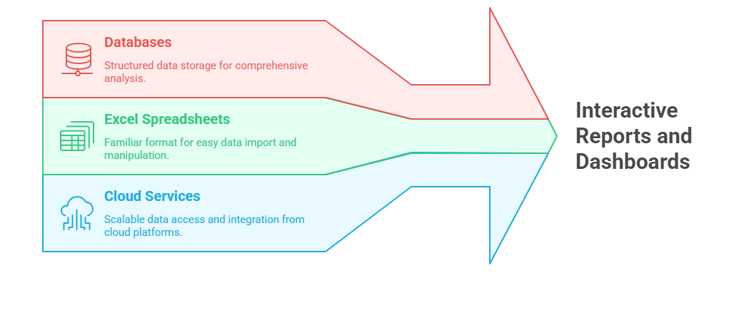
Overview of power bi
Power BI allows users to connect to various data sources, including databases, Excel spreadsheets, and cloud services, to create interactive reports and dashboards that help in understanding complex data sets.

Slide 4
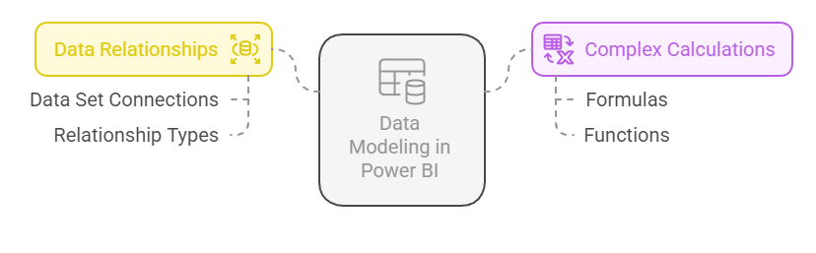
Key features
Data Connectivity: A wide range of data sources are supported, making it easy to import and analyze data from different platforms
Interactive Dashboards: Customizable dashboards provide a snapshot of key metrics and performance indicators (KPIs)
Data Modeling: Power BI offers great data modeling capabilities, allowing users to create relationships between different data sets and perform complex calculations.

Slide 5
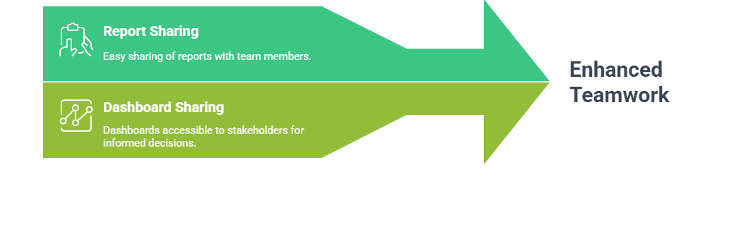
Key features
Real-time Analytics: Real-time data and insights enables timely decision-making.
Collaboration: Power BI facilitates collaboration by allowing users to share reports and dashboards with team members and stakeholders.
Mobile Access: The Power BI mobile app ensures that users can access their reports and dashboards on the go, providing flexibility and convenience.

Slide 6
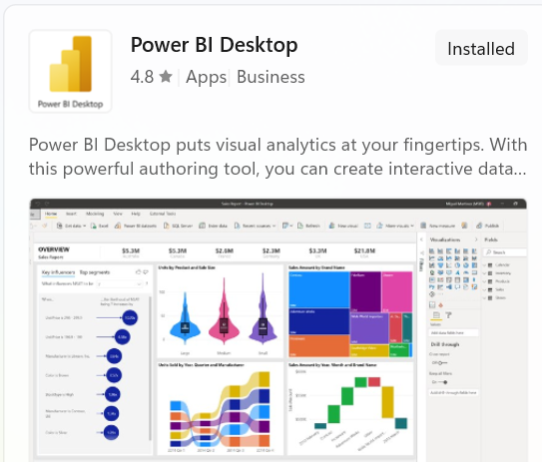
Getting started
Power BI Desktop application can be downloaded directly from
https://www.microsoft.com/en-us/power-platform/products/power-bi/downloads
Or selected to be downloaded from the Microsoft Store Application
After installation, users can connect to their data sources,
create visualizations,and publish their reports to the
Power BI service for sharing and collaboration.

Slide 7
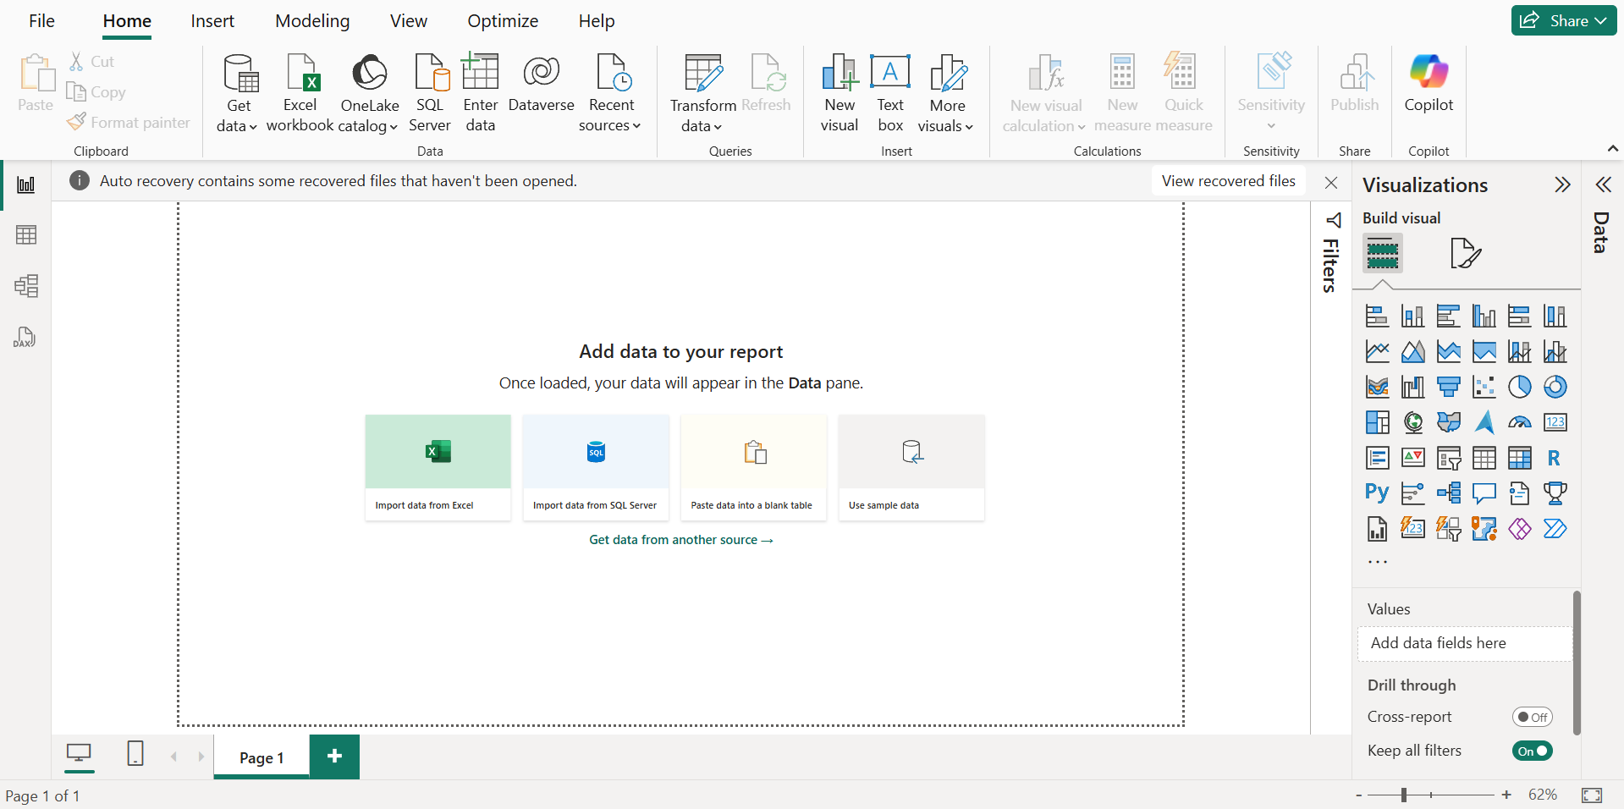
Getting started

Slide 8
conclusion
Power BI is an essential tool for businesses/professionals looking to leverage data for strategic decision-making.
Its intuitive interface, powerful features, and ability to connect to various data sources can greatly enhance the data analytics capabilities of organizations.
By utilizing Power BI, businesses can gain deeper insights into their operations and drive better outcomes.

