Slide 1

Employee Rights under the Employment Ordinance:
A Comprehensive Overview
Tutor: Okwudili O. ONWURAH, LL.B. (Nigeria); BL (Abuja, Nigeria); LLM (Exeter, UK); LLM (Qingdao, PRC); LLM (Shanghai, PRC)
PhD in Law (Hong Kong)
Dr Okwudili O. Onwurah

Slide 2
Minor House Keeping
The purpose of the online lesson is to encourage you to participate actively in achieving your needs and simplifying your legal education. I want you to be the best!
Will make the learning process more interactive discussions and feel free to ask any question or you can speak.
You have the right to choose whether to turn on your video or not.
Participation prepares you for your exam and learning needs with ease.

Slide 3

Introduction
Welcome to this comprehensive overview of employee rights under the Hong Kong Employment Ordinance. This presentation aims to provide human resources professionals, legal experts, and employees with a thorough understanding of the legal framework protecting workers in Hong Kong. We'll explore statutory rights, examine relevant case law, discuss protections against discrimination, and compare Hong Kong's system with that of the UK. By the end, you'll have a clear grasp of employee rights, enforcement mechanisms, and resources for further information.

Slide 4

Statutory Rights: Wages, Leave, and Termination Protection
1
Wage Protection
The Employment Ordinance mandates timely payment of wages, typically within 7 days after the end of the wage period.
Employers failing to pay wages on time may face criminal charges and civil liabilities.
2
Leave Entitlements
Employees are entitled to various types of leave, including annual leave (7-14 days based on years of service), statutory holidays (12 days per year), and sick leave (2 paid sick days per month, accumulating up to 120 days).
3
Termination Protection
The ordinance provides for notice periods or payment in lieu, as well as severance or long-service payments for eligible employees. Unreasonable and unlawful dismissal provisions offer additional protection against unfair termination.

Slide 5
Case Law: Hong Kong Trade Development Council v Wong Chi Ming
1
Background
The case of Hong Kong Trade Development Council v Wong Chi Ming (2008) was a landmark decision that clarified the scope of employee
rights under the Employment Ordinance.
2
Key Issue
The case centred on whether a continuous contract of employment existed, which would entitle the employee to certain benefits under the
ordinance.
3
Court's Decision
The Court of Final Appeal ruled that even if an employee works less than 18 hours per week, they may still be considered under a continuous contract if there is regularity and continuity in the employment relationship.
4
Impact
This decision broadened the protection of the Employment Ordinance, ensuring that more workers could access statutory benefits and protections.

Slide 6

Employee Protections in Disciplinary Actions
Right to Be Heard
Employees have the right to be informed of allegations against them and given an opportunity to respond before any disciplinary action is taken.
Proportionality
Any disciplinary action must be proportionate to the alleged misconduct. Employers must consider the severity of the offence and the employee's past record.
Appeal Process
Companies should have a clear appeal process in place for
employees who wish to challenge disciplinary decisions.
Documentation
All disciplinary proceedings should be properly documented to
ensure transparency and fairness throughout the process.

Slide 7
Equal Pay and Anti-Discrimination Provisions
Equal Pay for Equal Work
The Sex Discrimination Ordinance mandates equal pay for equal work, regardless of gender. This principle extends to all aspects of remuneration, including bonuses and benefits.
Anti-Discrimination Laws
Hong Kong has four main anti- discrimination ordinances covering sex, disability, family status, and race. These laws prohibit discrimination in employment, including recruitment, promotion, and termination.
Reasonable Accommodation
Employers are required to make reasonable accommodations for employees with disabilities, unless doing so would cause undue hardship to the organisation.

Slide 8

Comparison with the UK Framework
Aspect | Hong Kong | United Kingdom
Minimum Wage | Statutory Minimum Wage Ordinance | National Minimum Wage Act
Working Hours | No statutory limit | Working Time Regulations
Paid Leave | 7-14 days (based on service) | 28 days (including public holidays)
Parental Leave | 14 weeks maternity, 5 days paternity | 52 weeks maternity, 2 weeks paternity

Slide 9


Case Studies: Common Disputes over Employee Rights
Unpaid Overtime
Many disputes arise from employees claiming unpaid overtime. In a recent case, the Labour Tribunal ruled in favour of an employee who had documented evidence of regular unpaid overtime work.
Wrongful Dismissal
A common dispute involves claims of wrongful dismissal. In one notable case, an employee successfully argued that their dismissal was due to their participation in union activities, which is protected under law.
Discrimination Claims
Discrimination cases are increasingly common. The Equal Opportunities Commission recently handled a case where an employee was passed over for promotion due to their age, resulting in a substantial settlement.

Slide 10




Enforcement and Penalties
Labour Tribunal
The Labour Tribunal handles employment disputes efficiently and inexpensively. It has the power to make legally binding awards up to HK$15,000.
Labour Department
The Labour Department investigates and prosecutes employers for breaches of the Employment Ordinance. Penalties can include fines and imprisonment for serious offences.
Civil Courts
For claims exceeding the Labour Tribunal's jurisdiction, employees can pursue action in
the civil courts, which can award larger damages and issue injunctions.

Slide 11

Resources for Employees Seeking Legal Advice
1
Labour Relations Division
The Labour Department's Labour Relations Division offers free consultation services and conciliation for employment disputes. They can provide information on labour laws and employee rights.
2
Legal Aid Department
Employees who meet certain financial criteria can apply for legal aid to pursue their cases in court. This service covers both civil and criminal matters related to employment.
3
NGOs and Trade Unions
Various non-governmental organisations and trade unions in Hong Kong offer free or low-cost legal advice to workers. These include the Hong Kong Confederation of Trade Unions and the Justice Centre Hong Kong.

Slide 12

Recap: Key Employee Rights
Wage Protection
Timely payment of wages, minimum wage compliance, and protection against unlawful deductions are fundamental rights under the Employment Ordinance.
Leave Entitlements
Statutory annual leave, paid sick leave, and maternity/paternity leave are crucial benefits that contribute to work-life balance and employee well-being.
Termination Safeguards
Protection against unreasonable and unlawful dismissal, as well as entitlement to severance or long service payments under specific conditions.
Non-Discrimination
Equal opportunities in all aspects of employment, free from discrimination based on gender, race, disability, or family status.

Slide 13


Q&A: Common Employee Concerns
Can my employer change my contract without my consent?
Generally, no. Any changes to employment terms must be mutually agreed upon. Unilateral changes by the employer may constitute a breach of contract.
Am I entitled to overtime pay?
The Employment Ordinance does not mandate overtime pay. However, if your contract specifies overtime rates, your employer must honour them.
What should I do if I face workplace discrimination?
Document the incidents, report to your HR department, and consider filing a complaint with the Equal Opportunities Commission if the issue persists.

Slide 14
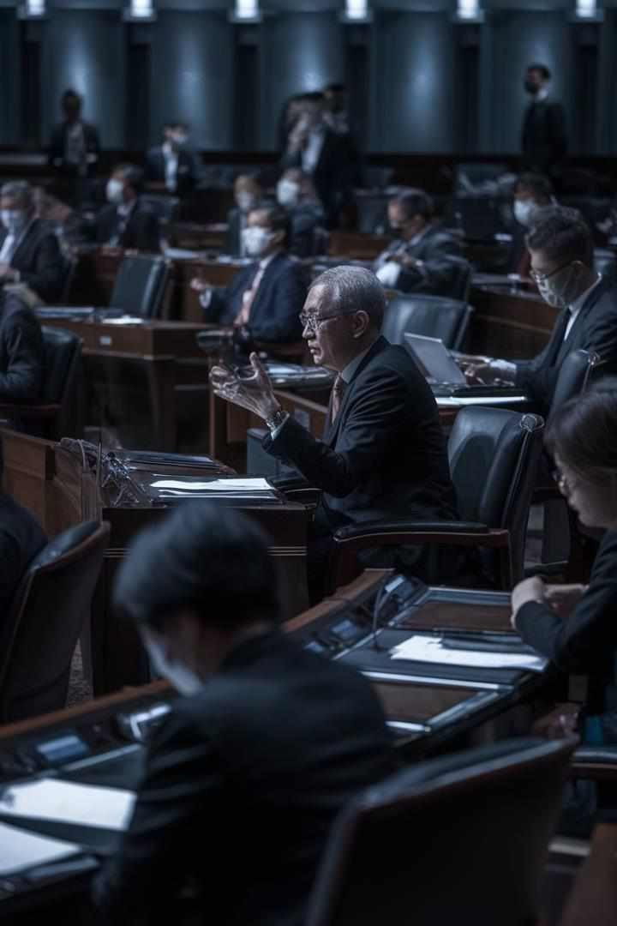
Recent Developments in Employment Law
1
2022: Extended Maternity Leave
Statutory maternity leave was extended from 10 to 14 weeks, with the additional 4 weeks funded by the government.
2
2023: Proposed Working Hours Regulation
Discussions are ongoing about introducing standard working hours legislation to address concerns over long working hours in Hong Kong.
3
2024: Enhanced Anti-Discrimination Measures
Proposed amendments to strengthen protection against workplace harassment and expand the scope of anti-discrimination laws.

Slide 15





Best Practices for Employers
Clear Policies
Develop and communicate clear, comprehensive employment policies that align with the Employment Ordinance and other relevant laws.
Open Communication
Foster an environment of open dialogue where employees feel comfortable discussing concerns without fear of retaliation.
Fair Procedures
Implement fair and transparent procedures for handling grievances, disciplinary actions, and performance evaluations.
Continuous Education
Provide regular training to managers and employees on their rights and responsibilities under employment law.

Slide 16
Future Trends in Employee Rights
Flexible Working Arrangements
As remote work becomes more prevalent, there's a growing push for legislation to protect employees' rights in flexible working arrangements, including the right to disconnect outside of working hours.
Gig Economy Protections
With the rise of the gig economy, there's increasing pressure to extend employment protections to freelancers and independent contractors, potentially redefining the employer-employee relationship.
AI and Automation
As AI and automation become more prevalent in the workplace, new regulations may be needed to protect employees from unfair treatment by algorithms and ensure transparency in AI-driven decision-making processes.

Slide 17

Conclusion: Empowering Hong Kong's Workforce
1
Knowledge is Power
Understanding your rights as an employee is crucial for maintaining a fair and productive work environment. Stay informed about the Employment Ordinance and its updates.
2
Collective Responsibility
Both employers and employees play a role in upholding workplace rights. Open communication and mutual respect are key to resolving issues effectively.
3
Continuous Improvement
As Hong Kong's economy evolves, so too must its employment laws. Engage in discussions about workplace rights and contribute to shaping the future of labour relations in Hong Kong.

