Slide 1
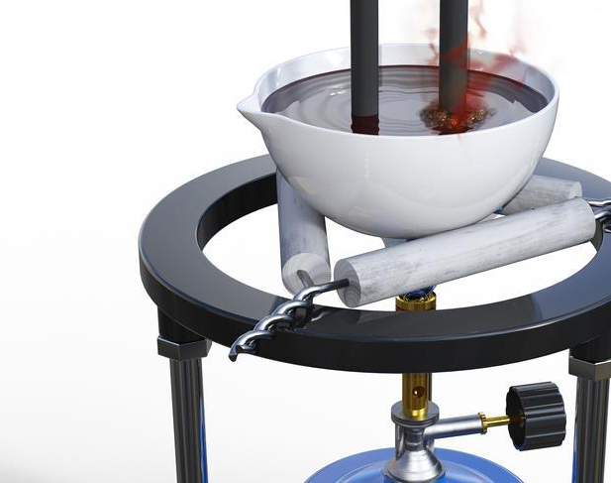

Electrolysis of molten ionic compounds
Notes:
Welcome to another one of my videos. This time I am going to introduce to you the electrolysis of molten ionic compounds. This is the principle used in the extraction of highly reactive metals.

Slide 2
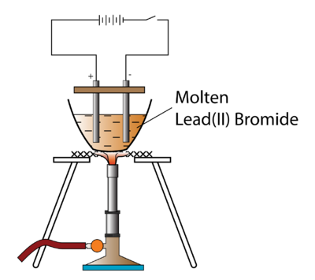
Example:
Notes:
Let’s take molten lead(II) bromide as an example.

Slide 3
Important points:
Endothermic
Redox
Constant heat source
Inert electrodes
Notes:
Electrolysis is the decomposition of an electrolyte using electricity. Since the reaction requires the input of electrical energy, electrolysis is endothermic.
During electrolysis, one of the ions in the electrolyte get reduced, and the other gets oxidized. We will learn how to write the half equations later on in this video.
Lead(II) bromide melts at over 370 degree Celsius. This means that constant heat is needed for the electrolysis to proceed. If the compound starts to crystallise, the ions will stop moving freely and won’t conduct electricity anymore.
Molten ionic compounds are always electrolysed using inert electrodes to avoid displacement reactions. Examples of inert electrodes include graphite and platinum.

Slide 4
List the ions:
CV
CV
Pb²⁺
Br⁻
Pb²⁺
Pb²⁺
Br⁻
Br⁻
Br⁻
Br⁻
Br⁻
Br⁻
Pb²⁺
Notes:
Now let’s take a closer look. Notice that the circuit is not switched on, yet. Since the electrolyte is molten lead(II) bromide, it contains NO water. So, there are only two kinds of ions, lead(II) and bromide.

Slide 5
Movements:
CV
CV
Pb²⁺
Pb²⁺
Br⁻
Br⁻
Br⁻
Br⁻
Br⁻
Br⁻
Pb²⁺
Notes:
When the circuit is switched on, the electrode attached to the positive terminal of the battery becomes positively charged, and the one attached to the negative terminal of the battery becomes negatively charged.

Slide 6
Movement 1:
Anode
Cathode
CV
CV
Ions
move to oppositely charged electrodes
Br⁻
Br⁻
Pb²⁺
Br⁻
Br⁻
Pb²⁺
Br⁻
Pb²⁺
Br⁻
Notes:
Then the positive ions, or the cations, are attracted to the negative electrode, or the cathode.
The negative ions, or the anions, are attracted to the positive electrode, or the anode.

Slide 7
Reactions:
Anode
Cathode
CV
CV
Anode
Bromide undergoes oxidation
Br⁻ → Br₂
e⁻
Br
e⁻
Pb²⁺
2
+ 2e⁻
Br
e⁻
Br
Pb²⁺
brown gas
Br
e⁻
Pb²⁺
e⁻
Br
e⁻
Br
Notes:
Let’s talk about the reaction on the anode. Bromide ions give away an electron and undergo oxidation reaction, forming bromine, which is a brown gas at this temperature.

Slide 8
e⁻
Movement 2:
Anode
e⁻
Cathode
e⁻
CV
Br
CV
Electrons
move from anode to cathode
e⁻
Br
Br
e⁻
Br
e⁻
Pb²⁺
Br
e⁻
Br
Pb²⁺
Pb²⁺
Notes:
The electrons released by bromide goes through the external circuit, or the wire, to the cathode.

Slide 9
e⁻
Reactions:
Anode
Cathode
e⁻
CV
Br
CV
Cathode
Lead(II) undergoes reduction
Pb²⁺ → Pb
Br
e⁻
Br
Br
e⁻
Pb²⁺
+ 2e⁻
Br
e⁻
Br
Pb²⁺
e⁻
Pb²⁺
e⁻
Notes:
On the cathode, lead(II) ions gain 2 electrons each and undergoes reduction to form lead metal, which is liquid at this temperature.

Slide 10
e⁻
Reactions:
Anode
Cathode
CV
Br
CV
Cathode
Lead(II) undergoes reduction
Pb²⁺ → Pb
Br
Br
Br
Pb
+ 2e⁻
Br
Br
Pb
silver liquid
Pb
Notes:
The electrons released by bromide goes through the external circuit, or the wire, to the cathode.

Slide 11
Let’s recap:
Ions : Pb²⁺ and Br⁻
Ions move through the electrolyte
Pb²⁺ is attracted to the cathode and undergoes reduction
Br⁻ is attracted to the anode and undergoes oxidation
Electrons move from the anode to the cathode
Notes:
In the electrolysis of molten lead(II) bromide, there are two types of ions present, lead(II) and bromide ions. Ions move to oppositely charged electrodes. The cations, lead(II), are attracted to the cathode where they gain electrons and undergo reduction. In the meantime, the anions, bromide, are attracted to the anode where they release electrons and undergo oxidation. Electrons are transferred from anode to cathode through the external circuit, or the wire.
Click the links above for exam-style questions on electrolysis of molten substances.

