Slide 1
gcse english Literature
Jordan MErna
Comprehending GCSE’s…
REMEMBER: Exams are not there to trick you, they are there so you can show off your knowledge!

Slide 2
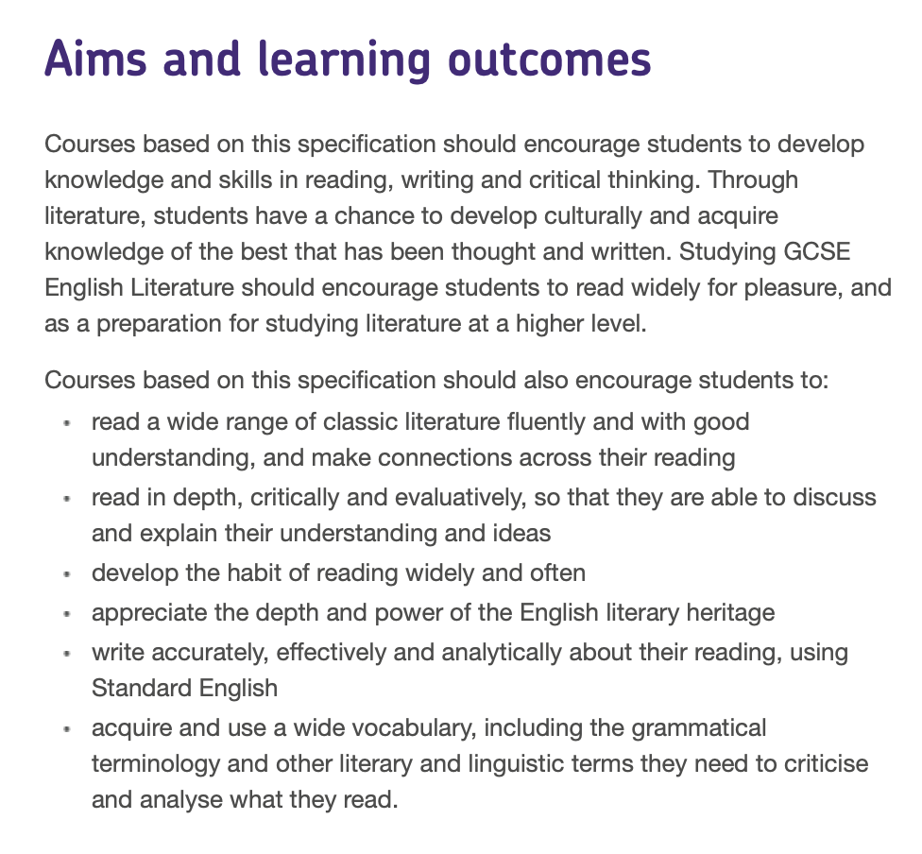
Aims and learning outcomes
(According to the GCSE website)

Slide 3
Aims and learning outcomes
(In plain English)
Pupil’s studying GCSEs should learn:
How to read for pleasure.
How to continue studying literature at a higher level.
How to make connections across their reading (very useful in terms of getting lots of marks).
How to use Standard English.
How to improve their vocabulary.
How to use the correct grammar.
How to read in depth and critically (talk about WHY literature is important and give evidence to your ideas).
REMEMBER: Exams are not there to trick you, they are there so you can show off your knowledge!

Slide 4
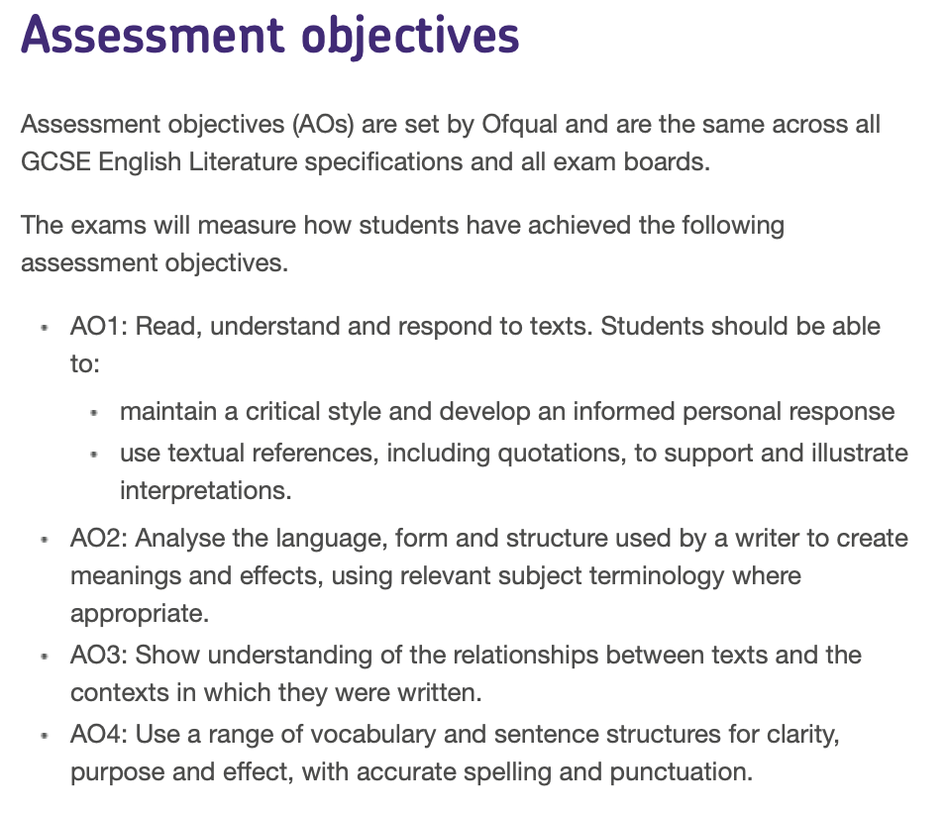
Assessment objectives
(According to the GCSE website)
Same across all exam boards

Slide 5
Assessment objectives
(In plain English)
How to get marks
AO1: Make a statement. Show evidence of that statement ‘quotations’. Decide what they wish to argue or show with this evidence.
AO2: Talk about the language used (adjectives, metaphors,). Talk about what kind of structure (beginning, end, flashbacks) is used by the author. Talk about the meanings and effects (imagery, connotations) this language uses.
AO3: Compare and contrast with other texts on the exam. Talk about why the text was important when it was written and how it is different today.
AO4: Do not keep repeating yourself. Use a wide range of English. Write clearly with correct spelling and punctuation.
REMEMBER: Exams are not there to trick you, they are there so you can show off your knowledge!

Slide 6
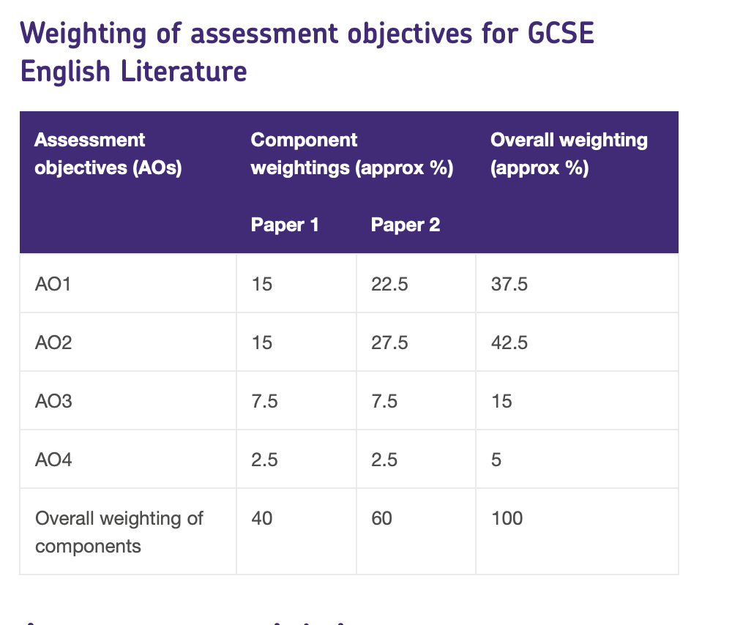
Which get the most marks?
How to get marks
Focus on AO1 & AO2
This is where we get the most marks!

Slide 7
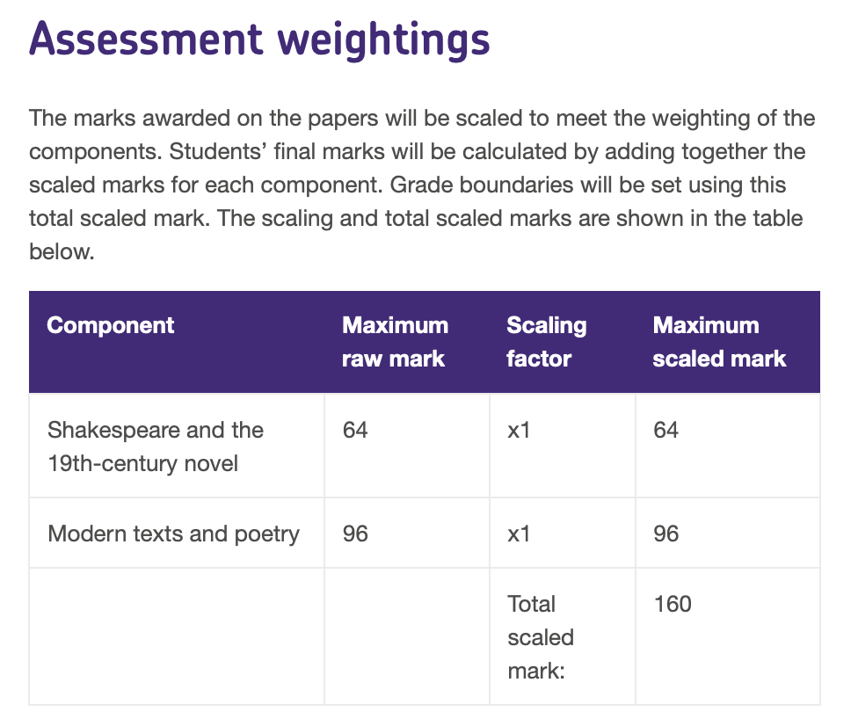
Which get the most marks?
How to get marks
Both have lots of marks on offer. However, modern texts and poetry have more.
So give yourself at least the same amount of time for each answer. Maybe slightly more on poetry!

Slide 8
So what does this all mean?
Let’s look at an example
GCSE 2017 - Macbeth by William Shakespeare
Question:
‘How does Lady Macbeth use language to manipulate her husband in the play?’

Slide 9
Before we begin
Look at what the question is really asking
‘How does Lady Macbeth use language to manipulate her husband in the play?’
‘How does Lady Macbeth use language to manipulate her husband in the play?’
Character question: write about Lady Macbeth
Specifically talk about her language (give evidence) (and for extra marks, her actions)
Manipulate = to control
Talk about how she specifically controls her husband (and give evidence)
Play = the question is telling you what kind of text it is, you need to add more detail… in this case ‘the play is a tragedy so we can expect bad things to happen’

Slide 10
AO1
(In plain English)
How to get marks
‘How does Lady Macbeth use language to manipulate her husband in the play?’
AO1: Make a statement. Show evidence of that statement ‘quotations’. Decide what they wish to argue or show with this evidence.
Lady Macbeth uses language to manipulate her husband for her own ambitious gain in the play. This can be seen through the quote ‘pour spirits in [Macbeth's] ear’. The verb ‘pour spirits’ means she is going to fill her husband's ‘ear’ with harsh words that will help convince him to murder King Duncan. The connotations surrounding ‘spirits’ are that of evil and supernatural, highlighting her wickedness and suggests she is similar to a witch.

Slide 11
ao2
(In plain English)
How to get marks
‘How does Lady Macbeth use language to manipulate her husband in the play?’
AO2: Talk about the language used (adjectives, metaphors,). Talk about what kind of structure (beginning, end, flashbacks) is used by the author. Talk about the meanings and effects (imagery, connotations) this language uses.
The language used to suggest Lady Macbeth will ‘fill’ her husband's body is the same way that women's bodies are ‘filled’ or, impregnated by men. This is Shakespeare expressing how Lady Macbeth is attempting to defy conventional gender roles and manipulate herself into a position of power by using traditionally masculine methods.

Slide 12
Ao3
(In plain English)
How to get marks
‘How does Lady Macbeth use language to manipulate her husband in the play?’
AO3: Compare and contrast with other texts on the exam. Talk about why the text was important when it was written and how it is different today.
This would have been extremely controversial in the 1600s (the time Shakespeare was writing). Therefore it could be interpreted that this text had to be labelled in the ‘tragedy’ genre, as a woman in power would be unheard of. If we compared this to modern times, we can see how society has changed significantly as Britain now has a female monarchy and women have much more control over their own destiny.
Other: Some might even argue Shakespeare was pioneering for women’s rights and that he was being ironic when calling Macbeth a tragedy. (Always another side to the argument).

Slide 13
Ao4
(In plain English)
How to get marks
‘How does Lady Macbeth use language to manipulate her husband in the play?’
AO4: Do not keep repeating yourself. Use a wide range of English. Write clearly with correct spelling and punctuation.
Suggests, implies, shows, connotes, highlights, explores.
Quotations, stage directions, pathetic fallacy, foreshadowing

Slide 14
Assessment objectives
Putting it altogether…
‘How does Lady Macbeth use language to manipulate her husband in the play?’
Lady Macbeth uses language to manipulate her husband for her own ambitious gain in the play v .This can be seen through the quote ‘pour spirits in [Macbeth's] ear’ v. The verb ‘pour spirits’ v means she is going to fill her husband's ‘ear’ with harsh words that will help convince him to murder King Duncan v. The connotations v surrounding ‘spirits’ are that of evil and supernatural v, highlighting her wickedness and suggests she is similar to a witch v. As Lady Macbeth forces her words into Macbeth’s ear, this will ‘fill’ her husband's body in the same way that women's bodies are ‘filled’ or, impregnated by men v. This is Shakespeare expressing how Lady Macbeth is attempting to defy conventional gender roles v and manipulate herself into a position of power (making herself Queen) by using traditionally masculine methods v. This would have been extremely controversial in the 1600s v as Britain was very much a patriarchal society during the times Shakespeare was writing v. Therefore, it could be interpreted that this text had to be labelled in the ‘tragedy’ genre, as a woman in power would be unheard of v. If we compared this to modern times, we can see how society has changed significantly, as Britain now has a female monarchy and women have much more control over their own destiny v.

Slide 15
Let’s compare answers
Sample Answer
In this scene, Macbeth wants to stop the murder and says "We will proceed no further". Lady Macbeth makes sure that Macbeth will do exactly as she tells him. She has strong ambitions to be Queen and uses different arguments to make sure that he does do what she wants him to do. She uses a comparison to call him a coward but he tells her that he is a real man. I think that she is right about him at this point. She also says he does not love her if he does not carry out the murder. Macbeth's biggest worry is about what will happen to them if they fail. Lady Macbeth says "We'll not fail" which just dismisses the idea. By the end of the scene she has persuaded him back again and the audience thinks that she is a stronger character than her husband.

Slide 16
Let’s compare answers
Sample Answer
In this scene (which scene?), Macbeth wants to stop the murder (which murder?) and says "We will proceed no further". Lady Macbeth makes sure that Macbeth will do exactly as she tells him (how?). She has strong ambitions to be Queen and uses different arguments to make sure that he does do what she wants him to do. She uses a comparison to call him a ‘coward’ (tell me what connotations a coward has?) but he tells her that he is a real man. I think that she is right about him at this point (why?). She also says he does not love her if he does not carry out the murder (this proves she is manipulative and uses emotional blackmail to control her husband). Macbeth's biggest worry is about what will happen to them if they fail. Lady Macbeth says "We'll not fail" which just dismisses the idea (if you give a quote, dissect it fully). By the end of the scene she has persuaded him back again and the audience thinks that she is a stronger character than her husband.
REMEMBER: You have to prove you know the answer. No proof, no marks!

Slide 17
Assessment objectives
Our Answer
Lady Macbeth uses language to manipulate her husband for her own ambitious gain in the play. This can be seen through the quote ‘pour spirits in [Macbeth's] ear’. The verb ‘pour spirits’ means she is going to fill her husband's ‘ear’ with harsh words that will help convince him to murder King Duncan. The connotations surrounding ‘spirits’ are that of evil and supernatural, highlighting her wickedness and suggests she is similar to a witch . As Lady Macbeth forces her words into Macbeth’s ear, this will ‘fill’ her husband's body in the same way that women's bodies are ‘filled’ or, impregnated by men. This is Shakespeare expressing how Lady Macbeth is attempting to defy conventional gender roles and manipulate herself into a position of power (making herself Queen) by using traditionally masculine methods .This would have been extremely controversial in the 1600s as Britain was very much a patriarchal society during the times Shakespeare was writing. Therefore, it could be interpreted that this text had to be labelled in the ‘tragedy’ genre, as a woman in power would be unheard of. If we compared this to modern times, we can see how society has changed significantly, as Britain now has a female monarchy and women have much more control over their own destiny.

Slide 18
Assessment objectives
Our Answer
Lady Macbeth uses language to manipulate her husband for her own ambitious gain in the play (good, perhaps mention she wants to be Queen). This can be seen through the quote ‘pour spirits in [Macbeth's] ear’. The verb ‘pour spirits’ means she is going to fill her husband's ‘ear’ with harsh words that will help convince him to murder King Duncan(good, specific). The connotations (looking at a top band pupil) surrounding ‘spirits’ are that of evil and supernatural, highlighting her wickedness and suggests she is similar to a witch (excellent). As Lady Macbeth (sticking to the question, very good) forces her words into Macbeth’s ear, this will ‘fill’ her husband's body in the same way that women's bodies are ‘filled’ or, impregnated by men. This is Shakespeare expressing how Lady Macbeth is attempting to defy conventional gender roles and manipulate herself into a position of power (making herself Queen) by using traditionally masculine methods. This would have been extremely controversial in the 1600s (good context) as Britain was very much a patriarchal society during the times Shakespeare was writing. Therefore, it could be interpreted that this text had to be labelled in the ‘tragedy’ genre (good knowledge of genre), as a woman in power would be unheard of. If we compared this to modern times, we can see how society has changed significantly, as Britain now has a female monarchy and women have much more control over their own destiny. (and no longer require a husband in order to progress with their ambitious desires).

