Slide 1
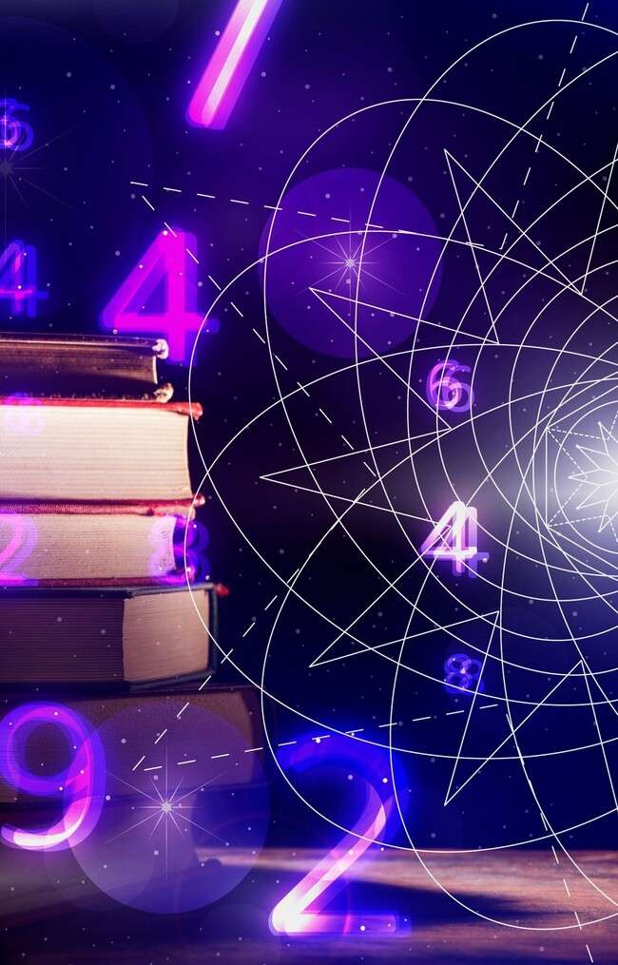
Unveiling the Mysteries: Navigating the Polar Realm of Complex Numbers

Slide 2
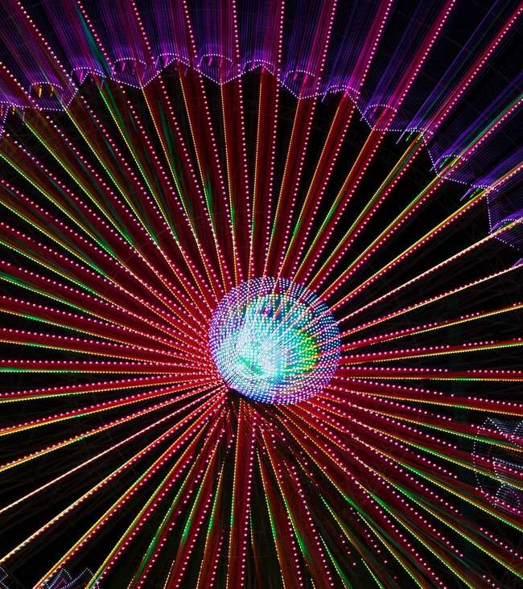







Introduction to Complex
Numbers
are not just a mathematical curiosity; they are a
gateway to understanding the
. This presentation will explore the and of complex numbers, revealing their beauty and signiﬁcance in various ﬁelds. Let's embark on this
together!

Slide 3
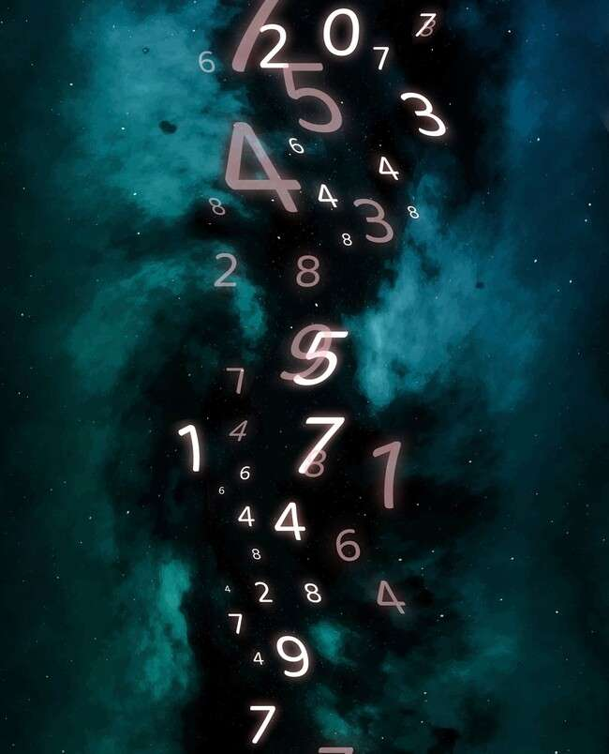







What Are Complex Numbers?
consist of a
and an , expressed as a + bi. They extend the concept of
numbers to a plane, enabling us to
solve equations that have no solutions in the realm of real numbers.
Understanding their structure is essential for navigating their
.

Slide 4





The Polar Form Explained
In the , a complex number is expressed as r(cos θ + i sin θ), where r is the
and θ is the . This representation allows us to visualize complex numbers as points in the
, making it easier to perform
multiplication and division. Let's uncover its signiﬁcance!

Slide 5




Magnitude and Argument
The of a complex number is its distance from the origin, calculated as √(a² + b²). The is the angle formed with the positive real axis.
Together, they provide crucial insights into the properties of complex numbers, allowing us to navigate their
with conﬁdence.

Slide 6
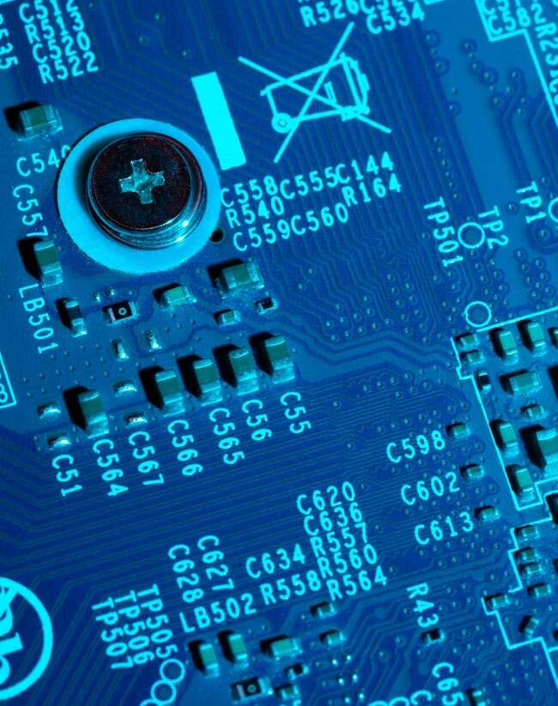




Applications in Engineering
play a vital role in
, particularly in
. Their polar representation
and
simpliﬁes the analysis of oscillatory systems, enabling engineers to design more efﬁcient solutions. Understanding this connection is key to leveraging their power in real-world applications.

Slide 7
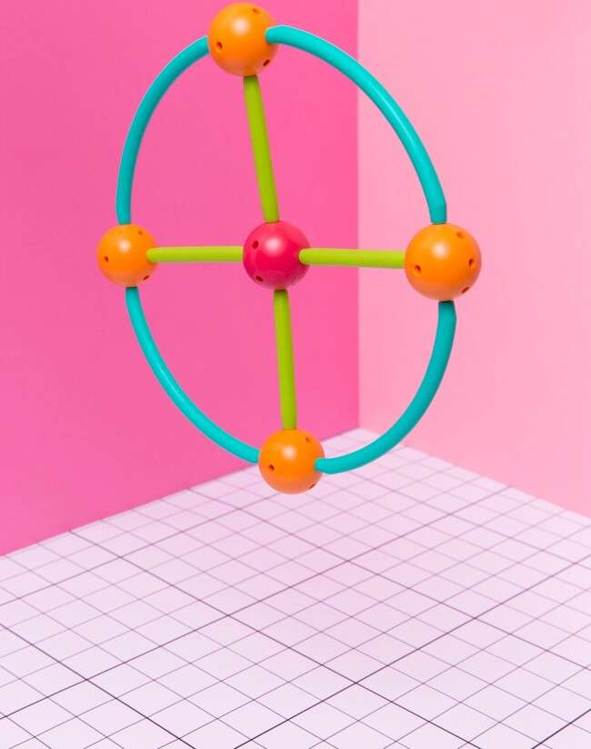


Exploring Euler's Formula
Euler's Formula, e^(iθ) = cos θ + i sin θ, beautifully links and .
This profound relationship allows us to express
complex numbers in a new light, revealing hidden connections and simplifying calculations
in the
. Let's delve deeper into this mathematical marvel!

Slide 8
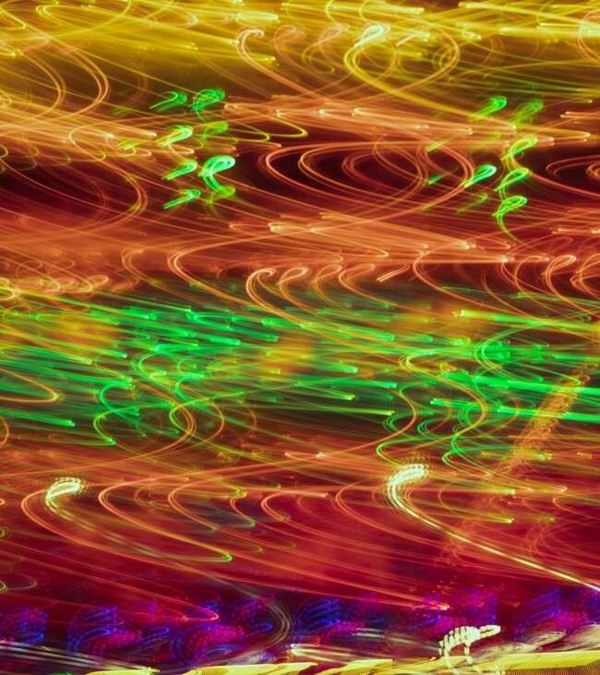







The Beauty of Fractals
are intricate patterns that emerge from complex numbers. By iterating functions in the
, we can create stunning visual art, such as the
. This intersection of mathematics and creativity showcases the aesthetic beauty of
complex numbers and their
.

Slide 9





Conclusion: Embracing Complexity
In conclusion, the
and
of complex numbers is rich with
. From engineering to art, their
versatility is undeniable. By embracing the complexity of these numbers, we unlock new ways of understanding the
world around us. Thank you for joining this
!

Slide 10
Thanks!
Do you have any questions? youremail@email.com
+91 000 421 838
www.yourwebsite.com @yourusername

