Slide 1

Trespass to Land:
Legal Principles and Defences
Tutor: Okwudili O. ONWURAH, LL.B. (Nigeria); BL (Abuja, Nigeria); LLM (Exeter, UK); LLM (Qingdao, PRC); LLM (Shanghai, PRC)
PhD in Law (Hong Kong)
Dr Okwudili O. Onwurah

Slide 2
Minor House Keeping
The purpose of the online lesson is to encourage you to participate actively in achieving your needs and simplifying your legal education. I want you to be the best!
Will make the learning process more interactive discussions and feel free to ask any question or you can speak.
You have the right to choose whether to turn on your video or not.
Participation prepares you for your exam and learning needs with ease.

Slide 3
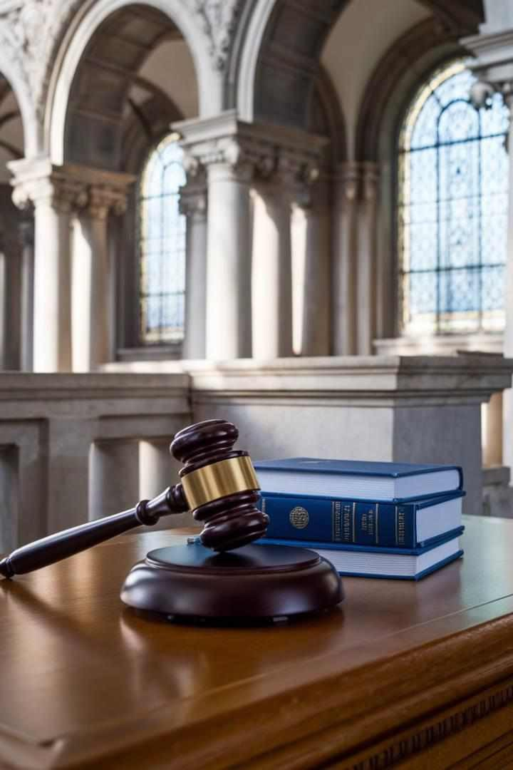
Introduction
Welcome to this comprehensive exploration of trespass to land, a fundamental concept in property law. This presentation will delve into the legal principles, landmark cases, and modern applications of trespass, with a focus on English and Hong Kong jurisdictions. We'll examine the elements that constitute trespass, analyse pivotal court decisions, and discuss the various defenses available. By the end of this presentation, you'll have a thorough understanding of how trespass to land is interpreted and applied in contemporary legal settings, equipping you with valuable knowledge for your legal studies or professional practice.

Slide 4
Definition of Trespass to Land
Legal Definition
Trespass to land is defined as the unjustifiable interference with another's right to the exclusive possession of their property. This tort protects the possessor's interest in the exclusive possession and use of their land.
Historical Context
The concept of trespass has its roots in medieval English common law, evolving from a criminal offense to a civil wrong. It reflects the longstanding legal principle of 'an Englishman's home is his castle'.
Modern Interpretation
In contemporary law, trespass is viewed as a strict liability tort, meaning that the defendant's intent or knowledge is generally irrelevant. The focus is on the act of intrusion itself, rather than the consequences or motivation behind it.
Scope of Protection
Trespass law protects not only the surface of the land but also the airspace above and the ground below, to a reasonable extent. This comprehensive protection underscores the law's commitment to safeguarding property rights.

Slide 5
Elements of Trespass: Unlawful Entry, Interference, and Intention
1
Unlawful Entry
The first element of trespass is unlawful entry onto another's land. This can be direct physical entry by the defendant or causing an object to enter the land. The entry must be voluntary, but the trespasser need not be aware that they are trespassing.
2
Interference
Interference with the possessor's exclusive right to their land is the second element. This can range from momentary intrusion to prolonged occupation. Even minimal contact with the land can constitute interference, as established in the case of League Against Cruel Sports v Scott (1985).
3
Intention
The final element is intention, which refers to the deliberate act of entering or remaining on the land, not the intention to trespass. As Lord Hoffman stated in OBG Ltd v Allan (2007), "The defendant must intend to enter upon the land in question... but need not intend to commit a trespass."

Slide 6
Case Law: Entick v Carrington (17G5)
Background
Legal Principle Established
Impact and Legacy
Entick v Carrington is a landmark case in English common law that significantly shaped the concept of trespass and civil liberties. John Entick, a writer critical of the government, sued Nathan Carrington and three other King's messengers for entering his home and seizing his papers.
The court ruled in favour of Entick, establishing that the defendants' actions constituted trespass. Lord Camden's judgment affirmed that every invasion of private property, regardless of how minor, is a trespass. The case established the principle that state agents cannot enter private property without lawful authority.
This case has had a lasting impact on property law and civil liberties. It established the need for specific legal authority for searches and seizures, influencing the development of constitutional protections in many common law jurisdictions, including the Fourth Amendment to the US Constitution.

Slide 7
Modern Example: Anchor Brewhouse Developments Ltd v Berkley House (Docklands) Developments Ltd
1
Case Overview
This 1987 case provides a modern interpretation of trespass in the context of urban development. It involved a dispute between two neighbouring property developers in London's Docklands area.
2
The Trespass Issue
Berkley House's construction activities resulted in the oversailing of a tower crane into Anchor Brewhouse's airspace. The court had to determine whether this constituted trespass.
3
Court's Ruling
The court held that the intrusion of the crane into Anchor Brewhouse's airspace was indeed a trespass. This ruling affirmed that trespass extends to the airspace above the land, not just the surface.
4
Implications for Modern Development
This case has significant implications for urban development, particularly in densely populated areas. It underscores the need for developers to consider neighbouring properties' rights when planning construction activities, especially those involving tall structures or equipment.

Slide 8

Statutory Interventions: Hong Kong's Lands (Miscellaneous Provisions) Ordinance
Provision | Description | Impact
Section 6 | Defines unlawful occupation of unleased land | Clarifies what constitutes trespass on government land
Section 6A | Empowers authorities to remove unlawful structures | Provides practical remedy for land trespass
Section 6B | Allows for recovery of removal expenses | Deters persistent trespassers
Section 6C | Establishes penalties for obstruction | Reinforces enforcement capabilities

Slide 9




Defenses to Trespass: License, Necessity, Lawful Authority
License
A license, whether express or implied, provides permission to enter the land. For example, in R v Jones (1997), the court held that an invitation to enter premises for a lawful purpose carries with it an implied license to remain for a reasonable time.
Necessity
The defense of necessity applies when entry is required to preserve life or property. In Esso Petroleum Co Ltd v Southport Corporation (1956), the court recognised necessity as a valid defense when a ship entered waters to avoid a storm.
Lawful Authority
Entry under lawful authority, such as police executing a valid search warrant, is not trespass. However, as established in Entick v Carrington, this authority must be explicitly granted by law.
Public Right of Way
Entry onto land via a public right of way is not trespass. In DPP v Jones (1999), the House of Lords held that peaceful assembly on a highway could be a reasonable use within the public's right of way.

Slide 10
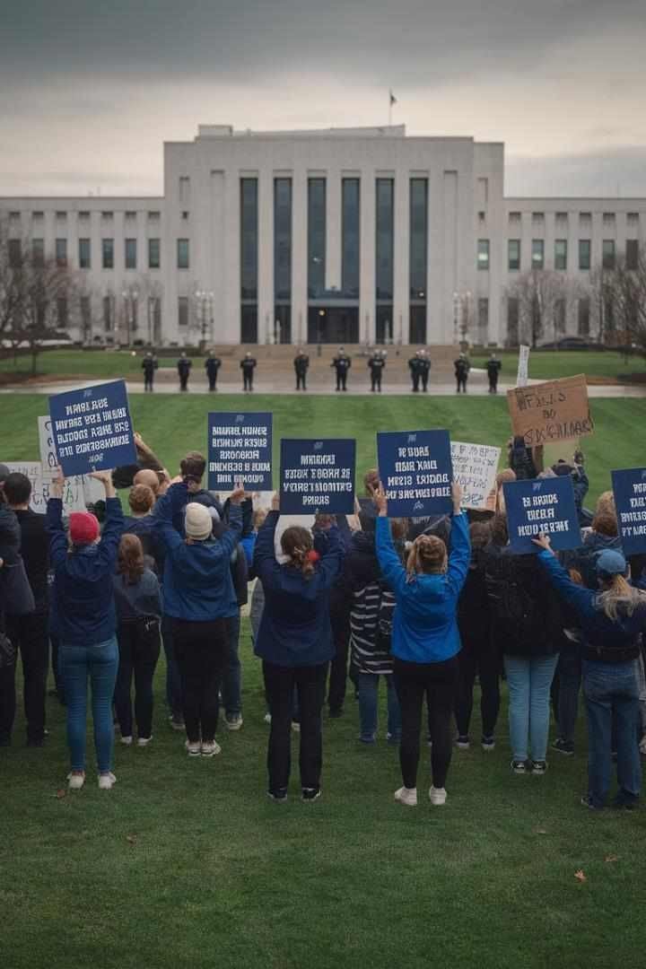

Practical Scenarios: Trespassing During Protests
Initial Assembly
Protesters gather on public land, exercising their right to freedom of assembly. At this stage, no trespass has occurred, as established in DPP v Jones (1999).
Encroachment on Private Property
Some protesters move onto private property. This could constitute trespass unless they have the owner's permission or can claim a valid defense.
Police Intervention
Police may intervene to remove trespassers. Their authority to do so must be clearly established to avoid claims of unlawful entry, as per the principles in Entick v Carrington.
Legal Consequences
Trespassers may face civil action from property owners or criminal charges if their actions meet the threshold for aggravated trespass under relevant legislation.

Slide 11
Remedies: Injunctions, Damages, and Possession Orders
Injunctions
Courts can grant injunctions to prevent future trespass. In Kettel v Bloomfold Ltd (2012), the court issued an injunction against oversailing cranes, demonstrating the remedy's applicability in modern construction disputes.
Damages
Compensatory damages may be awarded for actual loss suffered. In cases of continued trespass, courts may award damages in lieu of an injunction, as seen in Jaggard v Sawyer (1995).
Possession Orders
Where trespassers refuse to leave, a possession order can be obtained. The Civil Procedure Rules in England and Wales provide a streamlined process for possession claims against trespassers.
Self-Help
While not a court remedy, reasonable force may be used to remove trespassers. However, as cautioned in Hemmings v Stoke Poges Golf Club (1920), this right must be exercised carefully to avoid liability for assault.

Slide 12

Case-Based Group Activity: Part 1
1
Case Presentation
Students are presented with a hypothetical scenario involving a complex trespass dispute between a residential property owner and a construction company. The case involves issues of crane oversailing, temporary access for repairs, and alleged damage to property.
2
Group Formation
The class is divided into small groups, each assigned to represent either the property owner, the construction company, or to act as the judging panel. Groups are given time to review the case details and relevant legal precedents.
3
Preparation
Groups prepare their arguments or judgement criteria, drawing on the legal principles and cases discussed in the presentation. They are
encouraged to consider both established precedents and potential novel applications of trespass law.

Slide 13
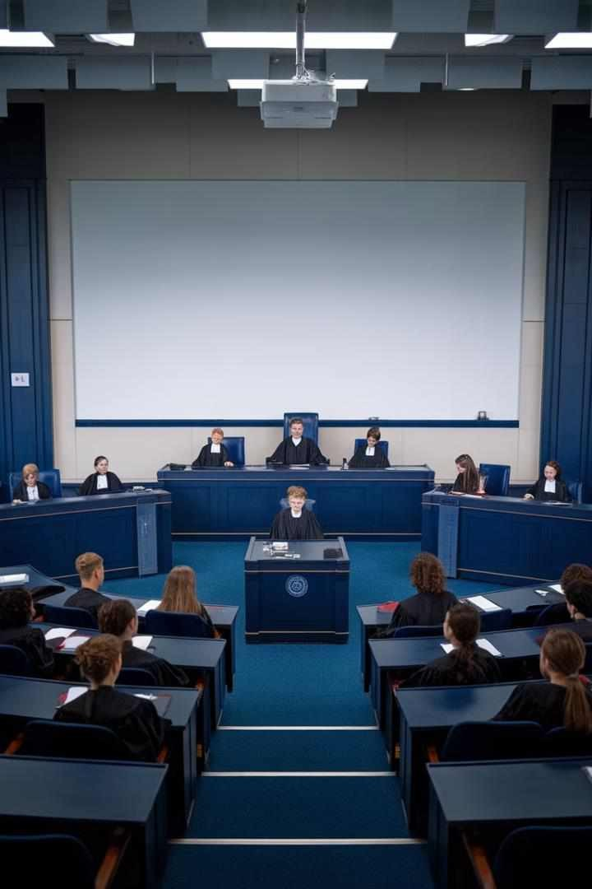

Case-Based Group Activity: Part 2
Opening Statements
Each group representing a party presents their opening statements, outlining their position and key arguments. The judging panel takes notes on the legal principles invoked.
Argument Presentation
Groups present detailed arguments, citing relevant cases such as Anchor Brewhouse Developments Ltd v Berkley House and discussing the applicability of various defenses to trespass.
Cross-Examination
The opposing groups and judging panel have the opportunity to ask questions, challenging the arguments presented and exploring potential weaknesses in each case.
Closing Arguments
Each group summarises their position, addressing any points raised during cross-examination and reiterating their main legal arguments.

Slide 14
Case-Based Group Activity: Part 3
Judging Panel Deliberation
Verdict and Reasoning
Class Discussion
The judging panel retires to consider the arguments presented. They discuss the strengths and weaknesses of each side's case, the relevance of cited precedents, and the potential implications of their decision.
The judging panel delivers their verdict, providing a detailed explanation of their reasoning. They discuss how they applied the principles of trespass law to the specific facts of the case and address any novel legal issues raised.
The instructor facilitates a class- wide discussion on the verdict, encouraging students to analyse the decision critically. Students consider how the outcome might differ under various jurisdictions or with slight changes to the fact pattern.

Slide 15
Recap: Key Principles of Trespass to Land
1
Definition and Elements
Trespass to land is the unjustifiable interference with another's right to exclusive possession of their property. The key elements are unlawful entry, interference, and intention to enter, as established in cases like League Against Cruel Sports v Scott (1985).
2
Scope of Protection
Trespass law protects not only the surface of the land but also the airspace above and the ground below, to a reasonable extent. This was demonstrated in Anchor Brewhouse Developments Ltd v Berkley House (Docklands) Developments Ltd (1987).
3
Defenses and Remedies
Valid defenses include license, necessity, and lawful authority. Remedies available to landowners include injunctions, damages, and possession orders, as seen in cases like Jaggard v Sawyer (1995) and Kettel v Bloomfold Ltd (2012).
4
Modern Applications
Trespass law continues to evolve, addressing contemporary issues such as drone usage, protests on private property, and complex construction disputes. It remains a crucial area of property law, balancing individual rights with societal needs.

Slide 16




Future Challenges in Trespass Law
Drone Technology
The increasing use of drones raises questions about airspace trespass. Courts may need to redefine the extent of property rights in low- altitude airspace, balancing privacy concerns with technological advancement.
Virtual and Augmented Reality
As AR and VR technologies develop, issues may arise regarding virtual trespass or the placement of virtual objects on real property without permission, challenging traditional concepts of physical intrusion.
Autonomous Vehicles
The advent of self-driving cars may lead to complex trespass scenarios, such as vehicles entering private property due to programming errors or emergency situations.
Climate Change and Property Rights
Rising sea levels and changing landscapes may blur property boundaries, potentially leading to new forms of trespass disputes and challenging established property rights.

Slide 17
Conclusion: The Enduring Relevance of Trespass to Land
Historical Continuity
Balancing Interests
Future Adaptations
From Entick v Carrington to modern cases, trespass to land has remained a fundamental principle in property law, protecting individuals' rights to exclusive possession of their property. Its evolution reflects changing societal values and technological advancements.
Trespass law continues to balance individual property rights with broader societal needs, as seen in cases involving protests, urban development, and environmental concerns. This balance is crucial in maintaining social order while respecting personal freedoms.
As we face new challenges like drone technology, virtual reality, and climate change, trespass law will need to adapt. Its core principles, however, will likely remain relevant, providing a framework for addressing novel property disputes in an ever- changing world.

