Slide 1


Integral Calculus: Unveiling the Secrets of Area and Change
Welcome to our journey into the fascinating world of integral calculus! This presentation will explore the core concepts, techniques, and applications of this essential branch of mathematics.
by ONYEDIKACHI ONWURAH

Slide 2
Understanding the Concept of Antiderivatives
The Inverse of Differentiation
Unlocking the Mystery of Area
Antiderivatives, also known as indefinite integrals, are the inverse of differentiation. Given a function, finding its antiderivative means finding a new function whose derivative is the original function.
The concept of antiderivatives forms the foundation of integral calculus, as it provides a powerful tool for calculating areas under curves, volumes of solids, and understanding how quantities change over time.

Slide 3
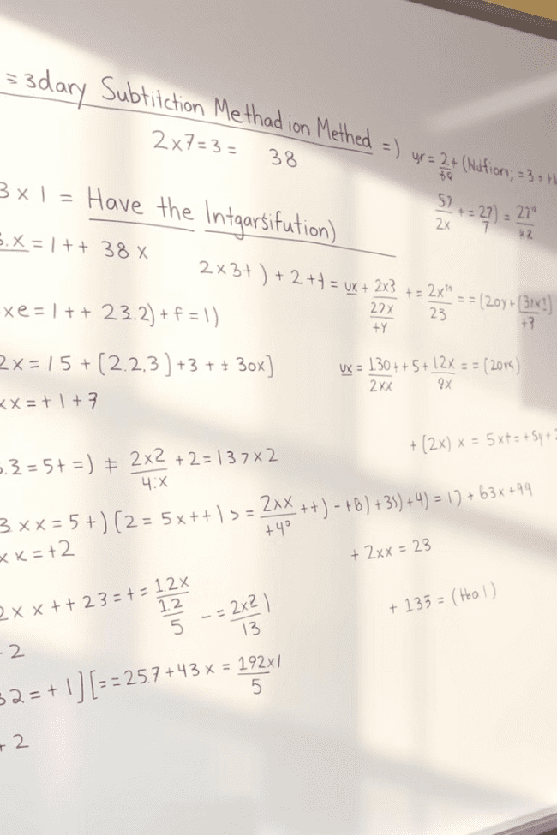
Techniques of Integration: Substitution Method
1
Transforming Integrals
2
Chain Rule in Reverse
The substitution method involves substituting a new variable to simplify complex integrals, making them easier to solve.
This method effectively reverses the chain rule of differentiation, making it a fundamental technique for integration.
3
Real-World Applications
The substitution method finds application in various fields, including physics, engineering, and economics, where it's used to solve problems involving rates of change.

Slide 4




Techniques of Integration: Integration by Parts
Breaking Down Complex Integrals
Integration by parts is a powerful technique used to integrate products of functions. It allows us to break down complex integrals into simpler ones.
The Formula
The formula for integration by parts is derived from the product rule of differentiation. It's a key tool for tackling a wide range of integral problems.
Applications in Various Fields
Integration by parts has applications in diverse fields, including physics, probability, and statistics, for solving problems involving work, volume, and probability distributions.

Slide 5
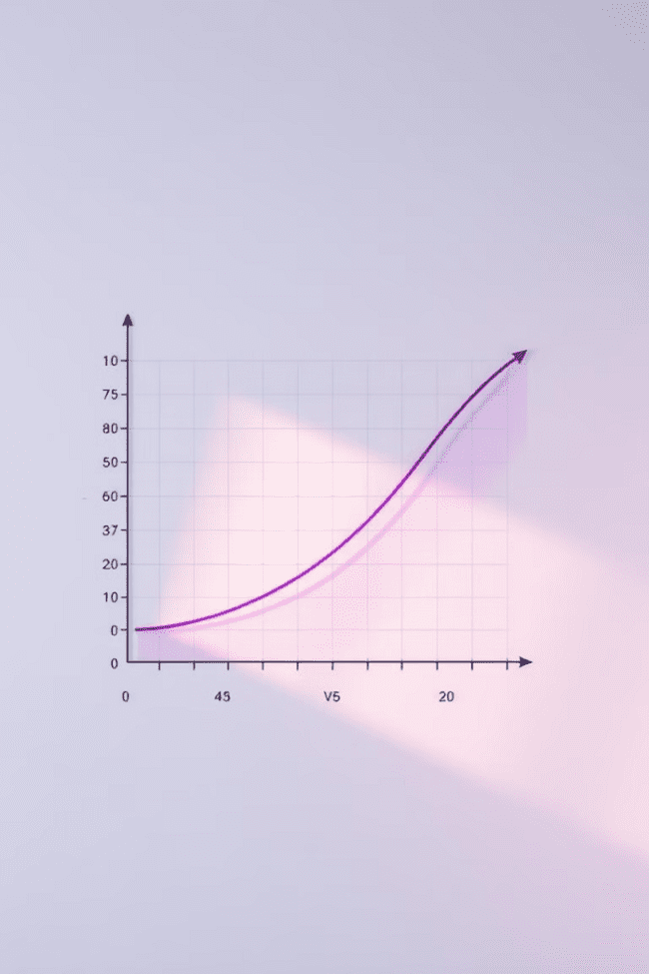
Calculating Definite Integrals and Their Applications
Definite Integrals
Applications in Geometry and Physics
Definite integrals calculate the exact area under a curve between two specified points, providing a numerical value for the area.
Definite integrals have wide-ranging applications in geometry, such as calculating areas of surfaces, volumes of solids, and lengths of curves, and in physics for calculating work, displacement, and pressure.
Finding Total Change
Definite integrals are particularly useful in physics for determining the total change of a quantity over a specified time interval.

Slide 6



The Fundamental Theorem of Calculus: Part 1 and Part 2
Part 1: Antiderivatives and Definite Integrals
Part 2: Rates of Change and Total Change
This part establishes a connection between differentiation and integration, stating that the definite integral of a function is equal to the difference of its antiderivatives at the limits of integration.
This part connects the rate of change of a function to its total change over an interval. It shows how the derivative of a function can be used to calculate the total change in the function over a given interval.

Slide 7
Improper Integrals and Their Convergence
Integrals with Infinite Limits
1
Improper integrals involve limits of integration that extend to infinity or include points where the integrand is undefined.
Convergence and Divergence
2
Improper integrals can either converge to a finite value, meaning they have a definite answer, or diverge, meaning they don't have a finite answer.
Applications in Probability and Statistics
Improper integrals find applications in probability and statistics, such as calculating the expected value of a random variable and determining the probability of an event occurring over an infinite time period.
3

Slide 8

Conclusion: The Importance of Integral Calculus
Integral calculus is a fundamental tool for solving problems involving areas, volumes, and rates of change in various fields. Its applications extend to physics, engineering, economics, probability, and statistics, making it a vital subject for any student of science, technology, or mathematics.

