Slide 1
Python 101
Adam Aulia Rahmadi

Slide 2
Trainer profile
Adam Aulia Rahmadi S.kom
Data Engineer / Scientist – PT XL AXIATA
Manage data pipelines from Cloudera
Support business with big data technology
Help data scientist build model in large scale
Experience 4 years in python , 2 years in big data

Slide 3

Founder
Guido van Rossum
Version :
2.*
3.*

Slide 4

Why Python ?
Simple
Extensive Support Libraries
Integration Feature

Slide 5

Top companies that using python

Slide 6
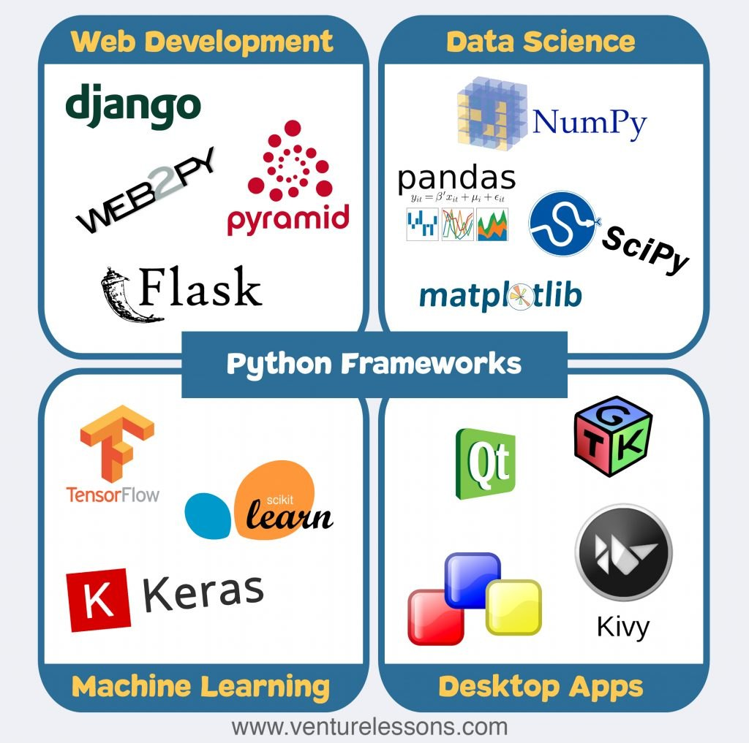
Python top library

Slide 7
overview
Variable
Operator
String and functions
Conditionals
Iterations
List
Tuple
Dictionary
File
Error handling

Slide 8

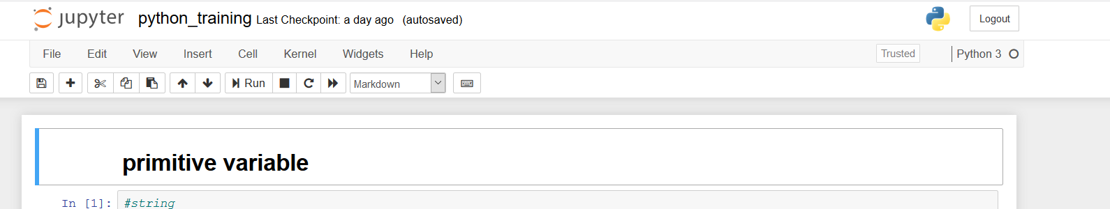
Jupyter notebook
Open cmd , type jupyter notebook

Slide 9
Primitive Variable
Types | Value
String | message = 'And now for something completely different'
Integer | n = 17
Double / Float | pi = 3.1415926535897931
Boolean | True / False

Slide 10
Complex variables
Types | Value
List | [] [1,2,’abc’]
Tuple | () (1,2,’abc’)
Dictionary | {} a={} a[‘day’]=‘monday’ a[‘date’]= 20191011

Slide 11
Math Operators
Type | Values
+ | Addition
- | subtraction
* | Multiplication
/ | division
** | Power
| | Modulo

Slide 12
Boolean expressions
Types | Values
> | Greater than
< | Less than
>= | Greater than or equal
<= | Less than or equal
!= | Not equal
== | equal

Slide 13
String Operators
first = 10
second = 15
print(first + second)
first = '100'
second = '150'
print(first + second)
first = ‘100’
second = 3
print(first*second)

Slide 14
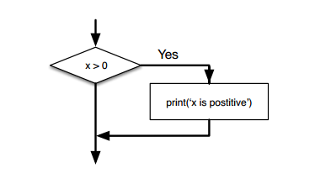

Conditional
One conditional

Slide 15
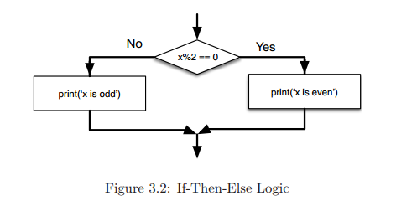
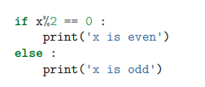
Conditional
Two conditionals

Slide 16
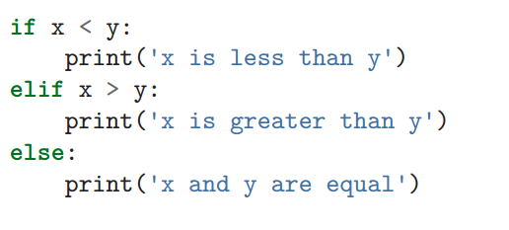
Chained Conditional
More than two conditionals

Slide 17
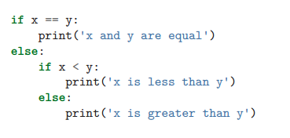
Nested Conditional

Slide 18
Functions
Type | Values
Build in functions | Max(), min(), avg(), type(), len(), int(), str()
Import functions | Import random, math
User defined functions | def function_name(argument_variable): return something

Slide 19
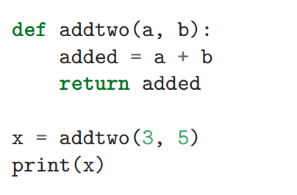
Functions

Slide 20
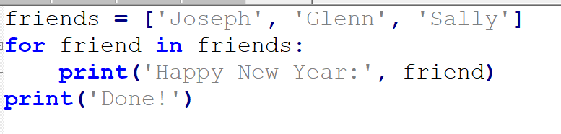
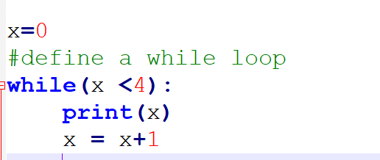
Loop
For loop
While loop

Slide 21

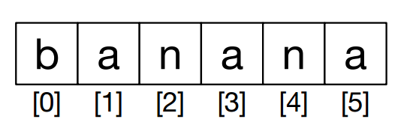
Strings
A string is a sequence of characters. You can access the characters one at a time
with the bracket operator

Slide 22
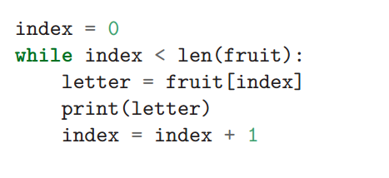

Strings
Traversal through a string with a loop

Slide 23
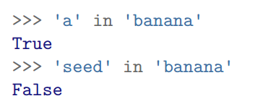
Strings (The in operator )

Slide 24
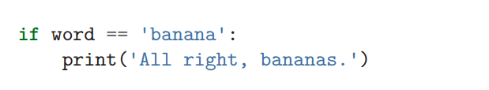
Strings (String comparison )

Slide 25
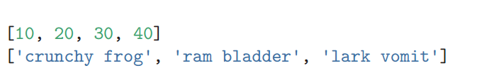
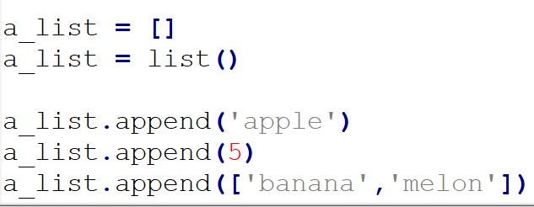


List
Sequence
Mutable
Initialize

Slide 26


List
Traversing a list

Slide 27
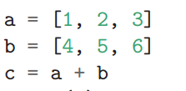

List Operations
The + operator concatenates lists:
Similarly, the * operator repeats a list a given number of times:

Slide 28






List SLICES

Slide 29

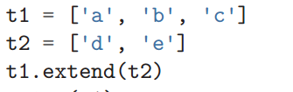
List methods
Append
Extend

Slide 30
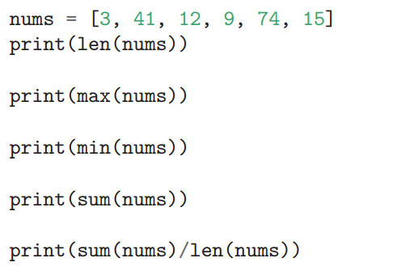
List and functions

Slide 31



Deleting elemEnt
Remove
Pop
del

Slide 32


Tuples
Sequence
immutable (no append)
Initialize

Slide 33

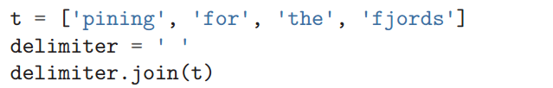
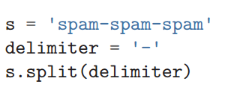
List and strings
String to list
List to string

Slide 34
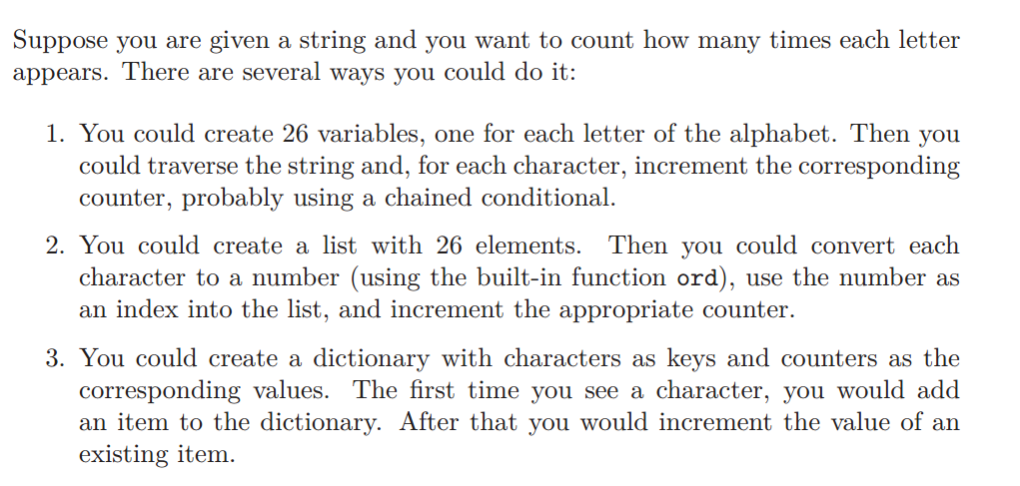
Dictionary

Slide 35


Dictionary
Create dictionary
Show dictionary key
a.keys()
Show dictionary values
a.values()

Slide 36
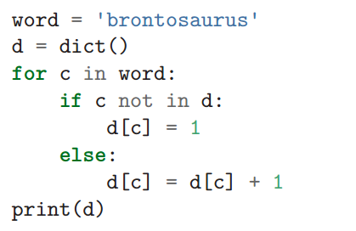
Dictionary

Slide 37
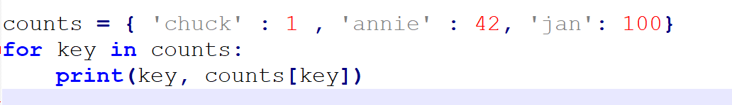

Looping and dictionary

Slide 38
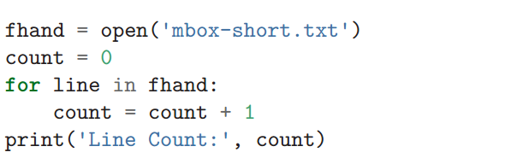
Files
Reading files

Slide 39
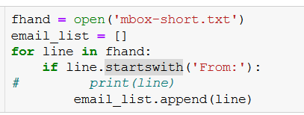
Files
Searching through a file

Slide 40




files
Write to file

Slide 41
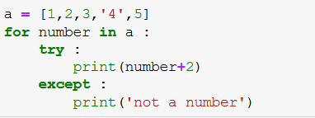
Error handling

Slide 42
source
http://do1.dr-chuck.com/pythonlearn/EN_us/pythonlearn.pdf

