Slide 1

Trespass and Environmental Law:
Protecting Natural Resources
Tutor: Okwudili O. ONWURAH, LL.B. (Nigeria); BL (Abuja, Nigeria); LLM (Exeter,
UK); LLM (Qingdao, PRC); LLM (Shanghai, PRC)
PhD in Law (Hong Kong)
Dr Okwudili O. Onwurah
11/29/2024
1

Slide 2

The purpose of the online lesson is to encourage you
to participate actively in achieving your needs and
simplifying your legal education. I want you to be the
best!
Minor
House
Will make the learning process more interactive
discussions and feel free to ask any question or you
can speak.
Keeping
You have the right to choose whether to turn on
your video or not.
Participation prepares you for your exam and
learning needs with ease.
11/29/2024
2

Slide 3

Introduction
Welcome to this thought-provoking exploration of the intersection between trespass law
and environmental protection. As we delve into this complex and increasingly relevant
area of law, we'll examine how legal principles developed for property rights are being
applied to safeguard our precious natural resources. From landmark cases to modern
legislation, we'll uncover the evolving landscape of environmental jurisprudence and its
impact on both individual rights and collective responsibilities. Join us on this journey
through the intricate web of trespass and environmental law, where we'll discover how the
legal system is adapting to meet the challenges of protecting our planet's invaluable
ecosystems.

Slide 4

The Intersection of Trespass Law and
Environmental Protection
Traditional Trespass Law
Environmental Protection
The Convergence
Trespass law has historically focused on
protecting individual property rights,
allowing landowners to exclude others
from their property and seek remedies for
unauthorised entry. This concept has
deep roots in English common law and
has been a cornerstone of property rights
for centuries.
Environmental law, on the other hand, has
emerged as a response to the growing
awareness of ecological issues. It aims to
protect natural resources, preserve
biodiversity, and prevent pollution. This
area of law often involves restrictions on
how individuals and corporations can use
their property.
The intersection of these two legal
domains creates a fascinating area of
study. Environmental concerns have
begun to reshape our understanding of
property rights, leading to new
interpretations of trespass law that
consider the broader impact of actions on
shared natural resources.

Slide 5

Legal Principles: Ownership of Natural Resources
Land Ownership
Water Rights
Traditionally, land ownership extended from the centre of the Earth
to the sky above. However, modern laws have limited these rights,
particularly concerning airspace and subterranean resources. The
concept of 'usque ad coelum et ad inferos' (up to the heavens and
down to hell) has been significantly modified.
Water rights vary depending on the jurisdiction. In some areas,
riparian rights allow landowners adjacent to water bodies certain
usage rights. In others, prior appropriation doctrines govern water
allocation. The increasing scarcity of water resources has led to
more stringent regulations.
Mineral Rights
Air and Atmosphere
Mineral rights can be severed from surface rights, leading to
complex legal scenarios. In the UK, most mineral rights belong to
the Crown, while in other jurisdictions, private ownership is more
common. This division of rights often leads to conflicts between
surface owners and mineral rights holders.
While traditionally considered common property, the regulation of air
quality and atmospheric resources has become increasingly
important. Emissions trading schemes and air pollution laws
represent attempts to manage these shared resources within a legal
framework.

Slide 6

Case Law: Rylands v Fletcher [1868]
1
2
3
4
Background
In 1868, the House of Lords established the principle of strict liability for abnormally dangerous things in Rylands v Fletcher. The case involved water from
a reservoir on the defendant's land flooding a neighbouring mine shaft.
The Rule
The court held that a person who brings onto their land something likely to cause damage if it escapes is strictly liable for any damage caused by its
escape. This rule has since been applied to various environmental hazards.
Modern Application
Today, the Rylands v Fletcher principle is often invoked in environmental cases involving pollution or hazardous substances. It has been particularly
relevant in cases of groundwater contamination and industrial accidents.
Limitations
While still significant, the rule has been limited by subsequent cases. Courts now consider factors such as foreseeability and the natural use of land when
applying the principle, balancing strict liability with more nuanced approaches to environmental responsibility.

Slide 7

Hong Kong's Waste Disposal Ordinance (Cap 354)
1
Purpose and Scope
2
Key Provisions
The Waste Disposal Ordinance (Cap 354) is Hong Kong's primary
legislation governing waste management. Enacted in 1980 and
subsequently amended, it aims to control and regulate the
production, storage, collection, treatment, recycling, and disposal of
waste in the territory.
The ordinance covers various types of waste, including domestic,
commercial, industrial, and chemical waste. It establishes licensing
requirements for waste collectors and disposal facilities, sets
standards for waste handling and disposal, and provides for the
designation of waste disposal facilities and public cleansing areas.
3
Enforcement and Penalties
4
Environmental Impact
The Environmental Protection Department is responsible for
enforcing the ordinance. Violations can result in significant fines and
imprisonment. The law empowers authorities to enter premises,
inspect waste handling practices, and issue compliance orders.
While the ordinance has improved waste management in Hong
Kong, challenges remain, particularly in reducing waste generation
and increasing recycling rates. The government continues to
update regulations and implement new initiatives to address these
ongoing environmental concerns.

Slide 8

Trespass in Pollution and Resource Extraction Disputes
Identifying Trespass
Proving Causation
Remedies and Damages
Balancing Interests
In pollution and resource extraction
cases, trespass often takes
unconventional forms. It may
involve the migration of pollutants
across property boundaries,
unauthorised drilling or mining
activities, or even the spread of
noise or odours. Courts must
grapple with defining the boundaries
of property rights in these complex
scenarios.
A significant challenge in these
disputes is establishing a clear
causal link between the alleged
trespasser's actions and the
Courts have developed various
approaches to remedies in
In resolving these disputes, courts
must balance the economic
interests of resource extraction
companies, the property rights of
affected landowners, and broader
environmental concerns. This
balancing act often leads to
nuanced decisions that shape the
evolving landscape of
environmental trespass cases.
These may include injunctions to
halt harmful activities, orders for
environmental remediation, and
monetary damages. The calculation
of damages can be particularly
challenging, often involving long-
term environmental and health
impacts.
environmental damage. This often
requires sophisticated scientific
evidence and expert testimony,
making these cases particularly
complex and resource-intensive.
environmental law.

Slide 9

Case Study: Forest Trespass
Disputes
Case
Key Issues
Outcome
Impact
Miner's Delight Ltd
v Mara Forest Ltd
[2010] (Kenya)
Mining company's
access rights vs
Court upheld forest
protection, limiting
mining activities
Strengthened
environmental
protections in
Kenya
forest conservation
Center for
Logging permits in
endangered
Court ordered
review of
Enhanced scrutiny
of forest
Biological Diversity
v U.S. Forest
Service [2015]
(USA)
species habitat
environmental
impact
management
practices
assessments
Regina v Mackey
[2003] (Canada)
Indigenous rights
vs government
Recognition of
Reshaped
aboriginal title and
forest use rights
understanding of
indigenous land
rights
forest regulations

Slide 10

Role of International Conventions: The Basel
Convention
Global Scope
Waste Reduction
Legal Framework
International
Cooperation
The Basel Convention on the
Control of Transboundary
The Convention promotes the
environmentally sound
By establishing a notification and
consent system for waste
The Convention fosters
Movements of Hazardous Wastes
and Their Disposal, adopted in
1989, addresses the challenges
posed by the international trade in
hazardous waste. With 188
parties, it creates a global
management of waste,
shipments, the Convention
international cooperation through
information exchange, technical
assistance, and capacity-building
initiatives. It provides a platform
for countries to work together in
addressing global waste
encouraging countries to minimise creates a legal basis for
waste generation and ensure
controlling transboundary waste
proper disposal. It emphasises the movements. This system helps
importance of treating and
disposing of hazardous wastes as
close as possible to their source
of generation.
prevent the illegal dumping of
hazardous waste, particularly in
developing countries.
framework for managing
management challenges and
environmental protection.
hazardous waste disposal.

Slide 11

Practical Tips for Compliance and Dispute Resolution
Environmental Due Diligence
Regulatory Compliance
Conduct thorough environmental assessments before acquiring or
developing property. This includes researching historical land use,
examining soil and water quality, and identifying potential
contamination sources. Proper due diligence can prevent future
disputes and liability issues.
Stay informed about relevant environmental regulations at local,
national, and international levels. Implement robust compliance
programmes, including regular audits and staff training. Proactive
compliance can prevent costly violations and reputational damage.
Stakeholder Engagement
Alternative Dispute Resolution
Engage with local communities, environmental groups, and regulatory
bodies early and often. Open communication can help identify and
address concerns before they escalate into disputes. Consider
establishing community advisory panels for larger projects.
When disputes arise, consider alternative resolution methods such as
mediation or arbitration. These approaches can be faster, less costly,
and more flexible than traditional litigation. They also allow for creative
solutions that balance environmental and economic interests.

Slide 12

Group Discussion: Balancing Property and Environmental
Rights
Property Rights Perspective
Finding Balance
Discuss the importance of strong property rights in promoting
economic development and efficient resource allocation.
Consider how property rights incentivise responsible
stewardship and investment in land improvement.
Analyse case studies where property rights and
environmental protection have been successfully balanced.
Consider innovative approaches such as conservation
easements, tradable pollution permits, and payment for
ecosystem services.
1
2
3
4
Environmental Protection Perspective
Future Challenges
Explore the need for environmental regulations to address
externalities and protect shared resources. Discuss the
concept of the "tragedy of the commons" and how it relates to
environmental degradation.
Identify emerging issues that may further complicate the
balance between property and environmental rights, such as
climate change, biodiversity loss, and resource scarcity.
Brainstorm potential legal and policy solutions.

Slide 13
The Public Trust Doctrine in Environmental Law
Historical Origins
Modern Application
Challenges and Controversies
The public trust doctrine has its roots in
Roman law, which held that certain
resources, particularly navigable waters
and the seashore, were common property
of all citizens. This concept was later
adopted into English common law and
subsequently incorporated into many
legal systems worldwide.
In contemporary environmental law, the
public trust doctrine has been expanded
to encompass a wider range of natural
resources. Courts in various jurisdictions
have applied it to protect air quality,
wildlife, and even entire ecosystems. The
doctrine imposes a duty on governments
to protect these resources for current and
future generations.
The expansion of the public trust doctrine
has not been without controversy. Critics
argue that it can infringe on private
property rights and create uncertainty in
resource management. Supporters
contend that it is a necessary tool for
addressing modern environmental
challenges that transcend individual
property boundaries.

Slide 14

Environmental Trespass in the Digital Age
1
Electromagnetic Fields
2
Data Collection and Privacy
The proliferation of wireless technologies has raised questions
about whether electromagnetic fields constitute a form of
trespass. Some lawsuits have alleged that cell phone towers
and other sources of electromagnetic radiation infringe on
property rights and pose health risks.
Environmental monitoring technologies, such as satellites and
drones, can collect vast amounts of data about private
property. This has led to debates about whether such data
collection constitutes a form of trespass and how to balance
environmental protection with privacy rights.
3
Virtual and Augmented Reality
4
Legal Responses
The emergence of virtual and augmented reality technologies
raises novel questions about property rights in digital spaces.
For instance, can the placement of virtual objects or
information in relation to real property constitute a form of
trespass?
Courts and legislators are grappling with how to apply
traditional trespass concepts to these new technological
realities. Some jurisdictions have begun to develop new legal
frameworks to address these issues, while others are
attempting to adapt existing laws to the digital context.

Slide 15
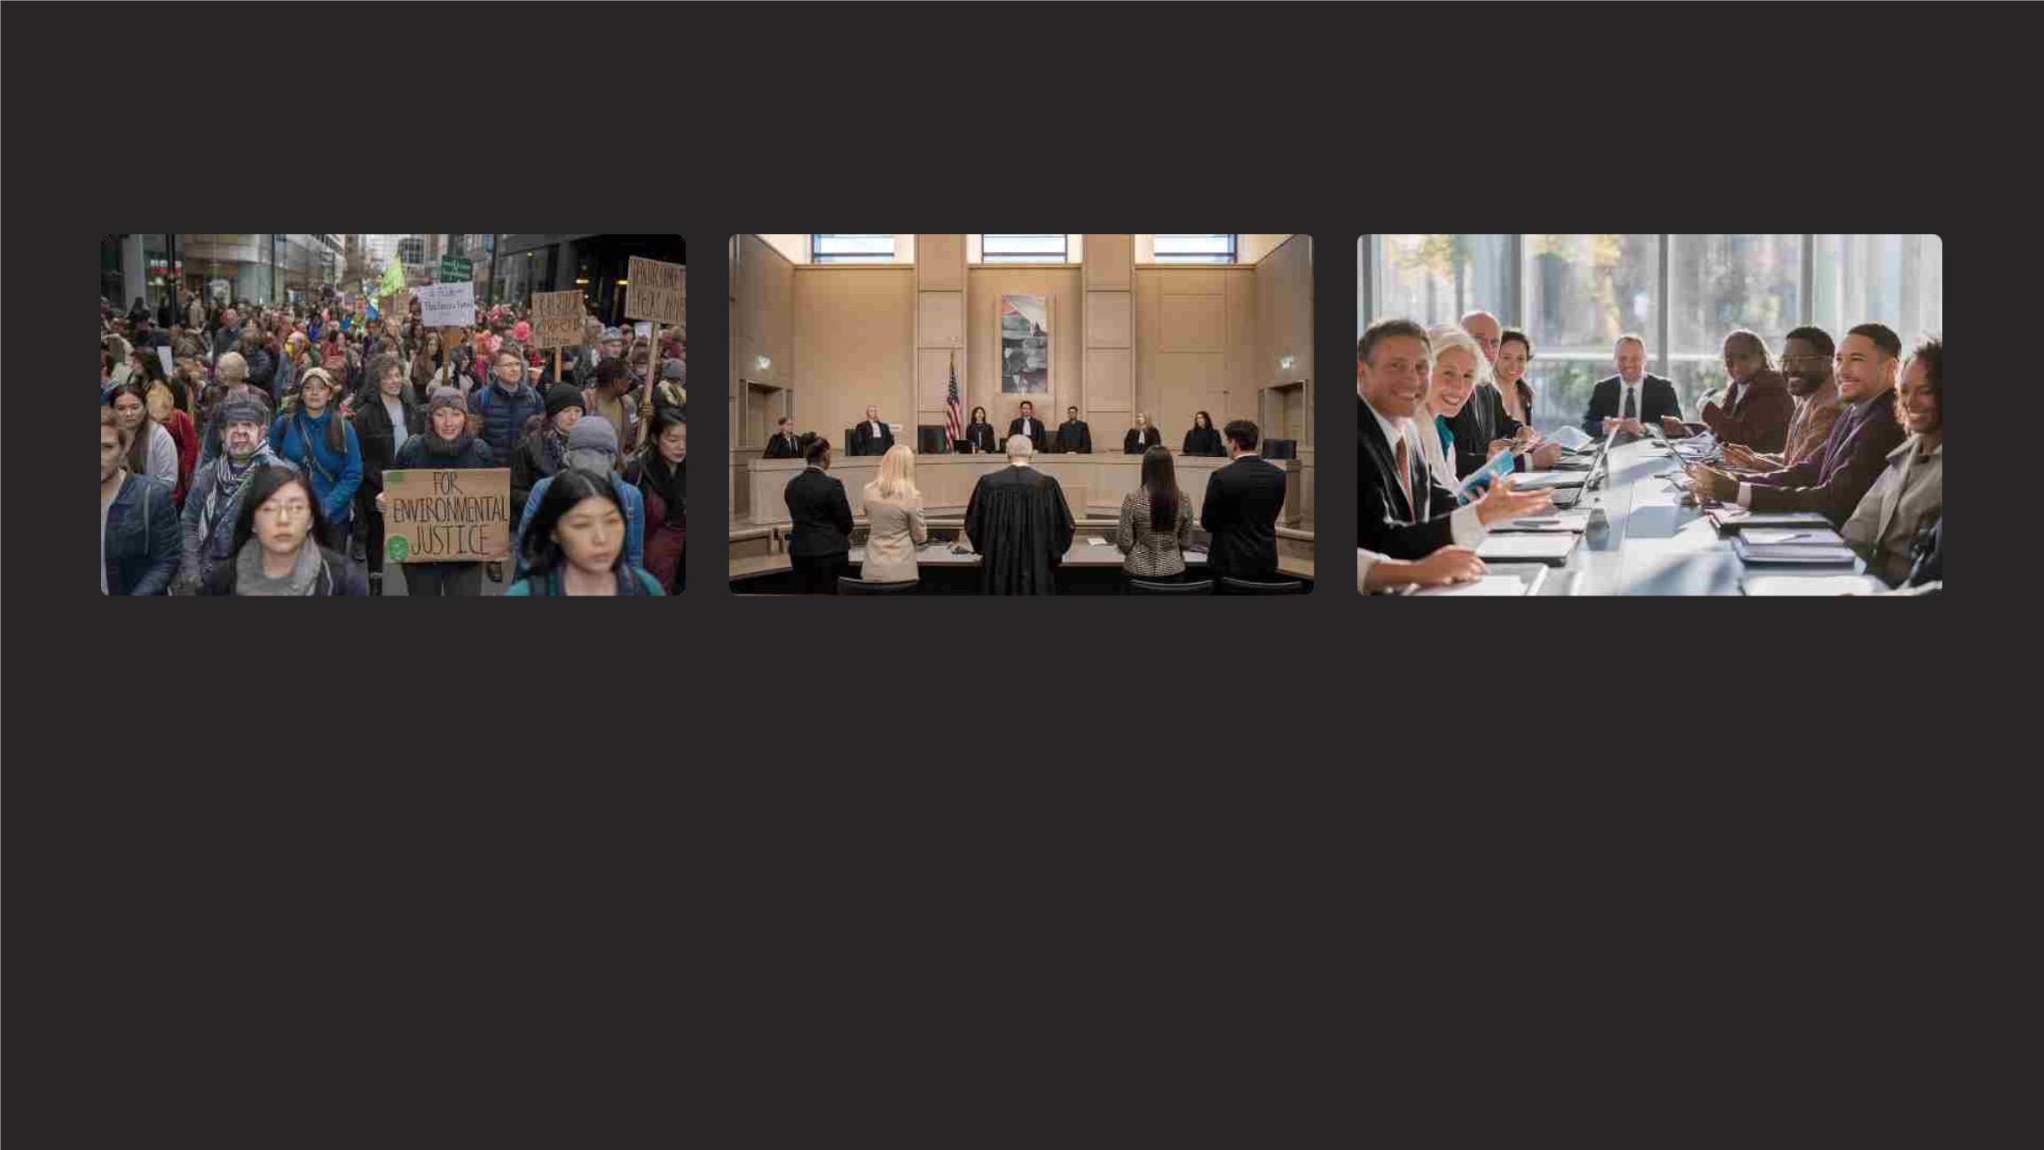
Environmental Justice and Trespass Law
Community Activism
Legal Innovations
Policy Responses
Environmental justice movements have
increasingly used trespass law concepts to
challenge the disproportionate impact of
pollution and environmental degradation on
marginalised communities. These efforts often
involve creative legal strategies that reframe
environmental harms as violations of property
rights.
Some courts have begun to recognise new
forms of environmental trespass that
disproportionately affect vulnerable populations.
For example, cases involving the cumulative
impact of multiple pollution sources on a
community have led to novel interpretations of
trespass law.
Governments are increasingly incorporating
environmental justice considerations into
environmental regulations and enforcement
priorities. This shift is influencing how trespass
laws are applied in cases involving pollution and
resource extraction, with greater emphasis on
protecting disadvantaged communities.

Slide 16

The Role of Scientific Evidence in Environmental Trespass Cases
Advancements in Environmental Science
Rapid progress in environmental science and monitoring technologies has revolutionised the ability to detect and measure pollution and ecological impacts. This
has significant implications for proving environmental trespass claims.
Challenges in Presenting Scientific Evidence
Courts must grapple with complex scientific concepts and data in environmental trespass cases. This often requires judges and juries to understand sophisticated
environmental models and statistical analyses.
The Role of Expert Witnesses
Expert witnesses play a crucial role in interpreting scientific evidence for the court. The selection and credibility of these experts can significantly influence the
outcome of environmental trespass cases.
Evolving Legal Standards
As scientific understanding of environmental processes improves, legal standards for proving environmental trespass are evolving. Courts are increasingly
receptive to new forms of scientific evidence, but also scrutinise its reliability and relevance.

Slide 17

Future Directions in Environmental Trespass Law
Climate Change Litigation
Biodiversity and Ecosystem Services
As the impacts of climate change become more severe, there is
growing interest in using trespass law concepts to hold greenhouse
gas emitters accountable. This could lead to novel legal theories
that treat climate change impacts as a form of global environmental
trespass.
There is increasing recognition of the value of biodiversity and
ecosystem services. Future developments in trespass law may
incorporate these concepts, potentially leading to legal actions
based on damage to ecosystem functions that cross property
boundaries.
International Environmental Trespass
Artificial Intelligence and Environmental Monitoring
As environmental issues increasingly transcend national borders,
there may be a push towards developing international legal
frameworks for addressing transboundary environmental trespass.
This could involve new treaties or the expansion of existing
international environmental law principles.
The integration of AI and advanced sensors in environmental
monitoring could revolutionise the detection and prosecution of
environmental trespass. This may lead to more proactive
enforcement and new legal challenges related to data privacy and
algorithmic decision-making in environmental law.

