Slide 1


Unlocking the Mysteries: The Enigmatic World of Cubic Functions

Slide 2





Introduction to Cubic Functions
Welcome to a journey through the
of cubic functions! In this presentation, we will explore their , , and the
they hold. Get ready to unlock the secrets behind these fascinating mathematical constructs!

Slide 3
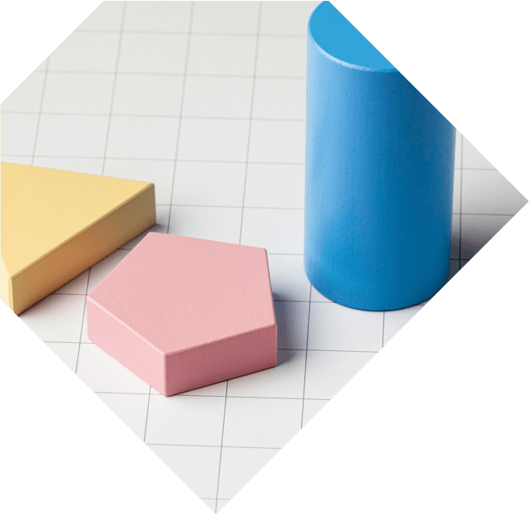



What Are Cubic Functions?
are polynomial functions of degree three, expressed as
. They exhibit unique properties such
as having up to three real roots and an
inflection point. Understanding their structure is key to unraveling their behavior in various contexts.

Slide 4



Graphing Cubic
Functions
The is a
smooth curve that can have one or two turning points. Its shape can vary dramatically based on the coefficients. By examining the
graph, we can uncover the
and of the function, revealing its hidden characteristics.

Slide 5




Real-World Applications
Cubic functions are not just theoretical; they have in fields
like physics, engineering, and economics.
From modeling to
predicting , these functions help us make sense of complex systems in the real world.

Slide 6






Solving Cubic Equations
Solving cubic equations can be a
. Techniques
such as , the
, and are
essential tools in our mathematical toolbox. Each method unveils different aspects of the cubic's nature
and solutions.

Slide 7




Cubic Functions in Nature
Cubic functions appear in nature, from the
to the trajectories of certain animals. Their
mirrors the complexity of the
natural world, revealing patterns and relationships that are both beautiful and profound.

Slide 8
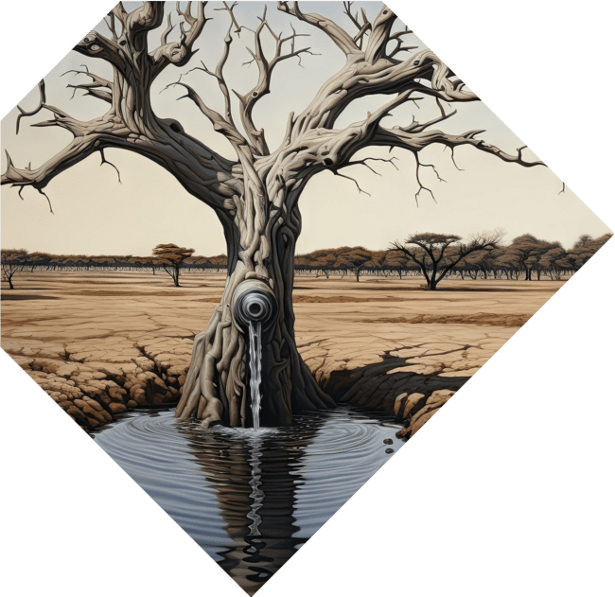


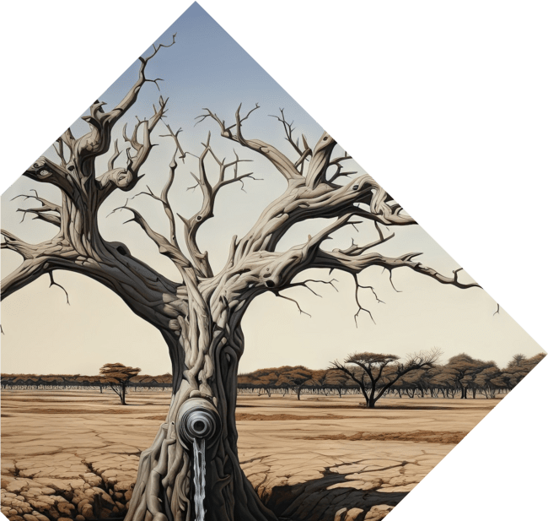
Exploring Complex Roots
Beyond real roots, cubic functions can also have . These roots contribute to the of cubic functions, expanding our understanding of their behavior and implications in advanced mathematics and engineering applications.

Slide 9





Conclusion: The Magic of Cubic Functions
In conclusion, cubic functions are more than just mathematical entities; they embody and
. By unlocking their secrets, we gain insights into both the
and the we
encounter every day.

Slide 10
Thanks!
Do you have any questions?
youremail@email.com
+91 620 000 838
www.yourwebsite.com @yourusername

