Slide 1



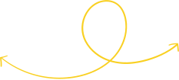





EXPONENTS &
LOGARITHMS
GRADE 10 Mathematics Tutorial

Slide 2




SESSION OUTLINE
RULES OF EXPONENTS
RULES OF LOGARITHMS AND NATURAL LOGARITHMS
SOLVING AND SIMPLIFYING LOGARITHMIC EXPRESSIONS
SAMPLE EXERCISES

Slide 3

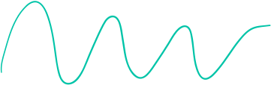
LEARNING OUTCOMES
By the end of the lesson, you'll be able to:
  Know rules of exponents and logarithms.
  Apply these rules to solve and simplify exponential and logarithmic expressions.

Slide 4
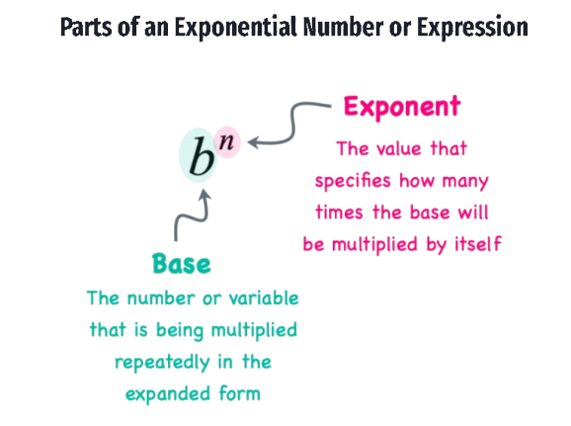
EXPONENTIAL NUMBER/ EXPRESSION
FOR EXAMPLE,
2⁵ = 2 • 2 • 2 • 2 • 2
x⁴ = x • x • x • x
4^{x} = “4 raised to a power of x”

Slide 5


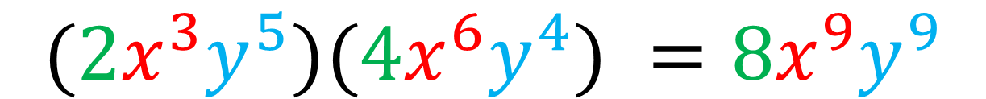
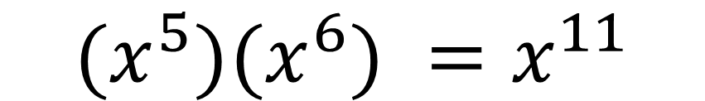
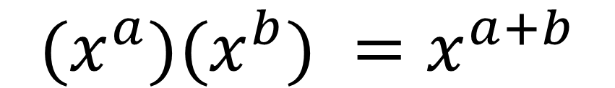
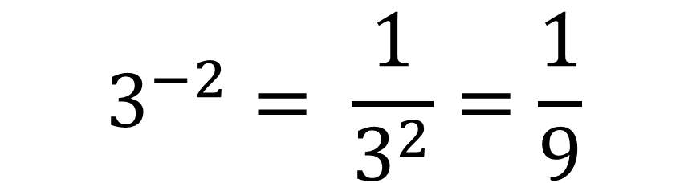

RULES OF EXPONENTS
1. Zero Property
3. Product Property of Exponent
x⁰ = 1
$${(x}^{a})(x^{b}) =x^{a+b}$$
EXAMPLE:
(2x²y)⁰ = 1
EXAMPLES:
$${(x}^{5})(x^{6}) =x^{11}$$
2. Negative Property of Exponent
$${(2x}^{3}y^{5})(4x^{6}y^{4}) =8x^{9}y^{9}$$
$$x^{−a}= \frac{1}{x^{a}}$$
4. Quotient Property of Exponent
EXAMPLE:
EXAMPLE:
$$\frac{{(x}^{a})}{(x^{b})} =x^{a−b}$$
$$3^{−2}= \frac{1}{3^{2}}=\frac{1}{9}$$
$$\frac{{(x}^{5}y^{8})}{(x^{4}y^{7})} =xy$$

Slide 6

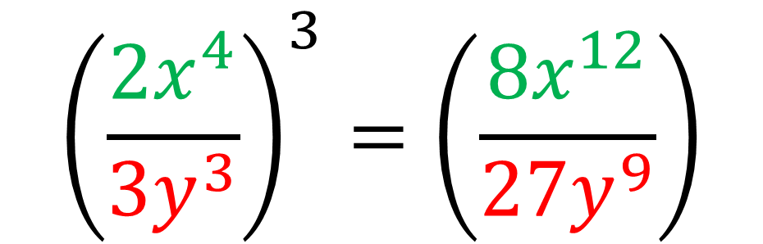
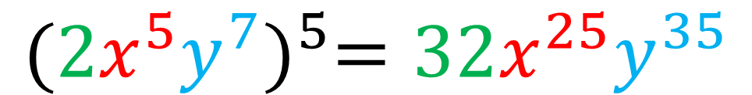

RULES OF EXPONENTS
5. Power of a Power Property
7. Power of a Quotient Property
(xª)^{b} = x^{ab}
$${\left(\frac{x}{y}\right)}^{a}=\left(\frac{x^{a}}{y^{a}}\right)$$
EXAMPLE:
(x²)⁴ = x⁸
6. Power of a Product Property
EXAMPLE:
$${(xy)}^{a}=x^{a}y^{a}$$
$${\left(\frac{{2x}^{4}}{{3y}^{3}}\right)}^{3}=\left(\frac{{8x}^{12}}{{27y}^{9}}\right)$$
EXAMPLE:
$${(2x^{5}y^{7})}^{5}=32x^{25}y^{35}$$

Slide 7



SAMPLE EXERCISES
Simplify
1.
3.
$${\left(\frac{−3x^{−4}}{y^{−2}}\right)}^{−3}$$
$$\frac{24t^{6}r^{4}}{15t^{6}r^{2}}$$
$${\left(\frac{27}{8}\right)}^{−\frac{2}{3}}$$
2.

Slide 8
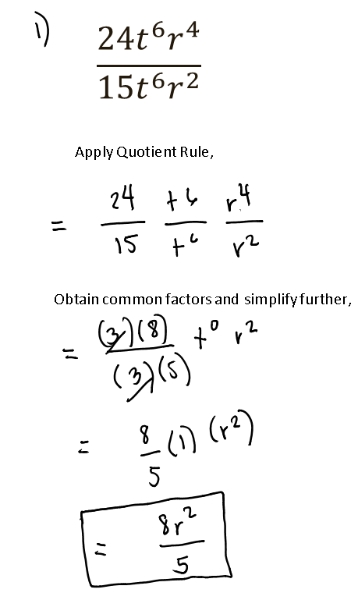
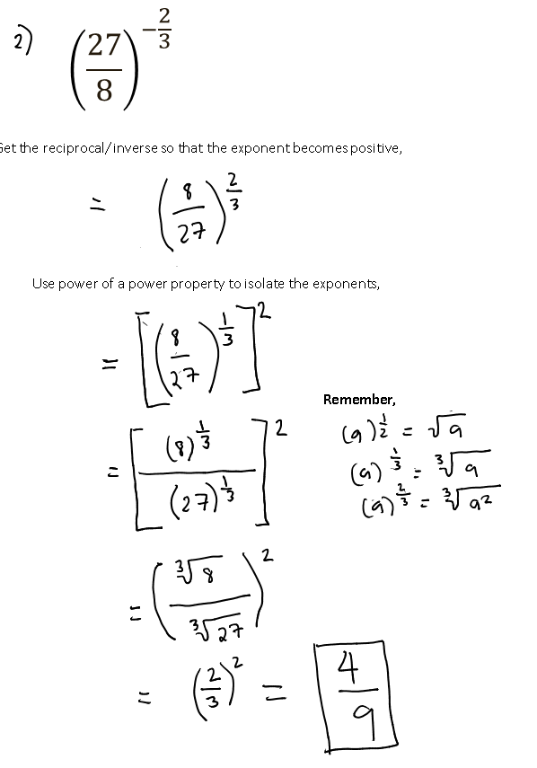
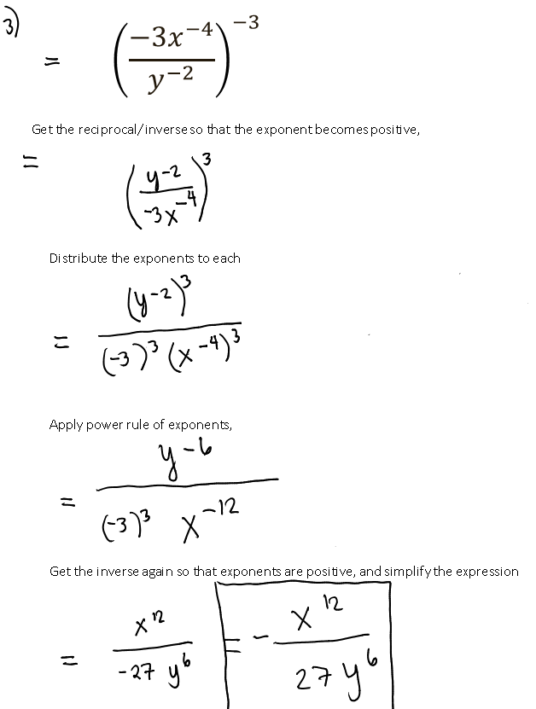
SOLUTIONS TO SAMPLE EXERCISES

Slide 9
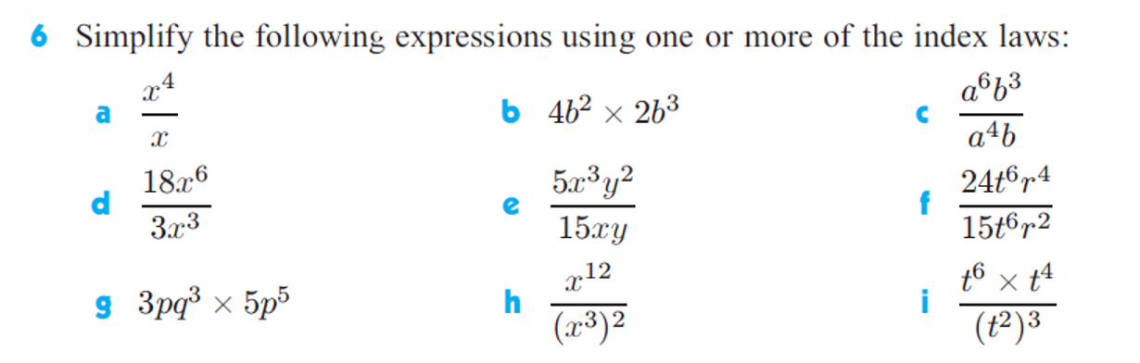
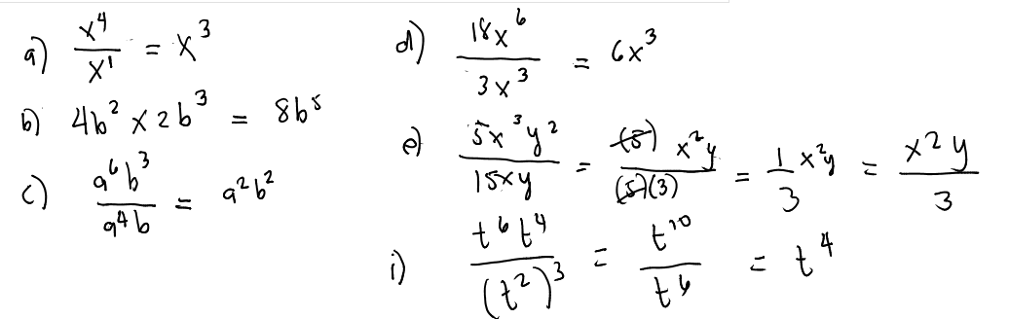
MORE SOLUTIONS TO SAMPLE EXERCISES

Slide 10
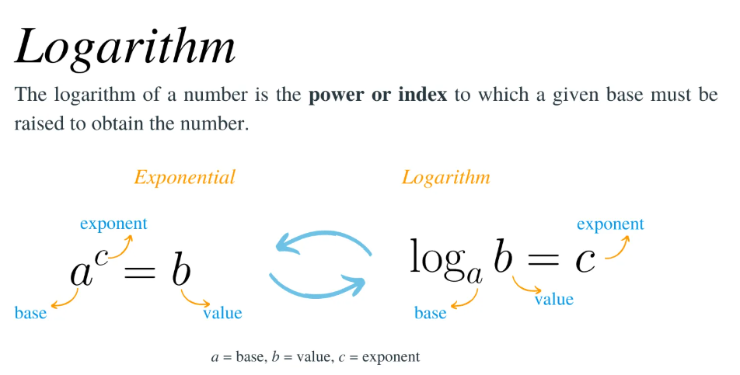
LOGARITHMIC EXPRESSIONS

Slide 11
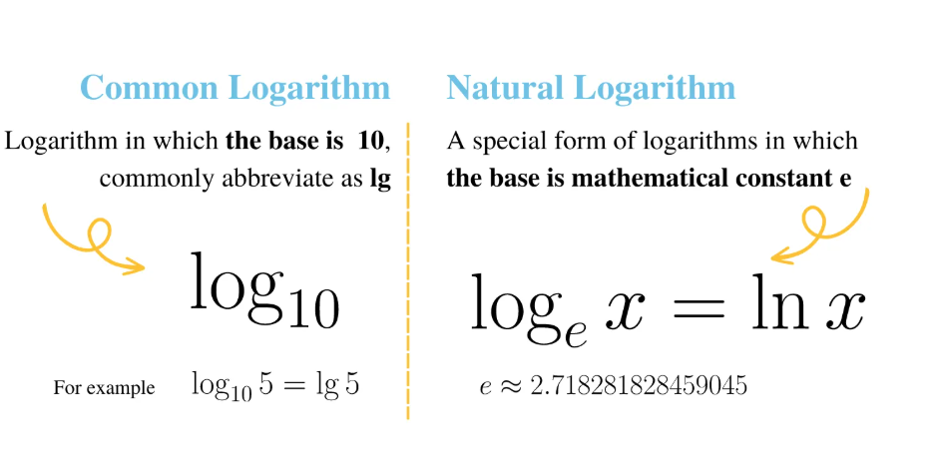
NATURAL LOGARITHMS

Slide 12
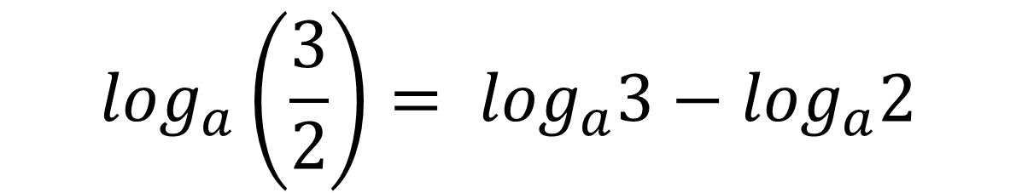
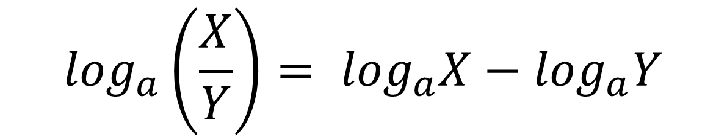
RULES OF LOGARITHMS
1. Product Rule
3. Power Rule
$$\log_{a}\left(X∙Y\right)= \log_{a}X+\log_{a}Y$$
$$\log_{a}\left(X^{b}\right)= {b log}_{a}X$$
EXAMPLE:
$$\log_{a}\left(6\right)= \log_{a}2+\log_{a}3$$
EXAMPLE:
$$\log_{a}\left(4^{3}\right)= {3 log}_{a}4$$
2. Quotient Rule
$$\log_{a}\left(\frac{X}{Y}\right)= \log_{a}X−\log_{a}Y$$
4. Zero Rule
EXAMPLE:
$$\log_{a}\left(1\right)=0$$
$$\log_{a}\left(\frac{3}{2}\right)= \log_{a}3−\log_{a}2$$
Granting that base (a > 0, a≠1)

Slide 13


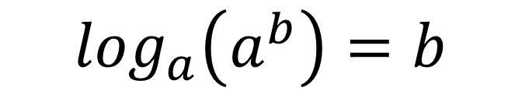



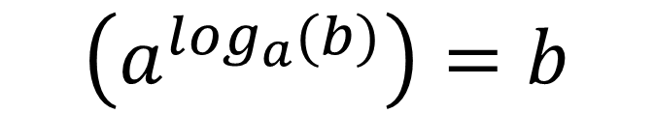
RULES OF LOGARITHMS
5. Identity Rule
7. Inverse Property of Exponent
$$\log_{a}\left(a\right)=1$$
$$for a>0$$
$$\left(a^{\log_{a}(b)}\right){=b}$$
EXAMPLE:
EXAMPLE:
$$\log_{3}\left(3^{4}\right)=4 \log_{3}3=4\left(1\right)=4$$
$$7^{\log_{7}10}=10$$
6. Inverse Property of Logarithm
8. Change of Base Formula
$$\log_{a}\left(a^{b}\right)=b$$
$$\log_{a}{X}= \frac{\log_{c}X}{\log_{c}a}$$
EXAMPLE:
EXAMPLE:
$$\log_{3}\left(3^{4}\right)=4$$
$$\log_{4}{8}= \frac{\log_{10}8}{\log_{10}4}$$

Slide 14
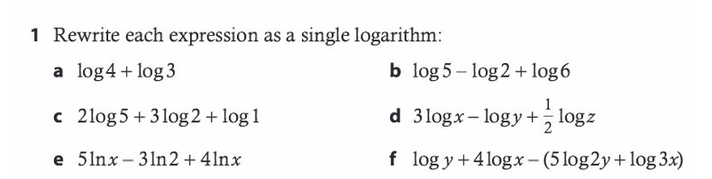
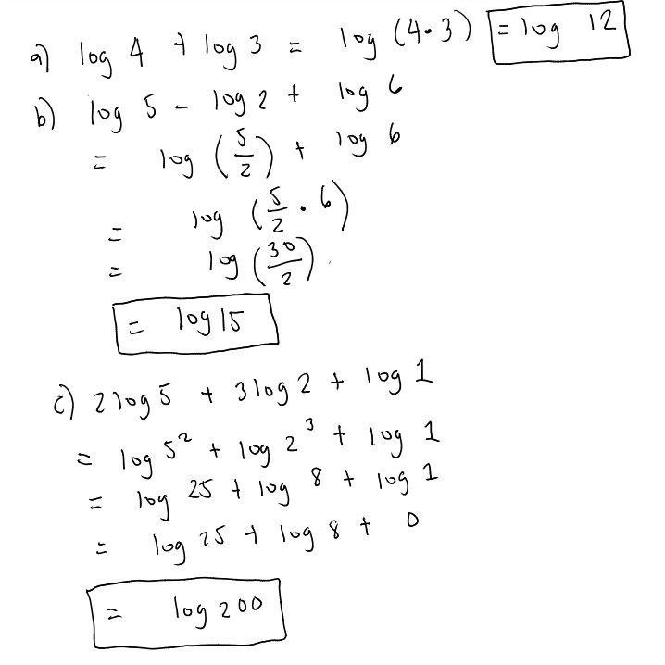
SAMPLE EXERCISES (a-c)

Slide 15




Any more questions?
GRADE 10 MATH TUTORIAL

Slide 16
End of Presentation

