Slide 1
🗓️ The Different Kinds
Of
Noun
Notes:
🗓️ The Different Kinds of Nouns
Theme: “Naming the Worl Around Us”
Main Goal: Students will be able to identify and use different kinds of nouns correctly in sentences.
Grade Level: 7th–8th Grade
Duration: 60–75 minutes
Materials: PowerPoint slides, picture prompts, online whiteboard, flashcards

Slide 2
🎯 Learning Objectives
By the end of the lesson, students will be able to:
Define what a noun is.
Identify and classify different kinds of nouns.
Use nouns correctly in speaking and writing.
Differentiate between proper, common, concrete, abstract, count, and mass nouns.

Slide 3
“Name It!” Game
Notes:
⏰ Lesson Flow (60–75 minutes)
1. Warm-Up (10 mins) – “Name It!” Game
🎯 Goal: Activate prior knowledge.
Teacher shows random pictures (e.g., 🐶 🍎 🏫 💻) or objects around the room.
Student says the name of each object aloud.

Slide 4

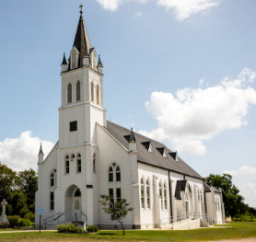
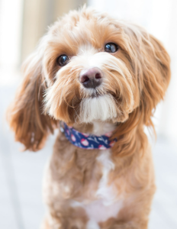

Slide 5



Notes:
✅ Mini recap:
Nouns are naming words — they name people, places, things, or ideas.

Slide 6
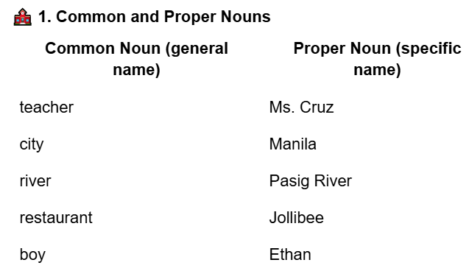
Notes:
Presentation (20 mins) – “Kinds of Nouns”
🧠 Introduce each kind with examples and visuals.

Slide 7
💬 Practice:
“school” → Common
“ABC High School” → Proper
🌟 Rule: Proper nouns always start with a capital letter.

Slide 8
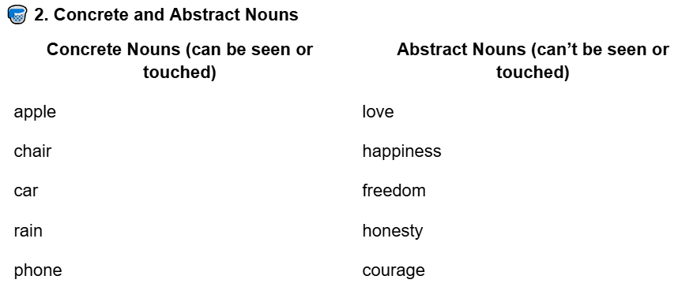
Notes:
💬 Tip: If you can touch it → it’s concrete.
If you can feel it in your heart → it’s abstract. 💖

Slide 9
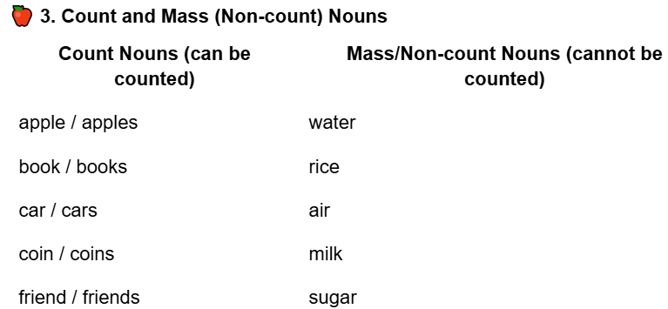
Notes:
💡 Note: Count nouns use a/an or numbers.
Mass nouns use some / much / a little.

Slide 10
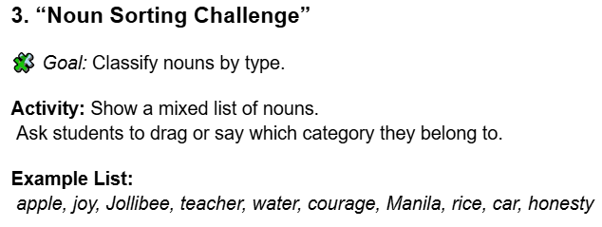
Notes:
Guided Practice (15 mins) – “Noun Sorting Challenge”

Slide 11
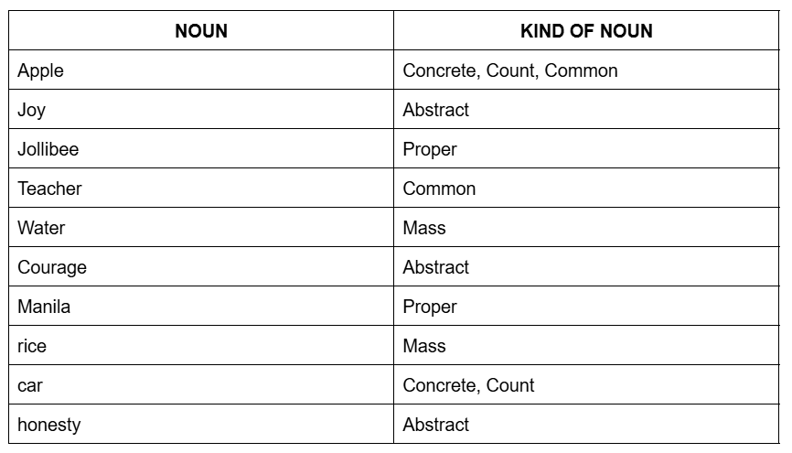
Notes:
💬 Follow-up:
Ask students to make one sentence for each kind.
Example:
Proper: “I live in Cebu City.”
Abstract: “Happiness is important.”

Slide 12
“My Noun Hunt!”
Write down 10 nouns they can see or think of, and label what kind each one is.
Notes:
Independent Practice (15–20 mins) - My Noun Hunt!
Ask students to look around their house or recall their school.
Write down 10 nouns they can see or think of, and label what kind each one is.
Link:
https://docs.google.com/document/d/10AVzvDWlVSg9TDYfhOCcNHyLaqNDDbi1GGnJ8uQubCY/edit?tab=t.hvfcha8ib5xl

Slide 13
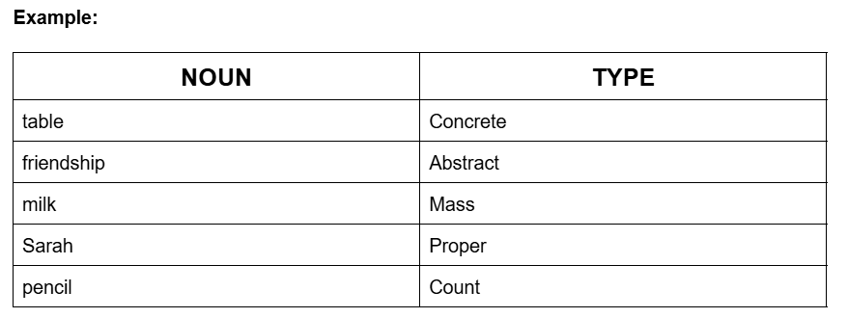
Notes:
Link:
https://docs.google.com/document/d/10AVzvDWlVSg9TDYfhOCcNHyLaqNDDbi1GGnJ8uQubCY/edit?tab=t.hvfcha8ib5xl

Slide 14
🧠 Bonus Task:
Write a short paragraph (4–5 sentences) using at least one of each kind of noun.
Example:
“My friend Anna and I went to SM Mall. We bought some rice and milk. She shared her happiness with me because she saw her favorite singer!”
Notes:
Link:
https://docs.google.com/document/d/10AVzvDWlVSg9TDYfhOCcNHyLaqNDDbi1GGnJ8uQubCY/edit?tab=t.hvfcha8ib5xl

Slide 15
“Noun Detective!” Game
Notes:
5. Wrap-Up (10 mins) – “Noun Detective!” Game
🎮 Quick Round:
Teacher reads short sentences, student identifies the noun(s) and kind(s).

Slide 16
“Love is patient.” →
“Ben plays the guitar.” →
“Water is important.” →
“I have three apples.” →
“We visited Tagaytay.” →
Notes:
“Love is patient.” → Abstract Noun 💖
“Ben plays the guitar.” → Proper, Common
“Water is important.” → Mass
“I have three apples.” → Count
“We visited Tagaytay.” → Proper

Slide 17
✅ Review Key Points:
Common/Proper – name of general or specific thing.
Concrete/Abstract – physical vs. idea.
Count/Mass – can count vs. can’t count.

Slide 18
🧠 Assessment
✔️ Oral noun classification quiz.
✔️ Sentence writing using all 6 noun types.
✔️ Mini paragraph check for variety of nouns.

Slide 19
Sentence | Type of Noun(s)
The students listened carefully.
Courage helps people face challenges.
Ice cream melts quickly on a hot day.
Jake went to Boracay last summer.
Books are my best friends.
Honesty is the best policy.
Notes:
💡 Extra Practice Sentences
* The students listened carefully.
Common, Count
* Courage helps people face challenges.
Abstract
* Ice cream melts quickly on a hot day.
Concrete, Mass
* Jake went to Boracay last summer.
Proper
* Books are my best friends.
Count
* Honesty is the best policy.
Abstract

Slide 20
🌈 Extension Activity
“Build a Noun Poem”
Notes:
🌈 Extension Activity (Optional)
“Build a Noun Poem”
Students write a short 4-line poem using at least one of each type of noun.

Slide 21
Example:
Sarah (Proper) smiles with joy (Abstract).
Her books (Count) are neat and clean.
She drinks water (Mass) every day,
While sitting on a chair (Concrete).
Notes:
🌈 Extension Activity (Optional)
Example:
Sarah (Proper) smiles with joy (Abstract).
Her books (Count) are neat and clean.
She drinks water (Mass) every day,
While sitting on a chair (Concrete).
✅ Integration Tip:
At the end of your Singular & Plural Nouns lesson, you can transition smoothly by saying:
“We’ve learned how to show one and more than one. Now, let’s learn about words that sound singular but actually mean many! That’s what we call Collective Nouns.”

Slide 22
💬 What is a Collective Noun?
A collective noun names a group of people, animals, or things considered as one unit.
Even though it represents many members, it is usually treated as singular in form.

Slide 23
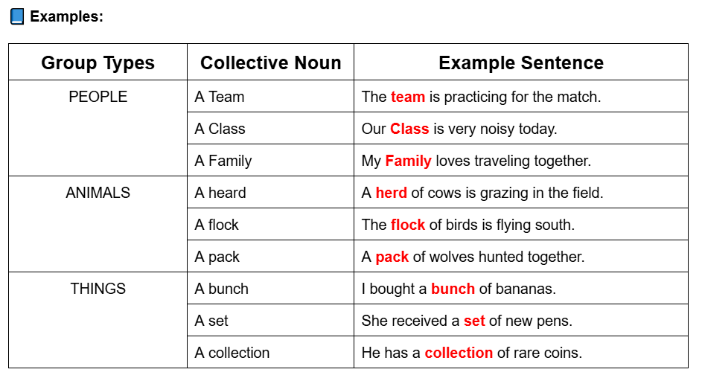

Slide 24
✨ Quick Tip:
Even though a collective noun refers to many, it acts as one, so we often use singular verbs with it.
💬 Examples:
The class is taking an exam. ✅
The team plays well together. ✅
The family eats dinner at 7 PM. ✅

Slide 25
However, in British English, collective nouns can sometimes take plural verbs if the group members act individually:
The team are arguing among themselves.

Slide 26
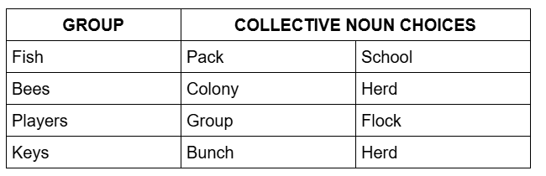
🧩 Mini Activity – “Name That Group!”
Instructions: Match the group to the correct collective noun.
Notes:
🧩 Mini Activity – “Name That Group!”
Instructions: Match the group to the correct collective noun.
✅ Answers:
1 → b (school), 2 → a (colony), 3 → b (team), 4 → a (group), 5 → a (bunch)

Slide 27
✍️ Writing Practice
Write your own sentences using each of the following collective nouns:
family
team
bunch
flock
group
Notes:
Link:
https://docs.google.com/document/d/10AVzvDWlVSg9TDYfhOCcNHyLaqNDDbi1GGnJ8uQubCY/edit?tab=t.0
💬 Sample Answers:
My family is watching a movie tonight.
The team won the championship.
She gave me a bunch of flowers.
A flock of birds flew over the park.
The group of students finished their project early.
💭 Bonus Discussion Prompt
Ask students:
“If you were part of a team, what kind of team would it be and why?”
→ This encourages them to use collective nouns naturally in conversation.

