Slide 1

It means that we have to divide a thing into two equal parts.
Half

Slide 2
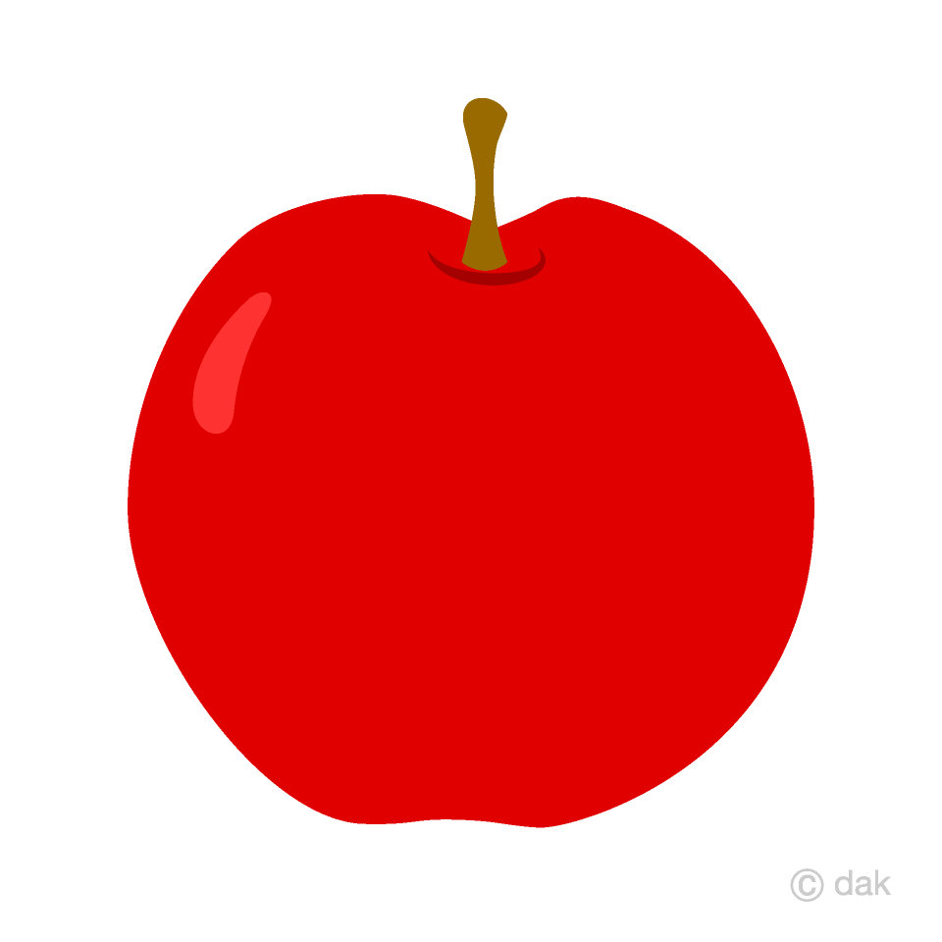
Whole

Slide 3
Half
Half

Slide 4
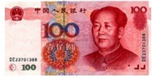
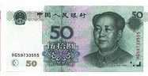
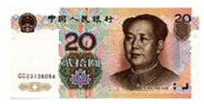
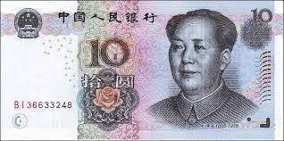
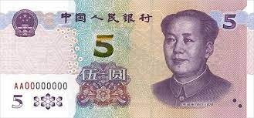
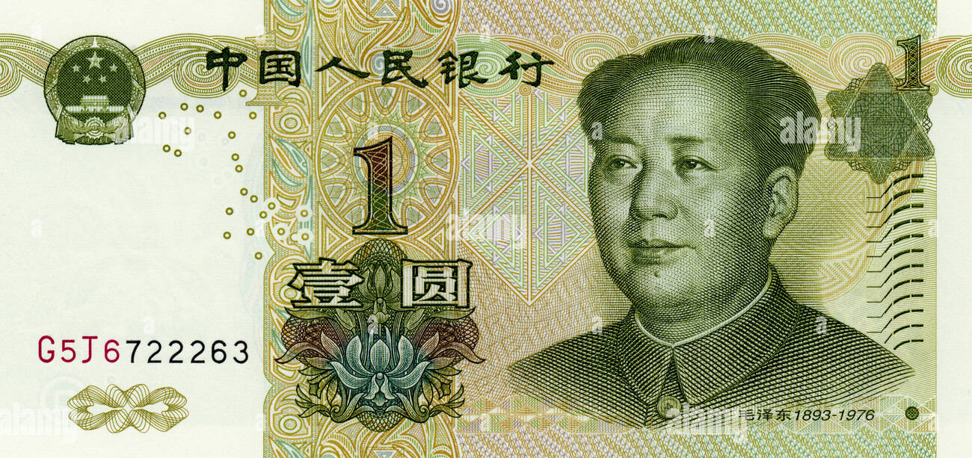
200

Slide 5
48

Slide 6
48

Slide 7
250

Slide 8
300

Slide 9
184

Slide 10
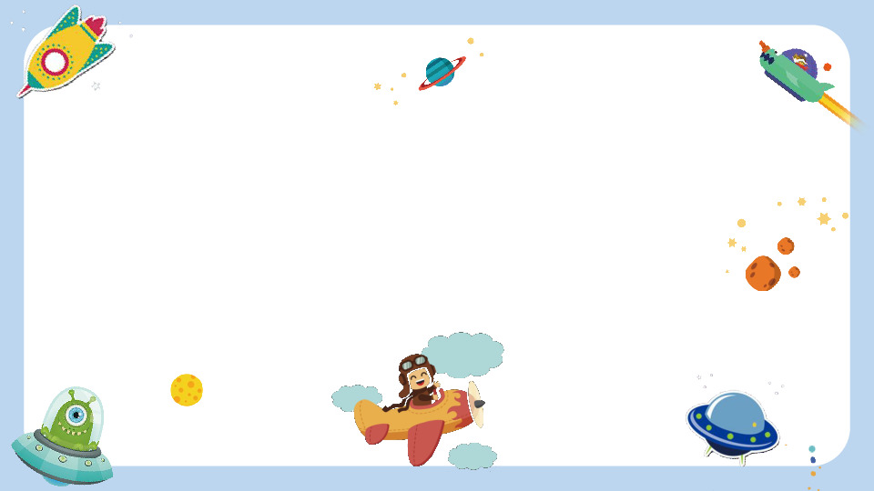
QUARTER
we have to divide a thing into four equal parts.

Slide 11
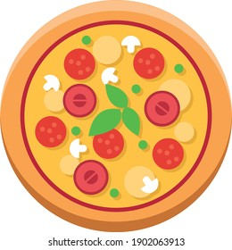
HALF
QUARTER

Slide 12
LEVEL 1

Slide 13
Peter has a quarter of 100 Yuan in his pocket.
How much money does he have?

Slide 14
Chris has a quarter of 20 Yuan in his pocket.
How much money does he have?

Slide 15
Luke has a quarter of 160 Yuan in his pocket.
How much money does he have?

Slide 16
LEVEL 2

Slide 17
James has a quarter of 40 Yuan in his pocket.
Tina has a quarter of 80 Yuan in her pocket.
How much money they both have?

Slide 18
Mat’s mom gave him a quarter of 200.
His dad gave him a quarter of 300.
How much money does he have?

Slide 19
LEVEL 3

Slide 20
An apple costs a quarter of 100.
A banana costs a quarter of 40.
An orange costs a half of 100.
A mango costs a half of 40.
How much money do you need to buy each of the fruits?

