Slide 1
Chord Construction

Slide 2
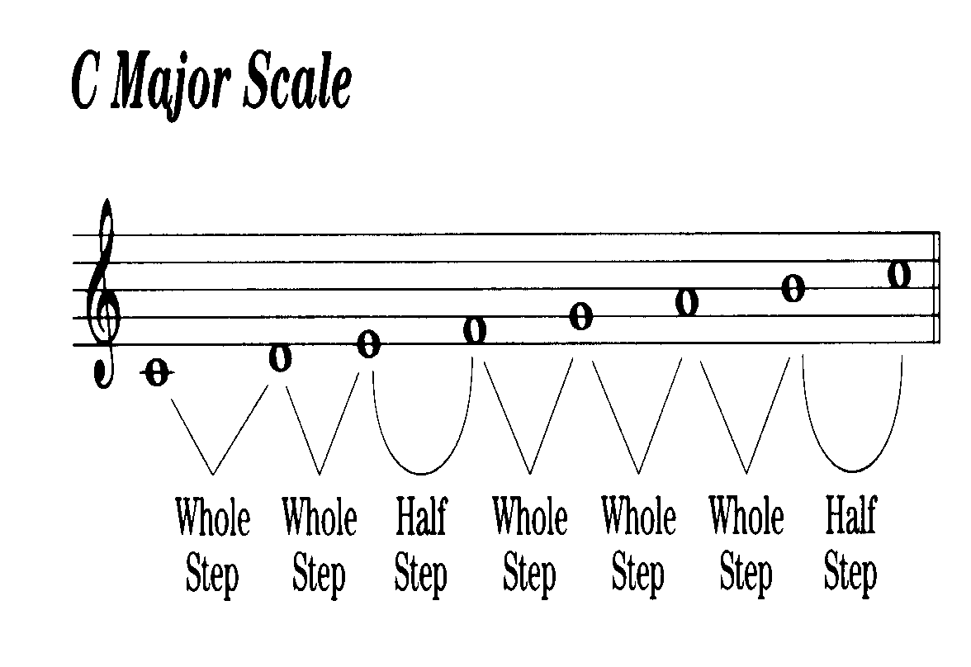
Notes:
ww.guitarnick.com/ode-to-joy-easy-guitar-song-beginners-tab.html

Slide 3
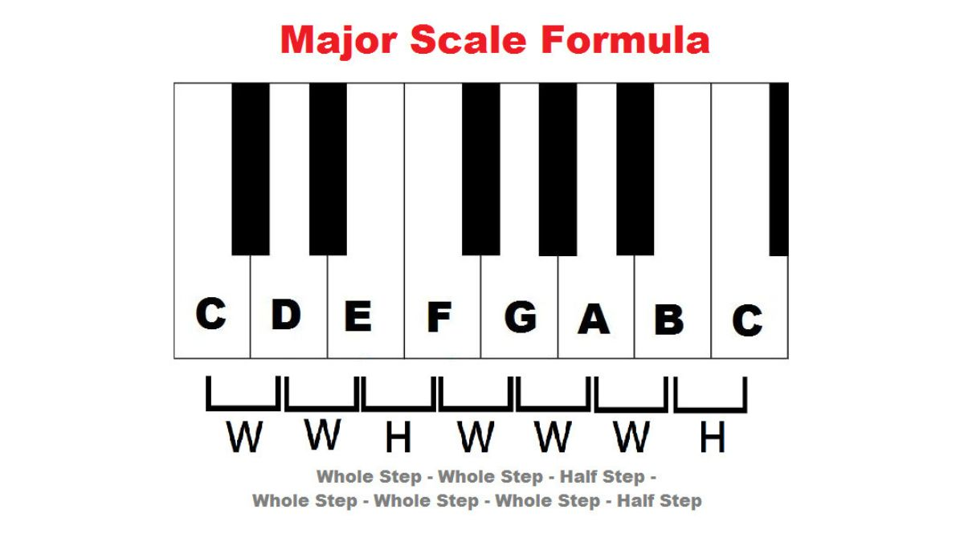

Slide 4
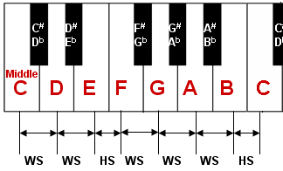

Slide 5
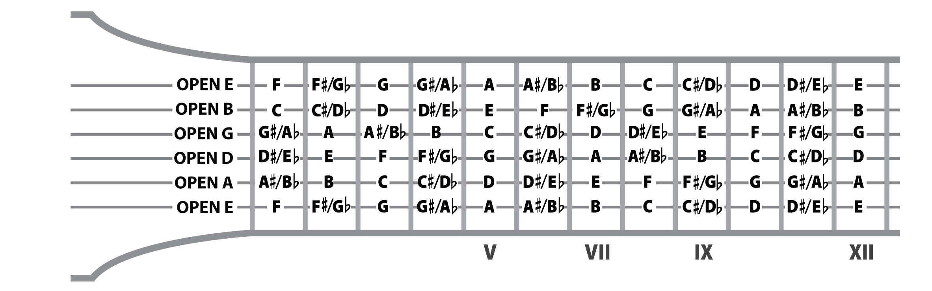

Slide 6
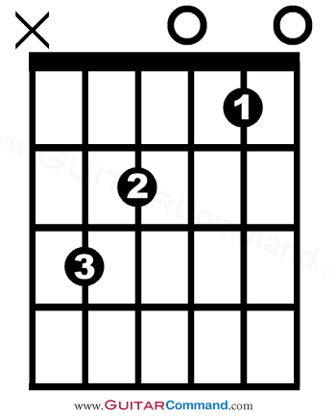
C Major Scale
C D E F G A B C
1 2 3 4 5 6 7 8
Key of C: Chord Formula
Major Chord
C E G
1 3 5
Minor Chord
C Eb G
1 b3 5
G
E
C
E
C

Slide 7
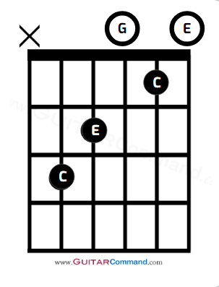
C Major Scale
C D E F G A B C
1 2 3 4 5 6 7 8
C Major
C E G
1 3 5
CM7 Major 7th
C E G B
1 3 5 7
C7 Dominant 7th
C E G Bb
1 3 5 b7
b7

Slide 8
C Major Scale
C D E F G A B C
1 2 3 4 5 6 7 8
C Major
C E G
1 3 5
CM7 Major 7th
C E G B
1 3 5 7
C7 Dominant 7th
C E G Bb
1 3 5 b7
1
1
b7
1
5
5
5
7
5
1
3
5
3
5
3

Slide 9
C Major Scale
C D E F G A B C
1 2 3 4 5 6 7 8
C Major
C E G
1 3 5
CM7
C E G B
1 3 5 7
C7
C E G Bb
1 3 5 b7
Cm
C Eb G
1 b3 5
Cm7
C Eb G Bb
1 b3 5 b7
C9
C E G Bb D
1 3 5 b7 9
CMaj11
C E G Bb D F
1 3 5 b7 9 11
Cmin/maj7
C Eb G B
1 b3 5 7
C Maj6
C E G A
1 3 5 6
CMaj9
C E G B D
1 3 5 7 9
Csus
C G D
1 5 9
Csus4
C G F
1 5 4
Cdim7
C Eb Gb Bb
1 b3 b5 b7
Caug
C E G#
1 3 5#

Slide 10
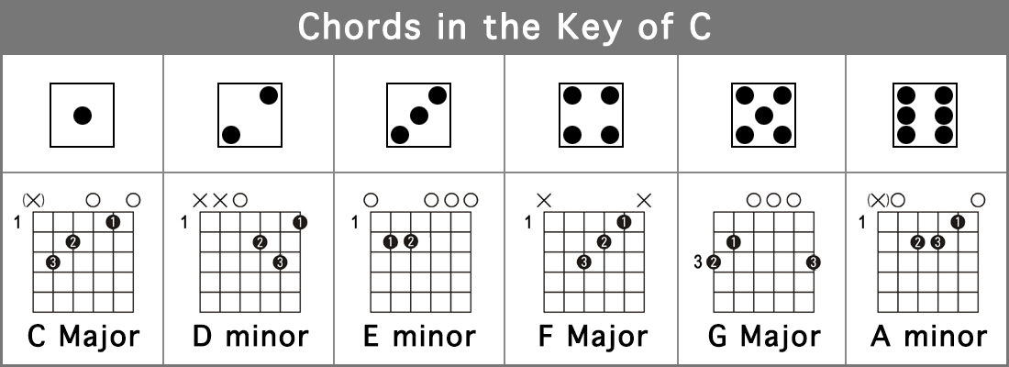
Chords Key of C
X
X
1
2
3
4
B Minor Dim

Slide 11
F | F | G | A | B | C | D | E | F
 | 1 | 2 | 3 | 4 | 5 | 6 | 7 | 8
Chords Key of C
W W H W W H
C | C | D | E | F | G | A | B | C
 | 1 | 2 | 3 | 4 | 5 | 6 | 7 | 8
G | G | A | B | C | D | E | F | G
 | 1 | 2 | 3 | 4 | 5 | 6 | 7 | 8
Dm | D | E | F | G | A | B | C | D
 | 1 | 2 | 3 | 4 | 5 | 6 | 7 | 8
Am | A | B | C | D | E | F | G | A
 | 1 | 2 | 3 | 4 | 5 | 6 | 7 | 8
Em | E | F | G | A | B | C | D | E
 | 1 | 2 | 3 | 4 | 5 | 6 | 7 | 8
B dim | B | C | D | E | F | G | A | B
 | 1 | 2 | 3 | 4 | 5 | 6 | 7 | 8

