Slide 1

Binomial Theorem
Unlocking the secrets of binomial expressions, this presentation explores the powerful Binomial Theorem and its applications in various fields.
IO
by IKENNA ONYI

Slide 2
Introduction to the Binomial Theorem
What is it?
Why is it important?
The Binomial Theorem provides a formula for expanding expressions of the form (x + y)^n, where n is a positive integer.
This theorem simplifies the expansion of binomial expressions, making it easier to calculate and analyze the terms.

Slide 3
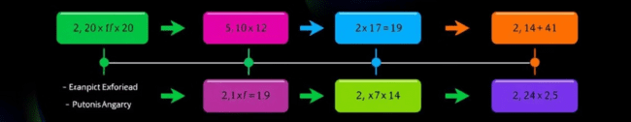
Binomial Expansion
1
Step 1
2
Step 2
3
Step 3
Determine the power 'n' in the binomial expression.
Identify the coefficients using the Binomial Coefficient formula or Pascal's Triangle.
Apply the formula to expand each term in the expression.

Slide 4
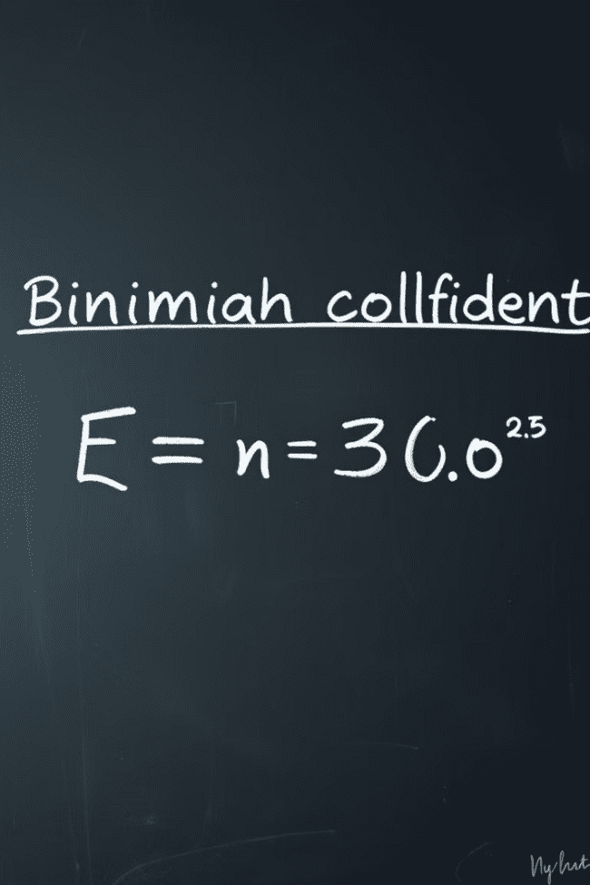

The Binomial Coefficient
Formula
The Binomial Coefficient, denoted by (n choose k), is calculated as n!/(k!(n-k)!), where n is the total number of items and k is the number chosen.

Slide 5
Pascal's Triangle
Rows
1
Each row represents a power of the binomial.
Numbers
2
The numbers in each row correspond to the binomial coefficients.
Pattern
3
The numbers in each row are the sum of the two numbers above them.

Slide 6

Binomial Probability
1
2
3
Probability
Success
Distribution
The Binomial Theorem can be used to calculate the probability of a specific outcome in a sequence of independent trials.
Each trial has only two possible outcomes: success or failure.
The Binomial Probability Distribution describes the probabilities of all possible outcomes.

Slide 7

Applications of the Binomial Theorem
Statistics
Finance
Engineering
Calculating probabilities in sampling and hypothesis testing.
Modeling compound interest and calculating the expected value of investments.
Analyzing and predicting the behavior of systems with multiple components.

Slide 8



Limitations of the Binomial Theorem
Discrete
1
Applies to a finite number of trials.
Independent
2
Assumes that trials are independent of each other.
Constant
3
Requires a constant probability of success for each trial.

Slide 9



Generalization to Multinomial Theorem
Extension
The Binomial Theorem can be generalized to the Multinomial Theorem, which expands expressions with multiple terms.
Applications
This generalization finds applications in probability, statistics, and data analysis.

Slide 10

Conclusion and Key Takeaways
The Binomial Theorem is a fundamental tool in mathematics with wide-ranging applications. It simplifies the expansion of binomial expressions, enables the calculation of probabilities, and provides a foundation for more advanced mathematical concepts.

