Slide 1

Conditional Probability: Understanding Relationships
Conditional probability is a fundamental concept in probability theory, providing insights into the likelihood of events occurring given that other events have already happened. This presentation explores its core principles, formulas, and practical applications.
IO
by IKENNA ONYI

Slide 2
What is Conditional Probability?
Definition
Key Concepts
Conditional probability quantifies the likelihood of an event occurring given that another event has already taken place. It's often denoted as P(A|B), representing the probability of event A happening given that event B has already occurred.
Conditional probability highlights the interdependence of events, where the occurrence of one event influences the probability of another. This concept is crucial in various fields, from decision-making to risk assessment.

Slide 3

The Multiplication Principle
1
Foundation of Conditional Probability
2
Mathematical Representation
P(A and B) = P(A) * P(B|A). This formula forms the basis for understanding conditional probability and calculating the probability of joint events.
The multiplication principle states that the probability of two events occurring in sequence is the product of the probability of the first event and the probability of the second event given that the first event has already occurred.

Slide 4
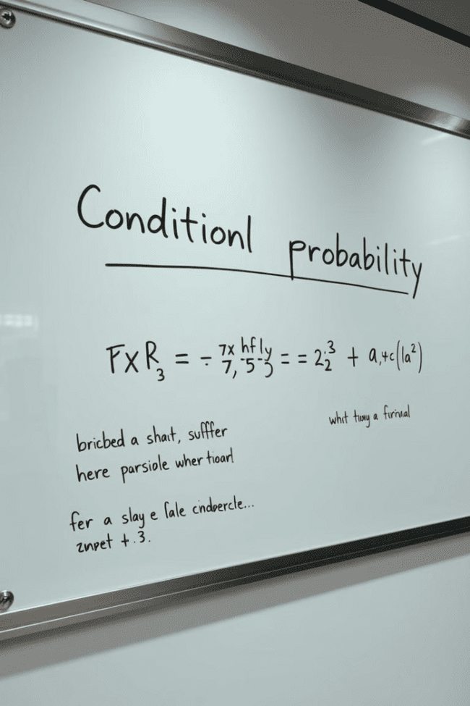
Conditional Probability Formula
P(A|B)
P(A and B)
The probability of event A happening given that event B has already occurred. This is the core concept of conditional probability.
The probability of both event A and event B occurring simultaneously. This is the joint probability of A and B.
P(B)
The probability of event B occurring. This represents the overall likelihood of event B happening.

Slide 5



Example: Probability of Hiring Given a College Degree
Scenario
Calculating Probability
A company is hiring for a position that requires a college degree. They have data on the probability of hiring someone with a college degree (P(Hiring|Degree)) and the overall probability of hiring someone (P(Hiring)).
Using the conditional probability formula, we can calculate the probability of hiring someone with a college degree, considering the overall hiring rate and the probability of having a degree.

Slide 6
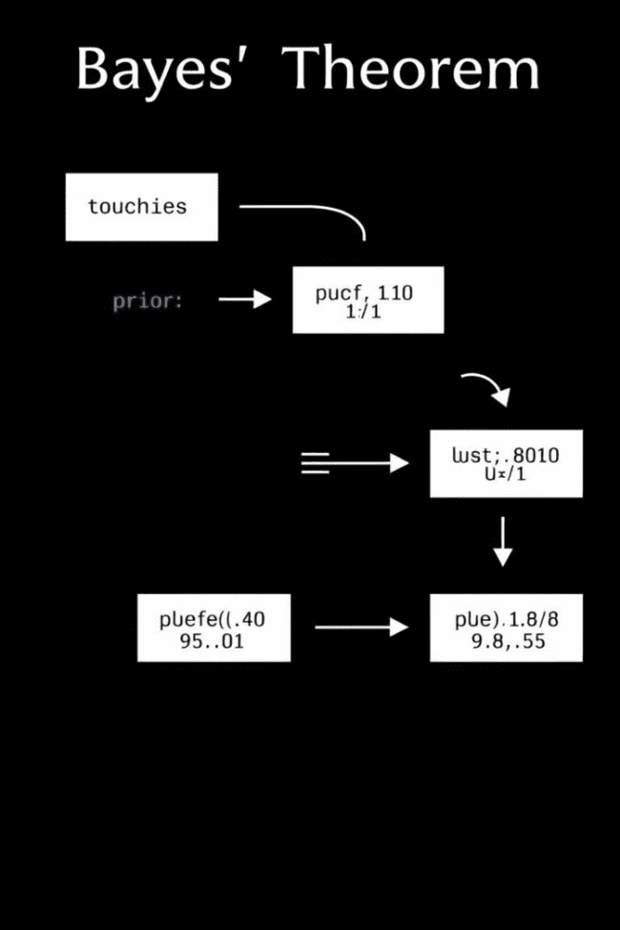
Bayes' Theorem
1
Foundation for Bayesian Inference
Bayes' Theorem is a fundamental tool in probability and statistics. It allows us to update our beliefs about an event based on new evidence or observations.
2
Updating Beliefs
Bayes' Theorem enables us to calculate the probability of a hypothesis (A) given observed evidence (B) by considering the prior probability of the hypothesis, the likelihood of observing the evidence given the hypothesis, and the probability of observing the evidence.

Slide 7



Example: Probability of Breast Cancer Given a Positive Mammogram
Problem
A woman receives a positive mammogram result, but she wants to know the actual probability of having breast cancer given the positive test result. This involves applying Bayes' Theorem.
Applying Bayes' Theorem
Bayes' Theorem helps us calculate the probability of breast cancer (A) given a positive mammogram (B), considering the prior probability of breast cancer, the accuracy of the mammogram, and the probability of a positive mammogram.

Slide 8


Law of Total Probability
Partitioning Events
The law of total probability states that the probability of an event occurring can be calculated by summing the probabilities of the event occurring under different mutually exclusive conditions or partitions.
1
Applications
This law is widely used in various fields, including risk analysis, machine learning, and decision theory, to calculate the overall probability of an event by considering different scenarios.
2

Slide 9
Example: Probability of Rain Given Cloud Cover
Problem
1
We want to determine the probability of rain (A) given the presence of cloud cover (B). This involves applying the law of total probability.
Calculating Probability
The law of total probability helps us calculate the overall probability of rain by considering the probabilities of rain under different cloud cover conditions (e.g., heavy cloud cover, light cloud cover, no cloud cover).
2

Slide 10

Independence and Conditional Probability
1
2
Independent Events
Dependent Events
Independent events are those where the occurrence of one event has no impact on the probability of the other event happening. In such cases, conditional probability is equal to the unconditional probability.
Dependent events are those where the occurrence of one event influences the probability of the other event. Conditional probability plays a crucial role in understanding the relationship between these events.

