Slide 1
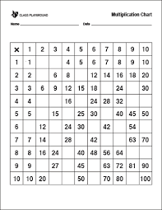
Can you fill in the missing
values for this times table grid?

Slide 2
2 3
4 10
21 27
Did you get them all?
Can you see any patterns?
8 12 20 36 40
10 20 35
6 18 36 48 60
21 35 49 56
32 72 80
18 36 54
30 40 60 90

Slide 3
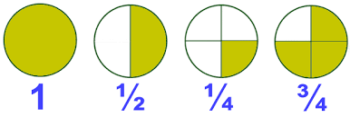
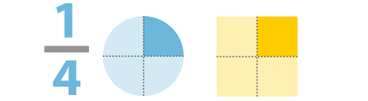
Fractions
Finding complex equivalent fractions

Slide 4

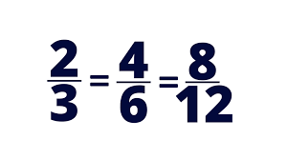
Ok, so let’s look at some equivalent fractions with bigger denominators.
How do we work those out without using a times table grid or trying to draw pizzas?

Slide 5
How many equal pieces is each square cut into?
2
4
8
16
How many are blue?
1
2
4
8
What fraction of each square is blue?
x2
x2
x2
Are these fractions equal/equivalent?
How do you get from one fraction to the next?

Slide 6
How many equal pieces is each square cut into?
3
9
36
How many are blue?
1
3
12
What fraction of each square is blue?
x3
x4
Are these fractions equivalent/the same size?
How do you get from one fraction to the next?

Slide 7
To find equivalent fractions you
multiply the numerator (the top number) and
the denominator (the bottom number) by the
same value (the multiplier).

Slide 8
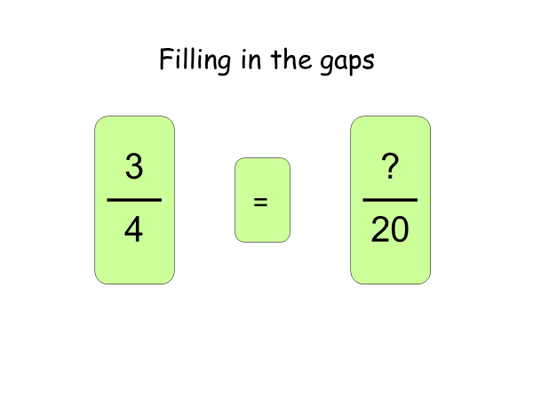

Slide 9
What do I need to multiply
4 by to get 20?

Slide 10
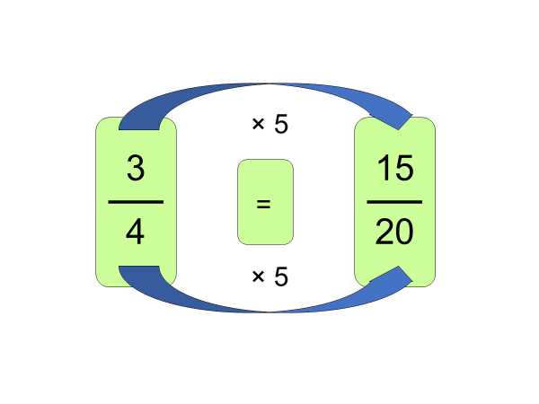

Slide 11
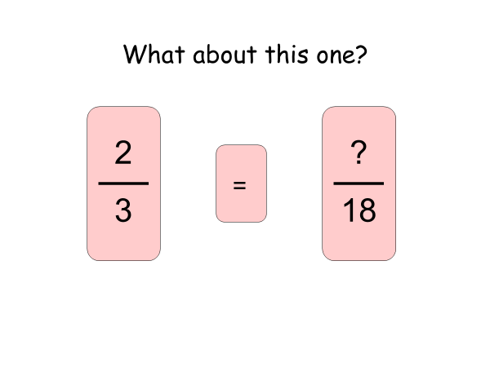

Slide 12
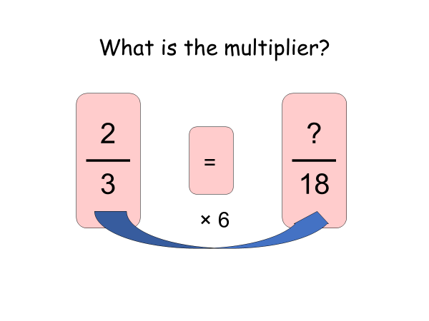

Slide 13
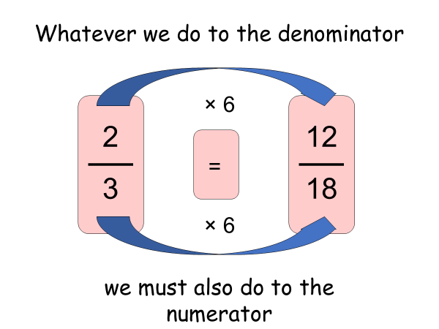

Slide 14
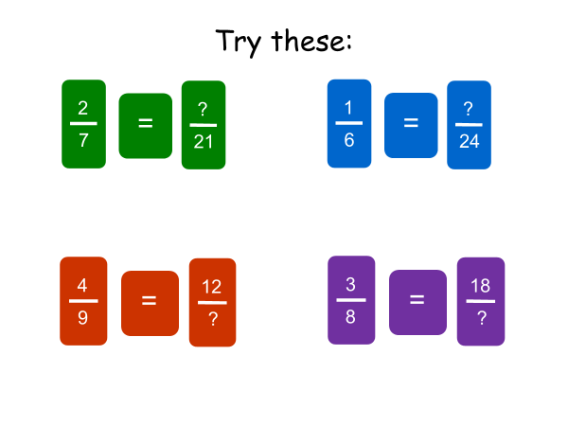

Slide 15
Think…..what have I multiplied my numerator or denominator by to get to the bigger number?

Slide 16
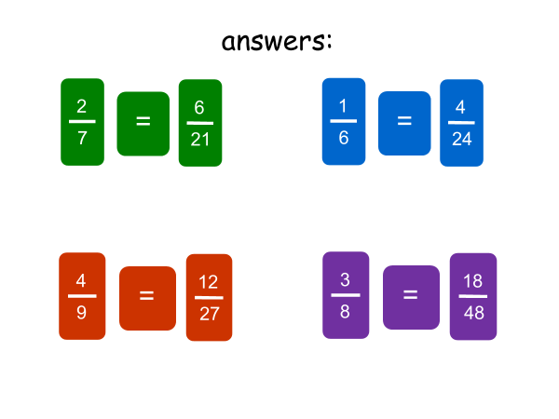

Slide 17
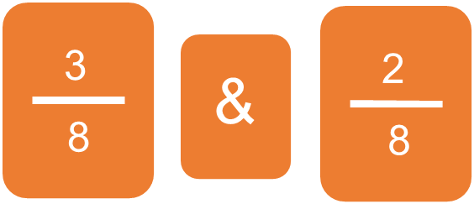
We need to be able to work out equivalent fractions so that we can compare fractions.
Which of these values is bigger?

Slide 18


Slide 19
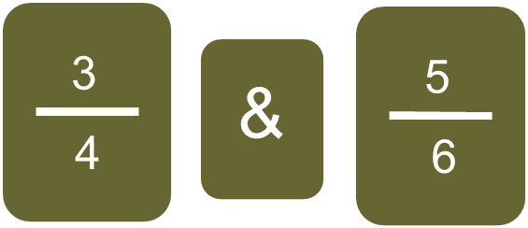
Which of these values is bigger?

Slide 20
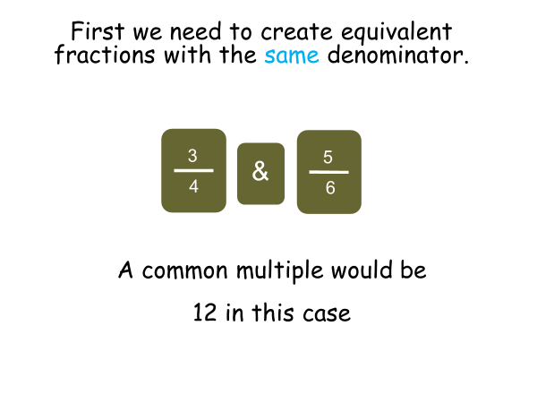

Slide 21
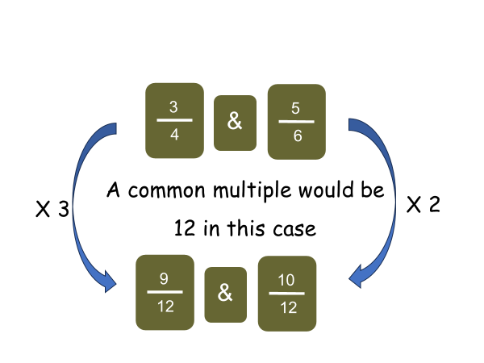
We use 12 because it is the lowest common denominator – we could have used any other number which is a multiple of both 4 & 6.

Slide 22
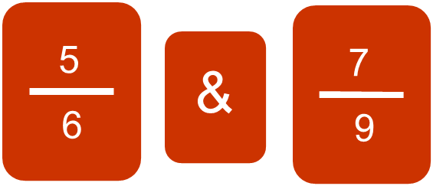
Which of these values is bigger?

Slide 23
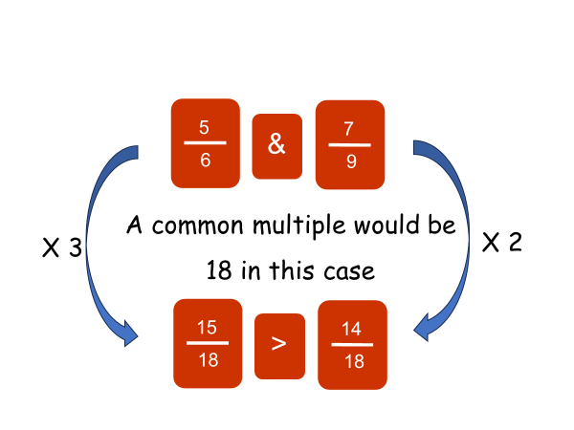
We use 18 because it is the lowest common denominator – we could have used any other number which is a multiple of both 6 & 9.

Slide 24
