Slide 1
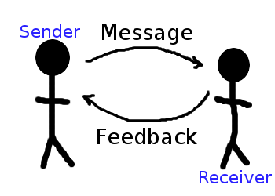

ORAL COMMUNICATION
Meaning:-
Oral communication is the interchange of verbal messages between sender and receiver . In oral communication , the sender & receiver exchange their thoughts or ideas verbally either face to face discussion or through any mechanical or electrical device like telephone ,etc. In business oral communication is used more than written communication . It is more natural and informal.
Definition:-
According to university of Virginia , Oral communication Competency report ,”Oral communication is defined as the effective interpretation , composition, and presentation of information , ideas and values to a specific audience.”

Slide 2
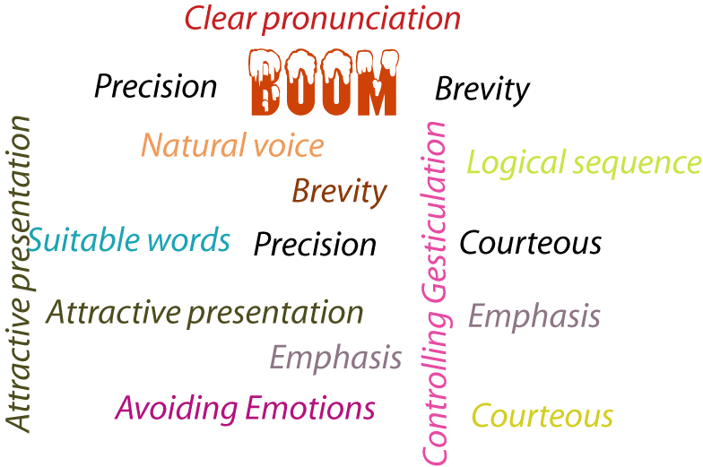
PRINCIPLES OF SUCCESSFUL ORAL COMMUNICATION
Well Planned
Clear Pronunciation
Brevity
Precision
Natural voice
Logical sequence
Suitable words
Attractive presentation
Avoiding emotions
Emphasis

Slide 3
Well Planned:- Before presenting something, there should be proper planning regarding the audience, topics to be delivered , timing & other factors . So person must be well-prepared to deliver his/her speech.
Clear pronunciation:- Words should be clearly & correctly pronounced . There should not be any lack of clarity , otherwise the communication would be confusing one.
Brevity:- The messages should be brief . If the sender take’s a long time for talking ,his message may not get the attention of the receiver.
Precision:- It is needed to make oral communication effective. There should not be any confusing words rather message to be delivered should be specific so that there is no misunderstanding.
Natural voice:- Any sort of unnatural voice may distort the message. Natural voice can do a lot to make oral communication effective.

Slide 4
Logical sequence:- Ideas should be organized in a sequential way to make the message communicative & attractive .
Suitable words:- Words have different meanings to different people in different situations in oral communication, a speaker should use the common , simple & familiar words so that receiver can react to the message without any problem.
Attractive presentation:- It is another principle to make oral communication effective . A speaker should deliver his / her speech in a very nice & sweet language so that receiver is attracted to take part in the communication.
Avoiding emotions:- Speaker must control his emotions to make oral communication effective . Too much emotion will take the speaker away from the main subject.
Emphasis :- The speaker must be knowledgeable regarding the portion of the speech where he/she should give emphasis. Giving emphasis on respective points will help draw the attention of the audience.

