Slide 1
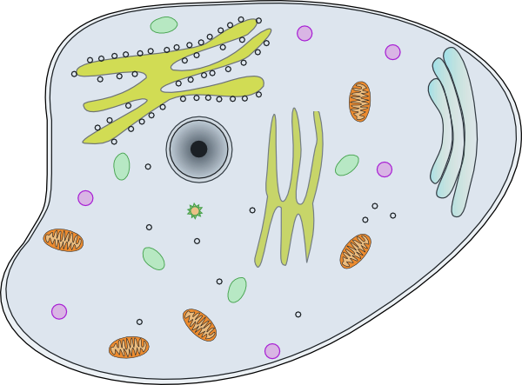
Topic 1: Cells biology
1.1 Introduction to cells

Slide 2
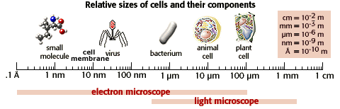
How do we know the sizes of these organisms?
The largest to smallest:
Cell >> organelles >> bacteria>>virus>>membranes>>molecules

Slide 3
Skills
Use of a light microscope to investigate the structure of cells and tissues, with drawing of cells.
Calculation of the magnification of drawings and the actual size of structures and ultrastructures shown in drawings or micrographs. (Prescribed Practical 1)

Slide 4
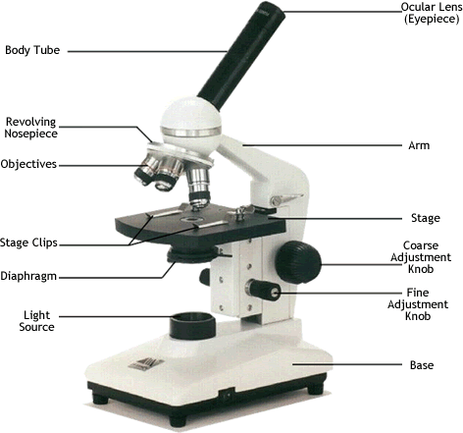

Slide 5
Drawing in DP Biology
Dark pen with clean and crisp lines
No shading, cross hatching, or colour
Use a straight line to label in pen (no arrows)
  Lines should NEVER cross each other
Include a diagram title and magnification at the bottom
  “Paramecium carries out all the life functions within its single cell (x323)

Slide 6
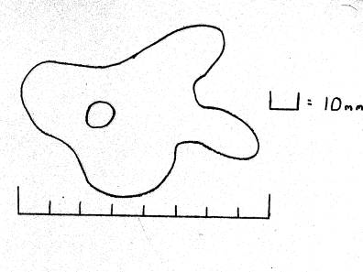
How do we calculate magnification?
Magnification = image size
actual size
Problem: What is the magnification if the actual size of the amoeba is 800μm?
*Make sure all measurements are in the SAME units
Notes:
Remember they must be in the same units!
M = 80nm/0.8nM = 100x

Slide 7
What is the scale bar?
Magnification = image size
actual size
Problem: What is the magnification if the actual size of the amoeba is 800μm?
Notes:
Remember they must be in the same units!
M = 80nm/0.8nM = 100x

Slide 8
Practice problems
Complete and SHOW ALL WORK in section A of handout:
The width of a human hair is 0.1mm. What is the width in micrometers?
The diameter of the drawing of the an amoeba is 100mm. The actual diameter of the amoeba is 100 micrometers. What is the magnification of the drawing?
E. coli has a diameter of 10 micrometers. The drawing is 200cm. What is the power of magnification?
A drawing of a virus has a length of 35 millimeters. The actual length is 1 nanometer. What is the magnification of the drawing?
The width of the plasma membrane of a cell is 9nm. In the drawing, it is 15mm. What is the magnification?

Slide 9
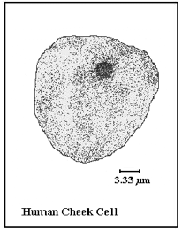
How do we use a scale bar?
Measure the length of scale bar. In this example, it is 1cm = 3.33μm
What is the magnification of the human cheek cell?
1cm = 10mm
3.33μm = 0.0033mm
Magnification = 10mm/0.0033mm
= 3003x
The magnification of the human cheek cell is 3003x

Slide 10
Practice problems
Complete section B of handout

Slide 11
Investigation: Is bigger better?
Which cube will be the most efficient at absorbing a solvent? Why?
Notes:
https://www.sciencelessonsthatrock.com/blog/cell-size-lab-examining-surface-area-to-volume-ratios

Slide 12
Investigation: Is bigger better?
Research question: How will the SA/V ratio of agar cubes affect the % diffusion of sodium hydroxide (0.1M NaOH) into them?
Hypothesis: ??

Slide 13

The importance of the surface area to volume ratio as a factor limiting cell size
These cats are really hot in Hong Kong. If we brought these cats to the North Pole, which cat would cool down the fastest? Why?

Slide 14
Imagine the cats as cubes…
SA (cm²) h x w x 6 sides | V (cm³) h x w x d | SA: V ratio
1 x 1 x 6 = 6 | 1 x 1 x 1 = 1 | 6:1
2 x 2 x 6 = 24 | 2 x 2 x 2 =8 | 24:8 3:1
3x3x6 = 54 | 3 x 3 x3 = 27 | 54:27 2:1
As cell size increases, the SA:V decreases
Notes:
SA of sphere = 4(pi)r squared
V of sphere = (4/3)(pi)(r cubed)

Slide 15
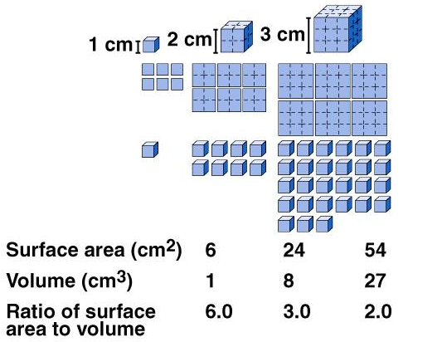
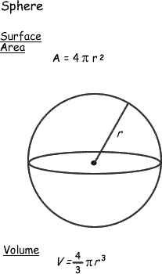
The surface area to volume ratio is a factor that limits cell size
Conclusion:
The volume of a cell increases at a much faster rate than does the cell surface.
Therefore, it is more efficient to have a high SA:V (smaller cell) and limits cell size

Slide 16
Multicellular organisms
The rate at which substances enter/leave the cell depend on SA
The rate at which substances are used/produced depends on V
Therefore, large cells will not be able to take in nutrients or excrete wastes fast enough
The problem is solved by making large organisms multicellular

