Slide 1
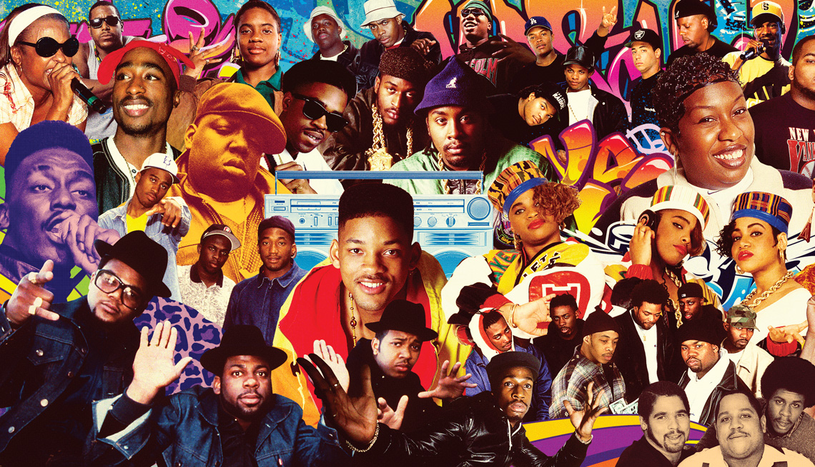
Lesson:2 theme: music
What artist in Hip Hop Culture do you still admire?
This lesson is using music as a theme for learning how to be able to start answering GED questions. While also learning to skim and scan pieces of text.
Hip Hop Culture

Slide 3

Review - Vocabulary Practice
Exercise 10:
Please try to make a sentence using the above three words we have been exploring?
Reading:
Definition Practice
Suggest: Giving advise or even considered providing information that the listener did not know before, to help the person asking a question.
Example: I would suggest that you take the stairs if you wish to get to your room quicker
Predict: Being able to guess what will happen next or in the future.
Example: I will predict that Louis Vuitton will soon begin to sell electronical items.
Indicate: Being able to point out the main information in either writing or speaking and is often a fact or a decision.
Example: The guest has indicated that they do not want towels in their room.
Speaking:

