Slide 1

Unlocking the Triangle: Understanding the Pythagorean Theorem

Slide 2



Introduction to the Pythagorean Theorem
The is a
fundamental principle in geometry, relating the sides of a right triangle. It states that the
is equal to the sum of the squares of the other two sides. This theorem is essential for various applications in mathematics and real-
life scenarios.

Slide 3




History of the Pythagorean
Theorem
The theorem is named after the ancient Greek mathematician
, who is credited with its
discovery. However, evidence suggests that this relationship was known to
and long before Pythagoras. Understanding its historical context enriches our
appreciation of this mathematical
concept.

Slide 4





Understanding Right Triangles
A is deﬁned as a triangle that has one angle measuring
. The sides of a right triangle are known as the (the two shorter sides) and the (the longest side opposite the right angle). This conﬁguration is crucial for applying the Pythagorean theorem.

Slide 5


The Formula Explained
The formula of the Pythagorean theorem is expressed as , where 'c' represents the hypotenuse and 'a' and 'b' represent the other two sides. This equation allows us to calculate the length of any side when the lengths of the other two are known.

Slide 6



Applications in Real Life
The Pythagorean theorem has numerous applications in real life, including in architecture, construction, and navigation. It helps in determining
, creating , and solving various .
Understanding its practical use is essential for professionals in many
ﬁelds.

Slide 7
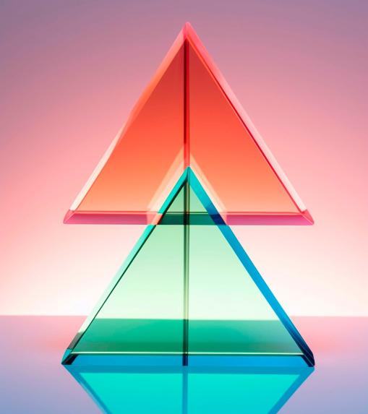
Visualizing the Theorem
Visual aids such as graphs and diagrams can greatly enhance our understanding of the Pythagorean theorem. By drawing squares on each side of a right triangle, we can visually demonstrate that the area of the square on the hypotenuse equals the sum of the areas of the other two
squares.

Slide 8



Common Misconceptions
Many people confuse the Pythagorean theorem's application with non-right triangles. It's important to remember that this theorem only applies to
. Misunderstanding this can lead to errors in calculations and applications, emphasizing the
need for clarity in its use.

Slide 9

Proof of the Theorem
Several proofs exist for the Pythagorean theorem, ranging from algebraic to geometric approaches. One popular proof involves rearranging squares to show that the areas relate as the theorem states. Understanding these proofs enhances comprehension and appreciation of this mathematical principle.

Slide 10

Interactive Learning
Engaging in interactive activities, such as using geometry software or solving real-world problems, can solidify your understanding of the Pythagorean theorem. These activities encourage critical thinking and application of the theorem in various contexts, making learning more enjoyable.

Slide 11
Conclusion: The Pythagorean Legacy
The Pythagorean theorem is not just a mathematical formula; it represents a legacy of knowledge that spans centuries. Its applications in various ﬁelds highlight its importance, making it a cornerstone of geometry. Understanding this theorem opens doors to further exploration in mathematics and science.

Slide 12
Thanks!

