Slide 1
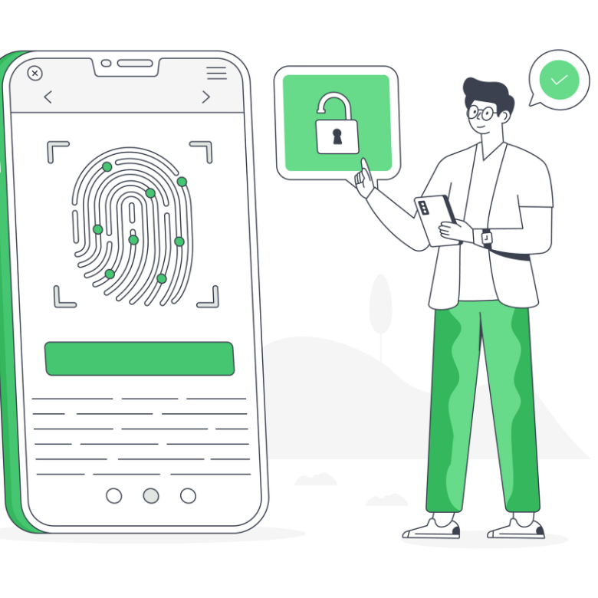
Biometrics – applications and implications
Notes:
To get an editable version of this presentation:
1. Click File > Make a copy > Entire presentation
OR
2. Click File > Download > Microsoft Powerpoint

Slide 2

Critical Reading Club
article link

Slide 3

Let’s get started
with a warm-up
ESL Brains

Slide 4

Look at the two parts of the term below and say what they might refer to.
BIOMETRICS

Slide 5

Let’s work with some vocabulary!
ESL Brains

Slide 6




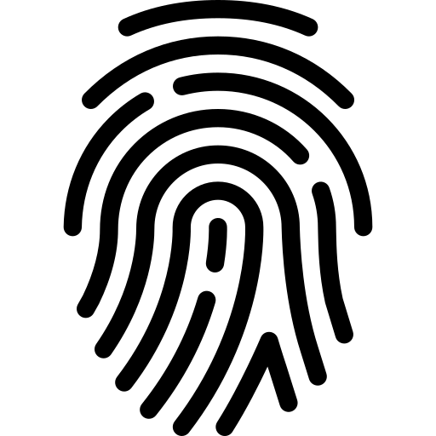
Read the definition of biometrics and complete the gaps with the correct forms of the words in brackets. Then, look at the icons and complete the examples of biometric identifiers in the final sentence.
Biometrics refers to the measurement and analysis of human _____ (DISTINCTION) characteristics. It can be used for _____ (RECOGNIZE) of individuals. With _____ (ADVANCE) in computer vision and AI, biometric technology can be applied to
_____ (AUTHENTIC) people based on their unique biometric identifiers. These include, e.g. ______________ , ______________ , ______________ , ______________ , ______________ .

Slide 7
Let’s check the answers.
Biometrics refers to the measurement and analysis of human _____ (DISTINCTION) characteristics. It can be used for _____ (RECOGNIZE) of individuals. With _____ (ADVANCE) in computer vision and AI, biometric technology can be applied to
_____ (AUTHENTIC) people based on their unique biometric identifiers. These include, e.g. ______________ , ______________ , ______________ , ______________ , ______________ .
distinctive
recognition
advancements
authenticate
palm print
iris
DNA
face
fingerprints

Slide 8

Let’s talk!
ESL Brains

Slide 9

Discuss the questions.
What kind of technology is the article about and what does it allow Mastercard users to do?
Mastercard says you can pay “with a smile or a wave”. Would you like to be able to authenticate your payments this way?
What identity, privacy and security concerns with regard to using biometric technology might there be?
Do you think it’s inevitable that biometric technology will become as ubiquitous as cameras in smartphones?
In what other areas of life might this technology be used?

Slide 10

Let’s think!
ESL Brains

Slide 11
Look at the list of biometric technology applications and say which of them (if any) you find intrusive and why.
Taking payments for school lunches by scanning the faces of pupils.
Using facial recognition in public places for police surveillance.
Voice recognition for banking, e.g. to check account balances or make payments.
Continual remote monitoring of patient’s biometrics by healthcare professionals.

Slide 12
THANKS!
ESL Brains

