Slide 1
The colours

Slide 15
Look at the colours….

Slide 16
blue
brown
green
pink
red
white
orange
black
yellow
grey

Slide 17
What colour is it?
It’s…

Slide 18
It’s white.

Slide 19
It’s yellow.

Slide 20
It’s blue.

Slide 21
It’s black.

Slide 22
It’s red.

Slide 23
It’s grey.

Slide 24
It’s pink.

Slide 25
It’s orange.

Slide 26
It’s brown.

Slide 27
It’s green.

Slide 28
Finish the word and write in English.
1. r _ d
2. g _ e_ n
3. bl _ _
4. b _ o _ n
5. y _ ll _w
6. _ r_y
7. w_ i _ e
8. p _ n _
9. _la_k
10. o _ a _ ge

Slide 30
What happens here?
a or an?
a red notebook
a pink pencil
a yellow book
a brown rubber
an orange pen

Slide 31
The correct word order in English
article →
adjective
→
noun
a blue pen
an orange pen

Slide 32

TRUE OR FALSE??
It’s a white pen.
FALSE

Slide 33

TRUE OR FALSE??
It’s a green ruler.
TRUE

Slide 34
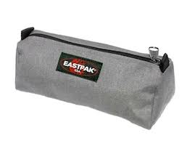
TRUE OR FALSE??
It’s a grey, black, white and red pencil case.
TRUE

Slide 35
TRUE OR FALSE??
It’s a blue and green rubber.
FALSE

Slide 36

TRUE OR FALSE??
It’s an orange, white, brown, yellow and blue book.
FALSE

Slide 37
Put the words in the correct order.
It’s blue pen a
It’s a blue pen.
2. a red It’s rubber
It’s a red rubber.
3. This board is white a
This is a white board.
4. yellow It’s pencil case a
It’s a yellow pencil case.
5. a There green is pencil
There is a green pencil.
6. bag is a brown It
It is a brown bag.

Slide 38
PLURAL
Add a ‘S’ to the object, the colour stays the same.
a blue pen
three blue pens
an orange pencil case
four orange pencil cases

Slide 39
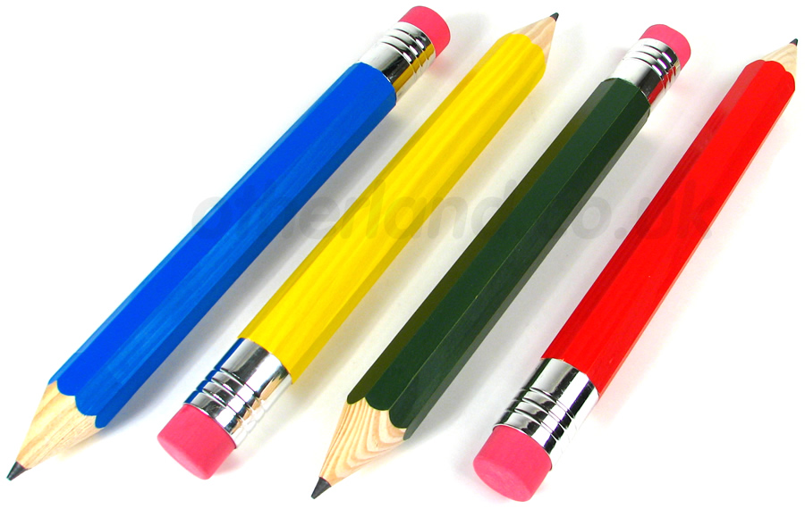
It’s a green pencil.
It’s a blue pencil.
It’s a red pencil.
It’s a yellow pencil.

Slide 40
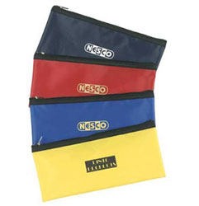
It’s a black pencil case.
It’s a blue
pencil case.
It’s a red pencil case.
It’s a yellow pencil case.

Slide 41
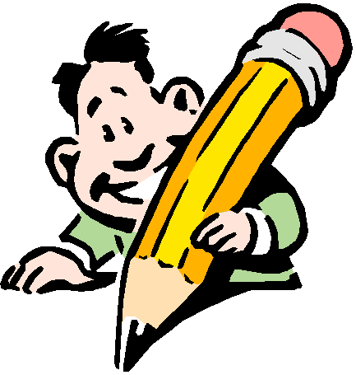
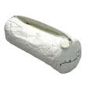
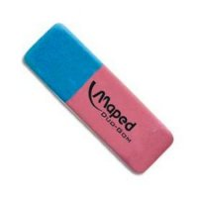
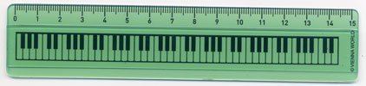
Write the colours of these objects.

Slide 42
