Slide 1

Introduction to Business Communication

Slide 2
Communication
It is derived from the greek word “communicare” or “communico” which means “to share”
Community implies a group of people living in one place

Slide 3
Communications is the process of sending & receiving messages.
OR
It is the process of exchanging information, ideas, data & opinions
It Involves transmission and reception of messages.
It involves people
Effective Communication – Happens when you transmit meaning –relevant meaning- to your audience

Slide 4
Business
Any legal activity undertaken for the sake of generating profit & satisfaction is called business
OR
It is the activity of making, buying, selling or supplying of goods & services for money

Slide 5
Business Communication
Communication that facilitates business deals/activities in & outside the organization.
Effective Business Communication
Communication that is used within the formal business environment and produces desired results and outputs

Slide 6
Features/ Nature
Two-way Process.
Information sharing & understanding.
Verbal & Non-Verbal.
Circular Flow.
Goal oriented.
Continuous Process.
Pervasive Activity.

Slide 7
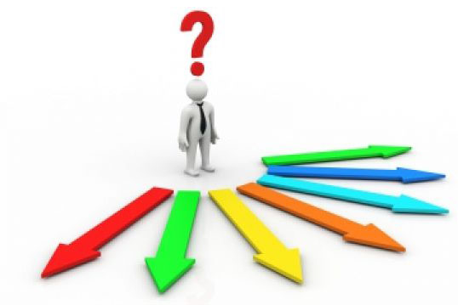
Purpose/Objectives of Communication
Exchange of Information.
Build Goodwill and Image
Build Relationship & self esteem
Advice & Counseling.
Persuasion.
Suggestion.
Education.
Motivation.
Warning.

Slide 8
Communication Model
Sender
Receiver
Message
to be
Conveyed
Feedback to Sender
Message
that was
Understood
N
o
i
s
e
N
o
i
s
e
N
o
i
s
e
N
o
i
s
e
Encode
Message
Decode
Message
Transmit
Message
Receive
Message
Communication Channel

Slide 9
Elements of Business Communication
Sender or Communicator.
Encoding.
Message.
Communication Channel.
Receiver
Decoding
Feedback

Slide 10
Verbal Channels | Non Verbal Channels | Written Channels
Face to Face meetings | Touch | Letters
Telephonic | Facial Expression | Email
VC | Body Language | Memos/Reports
Speeches | Tone of Voice | Fax
Different channels have different strengths and weaknesses. For example, it's not particularly effective to give a long list of directions verbally, while you'll quickly cause problems if you give someone negative feedback using email.

Slide 11
CONTEXT
The situation in which your message is delivered is the context. This may include the surrounding environment or broader culture (corporate culture, international cultures, and so on).
NOISE
In transmitting the message & receiving feedback, the message may be disrupted by noise. Any factor that disrupts, distorts or interferes with the receiver’s ability to receive the message is called noise.

Slide 12

Communication - Types
A.
Internal Communication.
Exchange of information & ideas within
an organization.
External Communication.
Touch with the External Environment.
Handling Competition.
Public Relations.
B.
Formal (Follow Lines of Authority)
Informal

Slide 13
 | INTERNAL | EXTERNAL
FORMAL | Planned communication among insiders(such as memos, reports, e mail, instant messages, blogs, conference calls, presentations etc. ) that follows the company’s chain of command. | Planned communication with outsiders (letters, reports, speeches, website, instant messages, news release, blogs etc.)
INFORMAL | Casual communication among employees (e mail, IM, Face to face conversations, phone calls, team blogs) that do not follows company’s chain of command. | Casual communication with suppliers, customers, investors & other outsiders ( such as e mail, IM, Face to face conversations, phone calls, customer support blog)

Slide 14
Communication Direction
Internal Communication
Formal Channels
Upward
Horizontal/ Lateral
Informal Channels
Grapevine
Diagonal
Downward

Slide 15
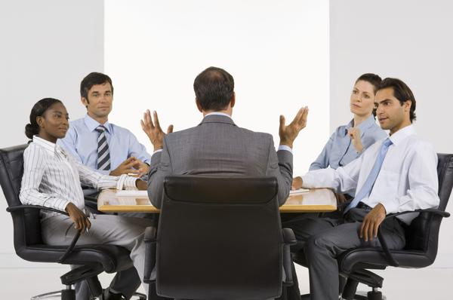
FORMAL CHANNELS OF COMMUNICATION

Slide 16
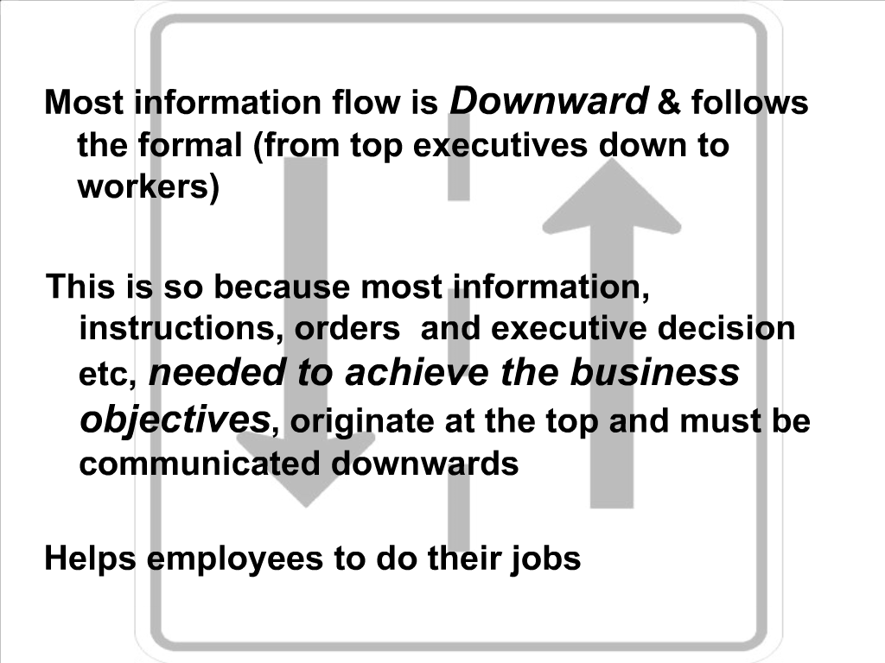

Slide 17
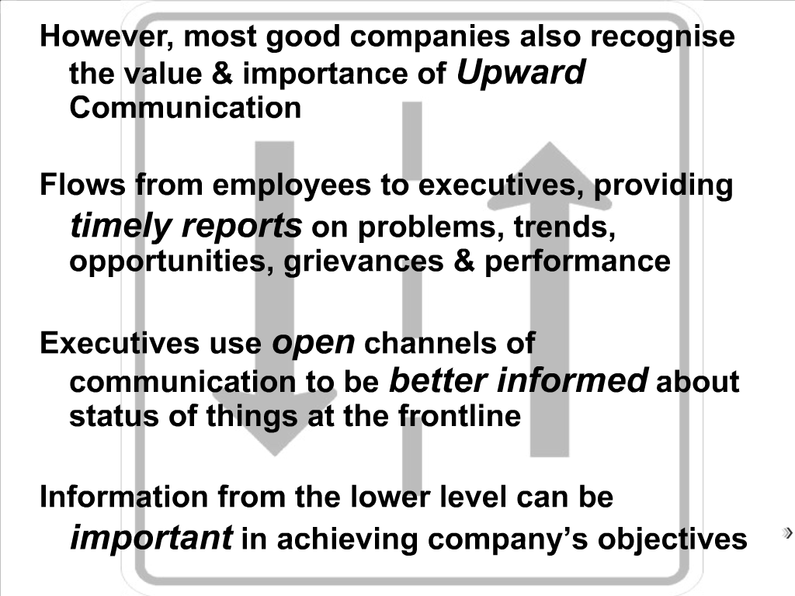

Slide 18
Main function is to supply information to the upper levels about what is happening at lower levels
Essentially participative in nature and can flourish only in democratic organizational environment

Slide 19
Lateral/ Horizontal Communication
Communication between two or more persons who are subordinates working under the same person or on the same level
Main objective is developing teamwork and promoting group coordination within an organization
More casual in tone and occurs more frequently
Saves time and facilitates cooperation
Carried out through informal discussions, management gossip, telephone calls, teleconferencing, memos, routine meetings…

Slide 20
Diagonal/Crosswise/Spiral Communication
Communication flowing between people belonging to different levels of hierarchy and having no direct reporting relationship
Is the result of growing realization of fraternity and equality in corporate sector.
Used generally to quicken the information flow, improve understanding

Slide 21
Grapevine
Informal channels transmit official news through unofficial and informal communicative interactions known as grapevine.
Includes teatime gossip, casual gatherings, lunch time meetings..
Such channels are more active in organizations which are not transparent

Slide 22
Communication
Verbal
Written
Spoken
Non Verbal
Kinesics
Self-presentation
cues
Paralanguage
Spatial Usage
C. Verbal & Non Verbal

Slide 23
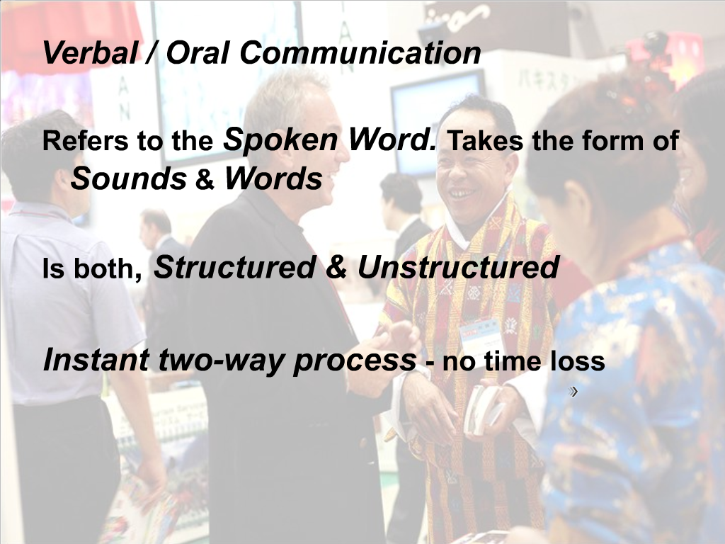

Slide 24
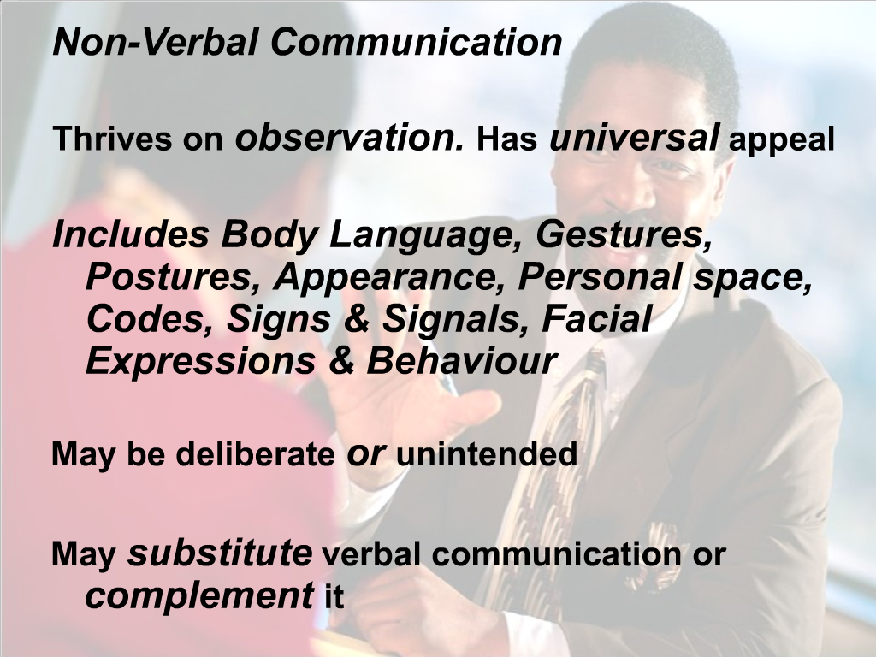

Slide 25
Non Verbal Communication
Non-verbal communication consists of all the messages other than words that are used in communication.
In oral communication Information is conveyed as words, tone of voice, and body language.

Slide 26
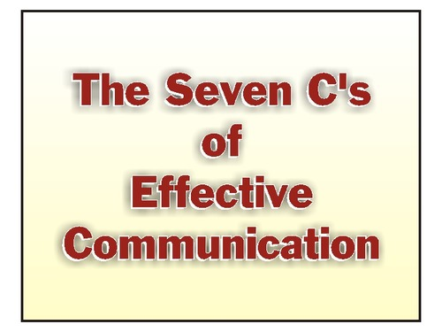

Slide 27
When We talk about “ Effective Communication” one thing that comes in mind, what are the basic principles of “effective communication” .
These principles tells us how your message can become effective for your target group,
These principles also tell about style and importance of the message.
These principles commonly known as 7 C’s of effective communication.

Slide 28


