Slide 1

Graphing Functions
Graphing functions is a fundamental concept in mathematics. This presentation will explore the basics of graphing, various types of functions, and how to analyze their graphs.
oi
by onyi ik

Slide 2
Introduction to Functions
Definition
Notation
A function is a rule that assigns each input value to exactly one output value. It's like a machine that takes an input, processes it, and produces an output.
Functions are often denoted by letters like f, g, or h. The input is represented by a variable like x, and the output is f(x).

Slide 3
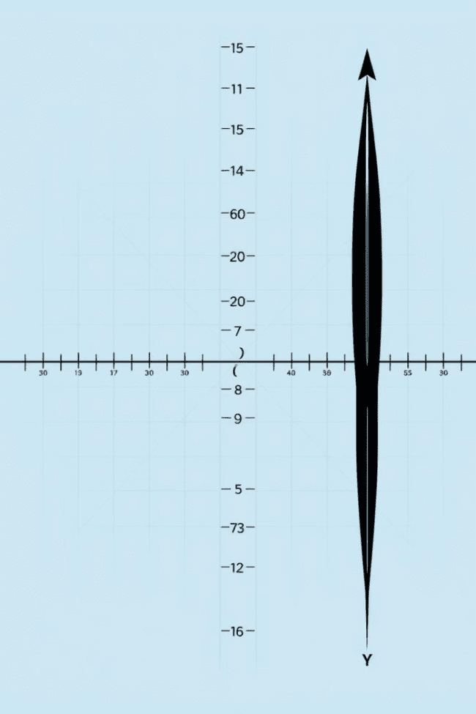
Cartesian Coordinate System
X-Axis
Y-Axis
The horizontal axis represents the input values.
The vertical axis represents the output values.
Origin
Quadrants
The point where the axes intersect is called the origin (0, 0).
The coordinate plane is divided into four quadrants based on the signs of the x and y coordinates.

Slide 4
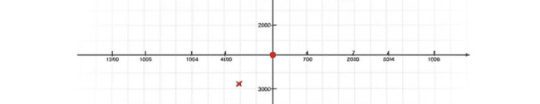



Plotting Points
Ordered Pairs
X-Coordinate
Y-Coordinate
Each point on the graph is represented by an ordered pair (x, y), where x is the input and y is the output.
The first number in the ordered pair represents the x-coordinate, which indicates the point's horizontal position.
The second number in the ordered pair represents the y-coordinate, which indicates the point's vertical position.

Slide 5



Graphing Linear Functions
Slope-Intercept Form
1
y = mx + b, where m is the slope and b is the y-intercept.
Slope
2
Represents the steepness of the line. A positive slope indicates an upward trend, while a negative slope indicates a downward trend.
Y-Intercept
3
Represents the point where the line intersects the y-axis. It's the value of y when x = 0.

Slide 6

Graphing Quadratic Functions
Axis of Symmetry
Standard Form
A vertical line that passes through the vertex and divides the parabola into two symmetrical halves.
y = ax^2 + bx + c, where a, b, and c are constants.
1
2
3
Vertex
The turning point of the parabola. The vertex's x-coordinate is -b/2a.

Slide 7
Graphing Exponential Functions
Standard Form
1
y = ab^x, where a and b are constants, and b > 0.
Growth Factor
2
The base b determines the rate of growth or decay. If b > 1, the graph represents exponential growth.
Horizontal Asymptote
3
The x-axis acts as a horizontal asymptote, which the graph approaches but never touches.

Slide 8
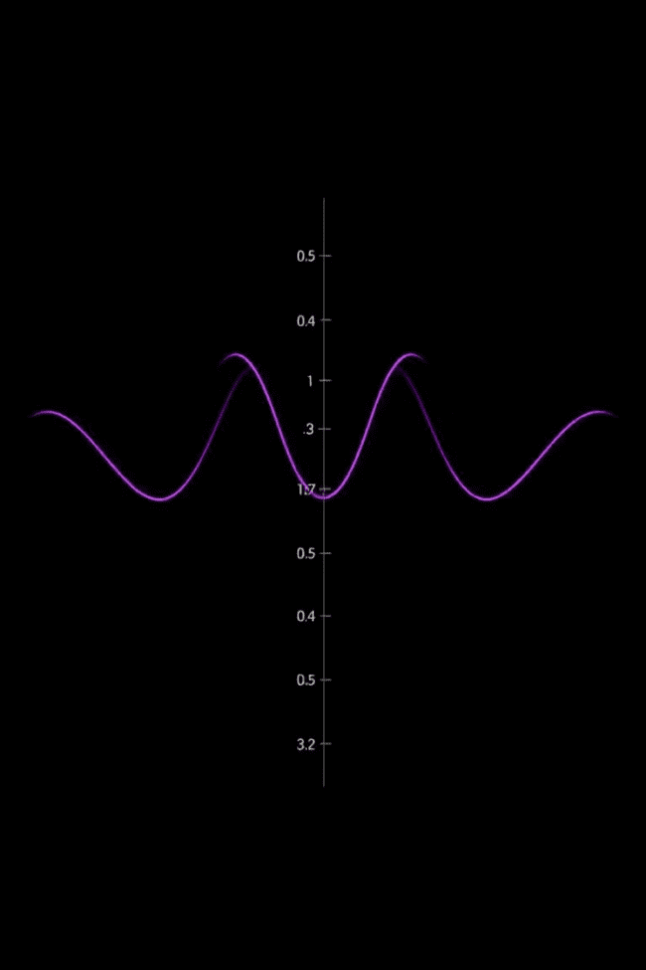
Graphing Trigonometric Functions
1
Sine
y = sin(x), periodic function with a period of 2π.
2
Cosine
y = cos(x), also periodic with a period of 2π.
3
Tangent
y = tan(x), periodic with a period of π.

Slide 9





Transformations of Functions
Vertical Shifts
Adding a constant to the function shifts the graph vertically up or down.
Horizontal Shifts
Adding a constant inside the function shifts the graph horizontally left or right.
Vertical Stretches/Compressions
Multiplying the function by a constant stretches or compresses the graph vertically.
Horizontal Stretches/Compressions
Multiplying the input by a constant stretches or compresses the graph horizontally.
Reflections
Negating the function or the input reflects the graph across the y-axis or x-axis, respectively.

Slide 10

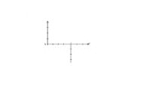
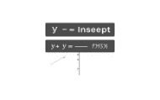
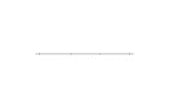
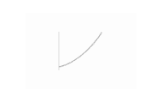
Analyzing Graphs

