Slide 1

Lasagne
Angling
Recycling
Ferocious
Legitimate
Feasible

Slide 2
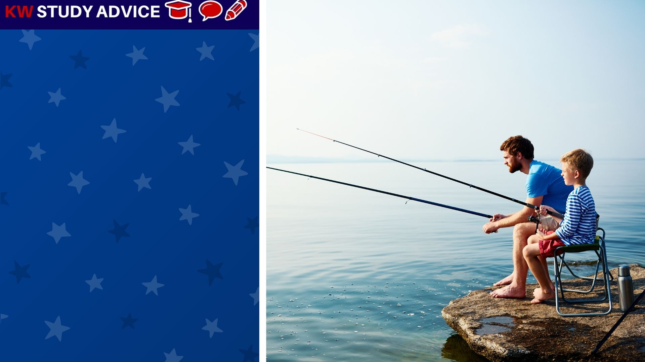
Angling
This is the sport of fishing with a long stick, line, hook and bait (fish food). Most people go angling at lakes or the sea.
The father and son went angling at the local lake. They were delighted to catch twelve fish in one afternoon of angling.

Slide 3

Recycling
The process of turning old products which are no longer needed into new products which can be used over again.
The couple thought it was very important to recycle as much of their waste as possible. This very much helps the environment.

Slide 4

Legitimate
This is a word which means something is officially known as something or recognised under certain rules.
The girl was delighted to be known as a legitimate student at her university. Her application was recently accepted.

Slide 5

Lasagne
Sheet pasta which also includes beef, vegetables and tomato sauce in many different layers. It also includes cheese.
The man cooked some delicious lasagne for his friends who came to his dinner party. They were disappointed when it was gone.

Slide 6

Ferocious
This can be something or someone who is known to be very fierce or scary. People should be careful not to make them angry.
The students recently visited a zoo and their favourite part was visiting the ferocious lions. Luckily the lions were behind bars.

Slide 7

Feasible
This is something which can be done very easily and with little effort. People are often happy to help others complete feasible tasks
The worker asked his colleague if he could set him up a website. The colleague said this would be feasible and started working on it.

Slide 8


