Slide 1

Drawing shapes!

Slide 2


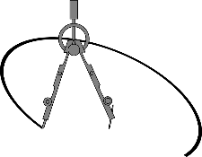
To draw circles, we need:

Slide 3
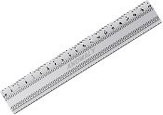
To draw other shapes, we need:

Slide 4

Now, can you name these 3D shapes?

Slide 5


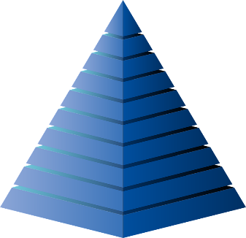
Cone
Sphere
Pyramid

Slide 6



Triangular Prism
Cuboid
Cylinder

Slide 7


Calculating volume!

Slide 8
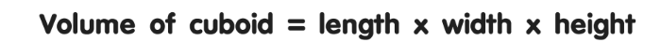
Volume of a cuboid
Can you calculate the volume of this box?
Don’t forget your answer will have the units cm³!
35cm
20cm
15cm

