Slide 1
IB Math AA SL Practice Exam
Sample worked sheets of Final Paper Questions
by Mario Willyam

Slide 2
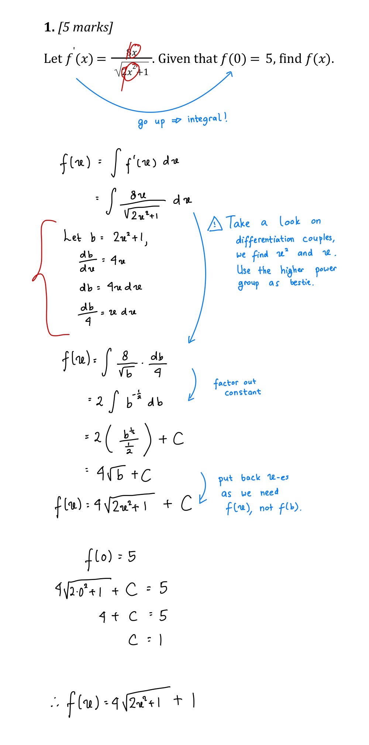
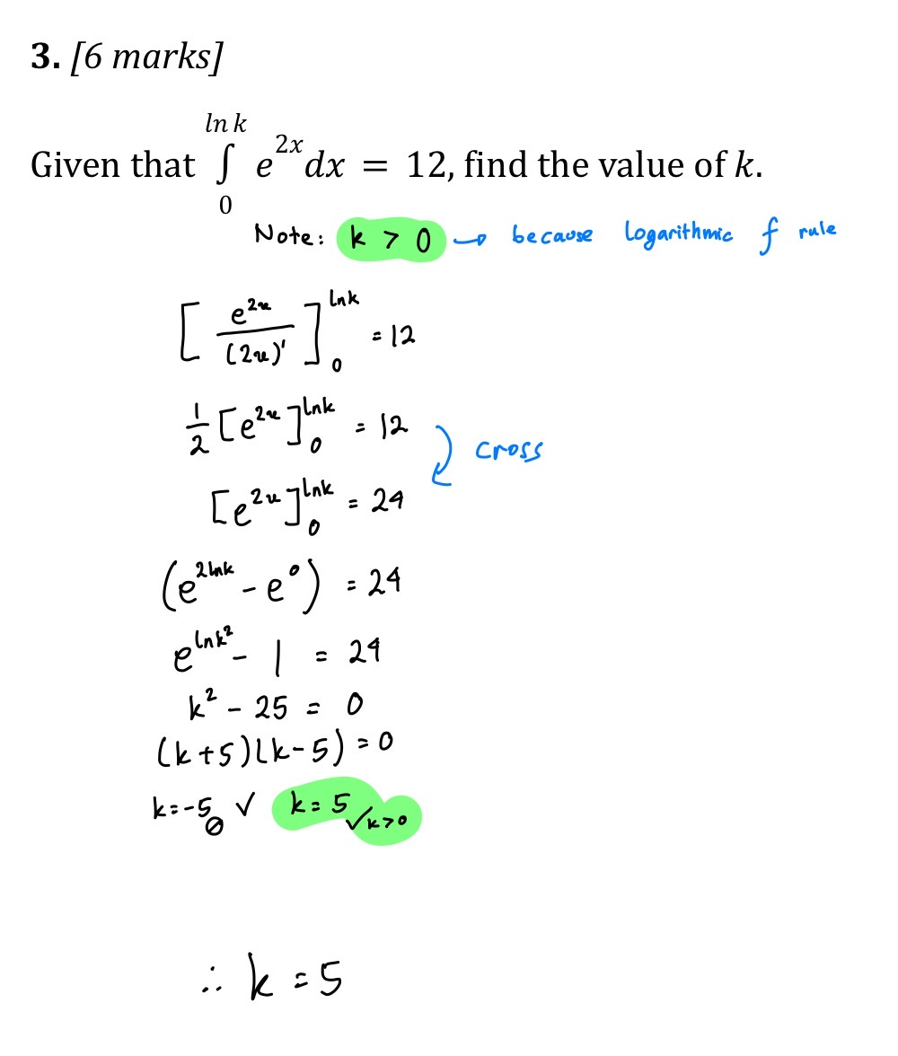
Calculus (Practice 1 and 2)

Slide 3
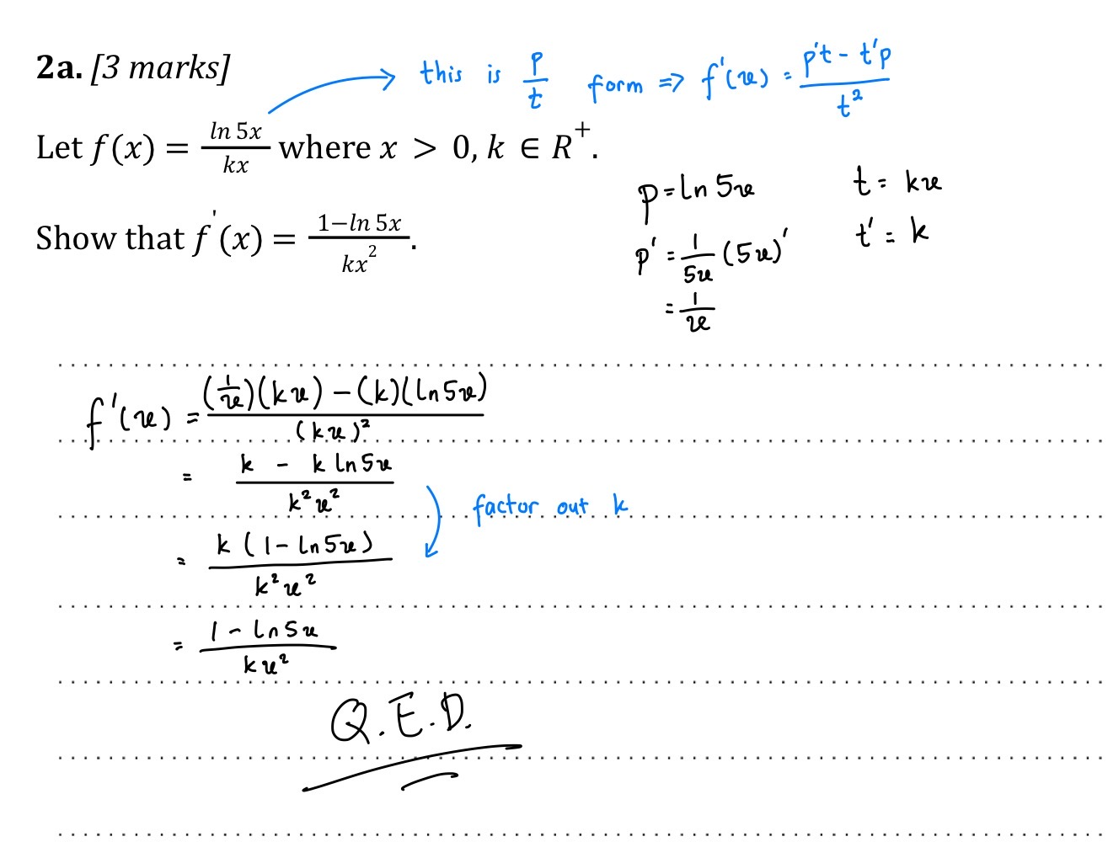
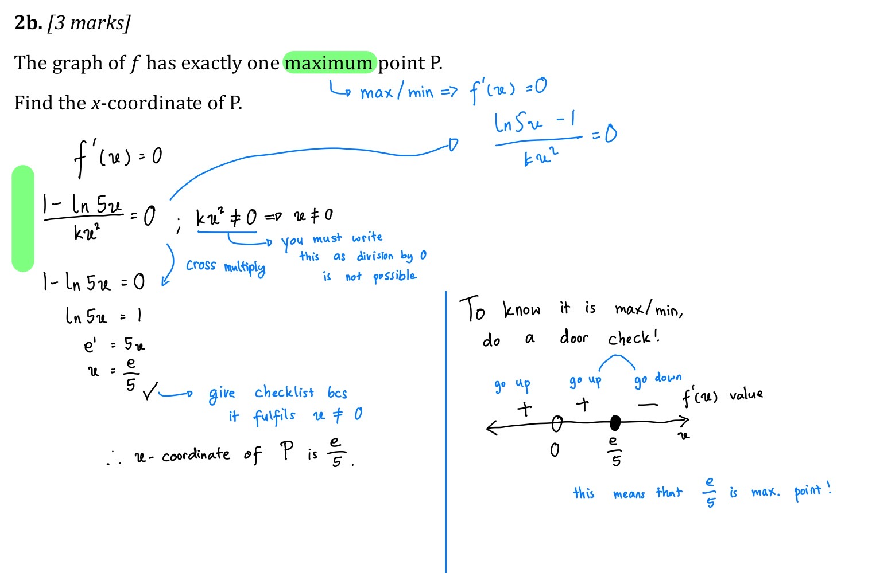
Calculus (Practice 3)

Slide 4
