Slide 1
System fundamentals
Chapter 1

Slide 2
SDLC
System life cycle refers to the stages through which the development of a new system passes through.
Existing System analysis
Maintenance
Requirement Specification
New System installation
Software Design
Testing and Debugging
Software Implementation

Slide 3
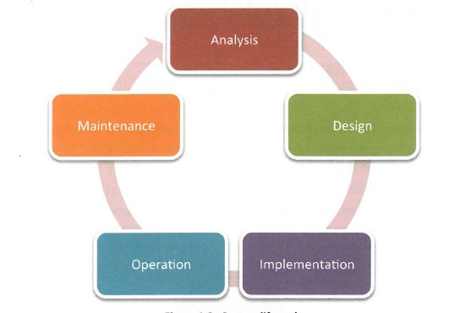
System Life Cycle

Slide 4
System in Organization
What is a System?
A computer system includes hardware, software, people working with it or using it and the immediate environment.
Why a new system is required?
To replace a system that is inefficient,
System no longer suitable for its original purpose
System is redundant or out-dated.
To increase productivity or quality of the output or even to minimize costs.
To reduce the errors or flaws of the existing one.

Slide 5
Planning
Planning should anticipate potential organization issues such as:
lack of guiding organizational and business strategies
lack of stakeholder and end—user participation
lack of end-user 'ownership' of system
lack of attention to required training
lack of attention to various organizational issues, such as organizational culture
lack of attention to the design of tasks and jobs, allocation of information system tasks, and the overall usability of the system.

Slide 6
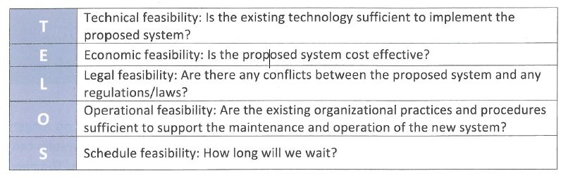
Feasibility Study
The feasibility study evaluates and analyses a project and its potential, based on various technical, economical, legal, operational and scheduling criteria.

Slide 7
The need for Change Management
Change management involves various parameters and is a process of shifting individuals, teams, departments and organizations from the present state to a desired state.
Successful change management guarantees that all stakeholders accept and embrace changes in their working environments.
The goal is to maximize benefits and minimize the negative impacts of change on individuals.

Slide 8
Compatibility issues resulting from situations including legacy systems or business mergers
Describe the importance of compatibility.
Identify the way legacy systems Interact with modern systems.
Suggest strategies for successful Integration during business mergers.
Identify the international dimensional of software compatibility.

Slide 9
Compatibility issues resulting from situations including legacy systems or business mergers
Legacy system :An old technology, hardware, computer system, or application program. Few legacy systems still play an important role and are part of an organization or may be its data cannot be converted to new formats or its application cannot be upgraded.
Business Merger: Combining of two or more business entities. The main reason companies merge is to reduce costs.

Slide 10
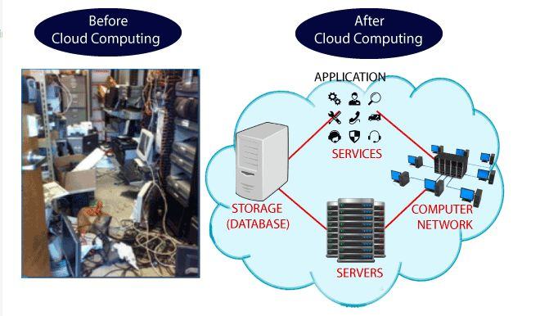
What is Cloud computing?
The term cloud refers to a network or the internet. It is a technology that uses remote servers on the internet to store, manage, and access data online rather than local drives. The data can be anything such as files, images, documents, audio, video, and more.
To establish such IT infrastructure, we need to spend lots of money. To overcome all these problems and to reduce the IT infrastructure cost, Cloud Computing comes into existence.

Slide 11
Define Cloud Computing
Cloud computing is on-demand access, via the internet, to computing resources—applications, servers (physical servers and virtual servers), data storage, development tools, networking capabilities, and more—hosted at a remote data center managed by a cloud services provider (or CSP). The CSP makes these resources available for a monthly subscription fee or bills them according to usage.

Slide 12
Characteristics of Cloud Computing
The characteristics of cloud computing are given below:
1)Agility :The cloud works in a distributed computing environment. It shares resources among users and works very fast.
2) High availability and reliability :The availability of servers is high and more reliable because the chances of infrastructure failure are minimum.
3) High Scalability :Cloud offers "on-demand" provisioning of resources on a large scale, without having engineers for peak loads.
4) Multi-Sharing :With the help of cloud computing, multiple users and applications can work more efficiently with cost reductions by sharing common infrastructure.
5) Device and Location Independence :Cloud computing enables the users to access systems using a web browser regardless of their location or what device they use e.g. PC, mobile phone, etc. As infrastructure is off-site (typically provided by a third-party) and accessed via the Internet, users can connect from anywhere.
6) Maintenance :Maintenance of cloud computing applications is easier, since they do not need to be installed on each user's computer and can be accessed from different places. So, it reduces the cost also.
7) Low Cost :By using cloud computing, the cost will be reduced because to take the services of cloud computing, IT company need not to set its own infrastructure and pay-as-per usage of resources.

Slide 13
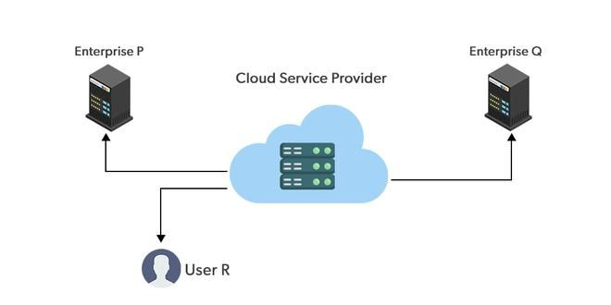
Types of Cloud Computing
There are four main types of cloud computing: private clouds, public clouds, hybrid clouds, Community cloud
Public Cloud: Public clouds are managed by third parties which provide cloud services over the internet to the public, these services are available as pay-as-you-go billing models. The term "public cloud" describes a cloud computing architecture in which a cloud service provider makes cloud resources like processing capacity, storage, and applications accessible to the general public via the internet. Users can access and use the resources on a pay-per-use basis, and they are shared among many users.
The fundamental characteristics of public clouds are multi tenancy. A public cloud is meant to serve multiple users, not a single customer.
Example : Microsoft Azure

Slide 14
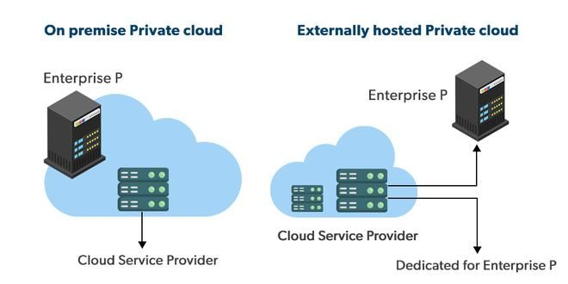
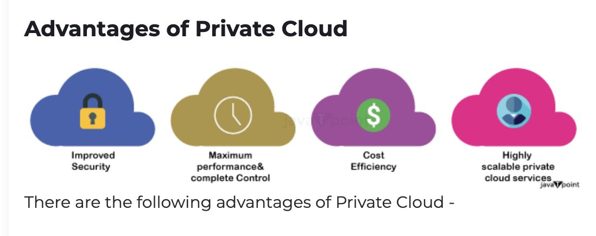
Private Cloud
Private clouds are distributed systems that work on private infrastructure and provide the users with dynamic provisioning of computing resources. T
he private cloud provides computing services to a private internal network (within the organization) and selected users instead of the general public.
The private cloud provides high security and privacy to data through firewalls and internal hosting. It also ensures that operational and sensitive data are not accessible to third-party providers.
Private cloud providers are HP Data Centers, Ubuntu, Elastic-Private cloud etc.

Slide 15
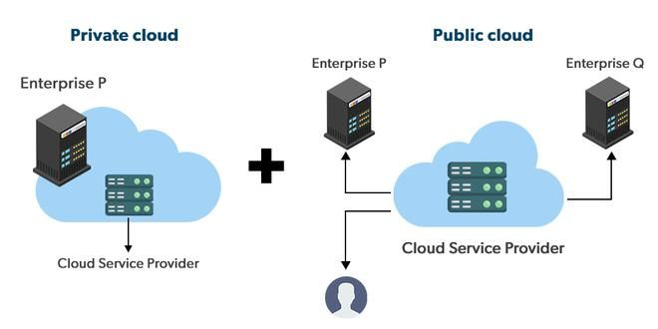
Hybrid Cloud
A hybrid cloud is a heterogeneous distributed system formed by combining facilities of the public cloud and private cloud. For this reason, they are also called heterogeneous clouds.
A major drawback of private deployments is the inability to scale on-demand and efficiently address peak loads. Here public clouds are needed. Hence, a hybrid cloud takes advantage of both public and private clouds.
Example : AWS Outposts

Slide 16
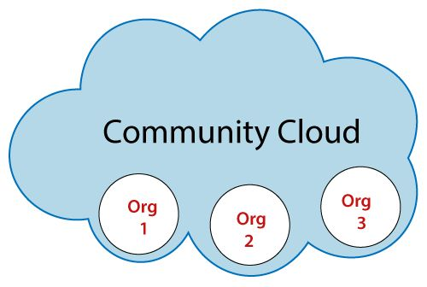
Community Cloud
Community cloud is a cloud infrastructure that allows systems and services to be accessible by a group of several organizations to share the information. It is owned, managed, and operated by one or more organizations in the community, a third party, or a combination of them.
Advantages of Community Cloud
There are the following advantages of Community Cloud -
Cost effective
Flexible and Scalable
Security
Sharing infrastructure

Slide 17

Notes:
https://www.youtube.com/watch?v=llIE-PwZG8A

Slide 18
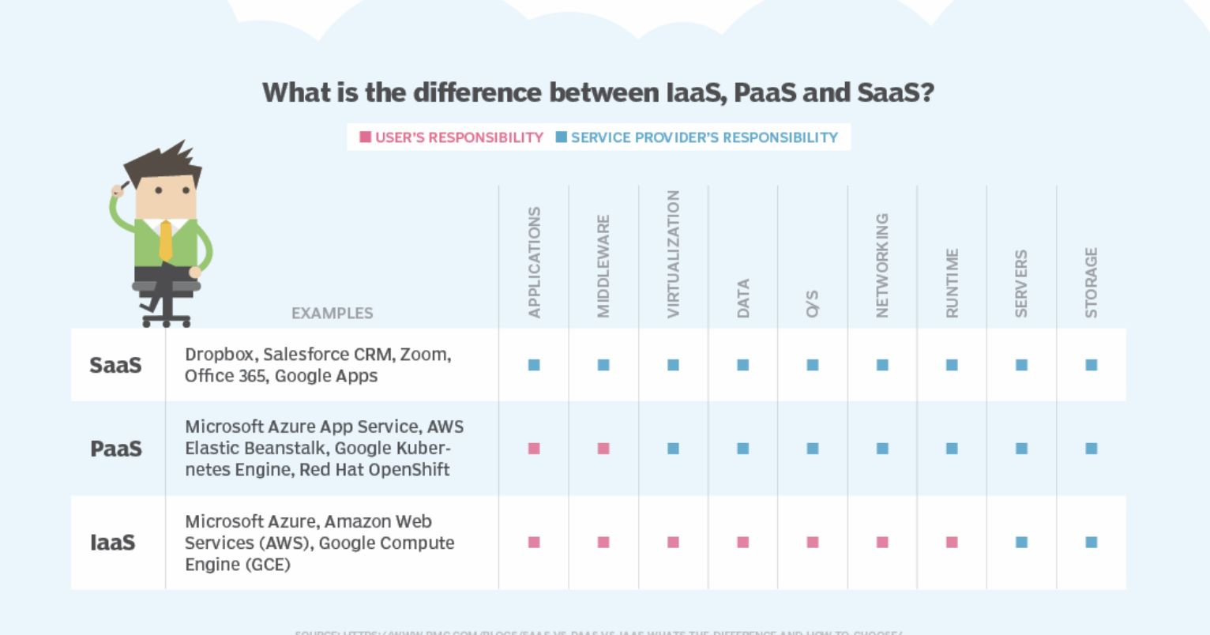

Slide 19
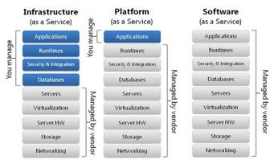
Different systems implementation

Slide 20
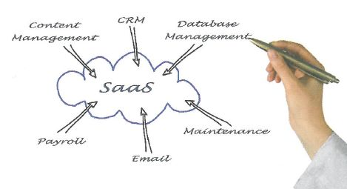
What is SaaS?

Slide 21
Record your understanding of Cloud Computing
https://flip.com/203bb171

Slide 22
Conclusion
To conclude :
IaaS provides access to resources such as virtual machines and virtual storage
PaaS provides execution environments, application development, and deployment tools
SaaS provides software as a service to end-users.

Slide 23
Installation Processes
The reason for an organization to choose one implementation method in favour of another is often a trade-off between costs and risk.
Types of Change over processes are:
Parallel : Both systems work in parallel for a short period of time. This method is very popular because of the limited risk. Outputs of both systems can be compared to ensure which system is better.
Big Bange(Direct): Very risky since the company plugs in the new system and unplugs the old one at the same time. Users need to be trained properly
Pilot : Mostly used in large organizations that have multiple sites. The new system is introduced in one of the sites and extended to other sites over time. The risk of this method is low and the pilot sites can serve as models for the rest of the company.
Phased: With the phased conversion method, a company converts one module of
the system at a time, meaning that different parts of the system are converted at different
times

Slide 24
Data Migration
Data migration refers to the transfer of data between different formats, storage types and computer systems.
Data migration happens when an organization changes, upgrades or merges its information systems
Problems with data migration:
(i) May be incapable of moving the information due to parameters such as incompatibility with the new system or non—recognizable data structures.
(ii) Data may be lost or not transferred due to an incomplete data transfer or errors during the process.
(iii) Data can also be misinterpreted due to incompatibilities, caused by the different conventions of each country concerning date, time and measurement units.

Slide 25
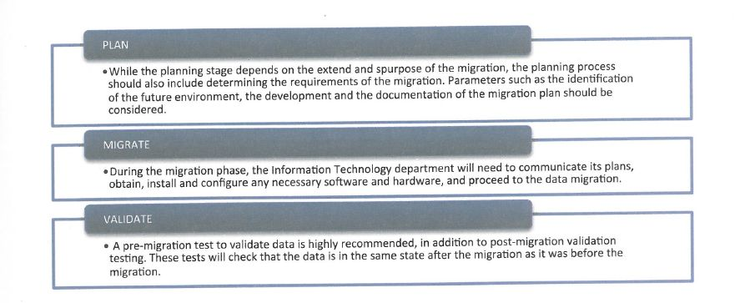
Data Migration Stages

Slide 26
Testing
Testing is investigating a computer system to find flaws, discrepancies or errors. There are various types of testing that can be applied to various parts of the development process
Types of Testing:
Functional testing tests individual commands, text input, menu functions, etc. confirms that they perform and function correctly according to the design specifications.
Data testing is when normal, abnormal and extreme data is put into the system.
Alpha testing is done before the software product is made available to the general public and is done by the company where the product was developed
Beta testing includes comments and suggestions of the users. Their feedback is valuable and can be used to fix defects and errors that were missed.

Slide 27
Testing
Dry-run testing is conducted using pen—and—paper by the programmer. During dry run testing the programmer mentally runs the algorithm.
In Unit testing, individual parts of the system are tested separately.
During the integration testing, the entire system is tested at the same time to verify that that all components can work together.
User acceptance testing is used to determine if the system satisfies the customer needs and in most cases is conducted in user premises before accepting transfer of ownership.

Slide 28
Test your skills…
What is DEBUGGING?
Identify the importance of incompatibility and incompleteness in data migration
A nuclear station is equipped with a highly automated control system. This system should be replaced by a new system. Suggest a suitable
implementation method. Justify your answer.

Slide 29
Validation/Verification
Validation is the process of evaluating whether data input follows appropriate specifications and is within reasonable limits.
Verification is the process of ensuring that the data input is the same as the original source data. A way of ensuring data verification is through double entry.

Slide 30
Types of Validation Checks
The different types of validation rules or checks are as follows:
  Range checks
  Length checks
  Type checks
  Presence checks
  Format checks
  Check digits

Slide 31
Documentation
A systematic and organized software development procedure ensures that all supporting documents are produced in an orderly and methodical fashion. It is very important to distinguish between internal documentation and external documentation.
Internal documentation is the code comprehension features and details provided as part of the source code itself.
External documentation is typically written as a separate document from the program itself. It is provided through various types of user supporting documents such as a users' guide, software requirements specification document, detailed description of the design and implementation features of the program and test document.

Slide 32
Internal Documentation
Proper internal documentation includes:
Appropriate module headers
Appropriate comments
Useful and meaningful variable names
Useful module, classes, methods and function headers
Appropriate code indentation
Appropriate code structuring
Appropriate use of enumerated types
Appropriate use of constant identifiers
Appropriate use of data types defined by the user

Slide 33
Importance of user documentation
User documentation can either be in a written or in an online form, so that the user can search the document more easily and quickly.
The document should be well structured and divided into the appropriate categories.
Documentation must include:
Requirements - Statements that identify attributes, capabilities, characteristics, or qualities of a system. This is the foundation for all that is implemented.
Architecture/Design - Overview of software. Includes relations to an environment and construction principles to be used in design of software components.
Technical - Documentation of code, algorithms, interfaces, and APIs.
End User - Manuals for the end-user, system administrators, and support staff.
Marketing - How to market the product and analysis of the market demand

Slide 34
Types of User Documentation
Manuals: Manuals can be Online or offline. One of the advantages of online manuals is the potential use of multimedia feature. The advantage of a printed manual is that it can be read without the use of a PC or internet connection.
Email Support: Online support is an asynchronous type of support and can be provided via an email address.
Embedded Assistance or integrated user assistance : Software suites like MS Office have inbuilt help systems (the! tips and dynamic page content within the system itself).
Frequently Asked Questions : FAQ are listed questions and answers, all supposed to give users answers to a common set of problems and pertaining to a particular topic.
Live chat sessions : Online support include a live chat technician will ask for the description of the occurring problem, and try to present a list of possible solutions.
Online portals or web portals : Online portals can provide updated manuals, support pages and FAQ pages.
Remote Desktop Connections : Remote Desktop will actually allow a specialized technician to take control of the user's PC as though he/she/she was sitting directly in front of it, but this has some security issues.

Slide 35
Different methods of Delivering User Training
To use the new systems properly the user has to be trained properly.
Staff can be trained by:
Self-instruction
Formal classes
Online training
Creating Educational material
User Training delivery depends on:
The number of students
The availability of instructors,
The size of the business
The training budget.

Slide 36
Different methods of Delivering User Training

Slide 37
Self Instruction or Self Study
Self-instruction allows the user to learn in his/her own time, until he/she achieves mastery of the subject. Printed manuals, books, e-books or other resources such as video tutorials or online exercises can be provided and used whenever the user needs to improve his skills.
Advantages:
User don’t have to pay the tuition fee.
The user can study whenever he/she wants (no formal class at a fixed time and a fixed place).
Disadvantage:
Lack of guidance or teacher support
The final result depends on the motivation of the user and their ability to learn on their own.

Slide 38
Formal Classes
A formal class offers an interactive setting that promotes open and free discussion between students and the teacher (instructor).
Advantages:
Allow students to exchange ideas with one another.
Direct interaction with the expert allows for ideas to be exchanged easily and
without any technical communication barriers
Disadvantages:
Shy members are not comfortable.
The classroom can also obstruct one’s ability to learn by allowing other, more self-assured students to dominate the discussion environment.

Slide 39
Remote/distance learning/online training”
Synchronous online learning is that it allows participants to take part in high quality courses from anywhere in the world provided they have a PC and Internet connection. This type of Virtual Classroom is accessible 24/7/365.
Advantages:
Time efficiency and time management are valuable strengths of distance learning.
Students can access their virtual courses, lectures, course materials, and class discussions at any time, day or night.
Interactive learning environments contributes to self-direction and promotes critical thinking
Disadvantages:
Lack of the required infrastructure will exclude otherwise eligible students from the online course.
Students and instructors must possess a minimum level of IT skills in order to function effectively in an online environment.
places greater responsibility on the student and gives students control over their learning experience, and thus is considered inappropriate for more dependent and immature learners.

Slide 40
System backup
Identify the negative impact of data loss.
Identify various causes of data loss.

Slide 41
Data Loss
Data loss refers to an error condition where data is lost or destroyed due to system failure, storage negligence, or even transmission or processing errors.
There are cases where data loss could have extremely serious consequences.
Data loss is not that dangerous in all cases, but retrieval is time consuming and might not always be possible
Range of methods that can be used to prevent data loss:
To prevent data loss the methods that can be used are:
Regular backup of files using hard disks or magnetic tapes
Firewall installation
Data storage in two or more locations (offsite storage)
Removed hard copies (printed versions of data)
Installation of an Antivirus program for antivirus

Slide 42
Failover and Switchover
Failover | Switchover
A failover system is a computer system which is on standby capable of switching to a spare computer system automatically, upon hardware failure, network failure, or any other type of error A failover is automatic and handles abnormal situations without human interference | Switchover is the manual switch from one system to a redundant or stand by computer server, system, or network upon the failure or abnormal termination of the previously active server, system, or network, or to perform system maintenance. Generally switch over is manual.
In a failover system when primary server fails the standby server is made primary | In a switchover system the primary and the secondary server interchange the primary role

Slide 43
Software Deployment

Slide 44
Strategies for managing releases and updates
Free online updates, released by the company that aim to improve the product , fix various deficiencies or perform minor changes. This is available online. A company stops releasing the updates when they wish to promote the newer versions.
Different ways how the updates are available:
Patches are used by software companies to update applications by fixing known bugs and vulnerabilities.
Upgrades always contain novel functionalities or characteristics, as well cumulative bug fixes. An upgrade is the act or replacing the existing product with a newer and often more superior version or product.
Updates improve a product in a minor way by adding new functionalities or fixing known bugs. In most cases updates are free.
Releases are final, working versions of software applications. These applications have already gone through alpha and beta software testing.

Slide 45
Test yourself…
State three methods that can be used to prevent “data loss”.
Does a programmer needs a computer to conduct ”dry run testing”?
State one difference between "alpha” and ”beta testing".
State the stages of Data Migration

Slide 46
System design basics
Computer hardware: The physical elements of a computer, e.g. screen, CPU etc.
Software: A series of instructions that can be understood by a CPU. These instructions guide the CPU to perform specific operations. Software is comprised of both programs and data.
Peripheral device: Any auxiliary device (not the core device) that can communicate and work with a computer. For Example : input/output devices , printers, etc. A peripheral device extends the capabilities of the computer system it is connected .
Computer Network: A set of computer systems that are interconnected and share resources, as well as data. For example: Local Area Network,
Wide Area Network, etc.
Human Resources: People who are using the system or could be used in an organization, business or economy.

Slide 47
Roles of a Computer in networked world
A dumb terminal is a device that usually consists of a keyboard, a monitor, and a network card that is connected to a server or a powerful computer. Dumb terminals depend entirely on the computer to which they are connected for computations, data processing and data management.
A thin client is a relatively low performance terminal, which heavily but not entirely, depends on the server to which it is connected.
A client receives data via the network, whereas the server has saved data on it and offers it to clients. A server may be a program or a computer that provides services requested by clients connected over a network while a client is an average computer or terminal (dumb terminal, thin client) used to access a computer-based system.
An email server is the equivalent of a post office that manages the flow of email in and out of the network, checks that an email address is valid, allows users to access their email, etc.

Slide 48
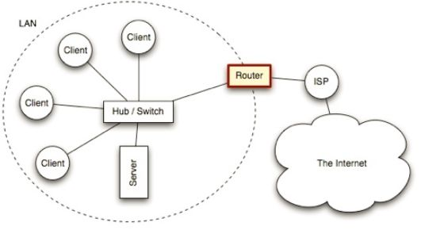
Router
A router is a network device that connects together two or more networks. A common use of a router is to join a home or business network (LAN) to the Internet (WAN).

Slide 49
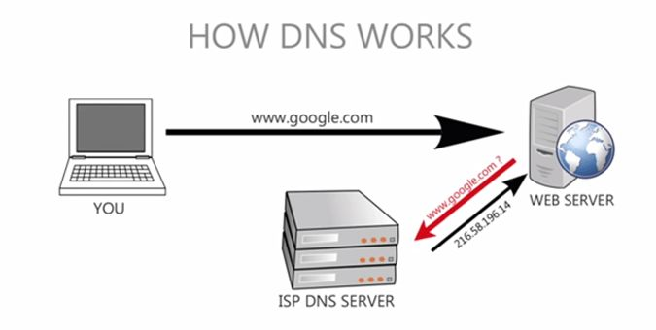
Domain Name Server
Domain Name Servers (DNS) are the Internet's equivalent of a phone book. They maintain a directory of domain names and translate them to Internet Protocol (IP) addresses.
This is necessary because, although domain names are easy for people to remember, computers or machines, access websites based on IP addresses.
When you type in a web address, e.g., www.jimsbikes.com, your Internet Service Provider views the DNS associated with the domain name, translates it into a machine friendly IP address

Slide 50
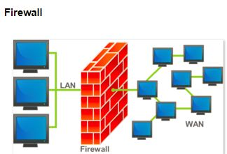
Firewall
A firewall is a system designed to prevent unauthorized access to or from a private network. You can implement a firewall in either hardware or software form, or a combination of both. Firewalls prevent unauthorized internet users from accessing private networks connected to the internet, especially intranets. All messages entering or leaving the intranet (i.e., the local network to which you are connected) must pass through the firewall, which examines each message and blocks those that do not meet the specified security criteria.

Slide 51
Client Server
A client-server refers to a software network architecture system where clients request information and servers perform tasks in order to provide the information.
The client computer is the computer where the end user works. It runs the applications managed by the server. Clients are generally personal computers of some kind. There are different classifications for clients : Fat Client and Thin Client
Fat Client : This sort of client will perform the bulk of the processing required by the end user. A personal computer is a good example of this.
Thin Client :
Client hardware and software can be streamlined in a thin client setup where the bulk of the processing and software is managed directly by the server and the thin client is little more than a screen with a computer that has a graphics card and a network card.

Slide 52
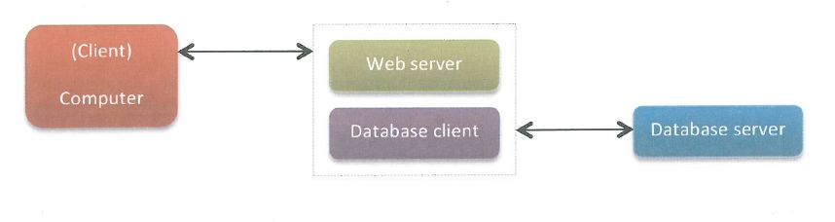
Servers
The purpose of the server is to share such things as data, hardware or software services, internet connections etc. Servers are computers that have a high specification in terms of the hardware. There are many types of servers such as
Data servers
Web servers
File servers
Print servers
Game servers
Application servers

Slide 53
Social and ethical issues associated with a networked world
Issues of social and ethical significance can have positive and negative ethical and social impacts. There are many social and ethical issues that may relate to the use of technology:
Reliability and integrity : Reliability refers to the operation of hardware, the design of software, the accuracy of data or the correspondence of data with the real world. Data may be unreliable if it has been entered incorrectly or if it becomes outdated. The reliability of machines, software and data determines our confidence in their value. Integrity refers to safeguarding the accuracy and completeness of stored data. Data lacks integrity when it has been changed accidentally or tampered with. Examples of data losing integrity are where information is duplicated in a relational database and only one copy is updated or where data entries have been maliciously altered.
Security : Security refers to the protection of hardware, software, machines and networks from unauthorized access. Security measures include restricted access to machines and networks for certain employees or to prevent access by hackers. The degree of security of information systems largely determines society’s confidence in the information contained in the systems.
Privacy and anonymity : Privacy is the ability of individuals and groups to determine for themselves when, how and to what extent information about themselves is shared with others. At its extreme, privacy becomes anonymity when, for instance, a person uses it to conceal his or her true identity in order to cyber-bully someone else. Conversely, excessive privacy could also conceal the perpetrators of criminal, terrorist or computer hacking acts from law enforcement agencies.
Authenticity : Authenticity means establishing a user’s identity beyond reasonable doubt. Authenticating the user is crucial in many scenarios, particularly in business and legal matters. A simple example of authentication is a user login to a network. A more advanced example would be the use of encrypted digital signatures in a business transaction or the use of watermarking on digital photographs.
Inconsistency : Problems may also arise if information is duplicated in a database and only one copy is updated, causing inconsistency (e.g. telephone field).

Slide 54
Social and ethical issues associated with a networked world
Intellectual property, Intellectual property includes ideas, discoveries, writings, works of art, software, collections and presentations of data. Copyright, trademarks and patents exist to protect intellectual property. However, the easy and accurate duplication methods made available through IT can undermine such protection..
The Digital Divide and Equality of Access, The growth of the use of IT systems has led to disparities in the use of, and access to, information technologies. Disparities exist not only internationally between countries, but also within countries between different socio-economic groups as well as within what may appear to be relatively homogenous groups. This may lead to groups or individuals without access to IT being disadvantaged. For example, while telelearning may bring previously unavailable opportunities to everyone’s doorstep, factors such as the cost and availability of hardware, software or access to the internet may create a “digital divide”.

Slide 55
Social and ethical issues associated with a networked world
Surveillance : Surveillance is the use of IT to monitor the actions of people. For example, monitoring may be used to track, record and assess employees’ performance. It can be used to support claims for promotion or to ensure that employees follow the organization’s internet policy appropriately.
Globalization and cultural diversity : Globalization means the diminishing importance of geographical, political, economic and cultural boundaries. IT has played a major role in reducing these boundaries. For example, any dramatic event anywhere in the world can be broadcast almost instantly by television or on the internet. However, the new “global village” may lead to the extinction of minority languages.

Slide 56
Social and ethical issues associated with a networked world
Policies : Policies are enforceable measures intended to promote appropriate and discourage inappropriate use relating to information technologies. They can be developed by governments, businesses, private groups or individuals. They normally consist of rules governing access to, or use of, information, hardware, software and networks. For example, a school policy on the use of IT would consist of each user signing an acceptable use policy. It would also address unlawful access to the network through, for example, identity theft or using hacking software, and how these transgressions would be treated. Many websites also require users to agree to specific policies before allowing access to their services. Policies also affect the exchange of information, for example, by making it subject to copyright laws and raising people’s awareness of plagiarism. In general, policies can promote or restrict access, guide behaviour, require the fulfilment of certain conditions prior to or during use, or need to be developed to address unforeseen issues such as cyber-bullying.
Standards and protocol are technical rules and conventions that enable compatibility and therefore facilitate communication or interoperability between different IT systems and their components. They might govern the design and use of hardware, software and information. For example, the communication protocols used on the internet, the ASCII representations for characters, or the design of the printer port on a personal computer are all governed by standards.

Slide 57
Social and ethical issues associated with a networked world
People and machines. The use of IT systems brings significant advantages, for instance in ease of use, being available 24/7, or through its use rather than exposing humans to a potentially hazardous environment. However, this can raise concerns about the rate at which technology is being introduced and issues that may arise from insufficient testing in critical situations such as air traffic control. The ultimate fear of many people is that future systems will be programmed to make decisions that would be better taken by humans, such as the decision to deploy nuclear weapons.
Digital Citizenship, which covers appropriate behaviour in a digital world. Appropriate behaviour includes using IT ethically, in a way that respects society, the law and does not expose any person to threats, danger, or a contravention of their human rights.

Slide 58
Your Research skills…
There is a vast amount of scientific information and educational material available on the WWW. According to your understanding what are the advantages and disadvantages of students having unrestricted and unsupervised access to a PC that is connected to the Internet.
Prepare a table to comment the pros and cons of the following causes :
Constant exposure to communication technology
Internet (Wired and Wireless)
Use of smartphones
Use of useful applications
Gaming
Mobile phones

Slide 59
Relevant stakeholders when planning a new system
Stakeholders are people, groups or organisations that have an interest in or might be affected by the outcome of a project.
The end-user is the person who is going to use the product. A relevant stakeholder can also be a frequent user of the current system. He/she will be able to identify flaws and errors of the current system or inconveniences that he/she has spotted.
Methods of obtaining requirements from stakeholders:
Interviewing stakeholders
Use of questionnaires
Direct observation of current procedures

Slide 60
Methods of obtaining requirements from stakeholders
Interviewing stakeholders. An interview is a direct face-to-face procedure that focuses on obtaining reliable and valid data in the form of verbal responses from a person or a group (group of stakeholders).
Structured interviews are strictly standardized and prescribed. A set of prepared questions is presented in the same manner and order to each stakeholder.
Unstructured interviews are flexible. Stakeholders are encouraged to express their thoughts and personal beliefs freely.
The use of questionnaires is effective when the questions are carefully constructed so as to elicit unambiguous responses. Questionnaires guarantee uniformity of questions and therefore yield data that is easier comparable than information obtained through an interview. Types of Questionnaire are :
Closed or restricted questionnaires involve "yes" or “no" answers, short response questions and box checking.
Open or unrestricted questionnaires involve free response questions but allows for greater depth of responses from the stakeholder

Slide 61
Methods of obtaining requirements from stakeholders
Direct observation of current procedures :Direct observation requires the analyst to be in situation to observe the current system working. The result is that the analyst get to know the system in an unbiased way. In some cases. The observation may be done in two ways :
Human observation where a person or people observe behaviour or the working of a system.
Mechanical observation where the human is replaced by another device such as a camera or other relevant sensor to record data.

Slide 62
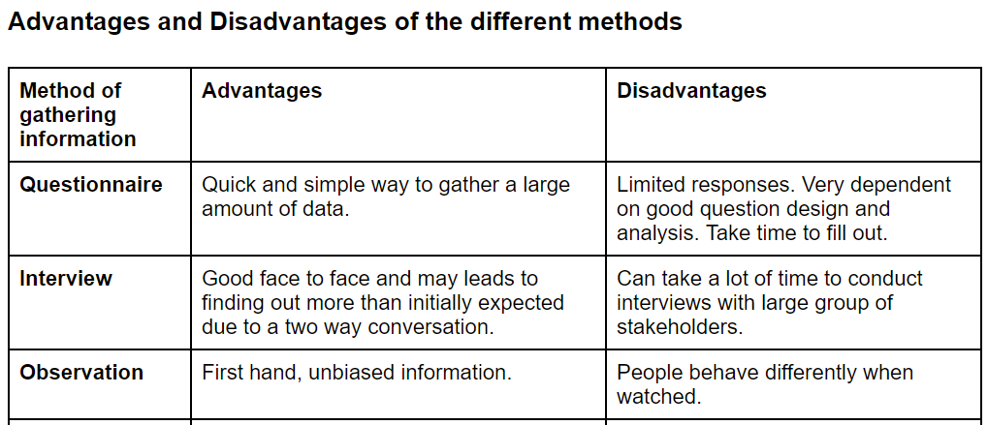

Slide 63
Appropriate techniques for gathering the information needed to arrive at a workable solution
Examining current systems is a process that involves the detailed examination of the current system, analysis of its functions and procedures, studying the business and system. Documents such as current order documents, logistics documents, and computer systems procedures and reports used by operations and senior managers.
One should keep in mind that a modern computer system should be planned to:
increase client trust
preserve brand strength
preserve organization reputation
maintain corporate resiliency
enhance organizational piece

Slide 64
Suitable representations to illustrate system requirements
System requirements are specified through a document called a requirements specification document. This document defines the specific customer requirements of a computer system. It is included within the system analysis and may be later used to test the system, after implementation, in order to evaluate it.
The various representations that are used to illustrate system requirements, it is very useful to examine the types of processing :
Batch Processing
Online Processing
Real Time Procesing

Slide 65
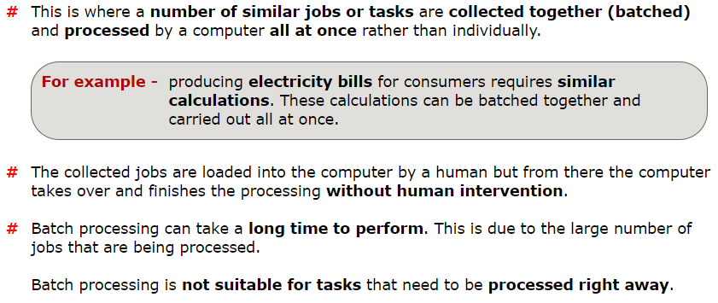
Batch Processing

Slide 66
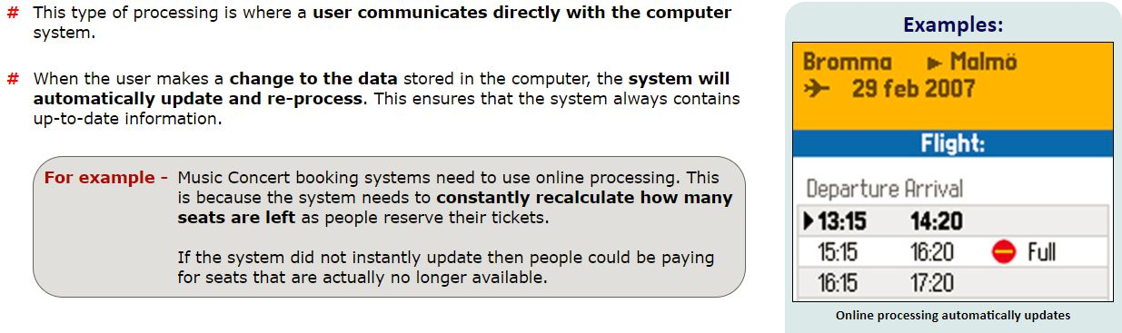
Online Processing

Slide 67
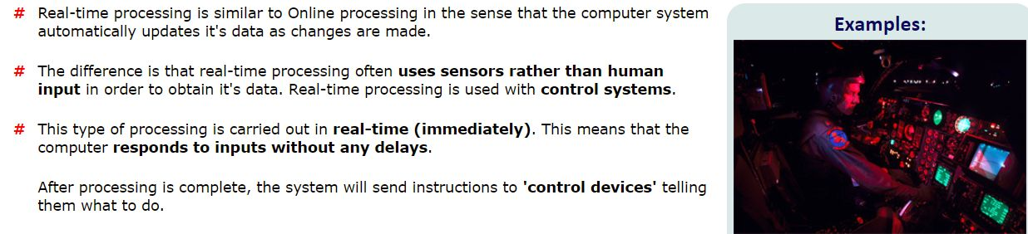
Real Time Processing

Slide 68

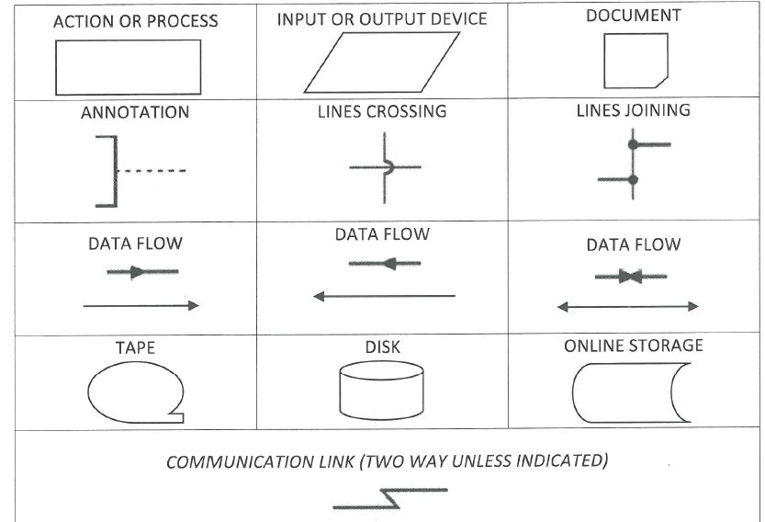
Construct suitable representations to illustrate system requirements
System flow charts : A system flowchart refers to the description of a data processing system, including the flow of data through any individual programs involved, but excluding the details of such programs. System flowcharts are frequently constructed during analysis activities and represent various computer programs, files, databases, associated manual processes, etc. They are able to show batch, real—time and online processing, and they are the only way to refer to hardware.

Slide 69
Test your skills

Slide 70
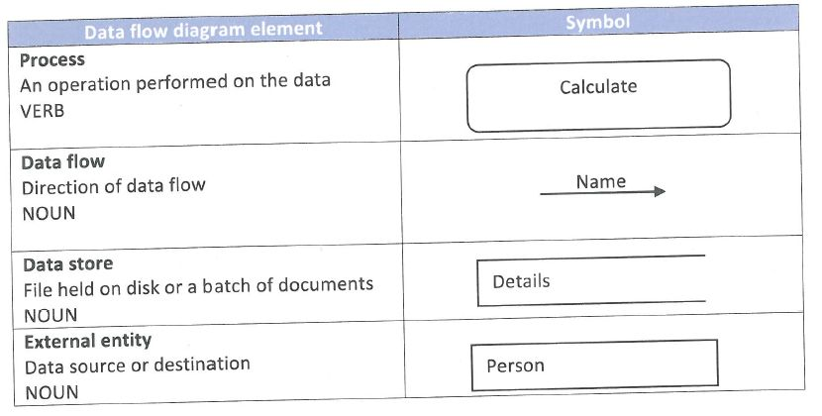
DFD
DFD may usually be used to describe the problem to be solved (analysis). A DFD shows how data moves through a system and the data stores that the system uses. A DFD does not specify the type of the data storage and the type of data.

Slide 71
Test Yourself

Slide 72
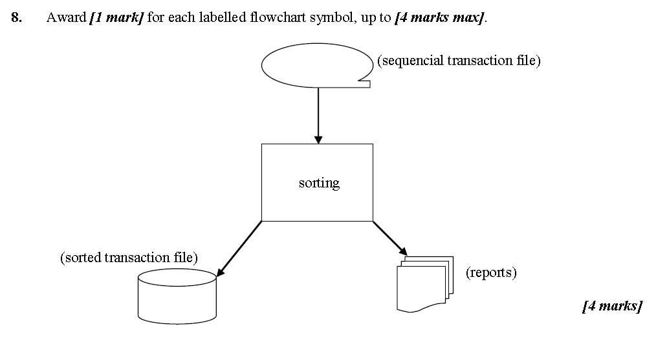
Test yourself

Slide 73
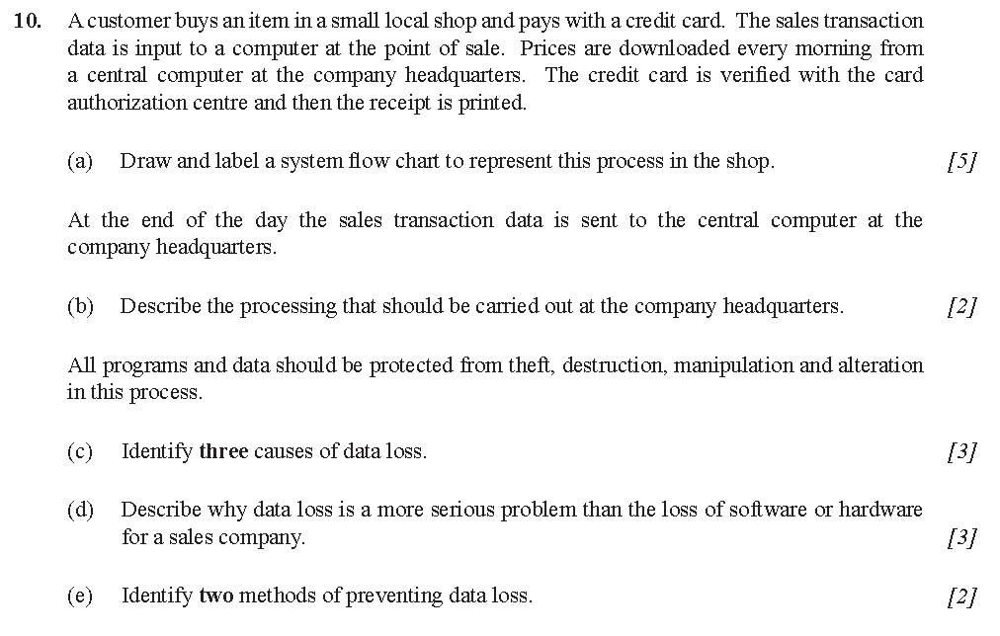

Slide 74
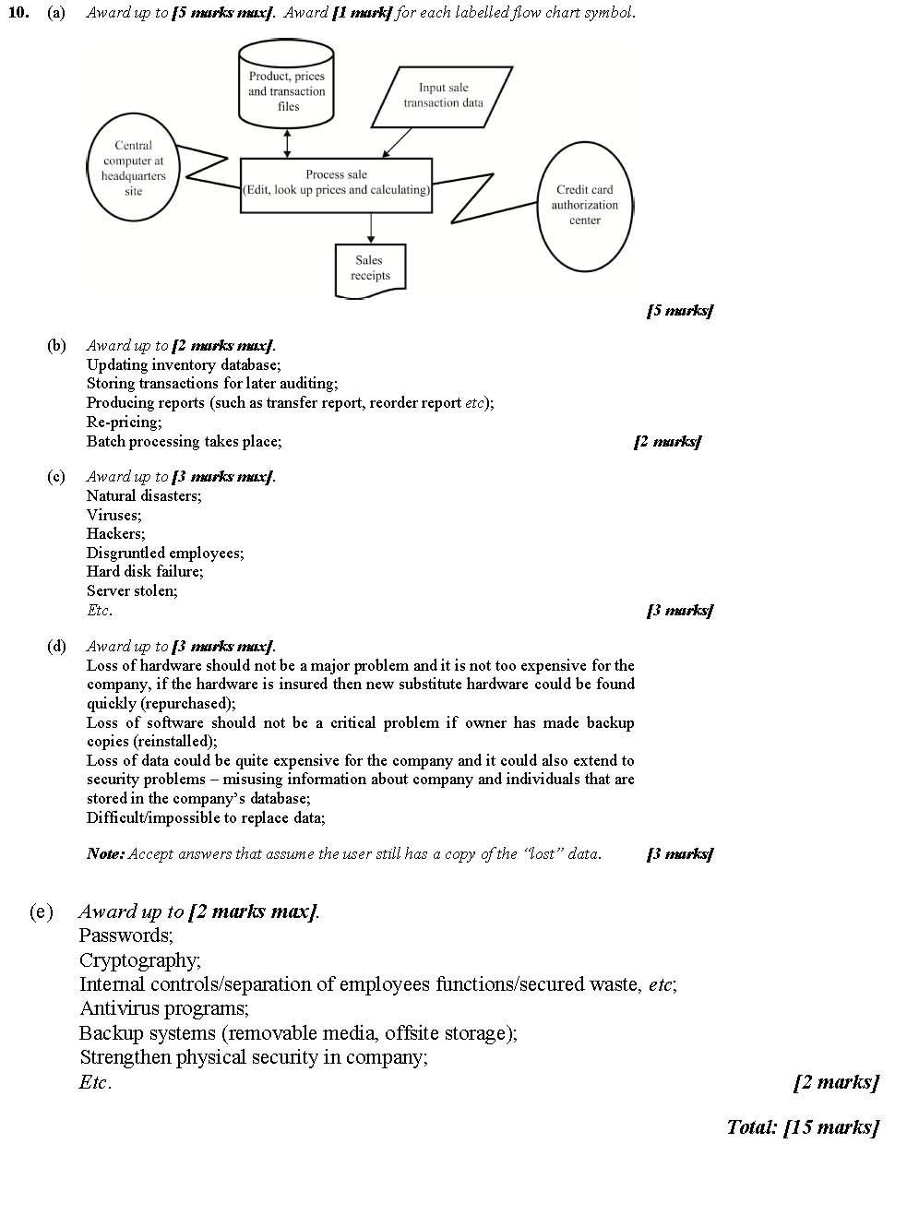

Slide 75
Structured Chart and Modular Design
A structure chart describes functions and sub-functions of a system, as well as the relationships between modules of a computer program. The organization of a structure chart is straightforward, allowing the analyst to split a large problem into smaller ones. Each module performs a specific function and each layer in a program performs specific activities. A structure chart makes the modular design development much easier.
Modular design is the process of designing system modules individually and then combining the modules to form a solution to an overall problem.

Slide 76
Terms related to modular design
Top—down design or ”stepwise refinement : This is a problem solving technique that involves the partition of a problem into smaller sub-problems. Each sub-problem is further broken down until all sub—problems are detailed enough and no more partition is required. Programmers are able to attack its sub-problem and develop the equivalent programming code.
Pseudocode : This is an artificial language that is not directly related to any particular hardware and is used to describe algorithms. Pseudocode does not follow the grammar of any specific computer language and requires conversion to a computer language before the resulting program can be used.
Module: It is a complete and independent part of a program and modularity or modular programming is the method of portioning the program into separate sub programs.

Slide 77
Purpose of prototypes
Prototype is either a working or non-working preliminary version of the final product or a simple version of the final system that is used as a part of design phase to demonstrate how the final product will work.
There are many advantages to creating a prototype.
A prototype:
Attracts the attention of the client, since it encourages them to use it or get a feel of it.
Provides just enough of the concept for the investors to decide if they want to fund the full production or not
Encourages active participation between users and developers
Gives an idea of the final product
Helps in the identification of problems with the efficiency or the design
Increases system development speed

Slide 78
Importance of Iteration
Iteration refers to the repetition of a set of instructions for a specific number of times or until the operations yield a desired result.
During the design phase designers of the product may have to step back several times and reconsider choices they have made. Even the best designers cannot design perfect products in a single attempt, so an iterative design methodology should be adopted.
Iterative development of software involves steady improvement of the design based on various evaluation and testing methods (e.g. user testing).

Slide 79
Possible consequences of failing to involve the end-user in the design process.
Involvement, collaboration and active participation of all key stakeholders is critical because a project with poorly-defined stakeholder goals is unlikely to be successful.
The failure to involve the end-user may lead to software that is not suitable for its intended use, which may have adverse effects on user productivity. End users can be consulted formally in a number or ways throughout the lifecycle.
Failure to involve the end user here will mean that a product may be released with bugs and the designers may not have a good idea what the end user thinks about the product or the extent of the usability of the product.

Slide 80
Social and ethical issues associated with the introduction of new IT systems
Machines are replacing humans in countless tasks, forcing millions of individuals into unemployment. A counterargument is that jobs don‘t vanish, but change. Finally, advances in robotics and artificial intelligence may eventually replace an increasingly large amount of workers with smart robots. This could create social disturbance similar to that during the Industrial Revolution.
Introducing new information technology systems and applications (or constantly developing old ones) certainly has a great impact on society and starts to pose ethical questions about the extent to which this uncontrollable development can or should continue.
Continuous development of computerized systems may absorb people and cause them to drift apart from the physical world and become enclosed in virtual environments. Participation in virtual environments may completely disorient some users.

Slide 81
Human interaction with the system
Accessibility refers to the potential of a service, product, device or environment to serve and meet the needs of as many individuals as possible.
Usability refers to the potential of a product, application or website to accomplish user goals. The term is not limited to computer science but extends to other products and services of all kinds.
Ergonomics or human engineering refers to the design of safe and comfortable products, systems or processes, specifically for people. For example, computer hardware, such as keyboards, are shaped by ergonomic consideration in order to improve users’ comfort.

Slide 82
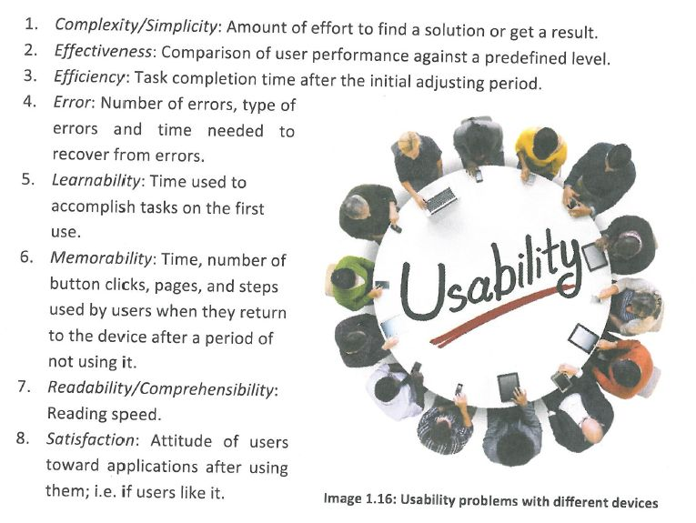
Usability problems with commonly used digital devices
Analyze the overall usability of a device using the eight quality components of usability:

Slide 83
USABILITY PROBLEMS - DIFFERENT DEVICES(Discuss)
GPS/navigation systems
TABLETS
Game Consoles
PCs
Digital Cameras
Mobile phones
MP3 Devices

Slide 84
Methods that can be used to improve the accessibility of systems
Visual impairment, from blindness to colour vision deficiency
Input methods and devices:
Braille input devices are available. Most blind people or seeing—impaired use touch
type with standard keyboards.
Output methods and devices:
Speech output devices can read the screen text. Screen readers are commonly used to convert text to speech using speech synthesizers. A braille display is a device that allows for braille characters to be displayed using pins, in order for blind users to be able to read text.
For people with colour blindness the capability to adjust the colour of the display or change the background and foreground colours is also of great value.

Slide 85
Methods that can be used to improve the accessibility of systems
Hearing and speech impairments:
Input methods and devices:
No problem with commonly used devices
Output methods and devices:
Replace sound signals with visual effects. Use of subtitles to replace audio speech track.
Cognitive Problems and learning disabilities
Cognitive Problems and learning disabilities:
Input and output methods and devices:
Special software that provides active participation, multi-sensory experiences, strong interaction, positive reinforcement, personalized instruction, individualized instruction, and repetition can be useful in skill building. A basic word processor can be a useful tool for persons with dysgraphia or dyslexia.

Slide 86
Methods that can be used to improve the accessibility of systems
Mobility impairments, limited hand mobility, Parkinson disease
Input methods and devices:
Specialized disk guides can assist while inserting and removing CD5, DVDS, diskettes etc. Disabled people that cannot use a normal keyboard can instead use a pointing device to press keys and control a personal computer. Mouth and head-sticks can also be used to control a personal computer if needed.
Left-handed and right-handed keyboards are available for individuals who lack one arm or who have lost the ability to use one arm, and those who have fine motor control but lack a range of motion great enough to use a standard keyboard or suffer from severely reduced strength. These keyboards provide more efficient key arrangements than usual keyboards designed for two-handed users.
Output methods and devices:
There is no necessity for different output devices.

Slide 87
Range of usability problems that can occur in a system:
Write the usability component and usability consideration for the following:
Ticketing systems
Online payroll systems
Scheduling System
Voice recognition system
System that provides feedback

Slide 88
Moral, ethical, social, economic and environmental implications of the interaction between humans and machines
Artificial Intelligence (AI) and robotics are two computer science fields that point towards a very different future. Living beings can be replicated by using silicon chips, computer networks, and software. But scientists are concerned that advances in AI might lead to unpredictable and dangerous situations with no human control over AI robots.

Slide 89
Test your memory…..
Question: Who would the major stakeholders be for a project that involves designing new administrative software for a national health service?
State two applications of real time processing.

Slide 90
Answers
End user: Doctors/Nurses/hospital Administrators
Project Management: Government/Locl Authorities
Project designers: Software design company
a

