Slide 1

Chapter 10
Project analysis and evaluation
FIN420 – Spring 2024

Slide 2
Learning objectives
Perform and interpret a sensitivity analysis for a proposed investment
Perform and interpret a scenario analysis for a proposed investment
Determine and interpret cash, accounting, and financial break-even points
Explain how the degree of operating leverage can affect the cash flows of a project
Discuss how capital rationing affects the ability of a company to accept projects

Slide 3
Chapter Outline
Evaluating NPV Estimates
Scenario and Other What-If Analyses
Break-Even Analysis
Operating Cash Flow, Sales Volume, and Break-Even
Operating Leverage
Capital Rationing

Slide 4
Evaluating NPV Estimates
An estimated NPV is positive is a good sign; but, more than anything, this tells us that we need to take a closer look
Projected cash flows are not likely to equal actual cash flows
  When we say something like, “The projected cash flow in Year 4 is $700,” what exactly do we mean?
    We do not necessarily think cash flow will actually be $700, but rather if we took all the possible cash flows that could occur in four years and averaged them, the result would be $700
Forecasting risk (i.e., estimation risk) is the possibility that errors in projected cash flows will lead to incorrect decisions
Source of value answers the question, “What is it about this investment that leads to a positive NPV?”
  First line of defense against forecasting risk
  Key factors to keep in mind are degree of competition and potential competition in the market

Slide 5
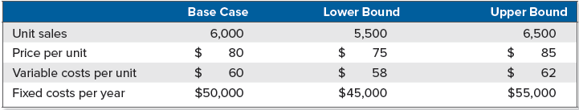
Scenario and other what-if analyses: getting started
First thing to do when investigating a new project is estimate NPV based on projected cash flows
  Initial set of projections are called the base case
After completing the base case, investigate how different assumptions about the future will impact our estimates
  One way to do this is by putting upper and lower bounds on the various components of the project
Project under consideration costs $200,000, has a five-year life, and has no salvage value. Depreciation is straight-line to zero. The required return is 12%, and the tax rate is 21%. In addition, we have compiled the following information:

Slide 6
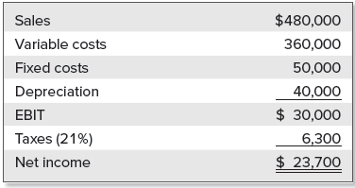
Scenario and other what-if analyses: getting started (2)
With this information, we can calculate the base-case NPV by first calculating net income:
Operating cash flow is $30,000 + 40,000 − 6,300 = $63,700 per year
At 12%, five-year annuity factor is 3.6048, so the base-case NPV is:
    Base-case NPV = −$200,000 + 63,700 × 3.6048
    = $29,624

Slide 7
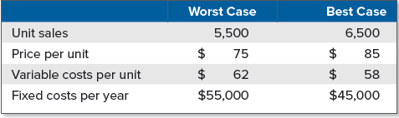
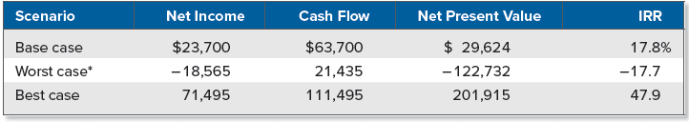
Scenario and other what-if analyses: scenario analysis
Scenario analysis is the determination of what happens to NPV estimates when we ask what-if questions
We can consider a number of possible scenarios, but let’s start with worst case and best case
For our project, these values would be the following:
We can now calculate the net income and cash flows for each scenario:

Slide 8
Scenario and other what-if analyses: scenario analysis (2)
To get the worst case, we assign the least favorable value to each item. This means low values for items like units sold and price per unit and high values for costs. We do the reverse for the best case.
What we learn is that under the worst scenario, the cash flow is still positive at $21,435. That’s good news. The bad news is that the return is −17.7% in this case, and the NPV is −$122,732. Because the project costs $200,000, we stand to lose more than half of the original investment under the worst possible scenario. The best case offers an attractive 47.9% return.

Slide 9
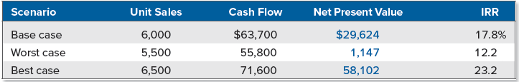
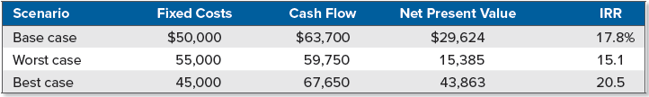
Scenario and other what-if analyses: sensitivity analysis
Sensitivity analysis is an investigation of what happens to NPV when only one variable is changed
Returning to our base case for every item except unit sales, we can calculate cash flow and NPV using the largest and smallest unit sales figures
We can freeze everything except fixed costs and repeat the analysis:
What we see here is that given our ranges, the estimated NPV of this project is more sensitive to changes in projected unit sales than it is to changes in projected fixed costs. In fact, under the worst case for fixed costs, the NPV is still positive.

Slide 10
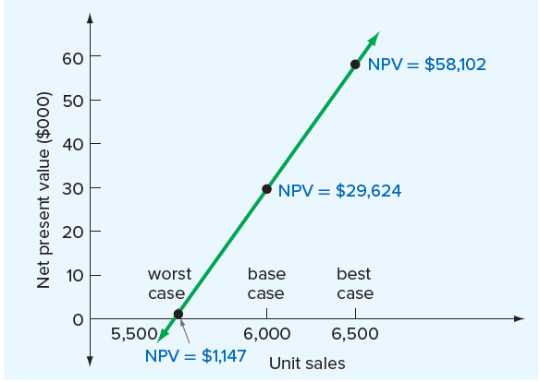
Scenario and other what-if analyses: sensitivity analysis (2)
Results of sensitivity analysis for unit sales can be illustrated graphically
  NPV on vertical axis and unit sales on horizontal axis
When we plot combinations of unit sales versus NPV, all possible combinations fall on a straight line
  The steeper the resulting line, the greater the sensitivity of estimated NPV to changes in projected value of variable being investigated

Slide 11
Scenario and other what-if analyses:
SIMULATION analysis
Simulation analysis is a combination of scenario and sensitivity analysis, wherein we allow all items to vary at the same time
  With scenario analysis, we let all the different variables change, but we let them take on only a few values
  With sensitivity analysis, we let only one variable change, but we let it take on many values
In the simplest case, we start with unit sales and assume that any value in our 5,500 to 6,500 range is equally likely
  Start by randomly picking one value and then randomly selecting a price, a variable cost, and so on
  Once we have values for all relevant components, calculate an NPV
  Repeat this sequence as many times as desired, probably several thousand times
  Result is many NPV estimates that we summarize by calculating the average value and some measure of how spread out the different possibilities are

Slide 12
Break-even analysis: fixed and variable costs
Break-even analysis is a popular and commonly used tool for analyzing the relationship between sales volume and profitability
  Sales volume is usually analyzed more closely than other variables
Variable costs change when the quantity of output changes, and they are zero when production is zero
  Relationship between total variable cost (VC), cost per unit of output (v), and total quantity of output (Q) can be written as:
    Total variable cost = Total quantity of output × Cost per unit of output
    VC = Q × v
Suppose variable costs (v) are $2 per unit. If total output (Q) is 1,000 units, what will total variable costs (VC) be?
    VC = Q × v
    = 1,000 × $2
    = $2,000

Slide 13
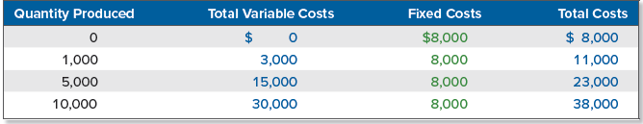
Break-even analysis: fixed and variable costs (2)
Fixed costs do not change when the quantity of output changes during a particular time period (e.g., lease payment)
Total costs (TC) for a given level of output are the sum of variable costs (VC) and fixed costs (FC):
    TC = VC + FC
    = v × Q + FC
If variable costs are $3 per unit and fixed costs are $8,000 per year, our total cost is:
  TC = $3 × Q + $8,000
  If we produce 6,000 units, our total production cost will be $3 × 6,000 + $8,000 = $26,000

Slide 14
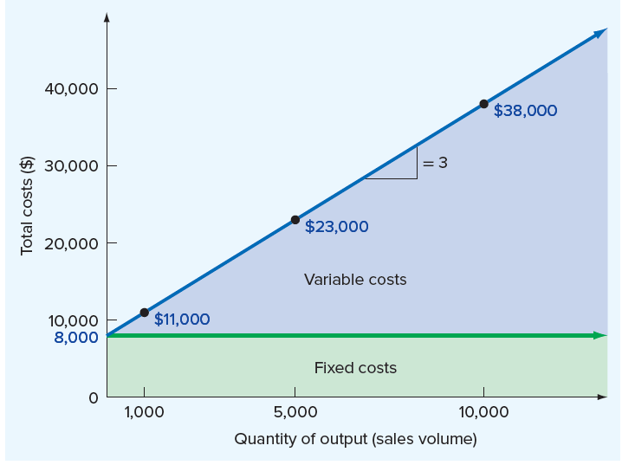
Break-even analysis: fixed and variable costs (3)
By plotting the points from the table in the previous slide, we see that the relationship between quantity produced and total costs is given by a straight line
Notice that total costs equal fixed costs when sales are zero
  Beyond that point, every one-unit increase in production leads to a $3 increase in total costs, so the marginal, or incremental, cost of producing one more unit is $3

Slide 15
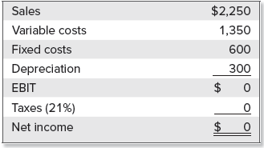
Accounting break-even
Most widely used measure of break-even is accounting break-even, the sales level that results in zero project net income
Suppose we retail one-petabyte computer disks for $5 each. We can buy disks from a wholesale supplier for $3 each. We have accounting expenses of $600 in fixed costs and $300 in depreciation. How many disks must we sell to break even (i.e., for net income to be zero)?
  For every disk we sell, we pick up $5 − 3 = $2 toward covering our other expenses (i.e., contribution margin per unit is $2)
  We must cover a total of $600 + 300 = $900 in accounting expenses, so we need to sell $900/$2 = 450 disks

Slide 16
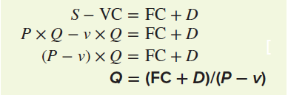
Accounting break-even: a closer look
Break-even level is equal to the sum of fixed costs and depreciation, divided by price per unit less variable costs per unit
  Breakeven level may be solved for using the following:
Where
  P = Selling price per unit
  v = Variable cost per unit
  Q = Total units sold
  S = Total sales = P × Q
  VC = Total variable costs = v × Q
  FC = Fixed costs
  D = Depreciation
  T_{C} = Tax rate

Slide 17
Uses for the accounting break-even
Why would anyone be interested in knowing the accounting break-even point?
  Accounting break-even and payback period are similar measures. Like payback period, accounting break-even is relatively easy to calculate and explain.
  Managers are often concerned with the contribution a project will make to the firm’s total accounting earnings. A project that does not break even in an accounting sense actually reduces total earnings.
  A project that just breaks even on an accounting basis loses money in a financial or opportunity cost sense. This is true because we could have earned more by investing elsewhere. Such a project does not lose money in an out-of-pocket sense.

Slide 18
Operating cash flow, sales volume, and break-even
Wettway Sailboat Corporation is considering whether to launch its new Margo-class sailboat. The selling price will be $40,000 per boat, variable costs will be $20,000 per boat, and fixed costs will be $500,000 per year. Total investment needed to undertake the project is $3,500,000, which will be depreciated straight-line to zero over the five-year life of the equipment. The salvage value is zero, and there are no working capital consequences. The required return is 20%.
Wettway projects total sales for the five years at 425 boats, or about 85 boats per year. Ignoring taxes, should this project be launched?
  Operating cash flow at 85 boats per year is:
    Operating cash flow = EBIT + Depreciation − Taxes
    = (S − VC − FC − D) + D − 0
    = 85 × ($40,000 − 20,000) − $ 500,000 = $1,200,000/year
  At 20%, the five-year annuity factor is 2.9906, so the NPV is:
      NPV = − $3,500,000 + $1,200,000 × 2.9906
      = − $3,500,000 + 3,588,735 = $88,735

Slide 19
Calculating the break-even level
Before fixed costs and depreciation are considered, Wettway generates $40,000 − 20,000 = $20,000 per boat (i.e., revenue less variable cost)
Depreciation is $3,500,000/5 = $700,000 per year
Fixed costs and depreciation together total $1.2 million, so Wettway needs to sell (FC + D)/(P − v) = $1.2 million/$20,000 = 60 boats per year to break even on an accounting basis
To calculate Wettway’s cash flow in this case, we note that if 60 boats are sold, net income will be exactly zero
  Recall that operating cash flow for a project can be written as net income plus depreciation (i.e., bottom-up definition)
  Operating cash flow is equal to the depreciation, or $700,000

Slide 20

Sales volume and operating cash flow
Ignoring taxes, a project’s operating cash flow, OCF, can be written as EBIT plus depreciation:
For the Wettway sailboat project, the general relationship (in thousands) between operating cash flow and sales volume is:
    OCF = (P − v) × Q − FC
    = ($40 − 20) × Q − 500
    = − $500 + $20 × Q
Relationship between operating cash flow and sales volume is given by a straight line with a slope of $20 and a y-intercept of −$500

Slide 21

Cash flow, accounting, and financial break-even points
We have shown the relationship between operating cash flow and sales volume (ignoring taxes) is:
      OCF = (P − v) × Q − FC
If we rearrange this and solve for Q, the result tells us what sales volume (Q) is necessary to achieve any given OCF
Looking at the graph on the previous slide, suppose operating cash flow is equal to depreciation (D)
  Recall this situation corresponds to our break-even point on an accounting basis
  To find the sales volume, substitute the $700 depreciation amount for OCF in our general expression:
      Q = ( FC + OCF ) / ( P − v )
      = ( $500 + 700 ) / $20 = $60

Slide 22
Cash break-even and financial break-even
Cash break-even is the sales level that results in a zero operating cash flow, and it is calculated as follows:
    Q = ( FC + 0 ) / ( P − v )
    = $500 / $20 = $25
  Wettway must sell 25 boats to cover the $500 in fixed costs
Financial break-even is the sales level that results in a zero NPV
  Determine what operating cash flow must be for the NPV to be zero, and then use this amount to determine the sales volume
  Recall Wettway requires a 20% return on its $3,500 (in thousands) investment. How many sailboats does Wettway have to sell to break even once we account for the 20% per year opportunity cost?
  Five-year annuity factor at 20% is 2.9906, and OCF is:
    $3,500 = OCF × 2.9906
    OCF = $3,500 / 2.9906 = $1,170
  We can now plug this OCF into the equation for sales volume:
    Q = ( $500 + 1,170 ) / $20 = 83.5

Slide 23
Operating leverage
Operating leverage is the degree to which a firm or project relies on fixed costs
  A firm with low operating leverage will have low fixed costs compared to a firm with high operating leverage
  Projects with a relatively heavy investment in plant and equipment will have a relatively high degree of operating leverage, and these projects are said to be capital intensive
Operating leverage has important implications for project evaluation
  Fixed costs act as a lever in the sense that a small percentage change in operating revenue can be magnified into a large percentage change in operating cash flow and NPV
  The higher the degree of operating leverage, the greater is the potential danger from forecasting risk

Slide 24
Measuring Operating leverage
Degree of operating leverage (DOL) is the percentage change in operating cash flow relative to the percentage change in quantity sold, and it is defined such that:
    Percentage change in OCF = DOL × Percentage change in Q
Based on relationship between OCF and Q, DOL can be written as:
Go back to the Wettway sailboat project; fixed costs were $500 and (P − v) was $20, so OCF was:
    OCF = −$500 + $20 × Q
Suppose Q is currently 50 boats. At this level of output, OCF is −$500 + 1,000 = $500. If Q rises by 1 unit to 51, then the percentage change in Q is (51 − 50)/50 = .02, or 2%. OCF rises to $520, a change of P − v = $20. The change in OCF is ($520 − 500)/$500 = .04, or 4%.
  2% increase in number of boats sold leads to a 4% increase in OCF
  DOL must be exactly 2

Slide 25
Measuring Operating leverage (2)
We can verify that DOL is exactly 2.00 by noting that:
    DOL = 1 + FC/OCF
    = 1 + $500/$500
    = 2
Suppose Q rises from 50 to 75, a 50 percent increase. With DOL equal to 2, operating cash flow should increase by 100 percent, or exactly double. Does it?
At a Q of 75, OCF is:
    OCF = −$500 + $20 × 75 = $1,000
Notice that operating leverage declines as output (Q) rises. For example, at an output level of 75, we have:
    DOL = 1 + $500/$1,000
    = 1.50

Slide 26
Operating leverage and break-even
At a Q of 85 boats, the degree of operating leverage for the sailboat project under the original scenario is:
    DOL = 1 + FC/OCF
    = 1 + $500/$1,200 = 1.42
Recall NPV at a sales level of 85 boats was $88,735, and the accounting break-even was 60 boats
Wettway could subcontract production of the boat hull assemblies, which would decrease the necessary investment to $3.2 million, decrease the fixed operating costs to $180,000, and increase the variable costs to $25,000 per boat, resulting in the following:
  NPV at 20% ( 85 units ) = $74,720
  Accounting break-even = 55 boats
  Degree of operating leverage = 1.16
This option results in a slightly lower estimated net present value, and the accounting break-even point falls to 55 boats from 60 boats

Slide 27
Capital rationing
Capital rationing exists if a firm has positive NPV projects but cannot find the necessary financing
Soft rationing occurs when units in a business are allocated a certain amount of financing for capital budgeting
  Corporation as a whole is not short of capital; more can be raised on ordinary terms if management so desires
  If the face of soft rationing, the following should be considered:
    Try to get a larger allocation
    If a larger allocation is not awarded, generate as large a NPV as possible within the existing budget
Hard rationing occurs when a business cannot raise financing for a project under any circumstances
  DCF analysis breaks down when hard rationing occurs
  Can occur when a company experiences financial distress or if the firm is unable to raise capital without violating a preexisting contractual agreement

Slide 28
End of Chapter

