Slide 1
Narrative
Vs
Descriptive

Slide 2
In a nutshell
What’s the difference between a narrative essay and a descriptive essay?
Narrative essay is designed to tell a complete story
Descriptive essay is meant to convey an intense description (5 senses) of a particular place, object, or concept.

Slide 3
This is Narrative
Narrative writing relates a series of events either real or imaginary from a particular point of view
We often use first person in narrative writing
Narrative writing involves the writer’s personal experience (you can make it up, but make it believable) no aliens, no ghosts, no monsters
Narrative writing usually has an intro เริ่ม and an ending จบเรื่อง

Slide 4
In every story, there is a problem
exposition
climax
resolution

Slide 5
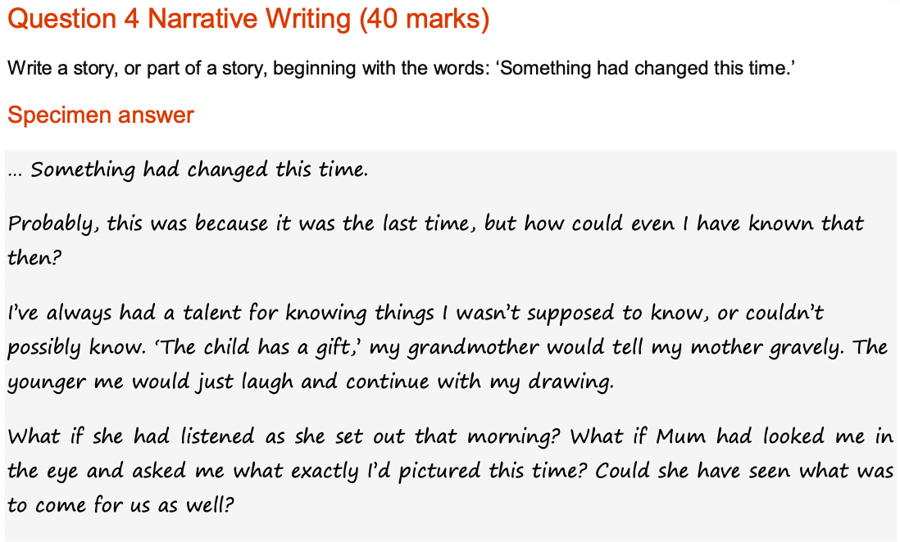
IGCSE
Example
Answer
The question
1st person
Exposition

Slide 6
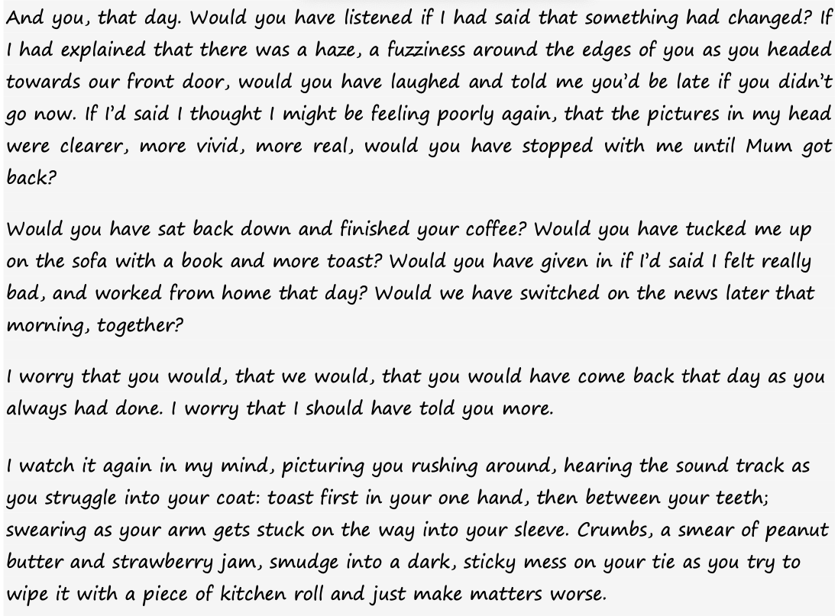
IGCSE
Example

Slide 7
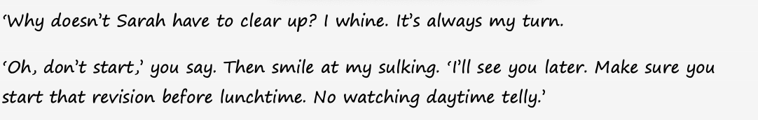
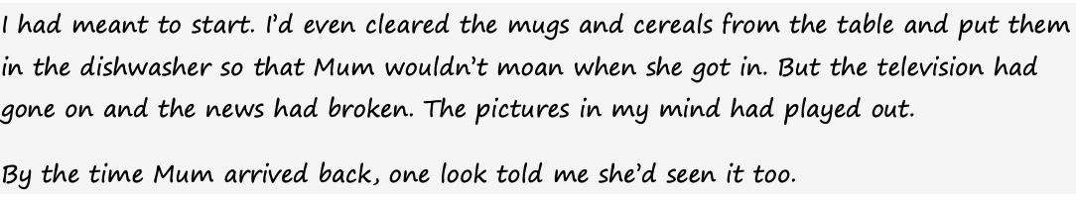
IGCSE
Example
Use of speech
The end

Slide 8
Write a story with the word “ This can’t be real”
This can’t be real!
exposition
climax
My wallet went missing and I am thinking back what could have been
Where I went
Did somebody steal it?
* I PANICKED*
Setting:
I am at home, and looking around everywhere
I found it well
Hidden under my
Pillow, where
I had thought
Would be a good idea to keep it
resolution

Slide 9
Teacher’s writing
But then, I remembered I needed my wallet. Not that the cashless payment would not work, but I was always more concerned about having my ID card and my debit cards with me, any emergency could arrive, and why taking the risk, right?
That is when the doom came lurking on my day.
I started looking in my drawer, no, it was not there. Then I moved to my bag closets, none had my wallet. I started looking at my living room, rummaging through the sofa, cushions scattered everywhere; I turned into a mad woman with tangled hair bending up and down searching for my wallet frantically.

Slide 10
Teacher’s writing
I remembered it vividly, I still scold myself every single time, with much embarrassment. I felt pretty terrible about it.
It was a Sunday morning, birds chirping and blue sky. I was telling myself, “ This is going to be one of my best days.” I contemplated going out to a nice coffee shop, sit down and read my favourite new book I just had purchased on Kindle.
With much giddiness, I took my Kindle, keys, mobile phone in my new canvas bag. I was dressed in a long skirt, sleeveless white tank top, sandals, and a beach hat! How relaxing was my day going to be! Could it get any more enjoyable?

Slide 11
Teacher’s writing
I sat down. Desperate, I recounted where I last used my wallet. I pictured the shopping mall, the metro, the bookstore, the tea shop…all of a sudden, I panicked.
Could I have been a victim of pickpocketing? This can’t be real.
Is there a disgusting pick-pocketer in my neighbourhood? Preying on innocent people who were just doing their chores and getting on with their life? I felt sick in my stomach.
I felt worried, Should I go to the police station? Should I call my friends? Should I call my banks to cancel the cards? All seemed far too much and I just wanted to lie down.

Slide 12
Teacher’s writing
I threw myself on the bed, the soft pillow supported my stiff neck. But I didn't feel right, then I reached out to reshape the pillow’s shape, that is when I saw a shiny black leather wallet, my wallet! under the pillow, in my bed!
I realised that last night I thought it was the best place to keep a wallet, just in case a burglar sneaked into my place. He or she would never find my wallet, I would be safe and worriness. I had suddenly recalled the satisfaction at my own smart idea and my self-congratulatory pat on the shoulder last night.
Look at how it turned out.
How ridiculous is this?

Slide 13
Write a story with the word “This can’t be real”
exposition
This can’t be real!
climax
Rising action
-biggest project
-all your friends did it
-Forgot to do homework
Setting:
In the car
On the way to school
Remember the calendar
Ending:
You survive because teacher is sick the due date is the nest 2 days
resolution

Slide 14
Student (1) trial: Setting
It was a fresh day, I was ready to go to school. I remembered woke waking up with a clear head. I was happily showering without thinking of anything specificly.
As I was in the car, I checked for my schedule. A random thought popped in my mind, but I couldn’t recall it. My heart felt a strange beat as if I was a main character in a horror movie.
I went down my got off the car, pulling all my bags out. I spotted a friend in my class. I picked up shot her with a question. “Why are you looking like a ghost?”, I said.
She looked at me in the eyes, saying ,”I was working on my Thai project last night.” The teacher gave too many requirement.” I mumbled, “What Thai work?”

Slide 15
Student (1) trial:
“The poem and slides,” she signed. I completely forgot about the project. My head was now fuzzy. I screwed up, today is the death of my life.
I grabbed my pocket to get my phone for the schedule, but it was nowhere to be found. “What?”, exclaimed I. I looked my friend and told moaned to her: “I’m no longer alive now, my phone is nowhere to be seen and I don’t know what assignments are to be submitted today”. “This can’t be real,” I screamed. With luck, I borrowed my friend’s phone to check for classes and pending tasks.

Slide 16
Student (1) trial
Lucky for me,my Thai class would be the last period. That means I could probably steal some break and lunch or other class time to finish the dreadful assignment. Such a blessing, I felt relieved.
As I attended the first period, all my mind was blended with solutions of how to juggle the assignment and note-taking without being caught by the teachers.
แก้จาก It was like a blessing in the dark, my Thai class was the last period. As I attended the first period, all my mind was blended with solutions to work this out.

Slide 17
Student (1) trial
As one of my Computing teacher’s favourite students, I took advantage of the computer room during break and lunchtime without any trouble. As the break ended, a quarter of the assignment was done; by lunchtime, I managed to get ¾ finished.
แก้จาก (make it flow)The bell rang for break, I sprinted toward the computer room. I felt a relief as I was my comsci teacher’s favorite student. I skipped my lunch. I did ¾ of the assignment.

Slide 18
Student (1) trial
The moment my hand started to work on the last slide, the second bell rang. I was quite relieved as most of the work was done. Maybe another 15 minutes would grant me an opportunity to complete this project.
Unfortunately, my afternoon classes were all intense, and I did not have even a single second to breathe. By the time Thai class started, I walked in the class with worry.

Slide 19
Student (1) trial
Then I spot a solitude substitute teacher sitting right in front of the class, not long after that he instructed, “Class, today I will be your substitute teacher. Your teacher told me you could work on the rest of the project. But if you are done, just do not disturb others who work.” Then he went back to the desk. This was a completely good news to me. I was glad to continue finishing the work. It was like the god’s gift to me I screamed joyfully inside my head. If I had bought a lottery today, I would’ve won a million.

Slide 20
Synonyms
say | Exclaimed, sighed, mumbled, shouted, screamed, shot a question, asked, instructed
think | considered, contemplated, imagined, judged, calculated, viewed, saw
walk | Sprinted, dashed, crawled, trudged เดินเหนื่อยๆ แบบไม่ไหวแล้ว, skip, reach
work | Project, assignment, task, job
happy | Glad, delighted, joyful, cheerful, relieved, blissful
happily | Cheerfully, delightedly, contentedly, joyfully, blissfullly

Slide 21
Synonyms
worried | Stressed, unhappy, anxious, distressed
worry | Stress, anxiety, worriness, trouble, problem
Busy working | Juggle many jobs, handle the workload, frantically do the homework,

