Slide 1
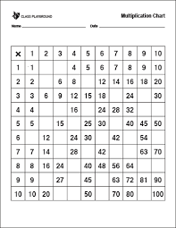
Can you fill in the missing
values for this times table grid?

Slide 2
2 3
4 10
21 27
Did you get them all?
Can you see any patterns?
8 12 20 36 40
10 20 35
6 18 36 48 60
21 35 49 56
32 72 80
18 36 54
30 40 60 90

Slide 3
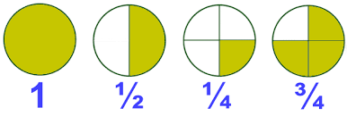
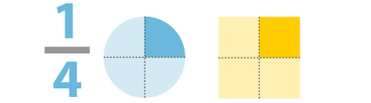
Fractions
What is a fraction
Identifying simple fractions
Finding equivalent fractions
Simplifying fractions

Slide 4
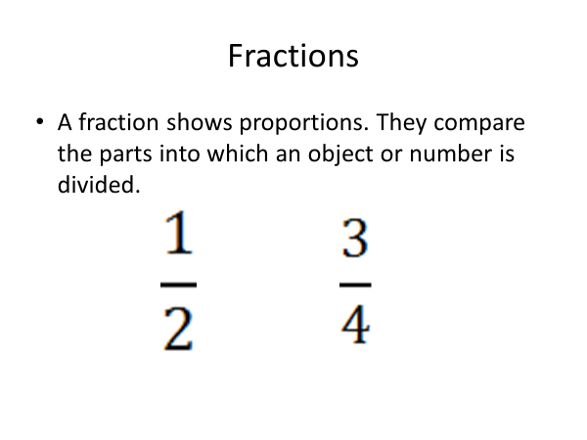

Slide 5
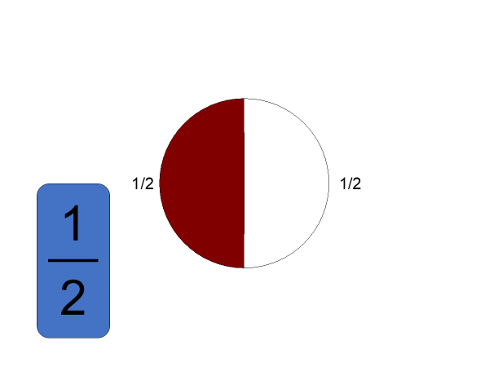

Slide 6
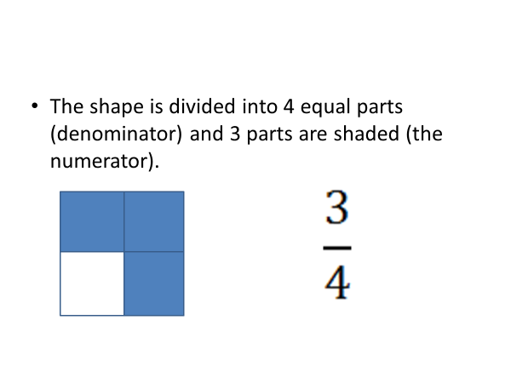

Slide 7
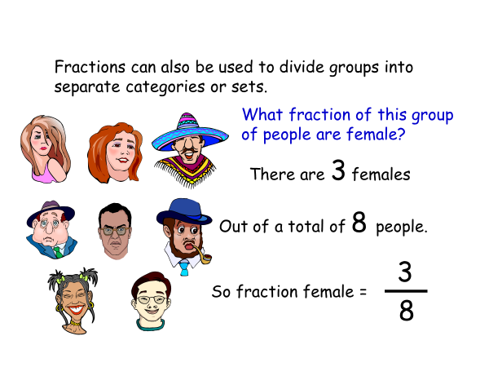

Slide 8
People Questions
What fraction of the people are wearing glasses?
Think……how many are wearing glasses?
…….out of how many people in total?

Slide 9
People Questions
4
What fraction of the people are wearing glasses?
18

Slide 10
4
What fraction of the people have a moustache?
15
Notes:
Answer to question coming up with the question

Slide 11
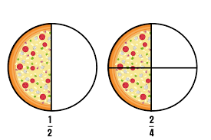
Equivalent fractions
What does the word equivalent mean?
Equal to, the same as.

Slide 12
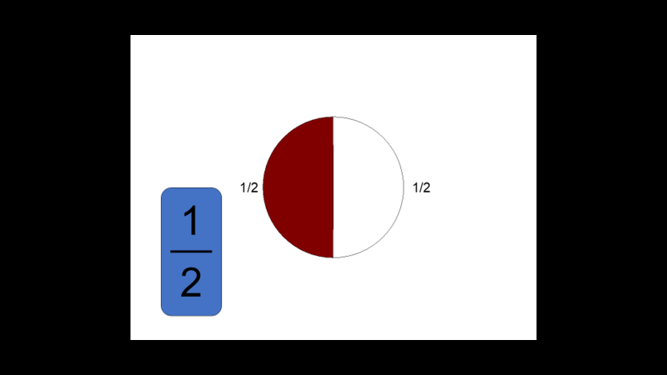

Slide 13
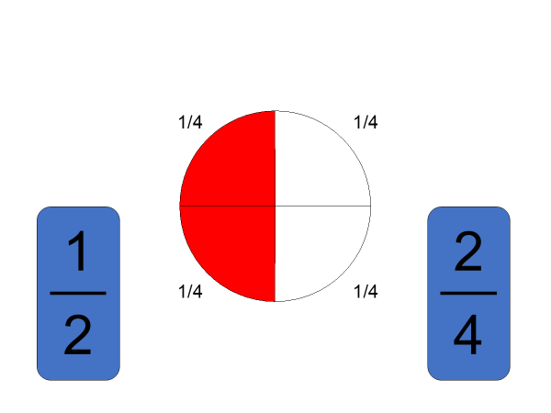

Slide 14
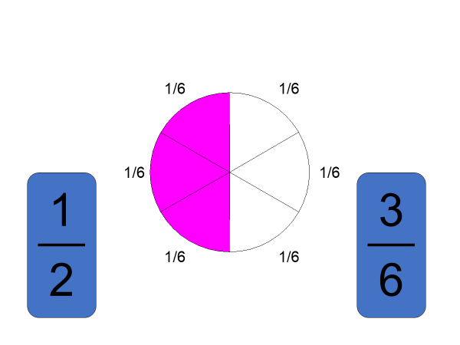

Slide 15
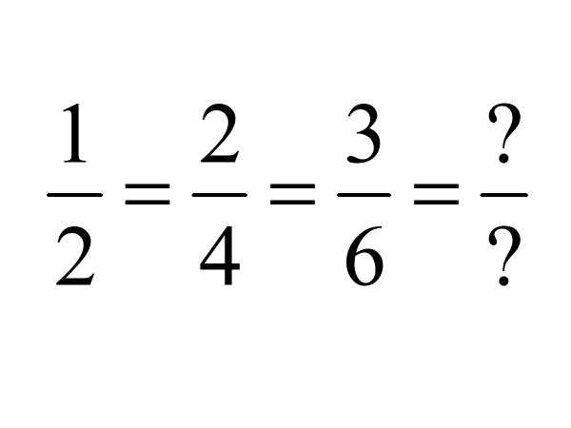

Slide 16

Let’s see if we can use a diagram to help

Slide 17
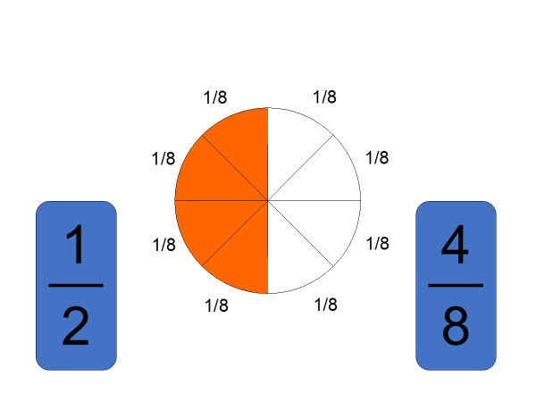

Slide 18
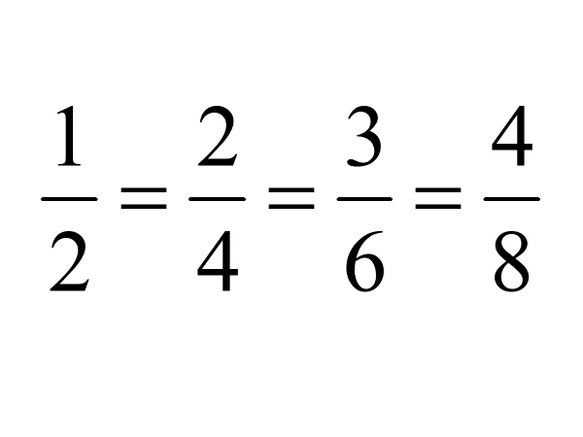

Slide 19
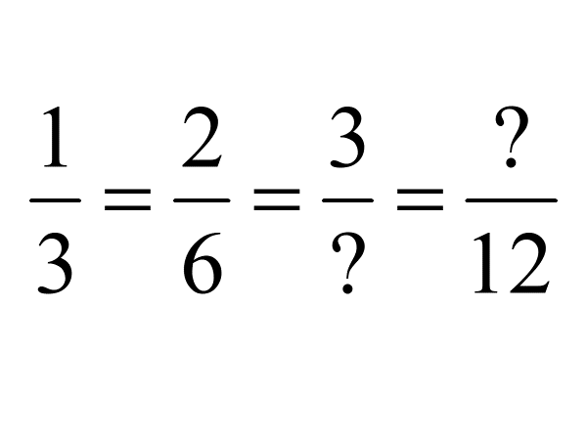

What are the missing values?

Slide 20
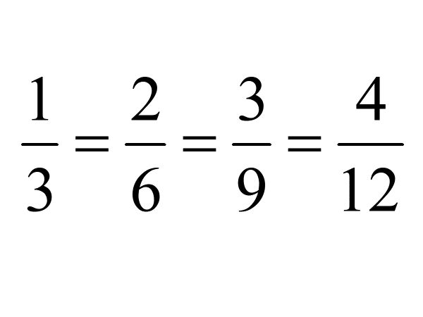


Slide 21
