Slide 1


Unlocking the Power of Statistics
Statistics is a powerful tool for understanding the world around us. It helps us to make sense of data, identify trends, and draw conclusions. This presentation will cover the basics of statistics, from the fundamental concepts to key applications in various fields.
by Onyedikachi Ikenna Onwurah

Slide 2
What is Statistics?
Collection
Analysis
Interpretation
Statistics involves gathering data from various sources, like surveys, experiments, or existing databases. This process ensures accurate and representative data for analysis.
Once collected, the data is analyzed to identify patterns, relationships, and trends. Statistical methods like calculations and visualizations help uncover insights hidden within the data.
The final step involves interpreting the results of the analysis, drawing meaningful conclusions, and making informed decisions based on the statistical evidence.

Slide 3
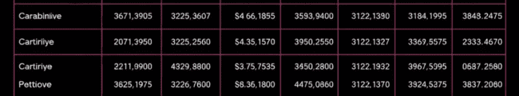
Types of Data
Quantitative
Qualitative
Ordinal
Quantitative data represents numerical values, such as height, weight, age, or temperature. It can be further categorized as discrete (countable) or continuous (measurable).
Qualitative data deals with descriptive characteristics, such as colors, opinions, feelings, or categories. It provides insights into qualities or attributes, rather than numerical measurements.
Ordinal data involves categories with a natural order, like satisfaction levels (low, medium, high) or rankings. While it provides a sequence, the differences between categories may not be equal.

Slide 4

Measures of Central Tendency
1
Mean
2
Median
3
Mode
The mean is the average of all values in a dataset. It's calculated by summing up all values and dividing by the total number of values.
The median is the middle value when the dataset is arranged in ascending order. It represents the value that divides the dataset in half.
The mode is the value that appears most frequently in a dataset. It indicates the most common occurrence in the data.

Slide 5
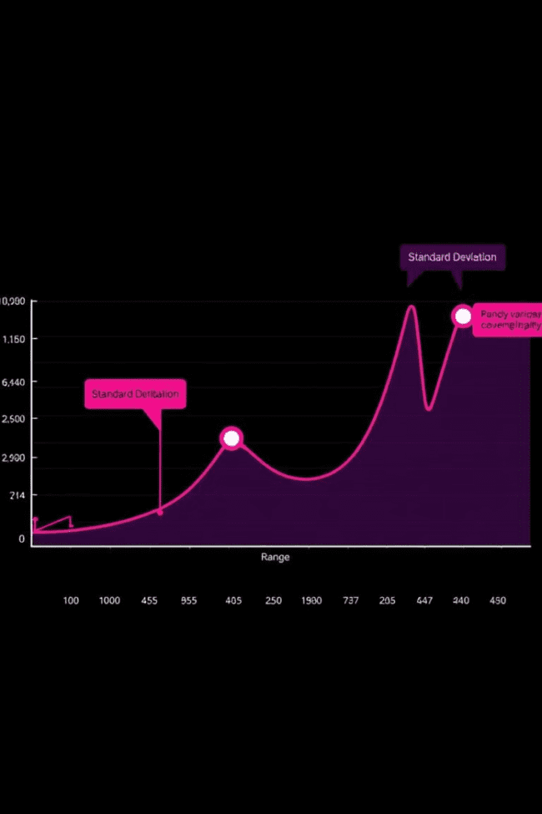



Measures of Dispersion
Range
The range measures the spread of data by subtracting the minimum value from the maximum value. It provides a basic understanding of data dispersion.
Variance
Variance measures the average squared deviation of each data point from the mean. It provides a more precise measure of data spread than the range.
Standard Deviation
The standard deviation is the square root of the variance. It's easier to interpret than the variance as it's expressed in the same units as the data.

Slide 6
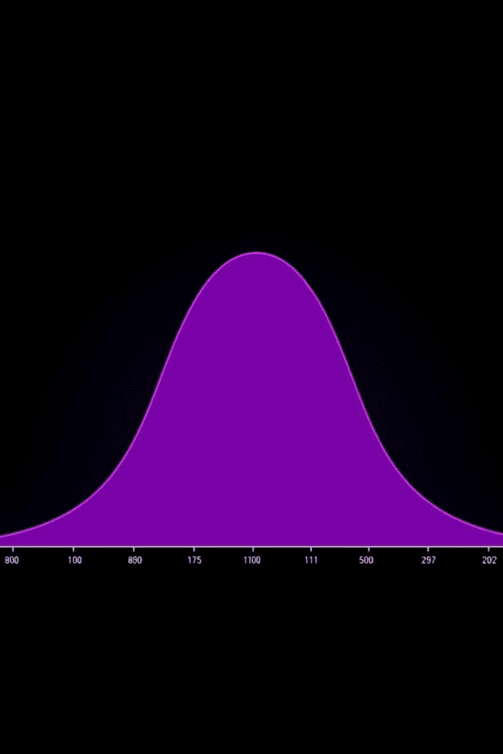
Probability Distributions
1
A probability distribution describes the likelihood of different outcomes in a random event. It helps understand the probability of each outcome and how they are distributed.
2
Normal distribution is a common and widely used distribution where data clusters around the mean. It's shaped like a bell curve, with most values close to the average.
3
Other distributions, like the binomial distribution, Poisson distribution, or exponential distribution, model different types of random events and provide valuable insights into their probability.

Slide 7
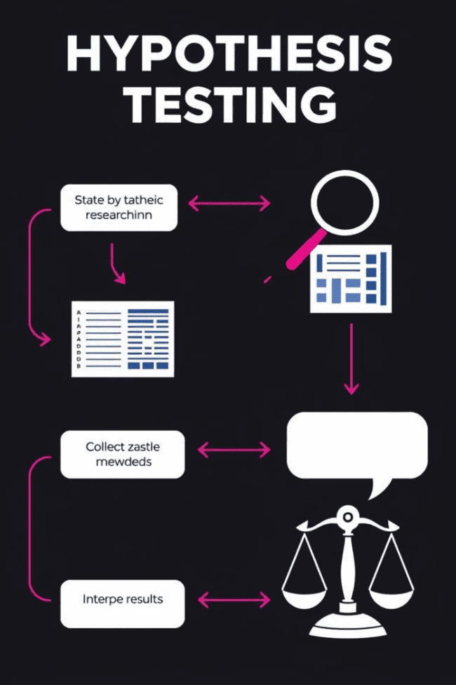




Hypothesis Testing
Formulate Hypothesis
Define a null hypothesis (no effect) and an alternative hypothesis (effect). These hypotheses are statements about the population that we want to test.
Collect Data
Gather data from a sample that is representative of the population. The data will be used to test the hypotheses.
Calculate Test Statistic
Use the collected data to calculate a test statistic, which measures how likely the observed data is under the null hypothesis.
Make Decision
Compare the test statistic to a critical value or p-value. If the test statistic is extreme enough, reject the null hypothesis and support the alternative hypothesis.

Slide 8



Correlation and Regression
Correlation
1
Correlation measures the strength and direction of the linear relationship between two variables. It ranges from -1 to +1, where 0 indicates no relationship.
Regression
2
Regression analysis aims to model the relationship between variables and predict the value of one variable based on the other. It helps to understand how changes in one variable affect the other.
Applications
3
Correlation and regression find wide applications in various fields, such as finance, marketing, healthcare, and social sciences.

