Slide 1
Changes in Temperature and Phase

Slide 2
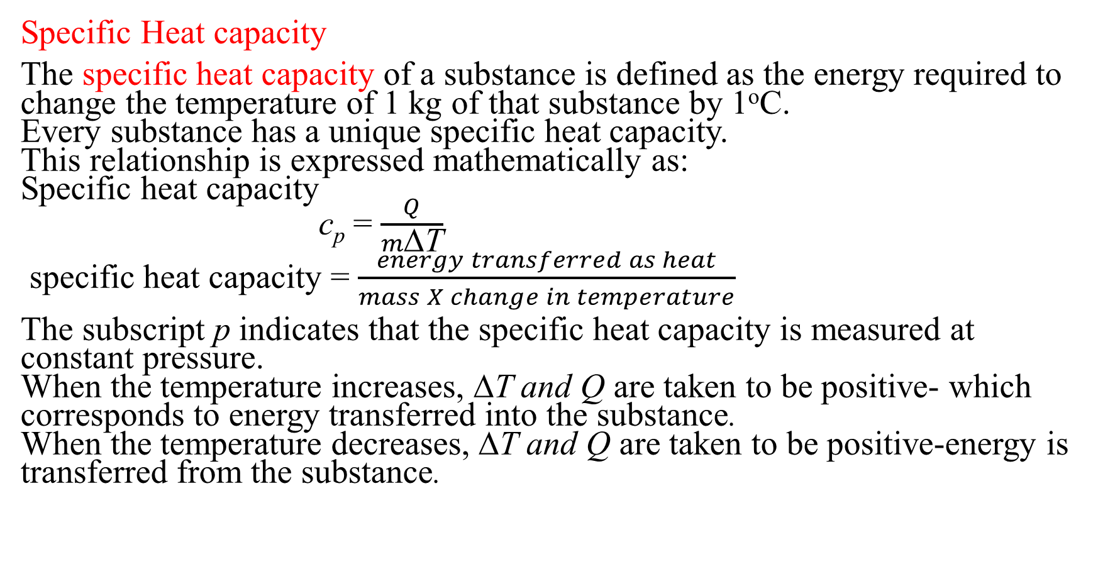
Changes in Temperature and Phase
Specific Heat capacity
The specific heat capacity of a substance is defined as the energy required to change the temperature of 1 kg of that substance by 1ºC.
Every substance has a unique specific heat capacity.
This relationship is expressed mathematically as:
Specific heat capacity
c_{p} = $\frac{Q}{m\text{Δ}\text{T}}$
specific heat capacity = $\frac{energy transferred as heat}{mass X change in temperature}$
The subscript p indicates that the specific heat capacity is measured at constant pressure.
When the temperature increases, ΔT and Q are taken to be positive- which corresponds to energy transferred into the substance.
When the temperature decreases, ΔT and Q are taken to be positive-energy is transferred from the substance.

Slide 3
Changes in Temperature and Phase
Calorimetry is used to determine specific heat capacity.
To measure the specific heat capacity of a substance, it is necessary to measure mass, temperature change, and energy transferred as heat.
Mass and temperature change are directly measurable, but the direct measurement of heat is difficult.
However, the specific heat capacity of water is known, so the energy transferred as heat between an object of unknown heat capacity and a known capacity of water can be measured.
If a hot substance is placed in an insulated container of cool water, energy conservation requires that the energy the substance gives up must equal the energy absorbed by the water.
Energy conservation can be used to calculate the specific heat capacity, c_{p,x}, of the substance as:
energy absorbed by water = energy released by the substance
Q_{w} = - Q_{x}
c_{p,w} m_{w}ΔT_{w}= - c_{p,x} m_{x}ΔT_{x}
This approach to determining a substance’s specific heat capacity is called calorimetry, and the devices that are used for making this measurements are called calorimeters.

Slide 4
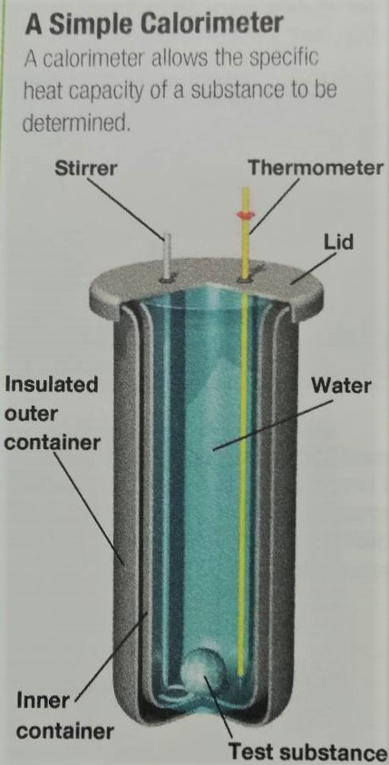
Changes in Temperature and Phase
Calorimetry is used to determine specific heat capacity.

Slide 5
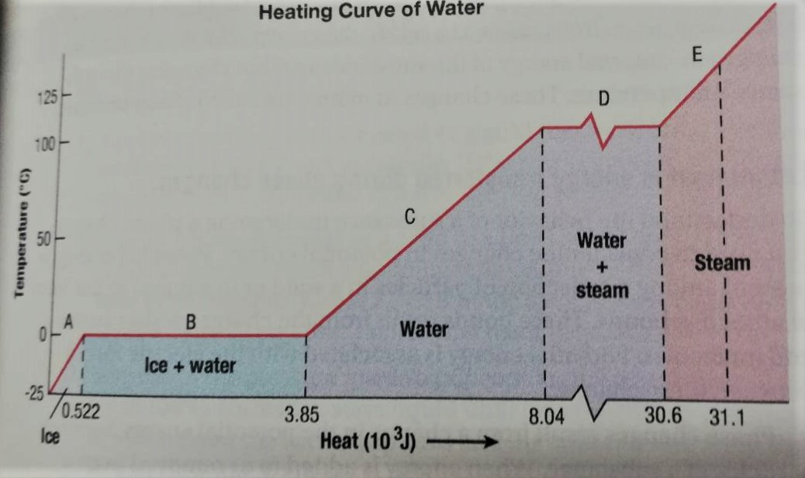
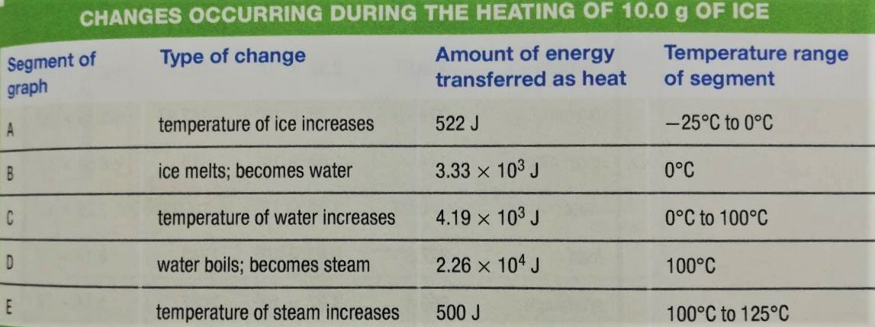
Changes in Temperature and Phase
Latent Heat
Suppose you place an ice cube with a temperature of -25ºC in a glass and then you place the glass in a room.
The ice cube slowly warms, and the temperature of the ice will increase until the ice begins to melt at 0ºC.
The graph and data show how the temperature of 10 g of ice changes as energy is added.

Slide 6
Changes in Temperature and Phase
Latent Heat
Temperature steadily increases from – 25ºC to 0ºC. (segment A of the graph).
At 0ºC, the temperature stops increasing. Instead, the ice begins to melt and to change into water (segment B). The ice-and-water mixture remains at this temperature until all of the ice melts.
Suppose that you now heat the water in a pan on a stovetop. From 0ºC to 100ºC, the water’s temperature stops rising, and the water turns into steam (Segment D).
Once the water has completely vaporized, the temperature of the steam increases (segment E).

Slide 7
Changes in Temperature and Phase
Latent Heat
Suppose When substances melt, freeze, boil, condense, or sublime, the energy added or removed changes the internal energy of the substance without changing the substance’s temperature.
These changes in matter are called phase changes.
Phase change: the physical change of a substance from one state to another at constant temperature and pressure.
Latent heat is energy transferred during phase changes.
Phase changes result from a change in the potential energy between particles of a substance.
When energy is added or removed from a substance that is undergoing a phase change, the particles of the substance rearrange themselves to make up for their change of energy.
This rearrangement occurs without a change in the average kinetic energy of particles.
The energy that is added or removed per unit mass is called latent heat, abbreviated as L.
Latent heat: the energy per unit mass that is transferred during a phase change of a substance.
As per this definition, the energy transferred as heat during a phase change simply equals the mass multiplied by the latent heat, as:
Q = mL
During melting, the heat that is added to a substance equals the difference between the total potential energies for particles in the solid and the liquid phases. This type of latent heat is called the heat of fusion. L_{f}
During vaporization, the energy that is added to a substance equals the difference in the potential energy of attraction between the liquid particles and between the gas particles. In this case, the latent heat is called the heat of vaporization. L_{v}
Notes:
n

