Slide 1








GRAMMAR
parts of speech
NOUNS

Slide 2



Learning Intention:
  To define what a noun is
  To identify nouns in text

Slide 3
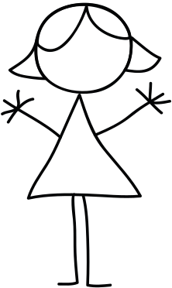


What is a noun?
A noun is a person, a place or a thing.

Slide 4

Person
girl
boy
teacher
coach
mum

Slide 5
Identify the noun:
The boy fell over.

Slide 6
Identify the noun:
The boy fell over.

Slide 7

Place
hospital
school
house
Australia
city

Slide 8

Identify the noun(s):
London is a great city to visit.

Slide 9
Identify the noun(s):
London is a great city to visit.

Slide 10


Thing
shoe
butterfly
book
sandwich
sun

Slide 11

Identify the noun(s):
The boat sailed through the wind.

Slide 12
Identify the noun(s):
The boat sailed through the wind.

Slide 13

How many nouns can you see?
The cat was so tired he fell asleep
on the mat.

Slide 14
How many nouns can you see?
The cat was so tired he fell asleep
on the mat.

Slide 15
Common & proper nouns
Nouns can be further divided into common and proper.
Common nouns: refer to general things.
e.g. city
Proper nouns: refer to specific things.
e.g. Sydney

Slide 16
Common
Proper
boy
Andrew
month
January
teacher
Miss Smith
country
Australia
religion
Christianity

Slide 17
Proper nouns start with a capital letter.

Slide 18
Identify the common nouns:
Dr. Jones enjoys hiking in the Andes Mountain range, and riding horses.

Slide 19
Common nouns:
Dr. Jones enjoys hiking in the Andes Mountain range, and riding horses.

Slide 20
Identify the proper nouns:
Dr. Jones enjoys hiking in the Andes Mountain range, and riding horses.

Slide 21
Proper nouns:
Dr. Jones enjoys hiking in the Andes Mountain range, and riding horses.

