Slide 1

Termination of Employment:
Legal Requirements and Best Practices
Tutor: Okwudili O. ONWURAH, LL.B. (Nigeria); BL (Abuja, Nigeria); LLM (Exeter, UK); LLM (Qingdao, PRC); LLM (Shanghai, PRC)
PhD in Law (Hong Kong)
Dr Okwudili O. Onwurah

Slide 2
Minor House Keeping
The purpose of the online lesson is to encourage you to participate actively in achieving your needs and simplifying your legal education. I want you to be the best!
Will make the learning process more interactive discussions and feel free to ask any question or you can speak.
You have the right to choose whether to turn on your video or not.
Participation prepares you for your exam and learning needs with ease.

Slide 3

Introduction
This presentation explores the legal landscape of employment termination in the UK and Hong Kong. We'll examine key legislation, notable case law, and best practices for HR professionals and business leaders.

Slide 4

Overview of Legal Requirements under EO
1
Notice Period
2
Payment in Lieu
Employees are entitled to notice periods based on length of service. Contracts may specify longer periods.
Employers may opt to pay in lieu of notice. This must equal wages for the notice period.
3
Termination Payments
Accrued wages, annual leave pay, and end-of-year payments must be settled within 7 days of termination.

Slide 5

Grounds for Fair Dismissal
Conduct
Capability
Serious misconduct or repeated breaches of workplace policies can justify dismissal. Documentation is crucial.
Poor performance, if properly managed and documented, may lead to fair dismissal. Proper procedures are essential.
Redundancy
Statutory Restriction
Economic circumstances or restructuring can necessitate redundancies. Fair selection criteria must be applied.
When continued employment would breach a statutory duty or restriction, dismissal may be fair.

Slide 6

Case Law: Wong Mei Man v Cosmopolitan Hotel
1
Background
Wong Mei Man worked as a room attendant at Cosmopolitan Hotel for over 10 years.
2
Dismissal
The hotel terminated her employment, citing poor performance and customer complaints.
3
Court Decision
The court ruled the dismissal unfair due to lack of proper documentation and performance management.
4
Implications
Emphasises the importance of thorough performance management and documentation in dismissal cases.

Slide 7
Unfair Dismissal: Polkey v AE Dayton Services Ltd [1988]
Case Summary
Court Ruling
The Polkey Principle
Polkey was dismissed without following proper procedures. The employer argued the outcome would have been the same regardless.
The House of Lords held that failure to follow proper procedures rendered the dismissal unfair.
Compensation may be reduced if proper procedures would not have altered the outcome. This is now a key consideration in unfair dismissal cases.

Slide 8

Redundancy and Severance Payments
Years of Service
Severance Payment
2-3 years
2 months' wages
3-4 years
3 months' wages
4-5 years
4 months' wages
5+ years
5 months' wages + 2/3 month per additional year

Slide 9





Best Practices for Termination Processes
Document Performance Issues
Maintain clear records of performance issues, warnings, and improvement plans.
Follow Procedures
Adhere to company policies and legal requirements throughout the termination process.
Communicate Clearly
Provide clear reasons for termination and explain next steps to the employee.
Offer Support
Provide information on outplacement services or job search assistance where appropriate.

Slide 10

Employer Liability for Wrongful Dismissal
Financial Compensation
Reputational Damage
Employers may be liable for lost wages and benefits. This can include future earnings in some cases.
Wrongful dismissal cases can harm company reputation, affecting recruitment and business relationships.
Legal Costs
Reinstatement Orders
Defending against wrongful dismissal claims can incur significant legal fees.
In rare cases, employers may be ordered to reinstate the dismissed employee.

Slide 11
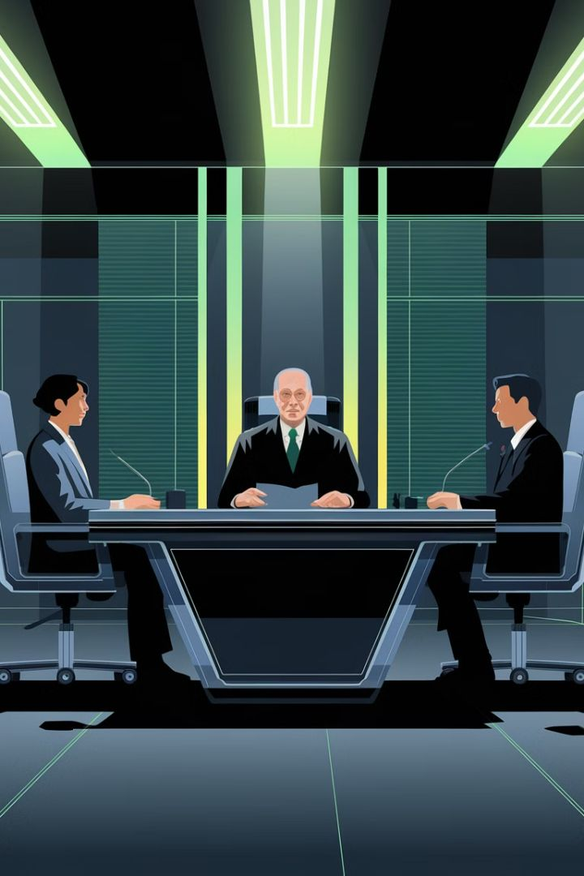
Role of Labour Tribunals in Termination Disputes
1
Claim Filing
Employees can file claims within 3 months of dismissal. The process is designed to be accessible.
2
Conciliation
Tribunals first attempt to resolve disputes through conciliation. This can lead to quicker resolutions.
3
Hearing
If conciliation fails, a formal hearing is held. Both parties present their cases.
4
Decision
The tribunal makes a binding decision. Appeals are limited to points of law.

Slide 12

Interactive Workshop: Drafting Termination Letters (Part 1)
1
Clear Statement of Termination
2
Reason for Termination
Begin with a clear statement of employment termination. Include the effective date.
Provide a concise, factual explanation for the termination decision. Avoid emotional language.
3
Notice Period Details
Specify the notice period or payment in lieu of notice arrangements.

Slide 13

Interactive Workshop: Drafting Termination Letters (Part 2)
1
Final Pay Information
2
Return of Company Property
Detail final salary, outstanding leave pay, and any other entitlements.
List company property to be returned and the process for doing so.
3
Confidentiality Reminder
Remind the employee of ongoing obligations regarding confidentiality and intellectual property.

Slide 14
Interactive Workshop: Drafting Termination Letters (Part 3)
Support Services
References
Contact Information
Include information on any outplacement or counselling services offered. Provide relevant contact details.
Clarify the company's policy on providing references. Specify who will handle reference requests.
Provide a point of contact for any questions or concerns. Include their name, position, and contact details.

Slide 15

Interactive Workshop: Drafting Termination Letters (Part 4)
Tone and Language
Legal Review
Use a professional, respectful tone throughout. Avoid accusatory or emotional language.
Have the draft reviewed by legal counsel to ensure compliance with employment laws.
Delivery Method
Documentation
Consider the most appropriate method for delivering the termination letter. In-person delivery is often best.
Keep a signed copy of the termination letter for company records.

Slide 16





Interactive Workshop: Drafting Termination Letters (Part 5)
Group Exercise
Participants draft a termination letter based on a provided scenario.
Peer Review
Participants exchange drafts for peer review and constructive feedback.
Expert Critique
An employment law expert provides feedback on selected drafts.
Best Practice Discussion
Group discussion on best practices and common pitfalls in termination letter drafting.

Slide 17





Conclusion: Key Takeaways
Legal Compliance
Documentation
Always adhere to employment laws and follow proper procedures to avoid unfair dismissal claims.
Maintain thorough records of performance issues, warnings, and improvement plans.
Communication
Best Practices
Ensure clear, respectful communication throughout the termination process.
Implement best practices in termination processes to protect both employer and employee interests.

