Slide 1
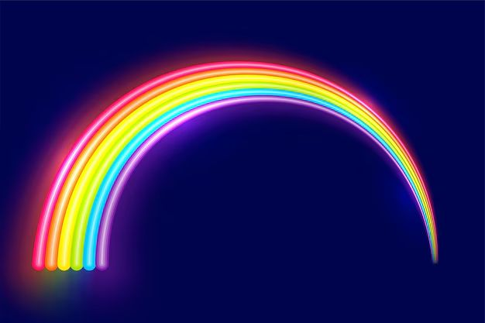
THE COLOR SPECTRUM
WHY WE SEE COLORS!
🌈📡

Slide 2

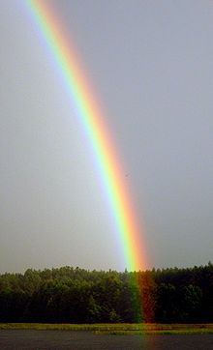
WHAT IS A SPECTRUM?
A spectrum is a range of colors arranged in a certain order.
We see colors in a light spectrum, like a rainbow!

Slide 3
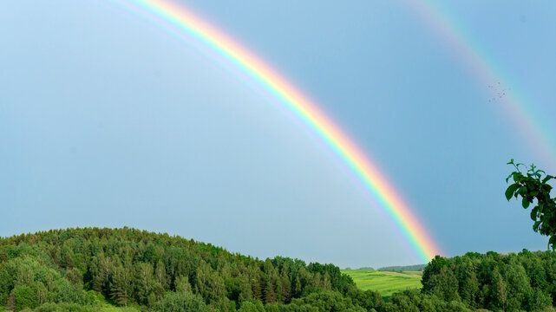
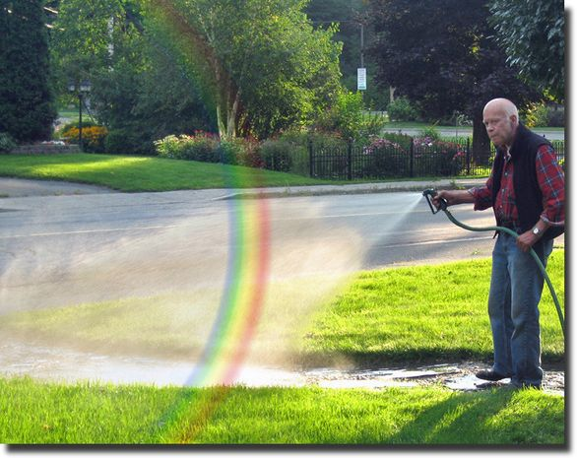

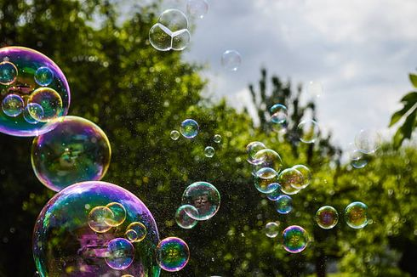
WHERE DO WE SEE RAINBOWS?
  After rain
  In water sprays (from a hose or fountain)
  On CDs/DVDs
  In bubbles
Think! Can you find
a rainbow at home?

Slide 4
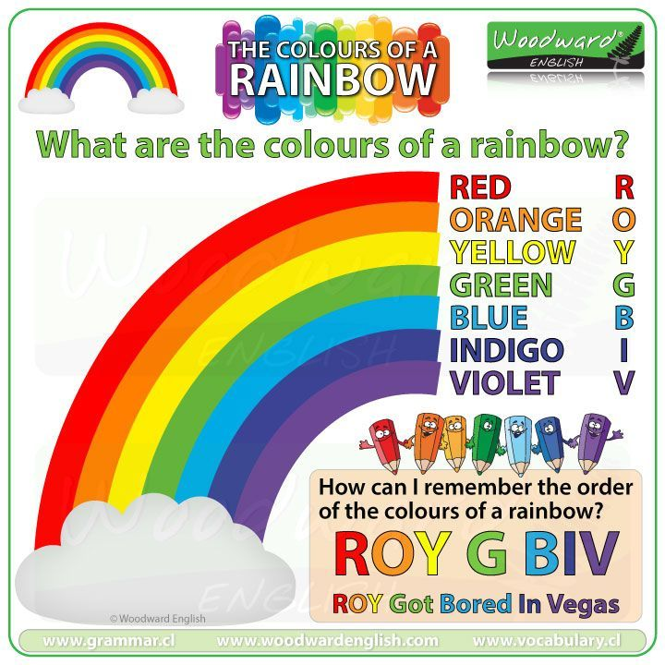
COLORS OF THE RAINBOW (ROY G. BIV)
The colors always appear in this order:
Red - Orange - Yellow - Green - Blue - Indigo - Violet

Slide 5
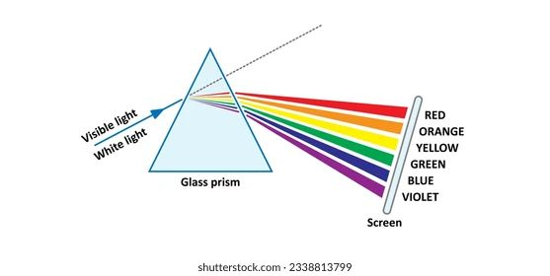
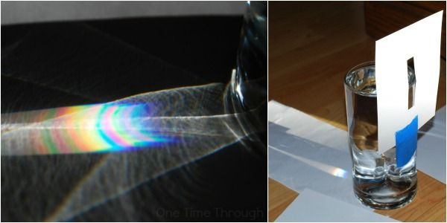
HOW RAINBOWS FORM
Light from the sun is white light.
Water droplets split the light into seven colors

Slide 6
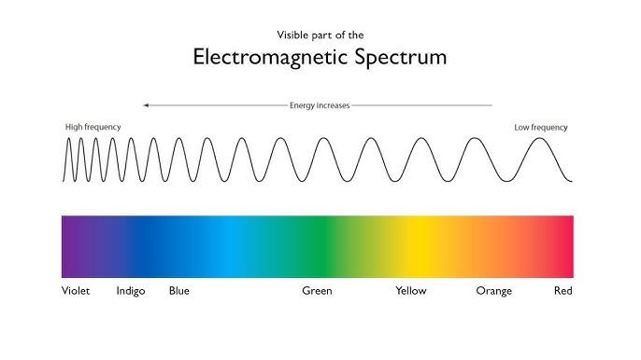
WAVELENGTH & FREQUENCY
  Light travels in waves, and each color has a different wavelength.
  Red has the longest wavelength (travels the farthest).
  Violet has the shortest wavelength (scatters the most).
  The colors are arranged from longest to shortest wavelength:
  Red → Orange → Yellow → Green → Blue → Indigo → Violet

Slide 7
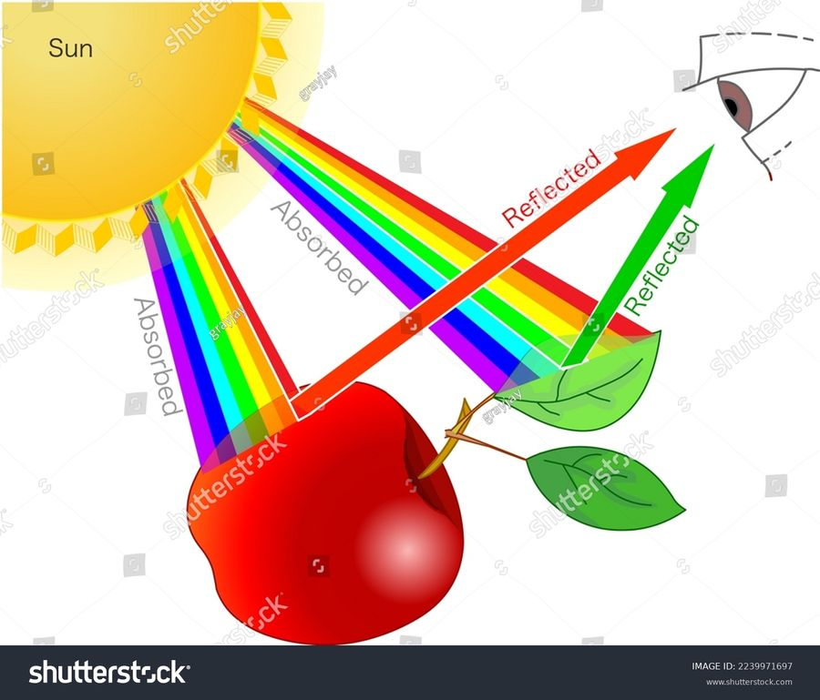
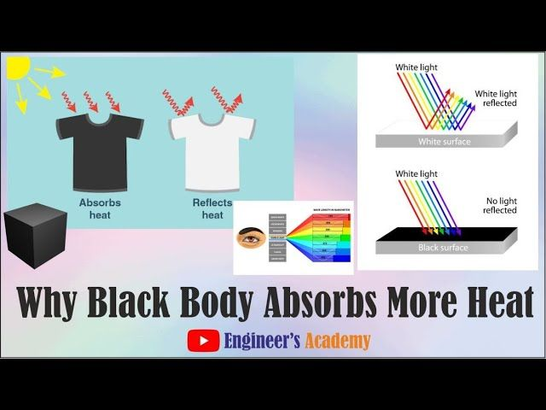
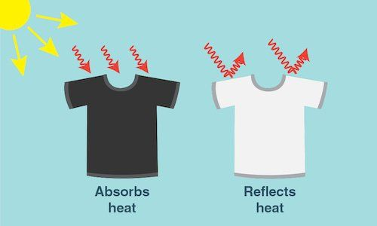
WHY DO OBJECTS HAVE COLOR?
  Objects reflect some colors and absorb others.
  A red apple looks red because it reflects red light!
  A white shirt reflects all colors.
  A black shirt absorbs all colors.

Slide 8


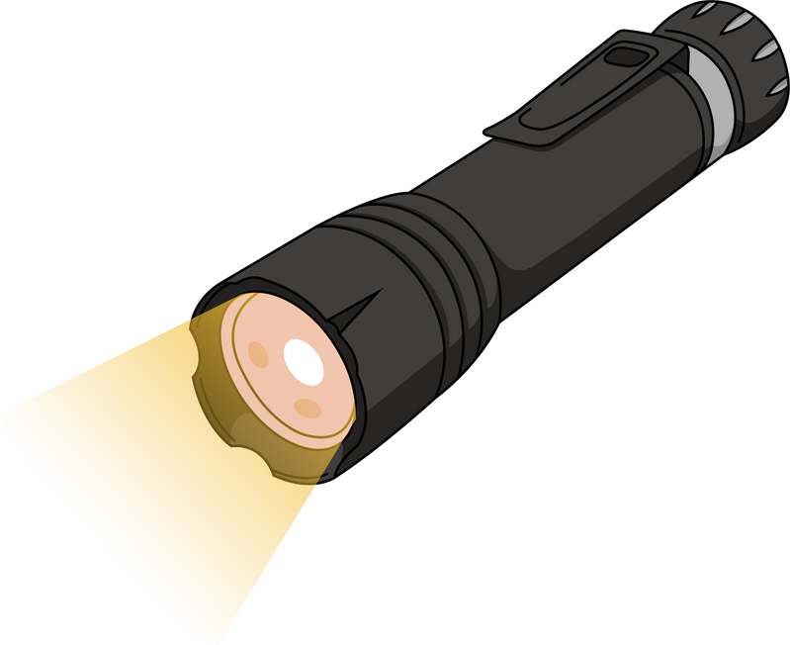
FUN ACTIVITY - MAKE YOUR OWN RAINBOW!
  Use a CD/DVD, flashlight, and a white paper.
  Shine light on the CD and see the rainbow reflection!
  Question: What colors do you see?

Slide 9
REVIEW QUESTIONS
  What are the colors of the rainbow?
  Why do objects appear in different colors?
  What is white light made of?
  How can we create a rainbow at home?

Slide 10







ELECTROMAGNETIC
SPECTRUM

Slide 11
Let’s watch a video about electromagnetic spectrum

Slide 12
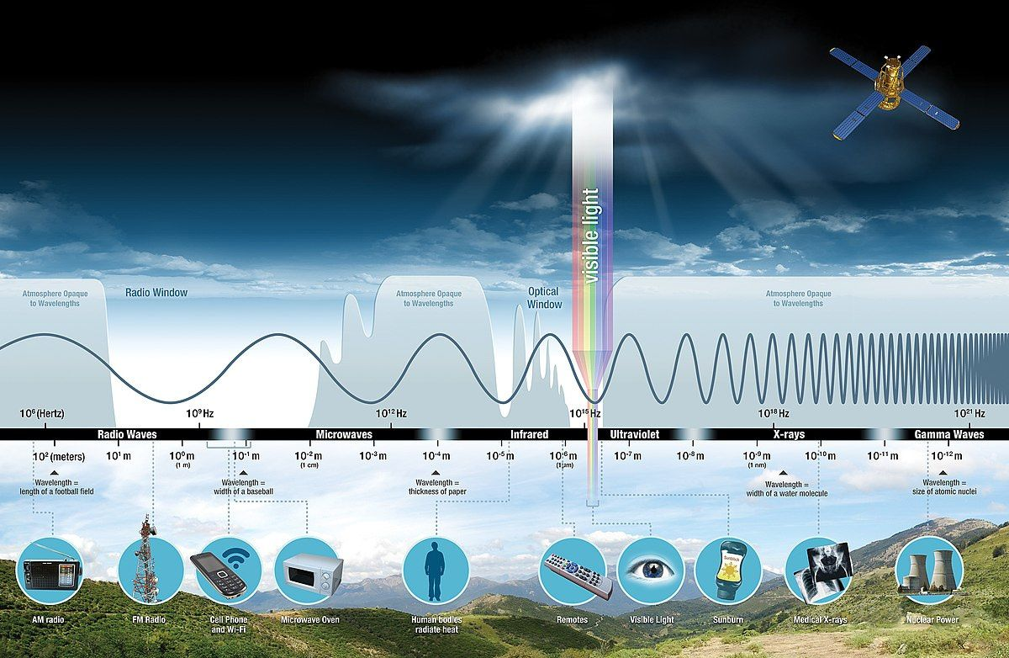
ELECTROMAGNETIC SPECTRUM
DISCOVER THE SECRET WORLD OF ELECTROMAGNETIC WAVES 🌈📡

Slide 13
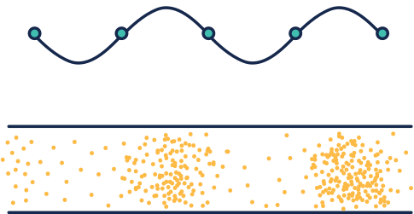
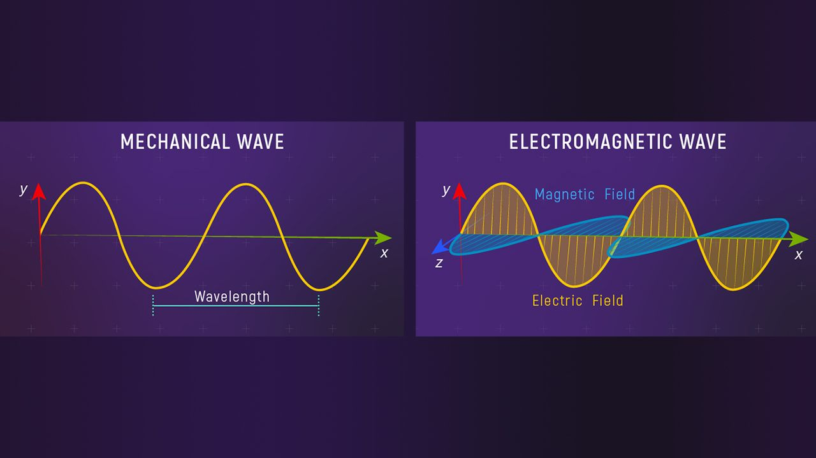
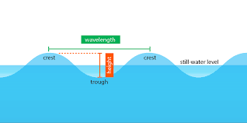
WHAT ARE ELECTROMAGNETIC WAVES?
  Energy waves that travel FASTER than anything (speed of light)!
  Made by vibrating particles (like shaking a jump rope!).
  They can move through empty space (no water or air needed!).

Slide 14
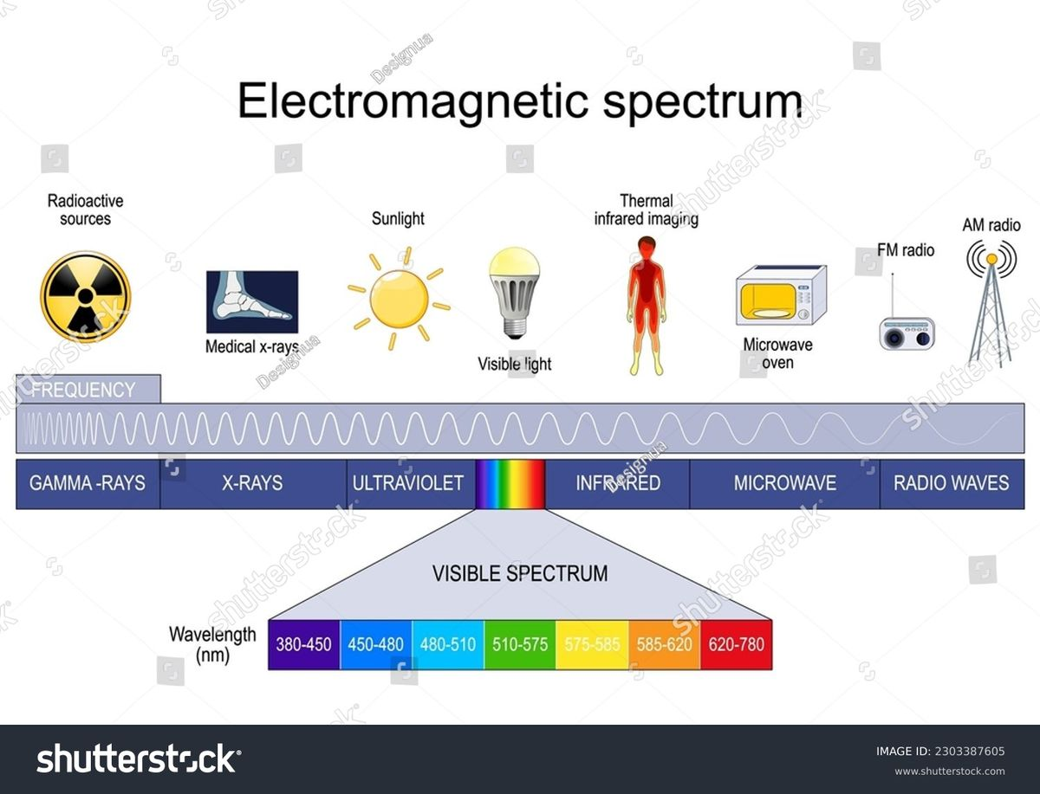
THE ELECTROMAGNETIC SPECTRUM
  From tiny gamma rays (smaller than atoms!) to giant radio waves (longer than mountains!).
  Visible light is just a tiny rainbow slice we can see!
Long waves = low energy (radio).
Short waves = HIGH energy (gamma).

Slide 15
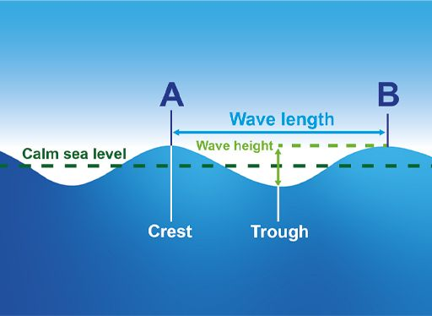
WAVELENGTH & FREQUENCY
Wavelength = Distance between wave 'hills' (crests).

Slide 16







EM WAVES IN YOUR LIFE!
TV remote (infrared)
WiFi (microwaves)
sunlight (visible + UV)
doctor’s X-rays!"
Infrared
Microwaves
Visible light + UV
Your eyes only see visible light. The rest are secret helpers!
x ray
radio waves
Gamma waves
Right now, thousands of waves are passing through you! 🌊

Slide 17
HOW DO WE SEE COLOR?
Our eyes are like radio tuners—they only pick up visible light!
A green leaf reflects green light (492–577 nm) and absorbs other colors!
EYE
= Visible Light Tuner

Slide 18



LET’S REVIEW!
  EM waves are everywhere—even in empty space!
  We see only visible light, but other waves help us cook, call, and explore space!
  Short waves = high energy (gamma/X-rays).
  Long waves = low energy (radio).
What EM wave does your favorite gadget use?

