Slide 1
Beirut Explosion
5 August 2020

Slide 2
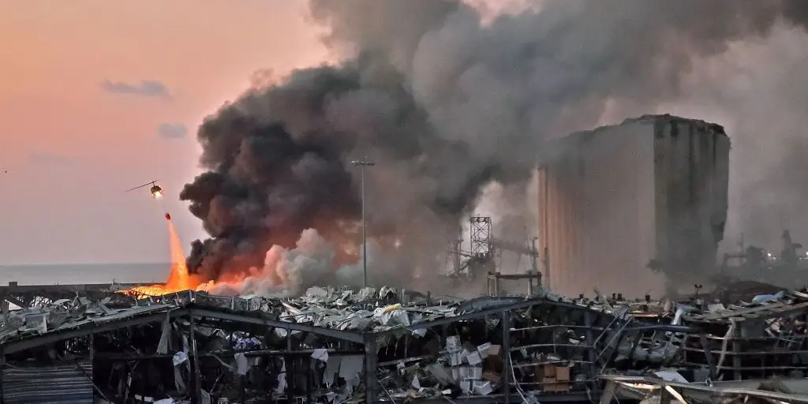
Beirut explosion

Slide 3
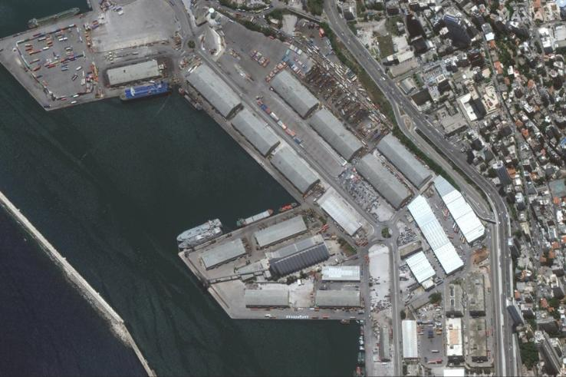
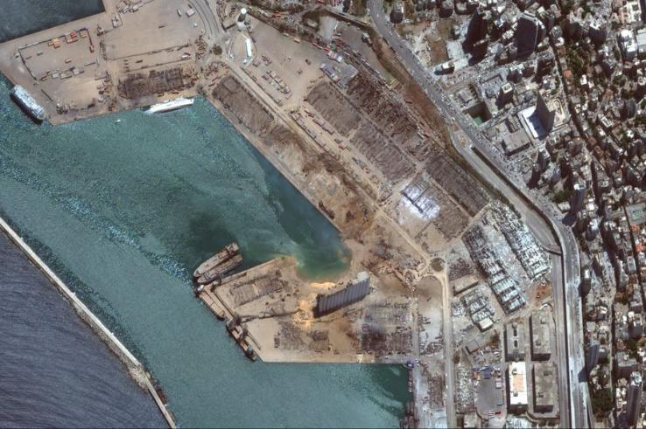
Beirut explosion

Slide 4
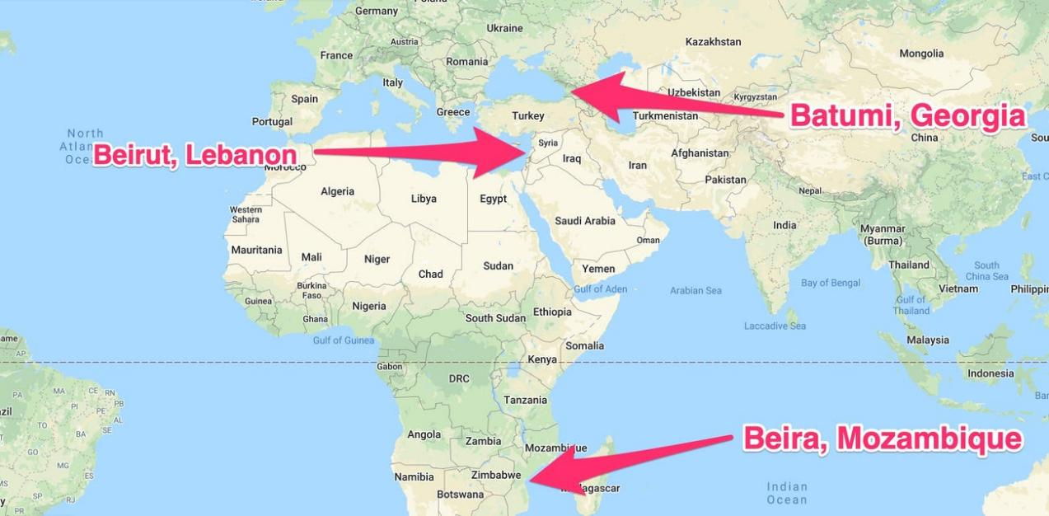
Beirut explosion – the background

Slide 5
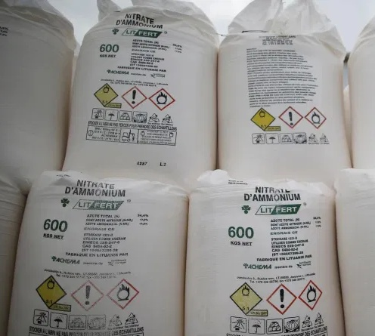
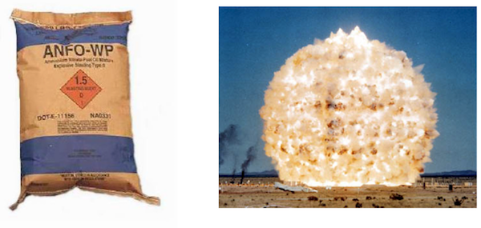
Ammonium nitrate

Slide 6

Beirut explosion

Slide 7
Ammonium nitrate and fuel oil (ANFO)
NH₄NO₃ → NH₃ + HNO₃ ΔH = +712 kJ
NH₄NO₃ → N₂O + 2H₂O ΔH = -559 kJ
NH₄NO₃ → ¾ N₂ + ½ NO₂ + 2H₂O ΔH = -314 kJ
NH₄NO₃ → N₂ + 2H₂O + ½ O₂ ΔH = -1450 kJ
8NH₄NO₃ → 5N₂ + 4NO + 2NO₂ + 16H₂O ΔH = -555 kJ

Slide 8
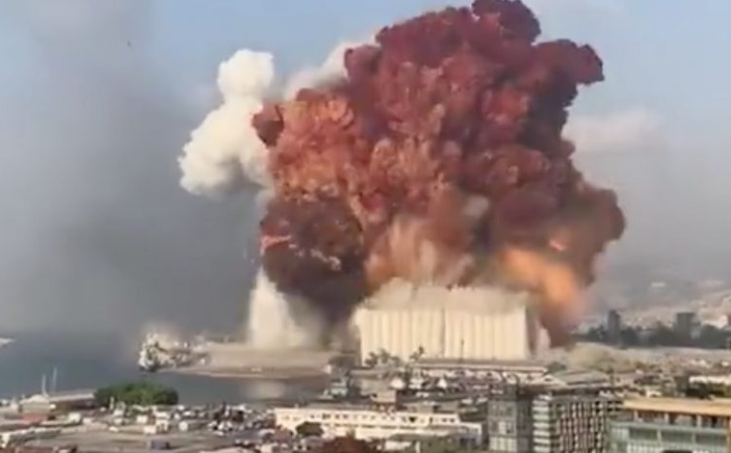
Beirut explosion
This brown gas is toxic to humans.
Why do you think that is?
How would it affect the environment?

Slide 9
Beirut explosion
NH₄NO₃(s) → N₂(g) + 2H₂O(g) + ½ O₂(g)
2750 tons of NH₄NO₃
Assuming that this is the only reaction that happens, calculate the total volume of gases produced.
Explain whether or not this is a redox reaction.

Slide 10
Beirut explosion
NH₄NO₃ → N₂O + 2H₂O ΔH = -559 kJ
Assuming that this is the only reaction that happens, calculate the total energy emitted from the exothermic decomposition of 2750 tons of NH₄NO₃.
Draw the labelled energy level (enthalpy) diagram.

