Slide 1
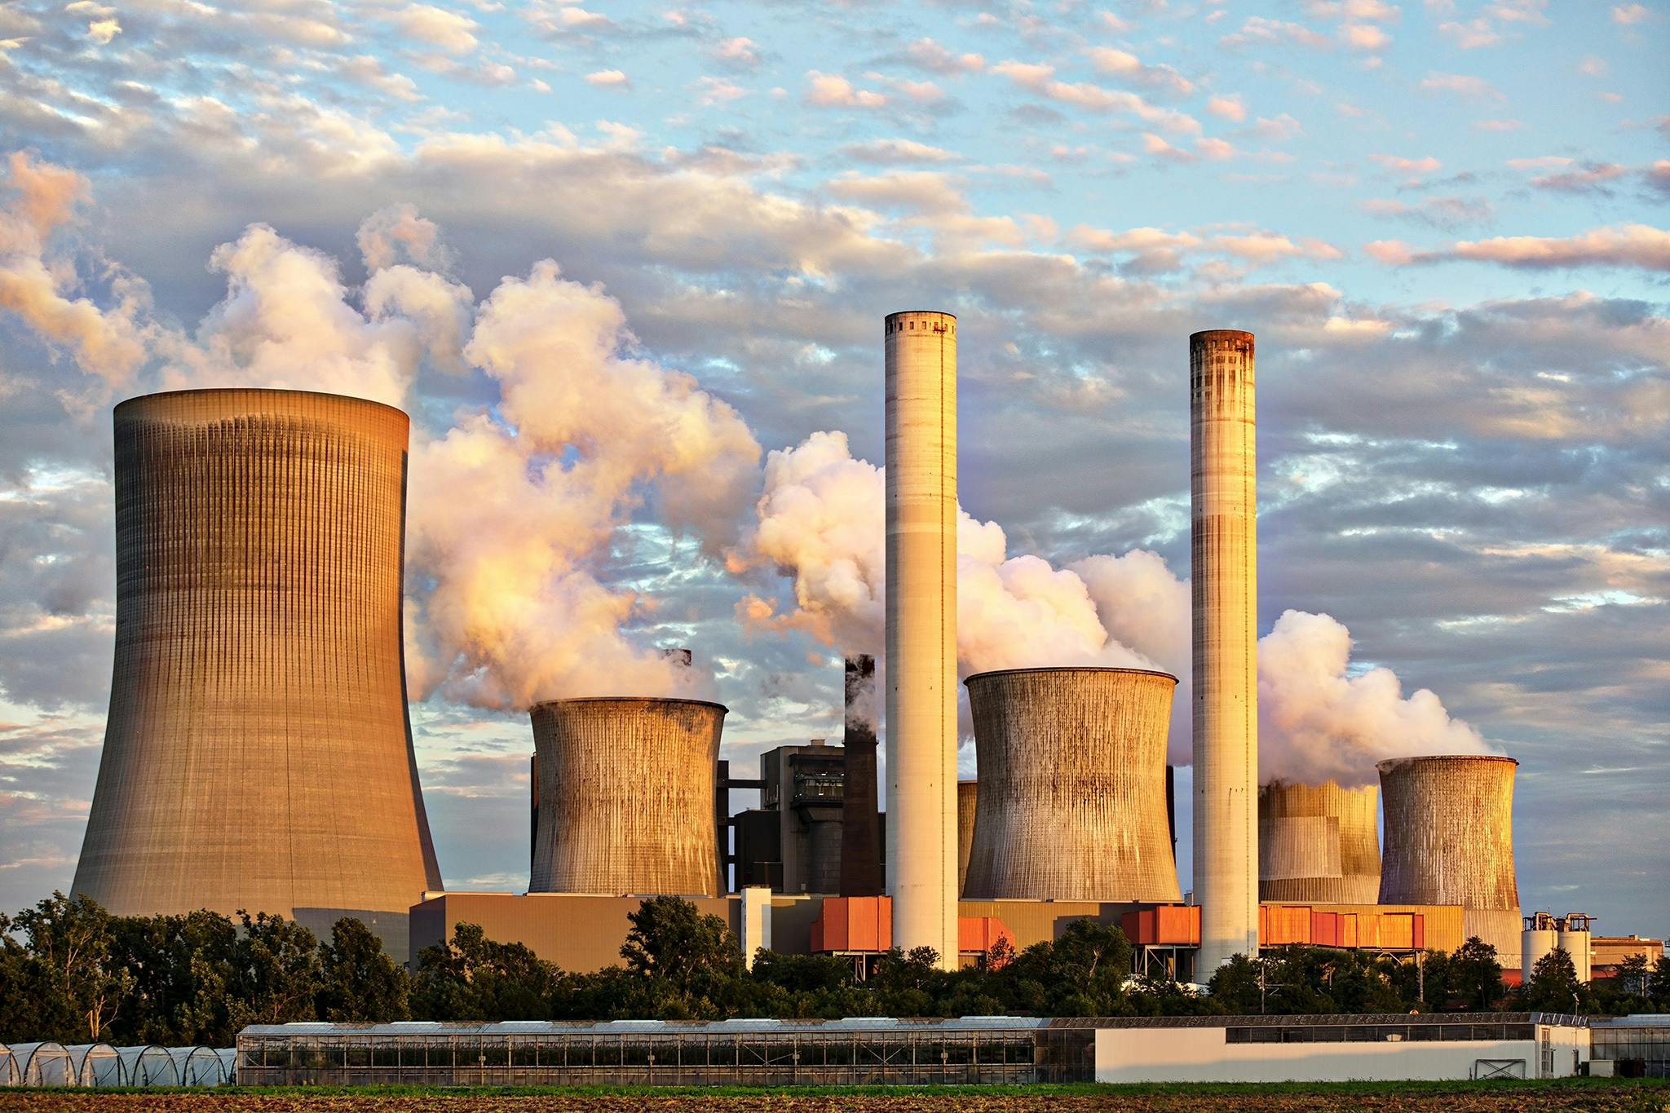
MEE224 THERMAL ENGINEERING
Second Law of thermodynamics
Reference books:
“Thermodynamics: An Engineering approach” by Cengel
“Engineering Thermodynamics” by R.K. Rajput
“Engineering Thermodynamics” by P. K. Nag

Slide 2

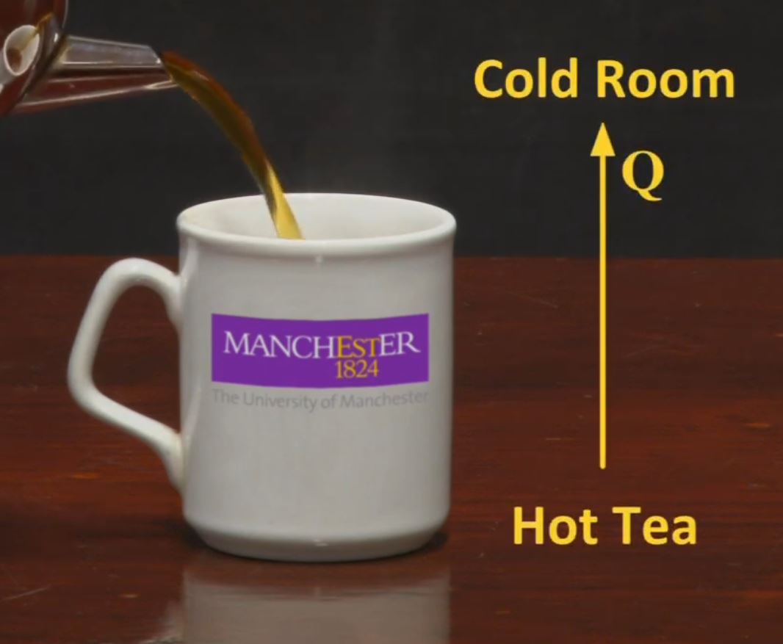

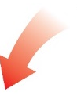

Introduction to Second law of thermodynamics
According to first law of thermodynamics, Energy lost by the tea should be equal to the energy gained by the surrounding (Law of energy conservation)
Example 1
Q_{lost, coffee} = Q_{gained, surrounding}
This process is natural and spontaneous
Whether this process can be reversed?
I mean, can energy transfer happen again, from surrounding to heat the cold coffee?
Naturally it is not possible
Example 2
Limitation of First law!
Heat is produced
First law only states the energy transformation from one form to another…
But it does not state, in which direction the energy can flow…
Electricity is passed through the copper coil
That is why, Second law of thermodynamics was framed!
Heat is added
If we reverse the process!
In general, this law states that,
Energy can flow only in certain direction, but not in the reverse direction…
Naturally Not possible
Even though, this is not violating the first law of thermodynamics, this process cannot happen.
Can we produce electricity?

Slide 3
Introduction to Second law of thermodynamics
Second law of thermodynamics, helps us to understand the energy transfer in terms of quantity and quality
Kelvin Planck statement
It is impossible to construct a heat engine that operates in a cyclic process, that absorbs heat from a single reservoir and convert all of that heat into work.
Some energy must be always rejected to the cooler reservoir.
Heat source
Heat source
100%
Impossible!
Useful work
Heat engine
Work output
Heat engine
100%
Heat rejection
No heat engine is 100% efficient
Heat sink
Consider a Car…
100% of fuel is not utilized to run the car. There is always a heat rejection and heat loss.

Slide 4
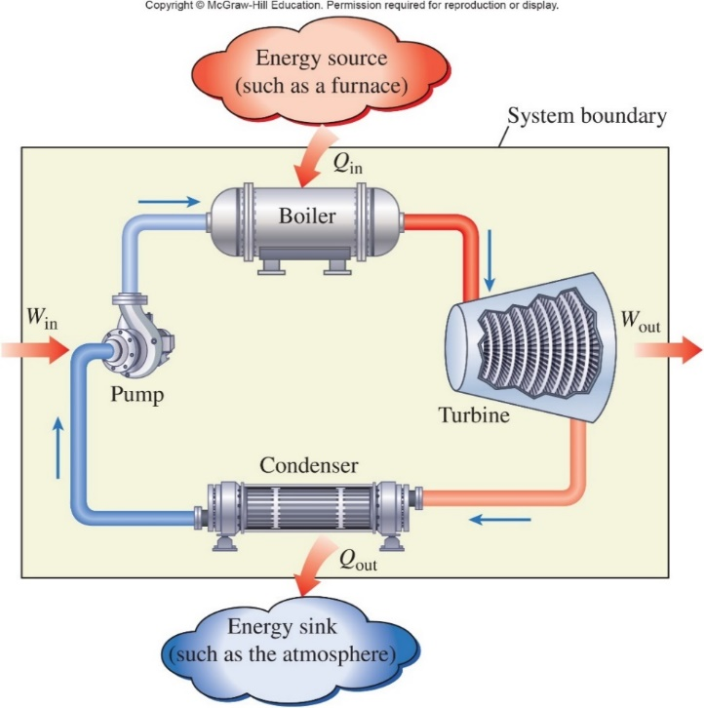

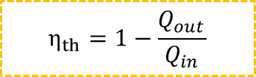









Energy balance and efficiency of a heat engine (Kelvin Planck statement)
Energy balance in steam power plant
$$E_{in }=E_{out }$$
$${(Q+W) }_{in }={(Q+W) }_{out }$$
1
LP and LT
liquid
HP and HT
Superheated steam
$$Q_{in}−Q_{out}=W_{out}−W_{in}$$
How to find the net-work ($W_{net, out}$), that we get out of the system?
$W_{net, out}=W_{out}−W_{in}$ (kJ)
2
From equations 1 and 2, we can write as,
$W_{net, out}=Q_{in}−Q_{out}$ (kJ)
3
LP and LT
liquid
Generally, how performance is evaluated?
LP and HT
Mixture steam
$$Performance=\frac{Desired Output}{Required Input}$$
In terms of thermal systems, we use the word “Efficiency”
$$So, Efficiency (η_{th})=\frac{Net work output}{Total heat input}$$
Q_{in} : Amount of heat supplied to steam in boiler from a high-temperature source at constant pressure
Q_{out} : Amount of heat rejected from steam in condenser to a low-temperature sink at constant pressure
W_{out} : Amount of work delivered by steam as it expands in turbine
W_{in} : Amount of work required to compress water to boiler pressure
$$Efficiency (η_{th})=\frac{W_{net, out}}{Q_{in}}$$
$$=\frac{Q_{in}−Q_{out}}{Q_{in}}$$
$$=\frac{Q_{in}}{Q_{in}}−\frac{Q_{out}}{Q_{in}}$$
$$η_{th}=1−\frac{Q_{out}}{Q_{in}}$$
Thermal efficiency of a heat engine is always less than 1 or less than100%, as both Q_{out} and Q_{in} are always positive values and Q_{out}< Q_{in}

Slide 5
Introduction to Second law of thermodynamics
Second law of thermodynamics, helps us to understand the energy transfer in terms of quantity and quality
Kelvin Planck statement
Clausius statement
It is impossible to construct a heat engine that operates in a cyclic process, that absorbs heat from a single reservoir and convert all of that heat into work.
It is impossible to develop a device (system) to occur which is operating in a cycle, where, the heat transfer occurs from a cooler body to a hotter body, without any help from an external work.
Some energy must be always rejected to the cooler reservoir.
Heat source
Heat source
Hot body
100%
We have to give some work to transfer heat from cold to hot body. Cannot happen naturally
Impossible!
Useful work
Heat engine
Work output
Heat engine
System
Work
input
100%
Heat rejection
No heat engine is 100% efficient
Heat sink
Cold body
Consider a Refrigerator…
Consider a Car…
We are supplying energy (work), to reduce the refrigerator’s temperature below atmospheric temperature.
100% of fuel is not utilized to run the car. There is always a heat rejection and heat loss.
Generally cooling occurs naturally, but refrigeration needs some external work

Slide 6
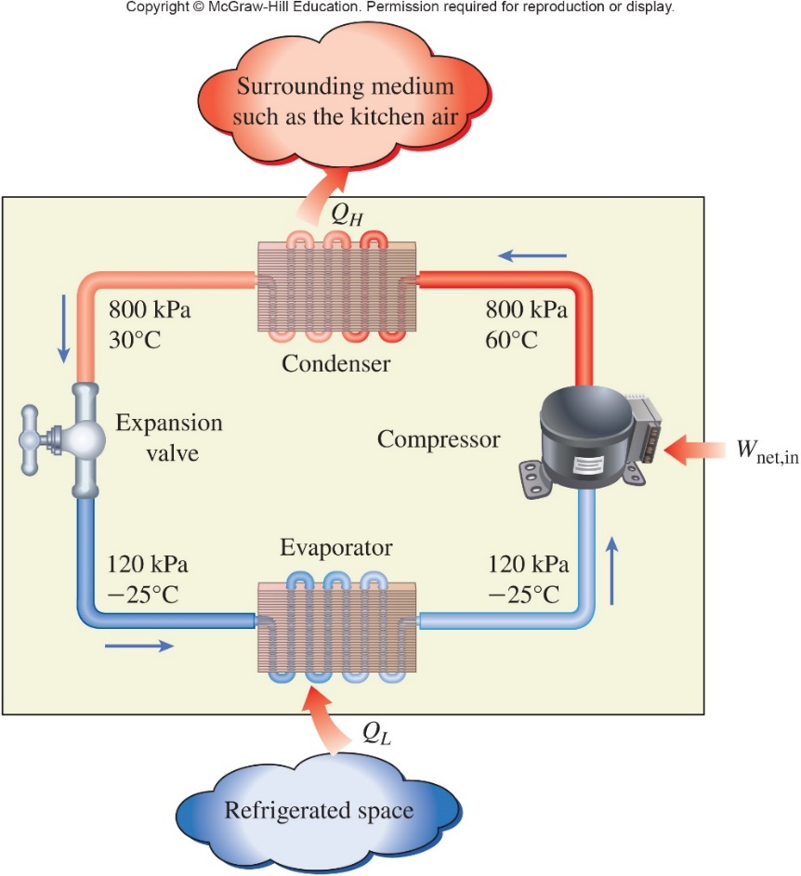
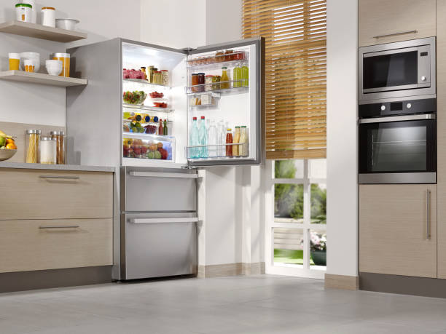
Proving Clausius statement
Imagine that you kept a refrigerator inside the insulated room.
Just think!!!!
You kept it open and switched it on
What will be the temperature of the insulated room after one hour?
Do you think that the room will be cooled?
Answer is, the temperature of the insulated room will be 79.2 ºC higher than the initial room temperature
Because….!
The refrigerant flows continuously in the refrigerator to absorb heat from the room
This heat should be lost to the surrounding with the help of condenser which is located at back side of refrigerator.
Time | Temperature rise from 27 ºC in 3m² room
1 min | 1.32 ºC
5 min | 6.6 ºC
10 min | 13.2 ºC
30 min | 39.6 ºC
1 hour | 79.2 ºC
But, here the heat is again dissipated in to the room, as the condenser is also inside the room. So this process happens continuously which will not reduce the temperature of the room.
In addition, continuous running of compressor, condenser fan due to electric supply, naturally generates heat which is also dissipated inside the room.
There should be an external energy or work given to the system, to transfer heat from cold body to hot body.
So, keeping the refrigerator open inside a room, will always increase the temperature of the room.
By the way, this will not happen in real time, as the walls and ventilations will dissipate the heat continuously outside. And compressor will shutdown due to over heat.
Note: Only if the room is 100% insulated

Slide 7






Coefficient of Performance (COP) of a refrigerator
Backside of refrigerator
In refrigerator, we do not use the word “efficiency”. But we use “Coefficient of Performance”
$$COP=\frac{Desired Output}{Required Input}$$
1
HP and LT
liquid
HP and HT
vapor
What is the desired output here?
Amount of heat $\left(Q_{L}\right)$ from refrigerated space to be removed
(Cooling effect)
What is the required input here?
Amount of work $(W_{net, in})$ required to run the compressor.
$Q_{H}=W_{net, in}+Q_{L}$(kJ)
2
LP and LT
Liquid
LP and LT
vapor
$${COP}_{R}=\frac{Desired output}{Required input}$$
Inside refrigerator
$${COP}_{R}=\frac{Q_{L}}{W_{net, in}}$$
Where, $Q_{L}$ > ${ W}_{net, in}$
Q_{L} : Amount of heat absorbed from the space where cooling is needed
Q_{H} : Amount of heat rejected to the atmosphere
W_{net, in} : Amount of work supplied as input, to get the desired cooling effect
Coefficient of Performance (COP) of a refrigerator should be greater than 1.
Commercial refrigerators have Coefficient of Performance (COP) ranging between 2 and 3

Slide 8













Heat pumps
Heat pumps are devices, that transfer the thermal energy from cold space to the warm place
T = 25 ºC
Consider that, you are in Sweden, at winter season. The temperature outside is 0 ºC. So, you need a device that supplies heat in to the room to maintain the room’s temperature at 25 ºC.
What is the desired output here?
Amount of heat $\left(Q_{H}\right)$ supplied in to the room (Heating effect)
What is the required input here?
Amount of work $(W_{net, in})$ required to run the device.
$${COP}_{P}=\frac{Desired Output}{Required Input}$$
$$Q_{H}$$
1
$$W_{net, in}$$
Work input
Heat pump
$So, Q_{H}=Q_{L}+W_{net, in}$ (kJ)
2
$$Q_{L}$$
$${COP}_{P}=\frac{Desired output}{Required input}$$
$$=\frac{Q_{H}}{W_{net, in}}$$
$$=\frac{W_{net, in}+Q_{L}}{W_{net, in}}$$
$$=\frac{Q_{L}}{W_{net, in}}+\frac{W_{net, in}}{W_{net, in}}$$
We know that,
$${COP}_{R}=\frac{Q_{L}}{W_{net, in}}$$
1
T = 0 ºC
$${COP}_{P}={COP}_{R}+1$$
Q_{L} : Amount of heat absorbed from the outside environment
Q_{H} : Amount of heat supplied in to the living room
W_{net, in} : Amount of work supplied as input, to get the desired heating effect
COP of a pump = COP of a refrigerator +1.

Slide 9
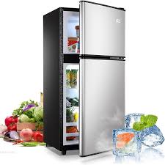
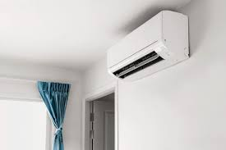
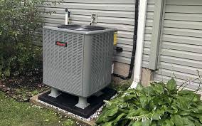
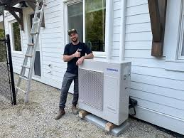





Difference between Refrigerator, Air conditioner and Heat pump
Refrigerator
Air conditioner
Heat pump
Refrigerator is a device, used to absorb heat from the inner space, and dissipate that heat to the surrounding.
This makes the food and vegetables cooler.
Common everywhere in the world
Air conditioner is a device, used to absorb heat from the living room, and dissipate that heat to the surrounding.
This makes the living room cooler.
Common in Hot countries.!
Heat pump is a device, used to absorb heat from outer space, and dissipate that heat in to the living room.
This makes the living room warmer.
Common in Cold countries.!
$${COP}_{R}=\frac{Desired output}{Required input}$$
$$=\frac{Q_{L}}{W_{net, in}}$$
$${COP}_{AC}=\frac{Desired output}{Required input}$$
$$=\frac{Q_{L}}{W_{net, in}}$$
$${COP}_{P}=\frac{Desired output}{Required input}$$
$$=\frac{Q_{H}}{W_{net, in}}$$
Rejects heat to the surrounding
Rejects heat in to the Living room
Absorbs heat from inner space
Absorbs the heat from living room
Rejects heat to the surrounding using condenser
Absorbs heat from the surrounding

Slide 10
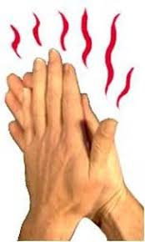
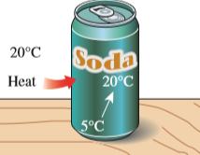
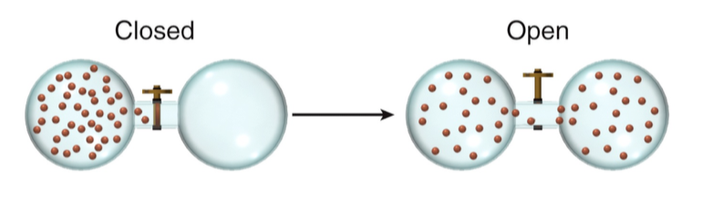
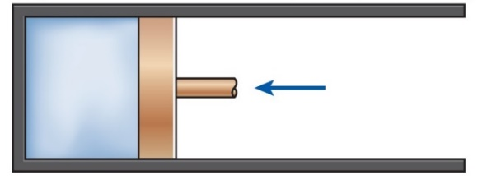
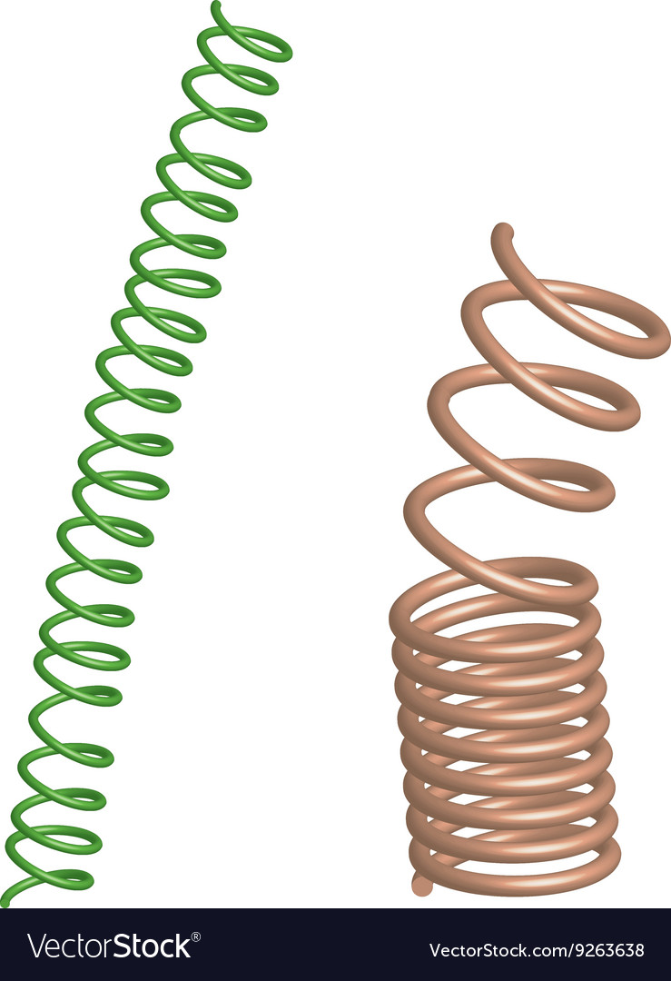
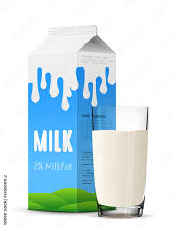
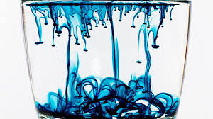
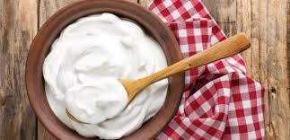
Reversible and Irreversible processes
Irreversible process
Reversible process
Initial state
Initial state
Reversible process
So, if the system cannot return to its initial position, it is called reversible process.
So, if the system follows the same path to return its original state and if there is no change in the system and its surrounding, it is called reversible process.
P
P
All the real time devices are irreversible
Not possible in real time
Final state
Final state
V
Irreversibility occur due to the following reasons:
V
1. Friction
2. Unrestrained expansion
3. Heat transfer
Then why should we study about reversible process, if it is not practically possible?
Vacuum
The reason is that, the reversible process shows the maximum theoretical efficiency of device, by absorbing least amount of work during compression.
Infinitesimally slow compression
Real time (fast) compression
Gas expanded
Friction and heat
4. Mixing of two fluids
5. Inelastic deformation of solids
6. Chemical reactions
Quasi static process
Almost no friction loss
Friction is present and so, heat is also produced.
Almost no heat loss
There are almost no losses. So you apply very very less work (energy) to move the piston
Because of friction, you need to give more work (energy) to move the piston.

Slide 11
Carnot Engine
An imaginary heat engine with complete reversible processes
Introduced by “Sadi Carnot” in 1824
1
The best known reversible cycle is the “Carnot Cycle”.
Q_{H}
T_{H}
2
P
4
T_{L}
Q_{L}
3
V
Process 1-2: Isothermal Expansion
Process 2-3:Isentropic (Adiabatic) Expansion
Process 3-4: Isothermal Compression
Process 4-1:Isentropic (Adiabatic) Compression

Slide 12
Carnot Engine
An imaginary heat engine with complete reversible processes
Introduced by “Sadi Carnot” in 1824
The best known reversible cycle is the “Carnot Cycle”.
Process 1-2: Isothermal Expansion
Process 3-4: Isothermal Compression
Heat is added to maintain the Internal energy of gas, during expansion (maintaining constant temperature).
Gas is compressed along with heat rejection, to maintain to maintain the Internal energy of gas (maintaining constant temperature).
1
No change in Internal energy
No change in temperature
3
No change in Internal energy
4
No change in temperature
2
Q_{rejected}
Q_{supplied}
U = C
T = C
U = C
T = C
Process 2-3:Adiabatic Expansion
Process 4-1:Adiabatic Compression
No heat transfer in or out, and further expanded only using the internal energy of the gas (temperature of gas reduces)
Gas is further compressed with any heat transfer in or out, to increase the Internal energy (increase the temperature as in initial state)
Internal energy
reduces
Internal energy
increases
2
3
4
1
Temperature reduces
U =
T =
Temperature increases
U =
T =

Slide 13
Carnot Cycle
Carnot heat engine
Reversed Carnot cycle
Carnot refrigeration
1
P
2
Q_{H}
Q_{H}
T_{H}
2
P
3
4
T_{L}
1
Q_{L}
3
Q_{L}
4
V
V
Process 1-2: Isothermal Expansion
Process 1-2: Isentropic (Adiabatic) compression
Process 2-3:Isentropic (Adiabatic) Expansion
Process 2-3:Isothermal heat rejection
Process 3-4: Isothermal Compression
Process 3-4: Isentropic (Adiabatic) expansion
Process 4-1:Isentropic (Adiabatic) Compression
Process 4-1: Isothermal heat absorption

