Slide 1
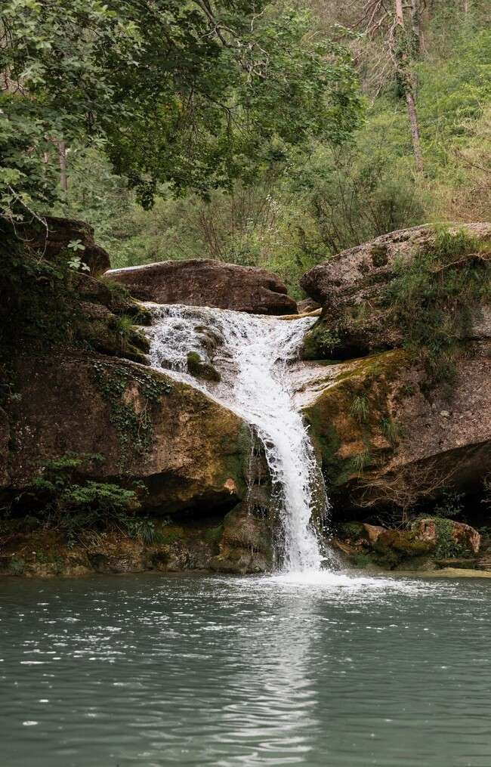
Parabolas Unveiled: The Art and Science of Curved Journeys

Slide 2
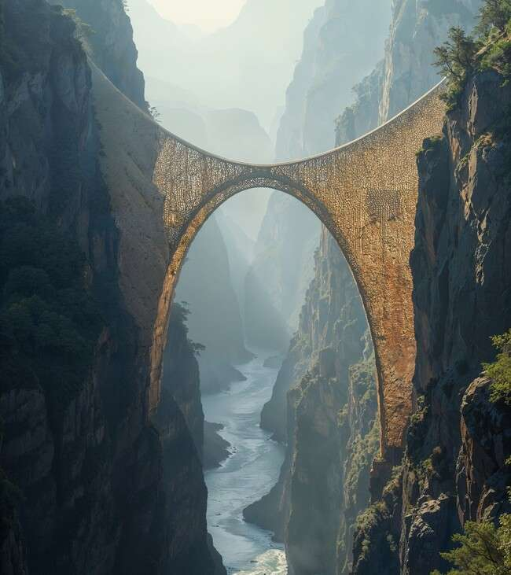




Introduction to Parabolas
Welcome to ! In this
presentation, we will explore the and behind parabolas. These
curves are not just mathematical constructs; they represent and
in various ﬁelds, from physics to architecture. Let's embark on this together!

Slide 3
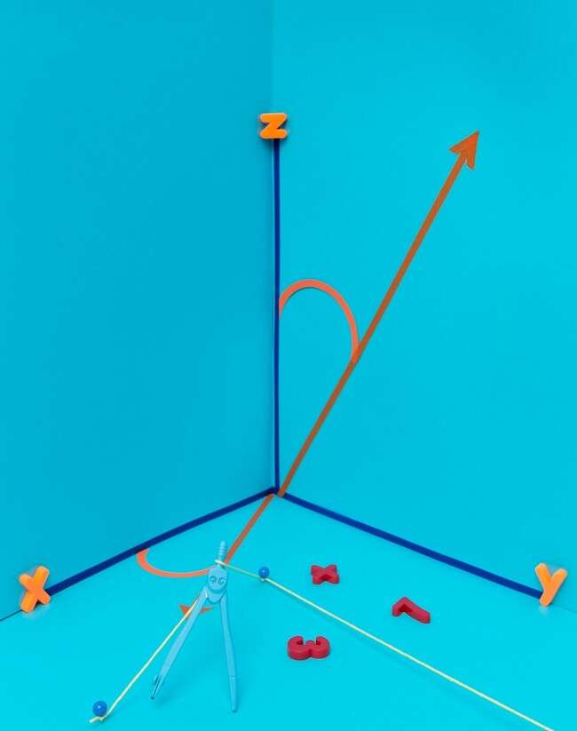








The Mathematical Essence
At the heart of parabolas lies the
. Deﬁned as , this equation describes a symmetrical curve. The
, , and are key components that help us understand the of
parabolas, revealing their .

Slide 4
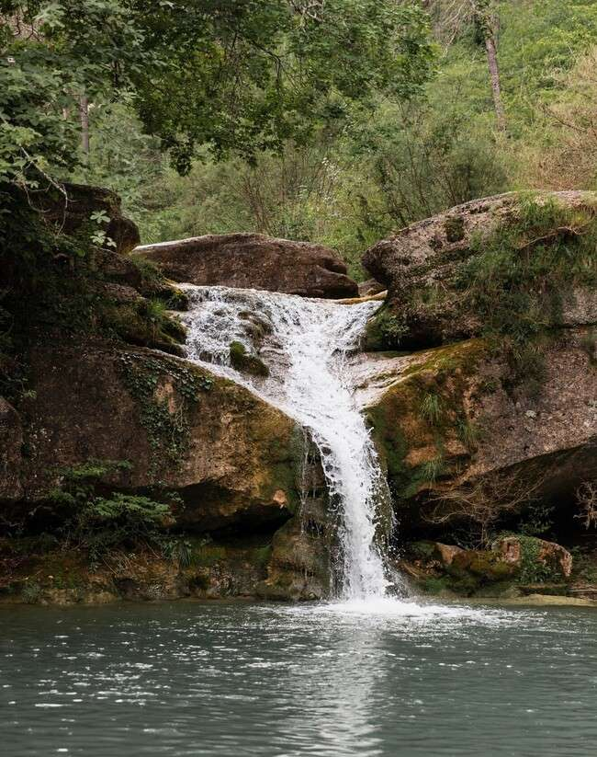



Parabolas in Nature
Nature showcases parabolas in .
From the trajectory of a thrown ball to the shape of a satellite dish, these curves optimize
and . Observing these natural phenomena can inspire us to appreciate
the surrounding us.

Slide 5
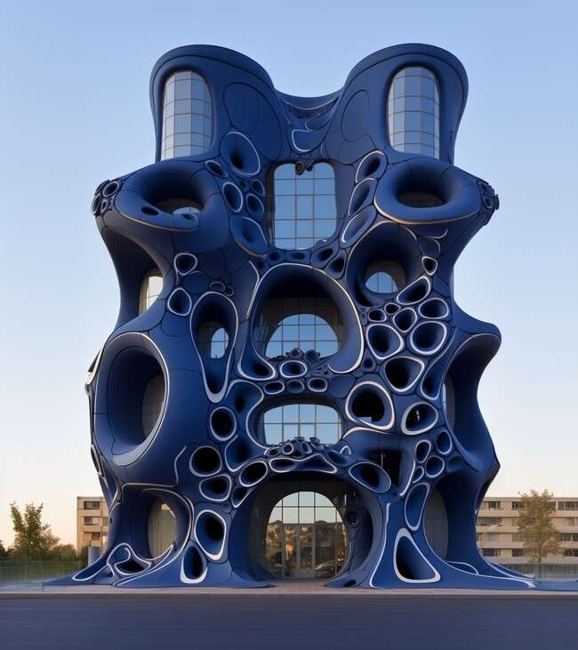





Artistic Interpretations
Parabolas have inﬂuenced
and curves add
alike. Their graceful
to structures
and artworks. From the
to modern sculptures, parabolas embody a
blend of
and
, showcasing the
harmony between these two worlds.

Slide 6
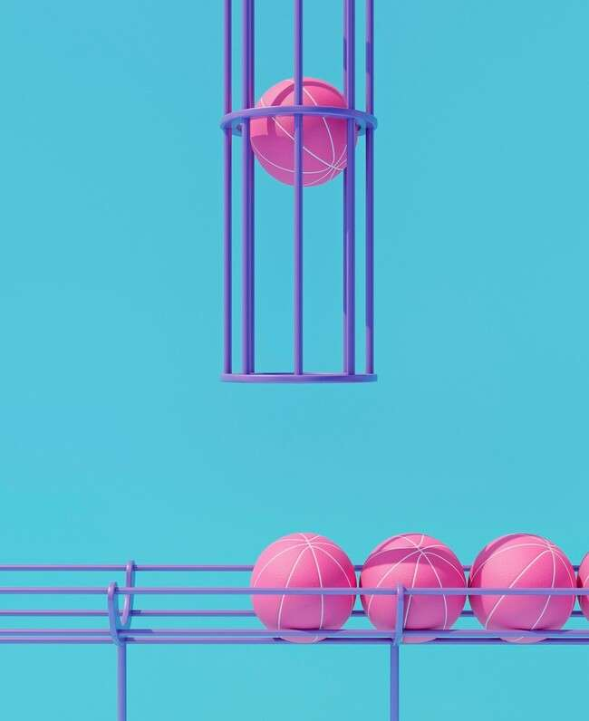





Parabolas in Physics
In physics, parabolas describe the
of projectiles. Understanding the principles of and allows
us to predict the path of an object in motion. This knowledge is crucial for ﬁelds like and , where precision is paramount.

Slide 7
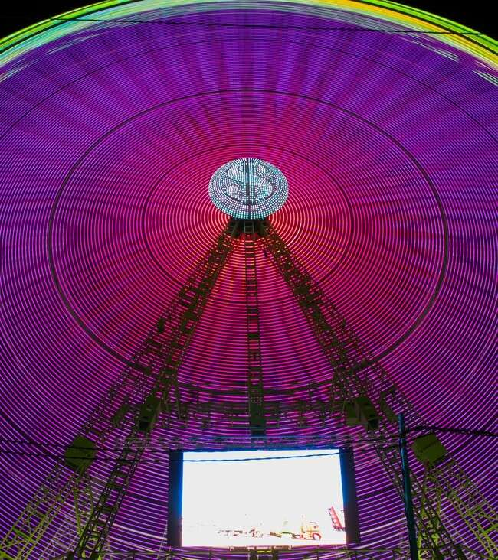

Technology and Parabolas
Parabolas play a vital role in
. They are used in the
design of in
telescopes and satellite dishes, enhancing signal reception. The
of parabolas ensure that waves are focused effectively, showcasing their practical
applications.

Slide 8
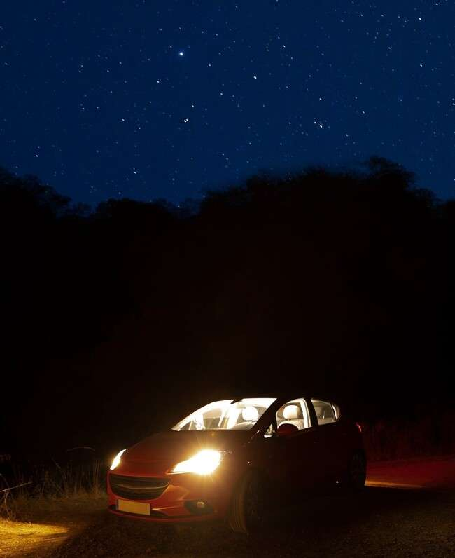



Parabolas in Everyday Life
From the of car headlights to the shape of water fountains, parabolas are embedded in our everyday experiences. Their unique properties not only enhance aesthetics but also improve
, making our environments
more and enjoyable.

Slide 9



Conclusion: Embracing Curved Journeys
In conclusion, parabolas are more than mere mathematical
curves; they represent the
nature. By understanding their
of art, science, and
, we can
appreciate the that shape our world. Let's continue to explore and celebrate these fascinating forms!

Slide 10
Thanks!
Do you have any questions? youremail@email.com
+91 620 000 838
www.yourwebsite.com @yourusername

