Slide 1
JUNE 25, 2019
System Dynamics
PRESENTED BY KARINA SUAREZ
Nonlinear Dynamics: Mathematical Approaches

Slide 2
System Dynamics
System Dynamics Outline
OUR DISCUSSION POINTS
An Introduction
Chaos
Deterministic Systems
Nonlinear Systems
Chaos in mathematical models

Slide 3

Chaos
Complex behavior, arising in a deterministic nonlinear dynamic system, which exhibits two special properties:
• sensitive dependence on initial conditions
• characteristic structure…
DETERMINISTIC SYSTEM
DYNAMIC SYSTEM
Systems that exhibit chaos are ubiquitous; many of them are also simple, well-known, and “well-understood”

Slide 4

Nonlinear
Dynamical System
A PENDULUM DOUBLE
Two pieces of aluminium and four ball bearings. Even though the system is physically very
simple, it's behavior is very complicated.
Moreover, this system is sensitively dependent on initial conditions.

Slide 5
Highlights
DETERMINISTIC SYSTEM
A deterministic system is one that is not
random. Cause and effect are linked and the current state determines the future
state.
DYNAMIC SYSTEM
(or a dynamical system)
either are fine, is a system that evolves with time
NONLINEAR SYSTEM
Is one where the relationships between the variables that matter are not linear.

Slide 6
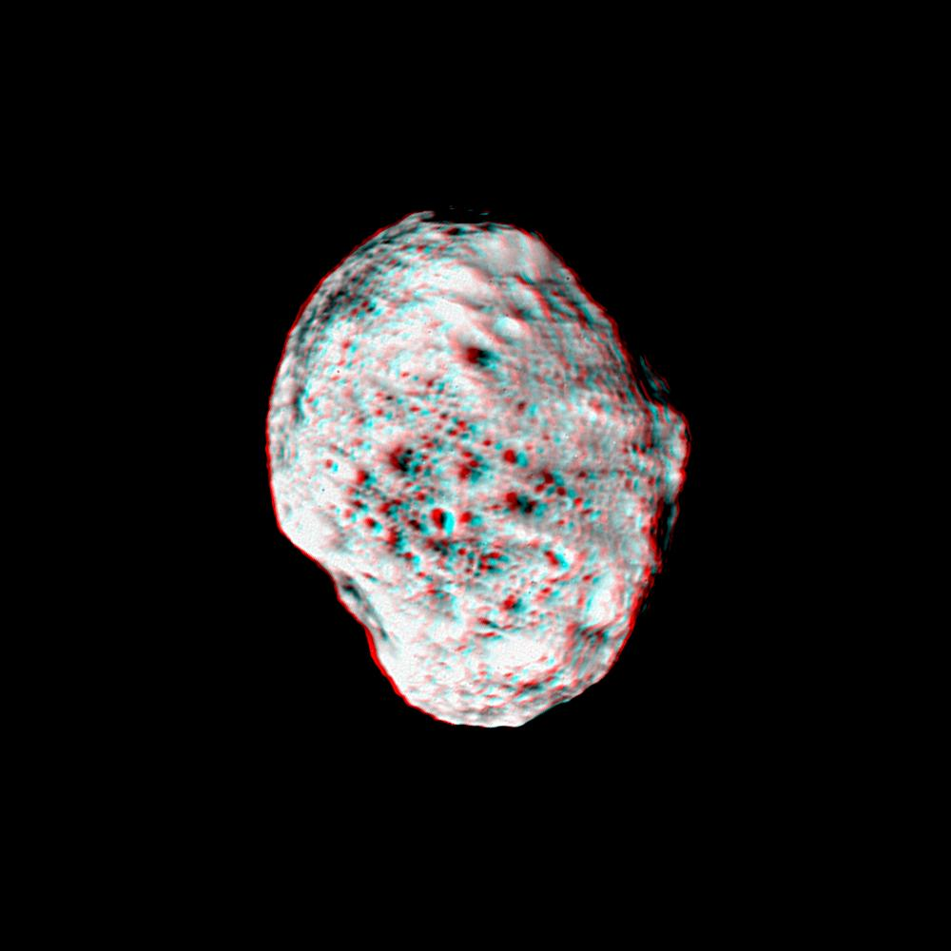
Hyperion
SATURN'S MOON HYPERION
Target Name: Hyperion
Is a satellite of: Saturn
Mission: Cassini-Huygens
Spacecraft: Cassini Orbiter
Instrument: ISS - Narrow Angle
Produced By: Cassini Imaging Team
Other Information: You will need 3D glasses
Primary Data Set: Cassini.
IIImage Credit: NASA/JPL/Space Science Institute

Slide 7

Hyperion
SATURN'S MOON HYPERION
Hyperion
is a very unusual shape and as a result of
that shape, it tumbles chaotically.
There's also chaos on how planets move
through space, not just how they tumble.
You may remember from Physics, that the
solutions in those cases can only be conic
sections, ellipses, parabolas and hyperbolas.
V Video Credit : NASA/JPL/Space Science Institute

Slide 8
As we will see, systems with
three or more bodies can be chaotic
NOW THINK ABOUT IT
HOW MANY BODIES ARE THERE IN THE SOLAR SYSTEM?
LOTS MORE THAN TWO..

Slide 9
Is the Solar System
Chaotic ?
THE ANSWER APPEARED IN THE 1980S.
Indeed the solar system is chaotic, although it is stable in a sense and we'll get back to that.
So just some brief history of our field, it really dates back to Henri Poincare in the late 1800s. But it really got going in the 1960s with Ed
Lorentz's paper, called Deterministic Non
periodic Flow.

Slide 10
Is the Solar System
Chaotic ?
THE ANSWER APPEARED IN THE 1980S.
Within the context of those patterns. In the 70s, this paper by Li and Yorke was the first to use the word "chaos" in conjunction with this behavior.
Lorentz was the first person to recognize the patterns of chaos and the sensitivity of the evolution of the system

Slide 11
Is the Solar System
Chaotic ?
THE ANSWER APPEARED IN THE 1980S.
In the late 70s and 80s, the chaos cabal at the University of California at Santa Cruz, got very interested in nonlinear dynamics, and one of the problems that they approached it with was trying to beat roulette, that is, modelling the path of a ball on a roulette wheel, and using that information to advantage.
After this, things really took off.

Slide 12
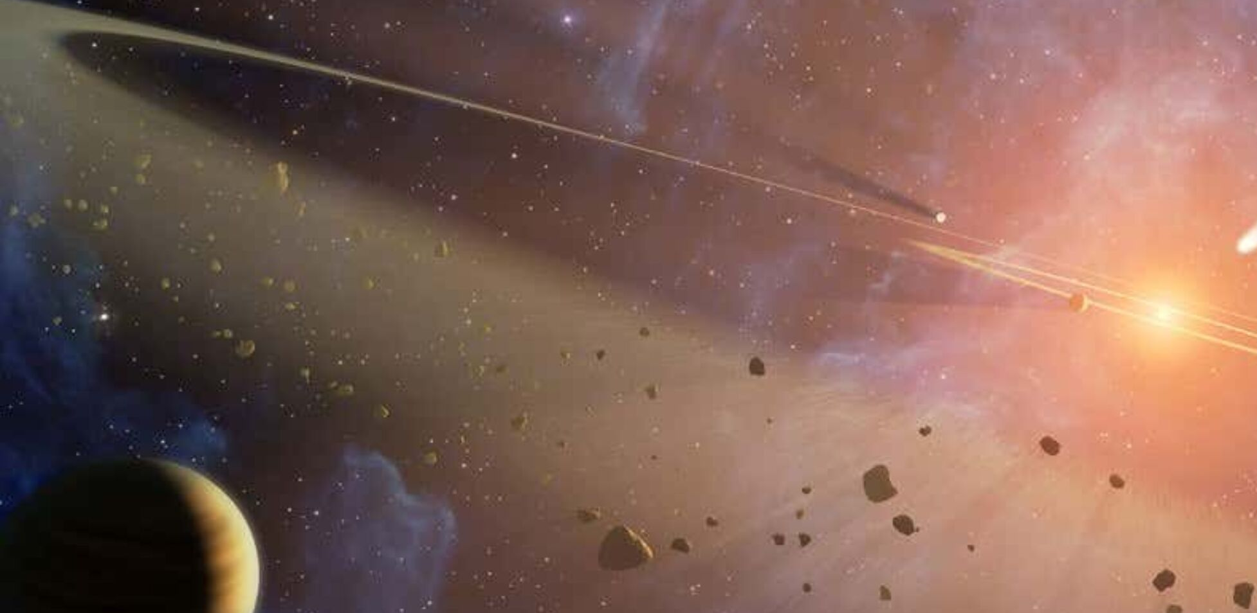
Chaotic
Solar System
DUAL ASTEROID STRIKE HINTS AT CHAOS

Slide 13
Three hallmarks of mathematical chaos
THE ‘BUTTERFLY EFFECT’ HAS BECOME A POPULAR SLOGAN OF CHAOS.
But is it really so surprising that minor details sometimes have major impacts?
Sometimes the proverbial minor detail is taken to be the difference between a world with some butterfly and an alternative universe that is exactly like the first, except that the butterfly is absent; as a result of this small difference, the worlds soon come to differ dramatically from one another.

Slide 14
Three hallmarks of mathematical chaos
THE ‘BUTTERFLY EFFECT’ HAS BECOME A POPULAR SLOGAN OF CHAOS.
The mathematical version of this concept is known as sensitive dependence. Chaotic systems not only exhibit sensitive dependence, but two other properties as well: they are deterministic, and they are nonlinear. In this chapter, we’ll see what these words mean and how these concepts came into science.

Slide 15

The
Butterfly
Effect
AGAIN, SMALL CHANGE, LARGE EFFECT,
SENSITIVE DEPENDENCE ON INITIAL CONDITIONS

Slide 16
Chaos in mathematical models
‘CHAOS IN MATHEMATICAL MODELS’
Surveys chaotic mathematical models. Lord May used the Logistic Map to explain biological population fluctuations. The randomness of the fluctuations was inherent to the system and not due to external forces. Higher dimension mathematical systems form flows instead of maps. Chaotic dynamics has provided insights in many fields of science. They can provide cures for oscillatory diseases, such as leukemia.

Slide 17
Chaos in mathematical models
‘CHAOS IN MATHEMATICAL MODELS’
In Hamiltonian systems the state space does not shrink. This property has allowed them to trace motion in the solar system. Insights from simple mathematical systems can also act as test beds for forecasting systems, but care must be taken when scaling them up. We would all be better off if more people realized that simple nonlinear systems do not necessarily possess simple dynamical properties.
Lord May (1976).

Slide 18
REFERENCES
Smith, Leonard A., 'Chaos in mathematical models' in Smith, Leonard Chaos: A Very Short Introduction (Oxford, 2007 ).
Holland, John H., 'Complex physical systems (CPS)' in Complexity: A Very Short Introduction (Oxford, 2014).
PIA06244 Hyperion moon Image Credit: NASA/JPL/Space Science Institute.
Dual Asteroid Strike Hints At Chaos
Image Credit : NASA/JPL-Caltech.

