Slide 1
Perimeter and Area

Slide 2
01
Introduction to Perimeter and Area
02
Formulas for Perimeter
03
Formulas for Area
CONTENTS
04
Relationship between Perimeter and Area
05
Problem Solving with Perimeter and Area
06
Conclusion and Future Insights

Slide 3
Introduction to Perimeter and Area
/
01

Slide 4
Definitions
R
What is Perimeter?
C
I
Perimeter is the total distance around the edge of a two-dimensional shape. It is calculated by adding the lengths of all sides of the figure involved, such as squares, rectangles, or circles, showcasing the outer boundary measurement.
What is Area?
Area is the measure of the space contained within a two-dimensional shape. It is expressed in square units and is calculated using different formulas depending on the shape, representing the extent of a surface.
E
A
Importance in Geometry
S
Understanding perimeter and area is crucial in geometry as they are foundational concepts used in various applications such as construction, land development, and even in art, defining the size and boundaries of objects.

Slide 5
Historical Context
Ancient Civilizations
Ancient civilizations like the Egyptians and Babylonians employed perimeter and area calculations in architecture and land measurement, laying the groundwork for future mathematical principles.
Modern Applications
Today, the concepts of perimeter and area are integral in various fields, including engineering, urban planning, and environmental science, contributing to design efficiency and resource management.
Evolution of Measurement
Measurement systems evolved over centuries, transitioning from rudimentary tools to standardized units, allowing for more precise calculations of perimeter and area in diverse fields.

Slide 6
Formulas for Perimeter
/
02

Slide 7
Basic Shapes
Circle
Triangle
The perimeter of a circle, known as the circumference, is calculated with the formula C = 2πr, where r is the radius, offering a precise measurement for circular objects.
Rectangle
To calculate the perimeter of a triangle, one sums the lengths of all three sides, given by the formula P = side1 + side2 + side3, essential for understanding triangular shapes.
The perimeter of a rectangle is calculated by the formula P = 2(length + width), providing a straightforward method to determine the boundary of rectangular areas.

Slide 8
Complex Shapes
01
02
03
Polygons
Composite Shapes
Applications in Real Life
The perimeter of a polygon is obtained by adding the lengths of all its sides. This concept extends to various polygons, enhancing our understanding of their overall dimensions.
For composite shapes, the perimeter is found by calculating the sum of the outer edges, which may involve separating the shape into simpler components for accuracy.
Practical applications of perimeter calculations can be seen in fencing properties, planning landscaping projects, and designing public spaces, illustrating the relevance of these formulas.

Slide 9
Formulas for Area
/
03

Slide 10
Area of Basic Shapes
Triangle
The area of a triangle can be calculated using A = 1/2(base × height), crucial for determining space allocation in architectural designs and land use planning.
Rectangle
The area of a rectangle is calculated using A = length × width, allowing for rapid determination of surface coverage in various applications like flooring and agriculture.
Circle
The area of a circle is computed with A = πr², where r is the radius, representing the space inside the circle and used in various fields such as astronomy and engineering.

Slide 11

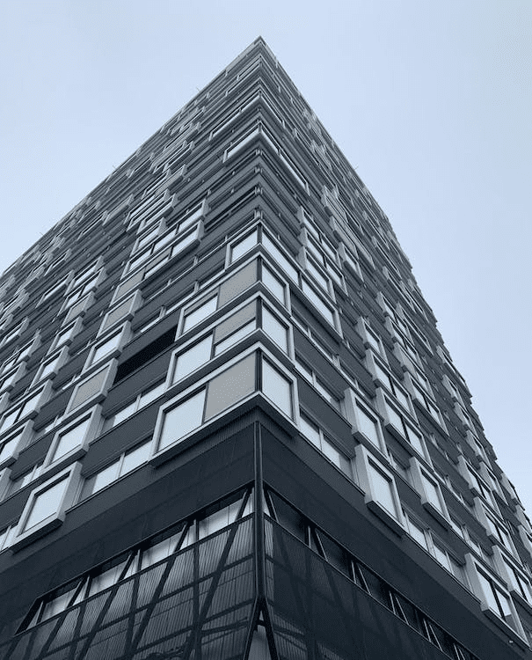

Area of Complex Shapes
Polygons
Practical Examples
01
For polygons, the area can be calculated by dividing the shape into triangles or using specific formulas based on the number of sides, which provides versatility in complex designs.
03
Real-world applications include estimating land used for agriculture, determining surface requirements for construction, and calculating space for community projects, exemplifying the importance of area calculations.
Composite Areas
02
Composite areas can be calculated by summing the areas of individual sections, making it feasible to measure areas that involve irregular shapes like park land or complex architectural layouts.

Slide 12
Relationship between Perimeter and Area
/
04

Slide 13

Comparison
Linear vs. Square Dimensions
The perimeter measures linear distance while area measures square space, highlighting the difference in dimensional measurement critical for accurate design and planning in various contexts.
Examples of Different Shapes
Shapes with the same perimeter can have vastly different areas, such as a long rectangle versus a square, illustrating the complex relationship between these two geometric properties.

Slide 14
Applications
01
Land Measurement
Perimeter and area are essential in land measurement for property lines and agricultural land, influencing legal boundaries and contributing to effective land management practices.
02
Architectural Design
In architectural design, understanding the relationship between perimeter and area informs building layouts, ensures efficient use of materials, and adheres to zoning regulations.
03
Environmental Considerations
Knowledge of perimeter and area calculations is vital in environmental assessments, aiding in the conservation of natural resources, determining habitat sizes, and urban ecosystem planning.

Slide 15
Problem Solving with Perimeter and Area
/
05

Slide 16

Example Problems
Calculation of Perimeter
Calculation of Area
Example problems often involve calculating the perimeter for various shapes, allowing students to practice applying formulae effectively and reinforcing geometric concepts.
Area calculation problems help learners engage with real-world scenarios, such as calculating the area of a room for flooring, promoting practical application of mathematical principles in daily life.

Slide 17
Real-World Applications
Construction
In construction, accurate measurements of perimeter and area are crucial for costing materials, land assessment, and ensuring compliance with regulatory guidelines throughout the project lifecycle.
Landscaping
Urban Planning
Landscape planning utilizes perimeter and area calculations to optimize garden layouts, manage dimensions of various installations, and maintain aesthetic balance in outdoor spaces.
Urban planning heavily relies on perimeter and area data to define property boundaries, create zoning plans, and analyze land use, contributing to sustainable community development decisions.

Slide 18
Conclusion and Future Insights
/
06

Slide 19

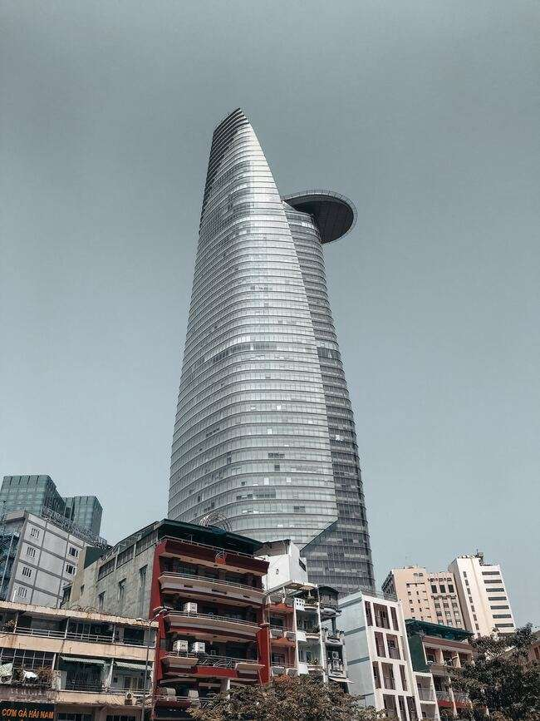
Summary of Key Points
Importance of Understanding
01
Key Formulas Recap
02
A robust understanding of perimeter and area allows individuals to make informed decisions in various fields, emphasizing their significance in mathematics and practical applications.
Recapping essential formulas for perimeter and area consolidates knowledge, aiding learners in their application across various shapes and scenarios encountered in real life.

Slide 20
Future Trends
Advances in Measurement Techniques
Integration with Technology
Emerging technologies, such as GIS and 3D modeling software, are refining measurement techniques, allowing for unprecedented accuracy and efficiency in calculating perimeter and area.
The increasing integration of AI and machine learning into spatial analytics promises to enhance our understanding and application of perimeter and area in fields such as architecture and environmental science.
01
02

Slide 21
Thanks

